Slide 1
Caesar Cipher
E
S
N
T
B
A
I
By
Sebastian Rodriguez
S
A

Slide 2
Caesar Cipher Basic
S
E
B
Each letter in plaintext is replaced by a letter
The replacement is set by a value, which shifts down the alphabet
V
H
E

Slide 3
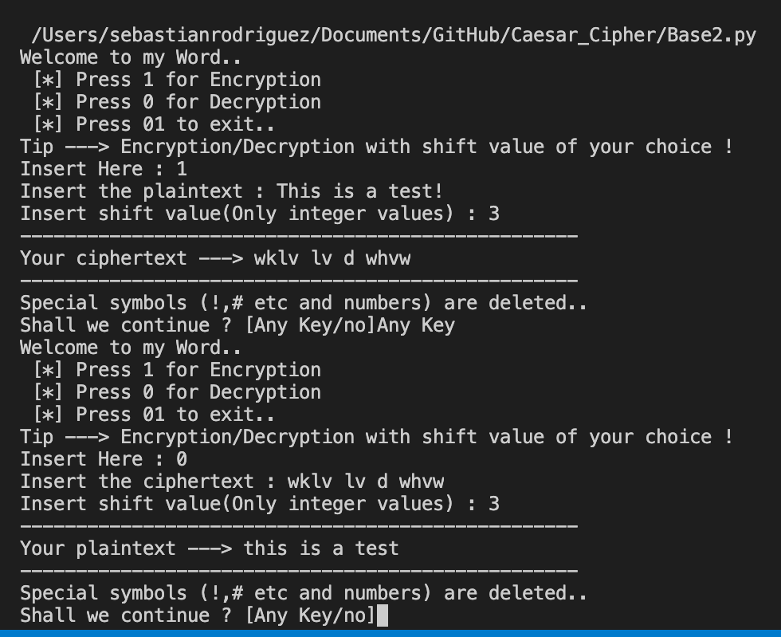
Base: ShadowRoot18
Input a sentence and number
Outputs on console
Shifts forward for encryption
Shifts back for decryption
https://github.com/ShadowRoot18/Caesar-Cipher-Python/blob/main/Caesar.py

Slide 4
GUI
Simple and useable
Takes text as input
Output results, without user altering
Tkinter
Comes with python

Slide 5
Complex Shifting
S
E
B
Shift each letter differently
Input number or random by computer
More work to decrypt
10 letters = 260 combinations
T
J
G

Slide 6
Symbols, Numbers, Spaces
!
3
Each symbol, number and space will be shifted
More work to decrypt
Maybe replaced by combination of letters
?
-
7

