Slide 1
Nerld
🤣
🤯
🥳
🤓
🧐
🥸
☺️
😃
😇
😭
By
Sebastian Rodriguez
🤩
😍
👩‍💻👨‍💻🧑‍💻👩‍💻👨‍💻🧑‍💻👩‍💻👨‍💻🧑‍💻👩‍💻👨‍💻🧑‍💻

Slide 2
What’s Nerld?
😯
swift
🥰
javascript
Where’s ok for be a nerd
Social media app for coders to share snippets of their creation
Mainly targeted for those who are curious or beginning in programming, but everyone is welcomed
Encourages the user to interact with like-minded individuals
Growing their network, creativity, and knowledge
Can be used as a stack overflow alternative, but more towards an instagram for code
kotlin
html
java
python
😜
😖

Slide 3
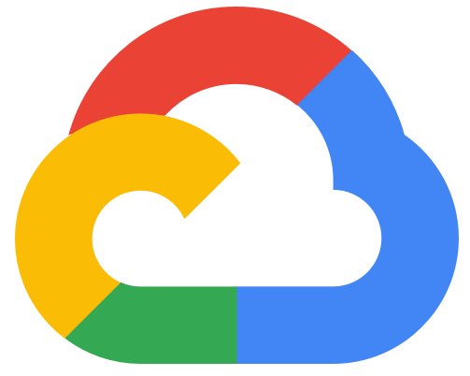
Development Details
🗒
iOS app
SwiftUI interface and Swift language
Google Firebase Firestore as the backend
Store all posts
Store all users (temporary, goal to transfer to Firebase Authentication)
Post code as text
Includes the user’s name and profile
User can customize their profile to express themself
🧑‍💻

Slide 4
Demo
📱
👩‍💻
📝

Slide 5
Q&A

