Slide 1
SEVEN-G · COURSE · CONSULTANT · SUPPORTING CLIENTS
SEVEN-G
Consultant · Supporting clients
What SEVEN-G is, how the initiative funnel gets filled all the way to the board dashboard, and how to apply it at your clients under your own name.
Fernando García Varela · Self-learning course · CC BY 4.0 · Examples with fictitious data

Slide 2
SEVEN-G · COURSE · CONSULTANT · SUPPORTING CLIENTS
The problem it solves
Many companies have AI pilots that work, but few reach production.
Value gets declared ("we freed up 200 hours") and almost nobody checks it.
Nobody has clear authority to stop an initiative that is not working.
The board asks about AI and gets a list of technical projects, not business decisions.
Is the company transforming with AI, or just a bit more efficient? Almost nobody can answer that with evidence.
This is not a technology problem: it is a governance and measurement problem.

Slide 3
SEVEN-G · COURSE · CONSULTANT · SUPPORTING CLIENTS
What SEVEN-G is and what it delivers
Seven-phase Enterprise Value & Governance: an enabling phase 0 and seven value phases, with governance throughout.
It organises AI as a portfolio: every initiative has a phase, a cost, expected value and an owner.
It places decision gates between phases: no verified evidence, no progress.
It separates who decides, who builds and who controls, and turns regulation into phases, roles and evidence.
It measures value in money and with a status —validated, declared or estimated— and shows it to the board on a dashboard.
It is free and modifiable: documents, Word templates and tools, under an open licence.

Slide 4
SEVEN-G · COURSE · CONSULTANT · SUPPORTING CLIENTS
Two levels: the company and each initiative
C1 · Diagnosis: inventory, maturity across seven dimensions and the transformation index.
C2 · Direction: the board approves the AI thesis, ambition per sphere and risk appetite.
C3 · Portfolio: which initiatives get funded, and in what order.
C4 · Oversight: board dashboard and the log of decisions and recommendations.
C5 · Annual review: what worked, what did not and what changes.
And, inside that portfolio, each initiative goes through its own eight-phase lifecycle.

Slide 5
SEVEN-G · COURSE · CONSULTANT · SUPPORTING CLIENTS
An initiative's lifecycle
Eight phases with a decision gate at the end of each; below, the funnel stage where each phase shows up
F0
Context and constraints
F1
Opportunity discovery
F2
Value hypothesis
F3
Feasibility and risk
F4
Solution design
F5
Delivery and validation
F6
Operation and governance
F7
Evolution or retirement
G0
G1
G2
G3
G4
G5
R6
G7
Proposed
Value hypothesis
Proof of concept
In development
In use

Slide 6
SEVEN-G · COURSE · CONSULTANT · SUPPORTING CLIENTS
What can happen at each gate
Five outcomes; whoever provides the evidence never verifies it or decides
Proceed
With conditions
Iterate
Pivot
Stop
All criteria are met and the evidence is verified: it moves to the next phase.
It proceeds, with a deadline and owner for what is pending. Never for critical security, legal or human-oversight controls.
The phase repeats with a specific adjustment and returns to the same gate. The third time, the higher body decides.
The hypothesis does not hold but another reasonable one exists: back to phase 2. Only at G1, G2 and G3.
No plausible value, or unacceptable risk. The reason and lessons are recorded. It is a good outcome.
At G7 the outcomes are Scale, Iterate or Retire.

Slide 7
FROM DOCUMENT TO DASHBOARD
How the funnel gets filled
Nobody draws the funnel or the dashboard: they come out of what is filled in and decided at each phase. This is the path.

Slide 8
SEVEN-G · COURSE · CONSULTANT · SUPPORTING CLIENTS
Phases 0 to 3: from idea to proof of concept
What is done, which templates are filled in and which gate closes each phase
F0
Context and constraints
F1
Discovery
F2
Value hypothesis
F3
Feasibility and risk
What is done. The idea is authorised: sponsor, owner, scope, constraints and intensity (Lite or Enterprise).
Filled in. P01 Initiative charter · P02 Context and constraints · P03 Roles · P04 Intensity · P05 Inventory entry.
What is done. Opportunities are compared, including non-AI alternatives, and a sphere and ambition level are proposed.
Filled in. P06 Opportunity portfolio and screening · P07 Sphere and ambition · P31 Use case sheet.
What is done. A falsifiable hypothesis in money, with baseline, attribution method and stop criteria set in advance.
Filled in. P08 Value hypothesis canvas · P09 Baseline. Support: T11 calculator.
What is done. Proof of concept: feasibility, regulatory classification, risks and suppliers. It is the main stop gate.
Filled in. P10 Feasibility · P11 Regulatory classification and impact · P12 Risks · P13 Mitigation · P14 Supplier.
G0 → enters "Proposed"
G1 → stays in "Proposed"
G2 → "Value hypothesis"
G3 → "Proof of concept"
Every gate decision is recorded in P29 and in the T01 register, with the status of each criterion and its evidence.

Slide 9
SEVEN-G · COURSE · CONSULTANT · SUPPORTING CLIENTS
Phases 4 to 7: from design to production and retirement
Go-live does not close the cycle: it opens operation, with periodic reviews
F4
Solution design
F5
Delivery and validation
F6
Operation and governance
F7
Evolution or retirement
What is done. Before building: architecture, data and model lineage, human oversight, security, rollback and adoption.
Filled in. P15 Architecture · P16 Lineage · P17 Human oversight · P18 Security · P19 Rollback · P20 Adoption.
What is done. Build, validate and pilot; the rollback is tested and go-live is signed off.
Filled in. P21 Delivery report · P22 Validation and pilot · P23 Go-live sign-off · P12 updated.
What is done. Monitoring, incidents, changes and tracking of realised value, with a periodic continuity review.
Filled in. P24 Operations manual · P25 Monitoring · P26 and P27 Incidents and changes · P28 Value · P65 R6 pack.
What is done. With realised value on the table, the decision is to scale, iterate or retire, and lessons are recorded.
Filled in. P28 Value tracking · P30 Scale-or-retire decision, with a retirement plan where applicable.
G4 → "In development"
G5 → moves to "In use"
R6 → stays "In use" or brings G7 forward
G7 → scale, iterate or "Disengaged"
Every gate decision is recorded in P29 and in the T01 register, with the status of each criterion and its evidence.

Slide 10
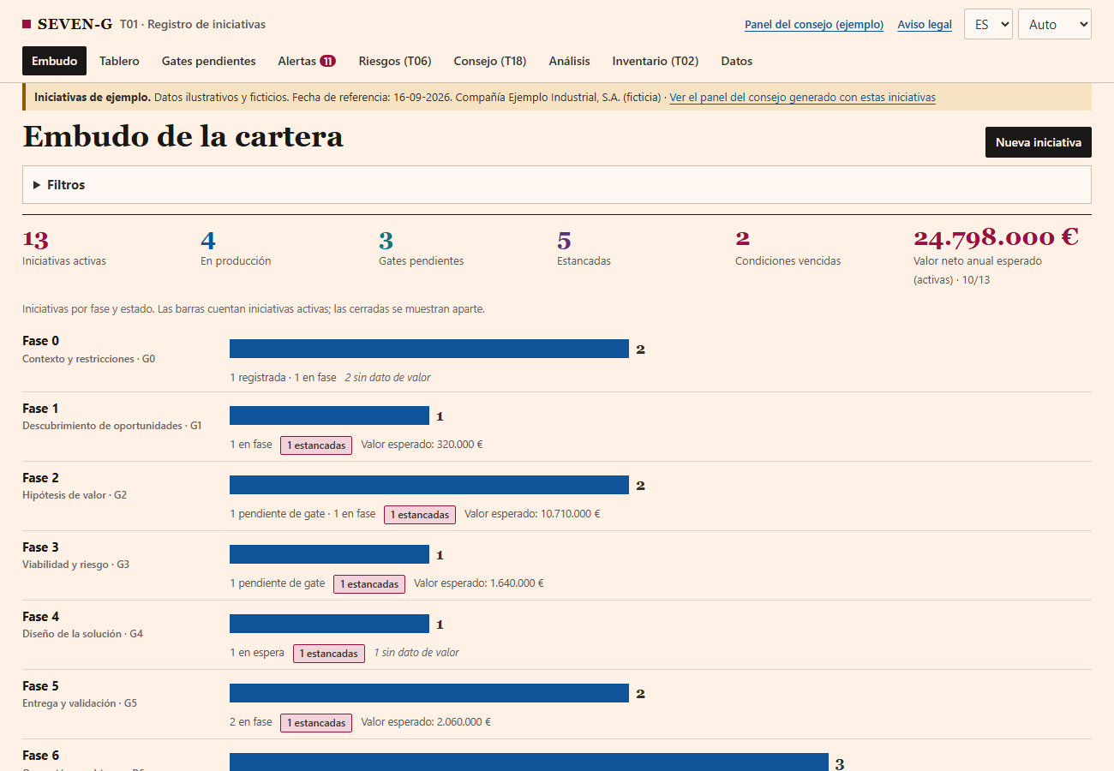
SEVEN-G · COURSE · CONSULTANT · SUPPORTING CLIENTS
The initiative register (T01): where everything is recorded
Each initiative is entered like an opportunity in a CRM; here, the sample register with fictitious data
One bar per phase: how many initiatives are in each one now and how much expected value they carry.
When a gate is decided, the register stores the date, the outcome, who verified and who decided, and the status of each criterion.
From those dates it works out time in phase by itself and flags as "stalled" those beyond the reference time limit.
Figures carry a status: validated, declared or estimated. What is unknown stays "no data", never zero.
Alerts: pending gates, overdue conditions, risks without an owner.
Everything is saved in the company's own JSON file: no server and no data sent to anyone.

Slide 11
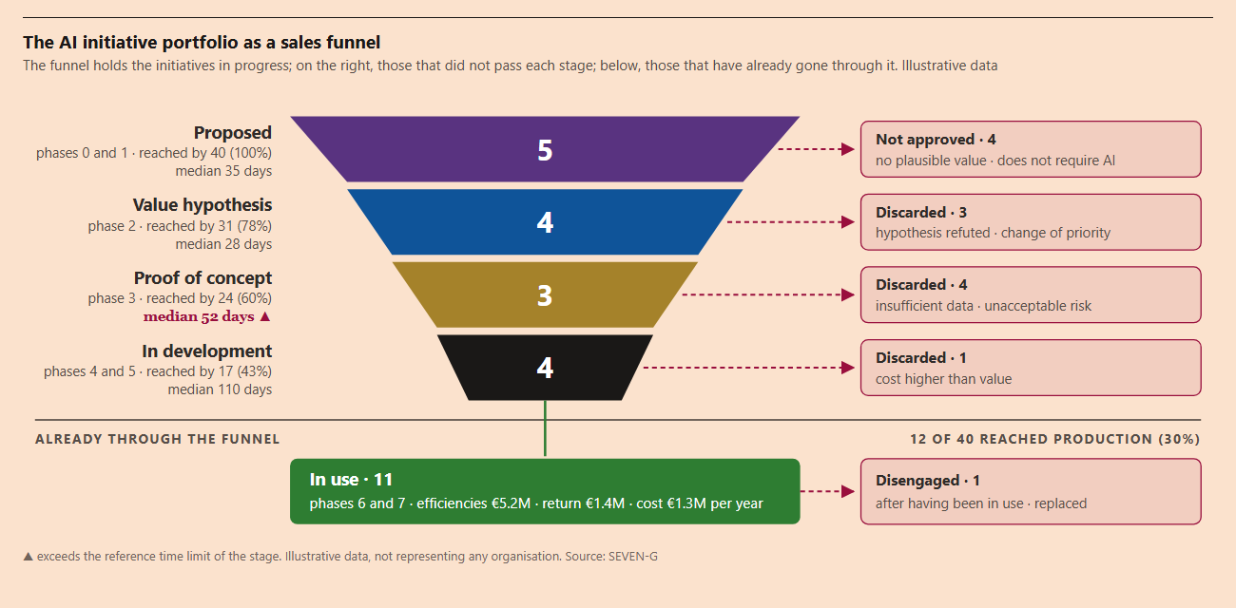
SEVEN-G · COURSE · CONSULTANT · SUPPORTING CLIENTS
The portfolio funnel: how to read it
The AI portfolio, read as a sales funnel. Illustrative data
Inside the funnel, only what is in progress: 5 proposed, 4 with a value hypothesis, 3 in proof of concept and 4 in development.
On the left, how many reached each stage (40 → 31 → 24 → 17) and how long they take. The red triangle warns: proof of concept exceeds its time limit.
On the right, those that did not pass each stage and why: no plausible value, hypothesis refuted, unacceptable risk, cost above value.
Below, those that made it through: 11 in use, with their value and cost, and 1 disengaged.
The goal is not to convert more: stopping an unviable initiative at G3 is a good outcome. 100% conversion would point to soft gates.

Slide 12
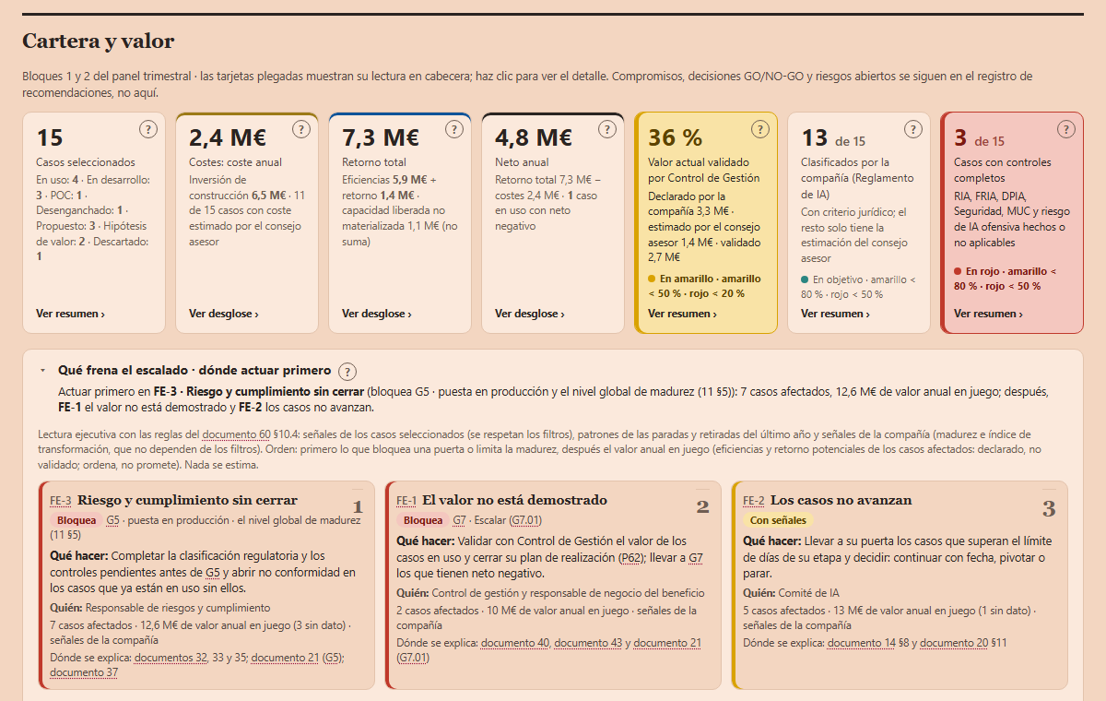
SEVEN-G · COURSE · CONSULTANT · SUPPORTING CLIENTS
The board dashboard (T17): how to read it
It is generated from the same register, with nothing typed twice. Fictitious data
At the top, the figures: 15 cases, costs of €2.4M a year, total return of €7.3M and annual net of €4.8M. Each figure can be clicked to open its cases.
The yellow card is the one that matters: only 36% of the value is validated by finance. In red: only 3 of 15 cases have all the controls.
Below, «What holds back scaling»: the three barriers to start with, with what they block, what to do, who and the value at stake (document 60 §10.4).
In the example: first risk and compliance (blocks G5), then unvalidated value (blocks G7 · Scale) and cases that do not move forward.
The value at stake ranks, it does not promise: it is declared, not validated.
If a figure on the dashboard looks wrong, the dashboard is not touched: the evidence is fixed in the register and it is generated again.

Slide 13
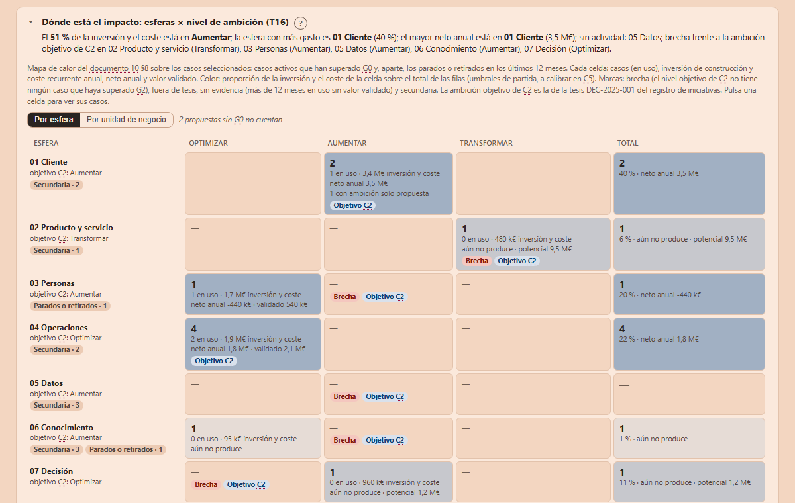
SEVEN-G · COURSE · CONSULTANT · SUPPORTING CLIENTS
Where the impact is: spheres × ambition
The portfolio heat map (T16) in the same dashboard. Fictitious data
Rows: the areas where AI creates value (customer, product, people, operations, data, knowledge, decision). Columns: optimise, augment, transform.
Each cell: cases, investment and cost, annual net and validated value; the colour shows where spending is concentrated.
«Gap»: the ambition management approved in C2 for that sphere has no case that has passed G2.
In the example: 40% of spending is in Customer, Data has no activity and five spheres have a gap.
The target ambition comes from the thesis approved in the register; it is not written in the dashboard.
The question it answers: where does AI have most impact in the company and where are we not playing? (document 10 §8)

Slide 14
TWO EXAMPLES
One initiative that stops and one that reaches production
Fictitious, illustrative data: they do not describe any real company.

Slide 15
SEVEN-G · COURSE · CONSULTANT · SUPPORTING CLIENTS
Example 1 · When an initiative stops
Candidate screening in recruitment (HR)
Phases 0 and 1: HR sponsors it (P01–P05). Because it decides about people, intensity is Enterprise (P04). It enters "Proposed".
Phase 2: the hypothesis (P08) promises 40% less screening time against the baseline (P09). The pilot confirms it: G2, Proceed.
Phase 3: the regulatory classification (P11) makes it a high-risk system. The bias test finds it penalises older candidates.
It iterates twice, adjusting variables: fixing the bias destroys the predictive power that justified the project.
G3: high residual risk with no viable mitigation (P12, P13). The AI committee decides to Stop; it is recorded in P29 with its reason.
In the funnel it shows to the right of "Proof of concept": Discarded · unacceptable risk. Lesson: test for bias earlier, in phase 2.
STOPPED AT G3 · BUILDING AND RUNNING AN UNVIABLE SYSTEM WAS AVOIDED

Slide 16
SEVEN-G · COURSE · CONSULTANT · SUPPORTING CLIENTS
Initiative 1, on the lifecycle
It reached phase 3 and did not pass gate G3
F0
Context and constraints
F1
Opportunity discovery
F2
Value hypothesis
F3
Feasibility and risk
F4
Solution design
F5
Delivery and validation
F6
Operation and governance
F7
Evolution or retirement
G0
G1
G2
G3
G4
G5
R6
G7
STOPPED AT G3 · it leaves the funnel as "Discarded", with its reason

Slide 17
SEVEN-G · COURSE · CONSULTANT · SUPPORTING CLIENTS
Example 2 · When an initiative reaches production
First-line IT incident response assistant
Phases 0 and 1: IT sponsors it; against the non-AI alternative (more staff), the operations sphere with Optimise ambition is proposed (P07).
Phase 2: hypothesis of 30% less resolution time for simple incidents; the controlled pilot yields 32%.
Phase 3: no relevant bias, medium residual risk accepted by the right body (P12), supplier assessed (P14). G3, Proceed.
Phases 4 and 5: mandatory human oversight above a severity level (P17), tested rollback (P19) and go-live sign-off (P23).
Phase 6: fourteen months in use. Finance validates €1.1M a year (P28); released capacity was reassigned to complex incidents.
In the funnel it sits under "In use"; on the dashboard it adds to annual net because its value is validated, not declared.
IN PRODUCTION · €1.1M OF VALIDATED ANNUAL RETURN · QUARTERLY R6

Slide 18
SEVEN-G · COURSE · CONSULTANT · SUPPORTING CLIENTS
Initiative 2, on the lifecycle
It went through phases 0 to 6 and remains in use; phase 7 will come with G7
F0
Context and constraints
F1
Opportunity discovery
F2
Value hypothesis
F3
Feasibility and risk
F4
Solution design
F5
Delivery and validation
F6
Operation and governance
F7
Evolution or retirement
G0
G1
G2
G3
G4
G5
R6
G7
IN USE · each R6 confirms it keeps delivering value under control

Slide 19
SEVEN-G · COURSE · CONSULTANT · SUPPORTING CLIENTS
How value is measured
Every amount carries a formula and a status: validated (finance), declared (the team) or estimated.
Released hours are not savings until they are materialised: a cost goes down or they are reassigned to a valuable activity.
Cost is complete: build, consumption, operation, human oversight and retirement.
The transformation index uses eight evidence signals to tell transformation apart from mere efficiency.
Ten measurement rules (document 40). No figure enters the portfolio net without its status.

Slide 20
FOR THE CONSULTANT
Applying SEVEN-G at clients, under your own name
The licence allows it, including in paid services and without hiring the author. In return it asks for fidelity, independence and honesty.

Slide 21
SEVEN-G · COURSE · CONSULTANT · SUPPORTING CLIENTS
What the licence allows and what you take on
You may use, adapt and apply the framework in paid services without asking permission: credit the author, indicate changes and do not suggest endorsement.
You answer to your client for your service: SEVEN-G is a reference framework, not a guarantee of results.
You state which version you apply and what you have adapted, in every deliverable.
Client information is not used with other clients or in examples, not even anonymised, without written authorisation.
Regulatory classification and legal matters require qualified legal judgement; carry the legal notice into your deliverables.
Document 91, section 2, and document 93.

Slide 22
SEVEN-G · COURSE · CONSULTANT · SUPPORTING CLIENTS
Six rules you cannot drop without saying so
Segregation of duties: whoever builds does not control, and nobody approves themselves.
Dual validation at the gates and a real ability to stop.
The ten measurement rules: a status for every amount, and released capacity does not count until materialised.
Ambition classified with the five questions.
Maturity based on observable evidence, not self-assessment.
A recommendations log with persistent identifiers and independent assessment.
If you drop any, your service may be inspired by SEVEN-G, but must not be presented as an application of SEVEN-G.

Slide 23
SEVEN-G · COURSE · CONSULTANT · SUPPORTING CLIENTS
Five engagement models
What each one delivers; durations are indicative
M1 · Diagnosis
M2 · Implementation
M3 · Audit
M4 · Board advisory
M5 · Ongoing support
4 to 6 weeks. Inventory, evidence-based maturity (T15), transformation index (T14), current value and cost. C1 report (P33).
90 days. Thesis and risk appetite, governance, portfolio, T01 register and dashboard with real data, and the first board pack.
Independent opinion: Compliant, Compliant with observations or Non-compliant. Plan, working papers and report (P58, P59, P60).
Annual mandate. Preparing sessions, reviewing the quarterly pack, logged recommendations and independent assessments.
Support to the AI office: register, funnel metrics and packs, always with a transfer plan and an exit date (P71).
In all of them the company decides; you prepare, propose, verify or advise.

Slide 24
SEVEN-G · COURSE · CONSULTANT · SUPPORTING CLIENTS
Independence: whoever implements does not audit
You cannot independently verify, audit or assess what you, your firm or a related entity designed, implemented or operated.
Implementation (M2) and audit (M3) are incompatible for the same scope; neither is advising the board (M4) on what you operate (M5).
After an incompatible service, let at least one full annual cycle pass before auditing that scope.
Declare in writing your relationships with technology vendors, your own tools and your fee scheme (P41).
Value-linked fees: only on value validated by finance or by an audit that is not yours.
Document 91, section 5.

Slide 25
SEVEN-G · COURSE · CONSULTANT · SUPPORTING CLIENTS
What you can and cannot say
SEVEN-G is a registered trademark of Fernando García Varela; the content licence does not grant the trademark
Yes
No
Do not promise
"Service based on SEVEN-G (version …), a framework by Fernando García Varela, CC BY 4.0." "Methodology adapted from SEVEN-G; changes: …" "Uses the sphere map and measurement rules of SEVEN-G."
"SEVEN-G certified", "accredited consultancy", "official partner", "endorsed by the author": there is no certification or partner programme. Nor "compliance guaranteed by SEVEN-G".
X% savings before the diagnosis, a maturity level by a date, "your company will transform", "no risk", or implementation deadlines without a diagnosis.
Document 91, sections 6 and 8.

Slide 26
SEVEN-G · COURSE · CONSULTANT · SUPPORTING CLIENTS
Your templates and leaving the engagement
P70 Proposal and engagement letter: scope, model (M1–M5), out of scope, roles on both sides and independence.
P41 Declaration of independence and conflicts of interest, at the start of every M3 or M4 service.
Quality: every deliverable states version and adaptations, links its evidence and is reviewed by a second professional.
P71 Transfer plan and exit note: registers in open format, evidence located, pending items with an owner and open risks.
The test of good work: the company does not need you to read or maintain anything you delivered.

Slide 27
Thank you
SEVEN-G is free: it is used, downloaded and adapted without registering, and the site will never write to you. If you want to talk to the author, the initiative is yours.
SEVEN-G is a registered trademark of Fernando García Varela · CC BY 4.0 (content) · MIT (code)
https://www.linkedin.com/in/fernandogarciavarela/
Legal notice: a generic, free methodological aid provided "as is" for information purposes; it is not legal advice and has not been legally reviewed for any case. Each organisation adapts it and is responsible for its legal review and its regulatory compliance; it may not reflect recent regulatory changes. To the fullest extent permitted by law, the author accepts no liability whatsoever for the effects of its application. It does not grant certification of any kind. Details in document 93.

