Slide 1
SEVEN-G · COURSE · PARTNER · BUILDING IT INTO YOUR METHODOLOGY
SEVEN-G
Partner · Building it into your methodology
What SEVEN-G is, how the initiative funnel gets filled all the way to the board dashboard, and how to build it into your own methodology or product.
Fernando García Varela · Self-learning course · CC BY 4.0 · Examples with fictitious data

Slide 2
SEVEN-G · COURSE · PARTNER · BUILDING IT INTO YOUR METHODOLOGY
The problem it solves
Many companies have AI pilots that work, but few reach production.
Value gets declared ("we freed up 200 hours") and almost nobody checks it.
Nobody has clear authority to stop an initiative that is not working.
The board asks about AI and gets a list of technical projects, not business decisions.
Is the company transforming with AI, or just a bit more efficient? Almost nobody can answer that with evidence.
This is not a technology problem: it is a governance and measurement problem.

Slide 3
SEVEN-G · COURSE · PARTNER · BUILDING IT INTO YOUR METHODOLOGY
What SEVEN-G is and what it delivers
Seven-phase Enterprise Value & Governance: an enabling phase 0 and seven value phases, with governance throughout.
It organises AI as a portfolio: every initiative has a phase, a cost, expected value and an owner.
It places decision gates between phases: no verified evidence, no progress.
It separates who decides, who builds and who controls, and turns regulation into phases, roles and evidence.
It measures value in money and with a status —validated, declared or estimated— and shows it to the board on a dashboard.
It is free and modifiable: documents, Word templates and tools, under an open licence.

Slide 4
SEVEN-G · COURSE · PARTNER · BUILDING IT INTO YOUR METHODOLOGY
Two levels: the company and each initiative
C1 · Diagnosis: inventory, maturity across seven dimensions and the transformation index.
C2 · Direction: the board approves the AI thesis, ambition per sphere and risk appetite.
C3 · Portfolio: which initiatives get funded, and in what order.
C4 · Oversight: board dashboard and the log of decisions and recommendations.
C5 · Annual review: what worked, what did not and what changes.
And, inside that portfolio, each initiative goes through its own eight-phase lifecycle.

Slide 5
SEVEN-G · COURSE · PARTNER · BUILDING IT INTO YOUR METHODOLOGY
An initiative's lifecycle
Eight phases with a decision gate at the end of each; below, the funnel stage where each phase shows up
F0
Context and constraints
F1
Opportunity discovery
F2
Value hypothesis
F3
Feasibility and risk
F4
Solution design
F5
Delivery and validation
F6
Operation and governance
F7
Evolution or retirement
G0
G1
G2
G3
G4
G5
R6
G7
Proposed
Value hypothesis
Proof of concept
In development
In use

Slide 6
SEVEN-G · COURSE · PARTNER · BUILDING IT INTO YOUR METHODOLOGY
What can happen at each gate
Five outcomes; whoever provides the evidence never verifies it or decides
Proceed
With conditions
Iterate
Pivot
Stop
All criteria are met and the evidence is verified: it moves to the next phase.
It proceeds, with a deadline and owner for what is pending. Never for critical security, legal or human-oversight controls.
The phase repeats with a specific adjustment and returns to the same gate. The third time, the higher body decides.
The hypothesis does not hold but another reasonable one exists: back to phase 2. Only at G1, G2 and G3.
No plausible value, or unacceptable risk. The reason and lessons are recorded. It is a good outcome.
At G7 the outcomes are Scale, Iterate or Retire.

Slide 7
FROM DOCUMENT TO DASHBOARD
How the funnel gets filled
Nobody draws the funnel or the dashboard: they come out of what is filled in and decided at each phase. This is the path.

Slide 8
SEVEN-G · COURSE · PARTNER · BUILDING IT INTO YOUR METHODOLOGY
Phases 0 to 3: from idea to proof of concept
What is done, which templates are filled in and which gate closes each phase
F0
Context and constraints
F1
Discovery
F2
Value hypothesis
F3
Feasibility and risk
What is done. The idea is authorised: sponsor, owner, scope, constraints and intensity (Lite or Enterprise).
Filled in. P01 Initiative charter · P02 Context and constraints · P03 Roles · P04 Intensity · P05 Inventory entry.
What is done. Opportunities are compared, including non-AI alternatives, and a sphere and ambition level are proposed.
Filled in. P06 Opportunity portfolio and screening · P07 Sphere and ambition · P31 Use case sheet.
What is done. A falsifiable hypothesis in money, with baseline, attribution method and stop criteria set in advance.
Filled in. P08 Value hypothesis canvas · P09 Baseline. Support: T11 calculator.
What is done. Proof of concept: feasibility, regulatory classification, risks and suppliers. It is the main stop gate.
Filled in. P10 Feasibility · P11 Regulatory classification and impact · P12 Risks · P13 Mitigation · P14 Supplier.
G0 → enters "Proposed"
G1 → stays in "Proposed"
G2 → "Value hypothesis"
G3 → "Proof of concept"
Every gate decision is recorded in P29 and in the T01 register, with the status of each criterion and its evidence.

Slide 9
SEVEN-G · COURSE · PARTNER · BUILDING IT INTO YOUR METHODOLOGY
Phases 4 to 7: from design to production and retirement
Go-live does not close the cycle: it opens operation, with periodic reviews
F4
Solution design
F5
Delivery and validation
F6
Operation and governance
F7
Evolution or retirement
What is done. Before building: architecture, data and model lineage, human oversight, security, rollback and adoption.
Filled in. P15 Architecture · P16 Lineage · P17 Human oversight · P18 Security · P19 Rollback · P20 Adoption.
What is done. Build, validate and pilot; the rollback is tested and go-live is signed off.
Filled in. P21 Delivery report · P22 Validation and pilot · P23 Go-live sign-off · P12 updated.
What is done. Monitoring, incidents, changes and tracking of realised value, with a periodic continuity review.
Filled in. P24 Operations manual · P25 Monitoring · P26 and P27 Incidents and changes · P28 Value · P65 R6 pack.
What is done. With realised value on the table, the decision is to scale, iterate or retire, and lessons are recorded.
Filled in. P28 Value tracking · P30 Scale-or-retire decision, with a retirement plan where applicable.
G4 → "In development"
G5 → moves to "In use"
R6 → stays "In use" or brings G7 forward
G7 → scale, iterate or "Disengaged"
Every gate decision is recorded in P29 and in the T01 register, with the status of each criterion and its evidence.

Slide 10
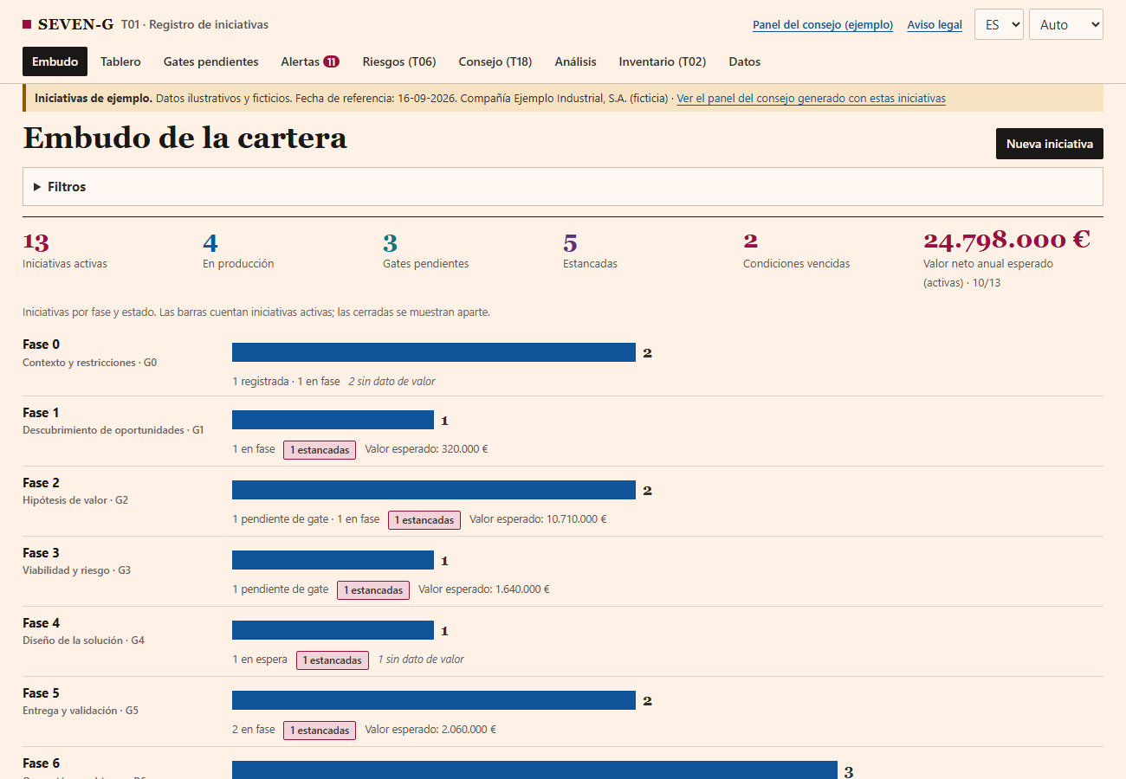
SEVEN-G · COURSE · PARTNER · BUILDING IT INTO YOUR METHODOLOGY
The initiative register (T01): where everything is recorded
Each initiative is entered like an opportunity in a CRM; here, the sample register with fictitious data
One bar per phase: how many initiatives are in each one now and how much expected value they carry.
When a gate is decided, the register stores the date, the outcome, who verified and who decided, and the status of each criterion.
From those dates it works out time in phase by itself and flags as "stalled" those beyond the reference time limit.
Figures carry a status: validated, declared or estimated. What is unknown stays "no data", never zero.
Alerts: pending gates, overdue conditions, risks without an owner.
Everything is saved in the company's own JSON file: no server and no data sent to anyone.

Slide 11
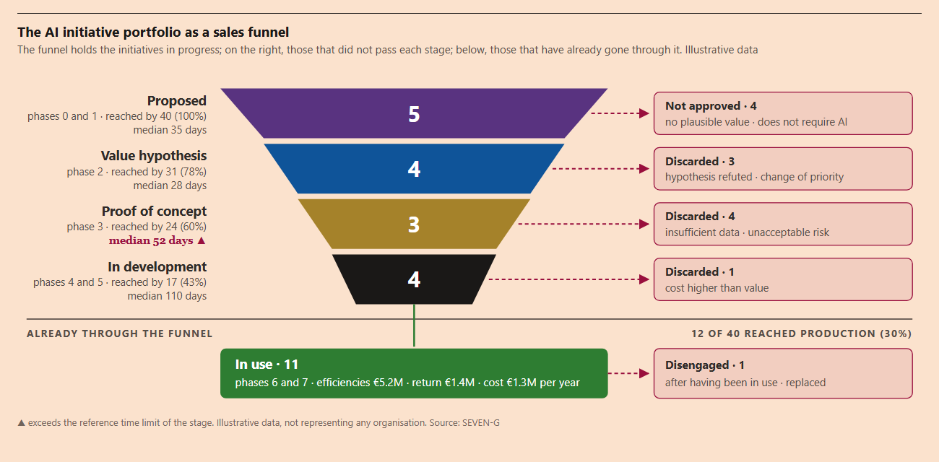
SEVEN-G · COURSE · PARTNER · BUILDING IT INTO YOUR METHODOLOGY
The portfolio funnel: how to read it
The AI portfolio, read as a sales funnel. Illustrative data
Inside the funnel, only what is in progress: 5 proposed, 4 with a value hypothesis, 3 in proof of concept and 4 in development.
On the left, how many reached each stage (40 → 31 → 24 → 17) and how long they take. The red triangle warns: proof of concept exceeds its time limit.
On the right, those that did not pass each stage and why: no plausible value, hypothesis refuted, unacceptable risk, cost above value.
Below, those that made it through: 11 in use, with their value and cost, and 1 disengaged.
The goal is not to convert more: stopping an unviable initiative at G3 is a good outcome. 100% conversion would point to soft gates.

Slide 12
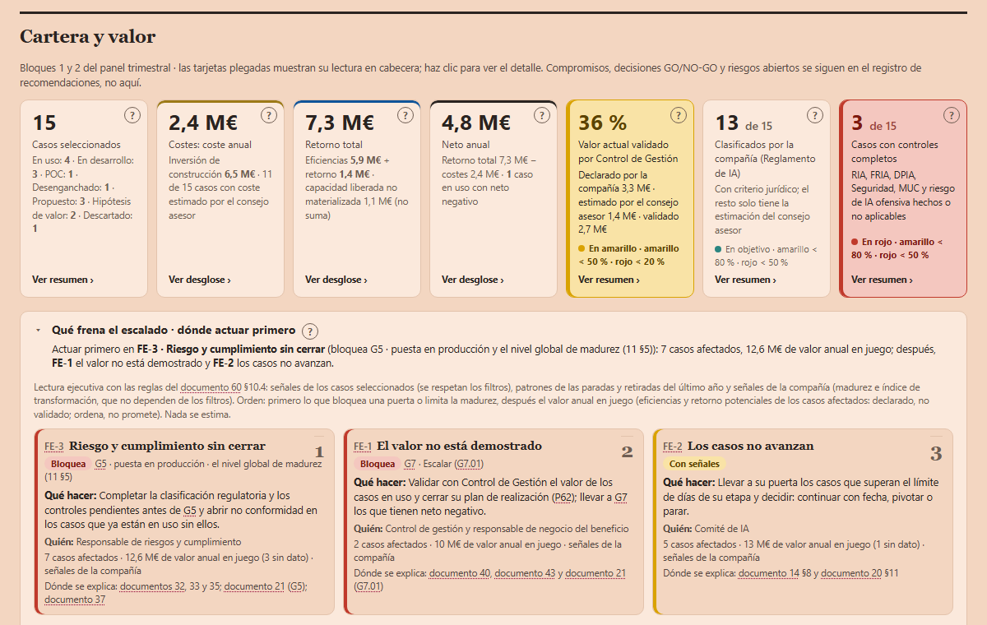
SEVEN-G · COURSE · PARTNER · BUILDING IT INTO YOUR METHODOLOGY
The board dashboard (T17): how to read it
It is generated from the same register, with nothing typed twice. Fictitious data
At the top, the figures: 15 cases, costs of €2.4M a year, total return of €7.3M and annual net of €4.8M. Each figure can be clicked to open its cases.
The yellow card is the one that matters: only 36% of the value is validated by finance. In red: only 3 of 15 cases have all the controls.
Below, «What holds back scaling»: the three barriers to start with, with what they block, what to do, who and the value at stake (document 60 §10.4).
In the example: first risk and compliance (blocks G5), then unvalidated value (blocks G7 · Scale) and cases that do not move forward.
The value at stake ranks, it does not promise: it is declared, not validated.
If a figure on the dashboard looks wrong, the dashboard is not touched: the evidence is fixed in the register and it is generated again.

Slide 13
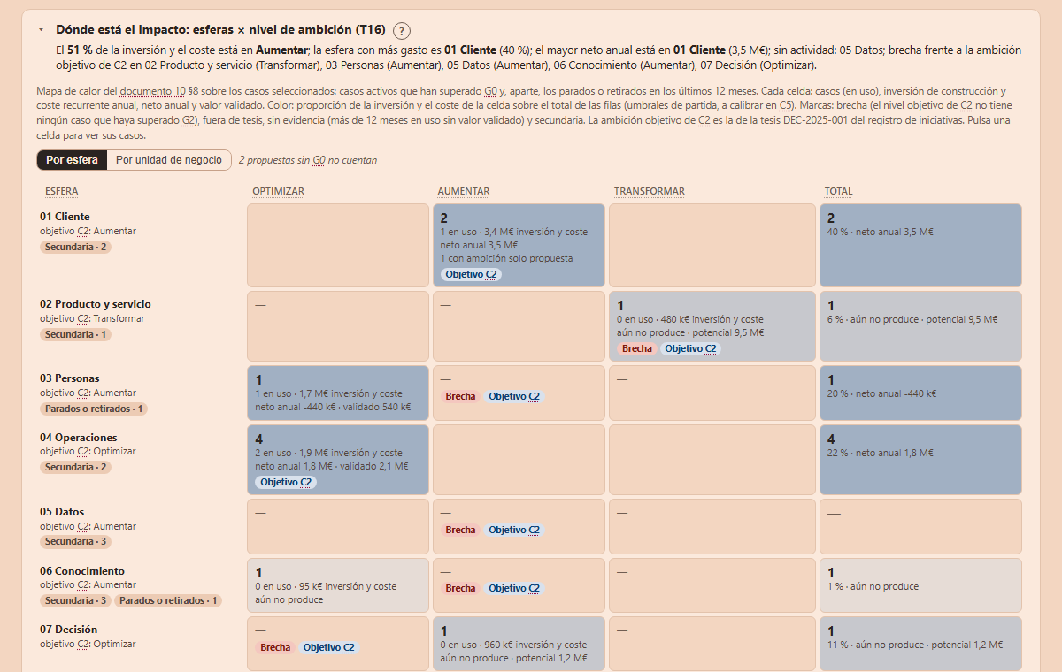
SEVEN-G · COURSE · PARTNER · BUILDING IT INTO YOUR METHODOLOGY
Where the impact is: spheres × ambition
The portfolio heat map (T16) in the same dashboard. Fictitious data
Rows: the areas where AI creates value (customer, product, people, operations, data, knowledge, decision). Columns: optimise, augment, transform.
Each cell: cases, investment and cost, annual net and validated value; the colour shows where spending is concentrated.
«Gap»: the ambition management approved in C2 for that sphere has no case that has passed G2.
In the example: 40% of spending is in Customer, Data has no activity and five spheres have a gap.
The target ambition comes from the thesis approved in the register; it is not written in the dashboard.
The question it answers: where does AI have most impact in the company and where are we not playing? (document 10 §8)

Slide 14
TWO EXAMPLES
One initiative that stops and one that reaches production
Fictitious, illustrative data: they do not describe any real company.

Slide 15
SEVEN-G · COURSE · PARTNER · BUILDING IT INTO YOUR METHODOLOGY
Example 1 · When an initiative stops
Candidate screening in recruitment (HR)
Phases 0 and 1: HR sponsors it (P01–P05). Because it decides about people, intensity is Enterprise (P04). It enters "Proposed".
Phase 2: the hypothesis (P08) promises 40% less screening time against the baseline (P09). The pilot confirms it: G2, Proceed.
Phase 3: the regulatory classification (P11) makes it a high-risk system. The bias test finds it penalises older candidates.
It iterates twice, adjusting variables: fixing the bias destroys the predictive power that justified the project.
G3: high residual risk with no viable mitigation (P12, P13). The AI committee decides to Stop; it is recorded in P29 with its reason.
In the funnel it shows to the right of "Proof of concept": Discarded · unacceptable risk. Lesson: test for bias earlier, in phase 2.
STOPPED AT G3 · BUILDING AND RUNNING AN UNVIABLE SYSTEM WAS AVOIDED

Slide 16
SEVEN-G · COURSE · PARTNER · BUILDING IT INTO YOUR METHODOLOGY
Initiative 1, on the lifecycle
It reached phase 3 and did not pass gate G3
F0
Context and constraints
F1
Opportunity discovery
F2
Value hypothesis
F3
Feasibility and risk
F4
Solution design
F5
Delivery and validation
F6
Operation and governance
F7
Evolution or retirement
G0
G1
G2
G3
G4
G5
R6
G7
STOPPED AT G3 · it leaves the funnel as "Discarded", with its reason

Slide 17
SEVEN-G · COURSE · PARTNER · BUILDING IT INTO YOUR METHODOLOGY
Example 2 · When an initiative reaches production
First-line IT incident response assistant
Phases 0 and 1: IT sponsors it; against the non-AI alternative (more staff), the operations sphere with Optimise ambition is proposed (P07).
Phase 2: hypothesis of 30% less resolution time for simple incidents; the controlled pilot yields 32%.
Phase 3: no relevant bias, medium residual risk accepted by the right body (P12), supplier assessed (P14). G3, Proceed.
Phases 4 and 5: mandatory human oversight above a severity level (P17), tested rollback (P19) and go-live sign-off (P23).
Phase 6: fourteen months in use. Finance validates €1.1M a year (P28); released capacity was reassigned to complex incidents.
In the funnel it sits under "In use"; on the dashboard it adds to annual net because its value is validated, not declared.
IN PRODUCTION · €1.1M OF VALIDATED ANNUAL RETURN · QUARTERLY R6

Slide 18
SEVEN-G · COURSE · PARTNER · BUILDING IT INTO YOUR METHODOLOGY
Initiative 2, on the lifecycle
It went through phases 0 to 6 and remains in use; phase 7 will come with G7
F0
Context and constraints
F1
Opportunity discovery
F2
Value hypothesis
F3
Feasibility and risk
F4
Solution design
F5
Delivery and validation
F6
Operation and governance
F7
Evolution or retirement
G0
G1
G2
G3
G4
G5
R6
G7
IN USE · each R6 confirms it keeps delivering value under control

Slide 19
SEVEN-G · COURSE · PARTNER · BUILDING IT INTO YOUR METHODOLOGY
How value is measured
Every amount carries a formula and a status: validated (finance), declared (the team) or estimated.
Released hours are not savings until they are materialised: a cost goes down or they are reassigned to a valuable activity.
Cost is complete: build, consumption, operation, human oversight and retirement.
The transformation index uses eight evidence signals to tell transformation apart from mere efficiency.
Ten measurement rules (document 40). No figure enters the portfolio net without its status.

Slide 20
FOR THE PARTNER
Integrating SEVEN-G into your own methodology or product
Here, "partner" means a company that builds the framework into its own offering under its open licence. There is no partner programme and no "official partner" status.

Slide 21
SEVEN-G · COURSE · PARTNER · BUILDING IT INTO YOUR METHODOLOGY
What the licence allows and what it requires
Content: CC BY 4.0. Tool code: MIT
It allows
It requires
It does not grant
Copying, adapting, translating, trimming, renaming, merging with your methodology and building into products, including commercially, without asking permission or paying.
Crediting the author (Fernando García Varela), linking the licence, indicating changes and keeping the legal notice. In code, keeping the copyright notice and the MIT licence.
The trademark: SEVEN-G is a registered trademark. You may name it to state accurately what you used; not to suggest endorsement, accreditation or certification.
Published versions are not revoked: what you integrate today you can keep using (document 93).

Slide 22
SEVEN-G · COURSE · PARTNER · BUILDING IT INTO YOUR METHODOLOGY
Modular adoption: four components
You can integrate the whole framework or just the pieces your methodology lacks
A · Impact map
B · Governance
C · Measurement
D · Tools
Nine spheres by three ambition levels (Optimise, Augment, Transform). Useful to prioritise and to talk to the board without technology.
Phases, gates with dual validation, segregation of duties, risk, regulation and nonconformities.
Ten measurement rules, amount statuses, full costs and the transformation index.
T01 register, calculators, maturity diagnostic and board dashboard: serverless HTML, JSON data, MIT code.
If you call it "SEVEN-G", respect its six essential rules; otherwise say "adapted from" and state what changes.

Slide 23
SEVEN-G · COURSE · PARTNER · BUILDING IT INTO YOUR METHODOLOGY
How to fit it into your methodology
Build a mapping table: your stages against phases 0 to 7, your committees against the bodies, your deliverables against the P templates.
Keep the codes (G0–G7, P01–P74, T01–T22) or publish your equivalence: your clients will be able to check against the source.
You may change names, thresholds, deadlines and weights. Do not change what protects the client: segregation of duties, evidence before deciding and a status for every amount.
State the base version and your changes; when the framework evolves, decide whether you update, and say so.
In a work that mixes frameworks it must be clear what comes from SEVEN-G. You may license your own contributions as you wish, without blocking the original's licence.

Slide 24
SEVEN-G · COURSE · PARTNER · BUILDING IT INTO YOUR METHODOLOGY
Technical integration: data and tools
One data model for everything: the T01 register's JSON, with its published schema. It can be imported, exported and merged by initiative code.
You can feed that JSON from your own platform (project management, GRC, CRM) and generate the board dashboard with the T17 connector.
The tools are serverless HTML: host them wherever you like, with your brand next to the attribution, and they send data to no one.
The 74 templates are generated in Word from Markdown: you can change styles and cover and regenerate them with your branding.
New schema versions only add optional fields: old files keep working.
The client's data belongs to the client: always leave it in an open format.

Slide 25
SEVEN-G · COURSE · PARTNER · BUILDING IT INTO YOUR METHODOLOGY
How to name it in front of your clients
Stating accurately what was used is mandatory; suggesting endorsement is not allowed
Appropriate
Inappropriate
Notice to keep
"Based on SEVEN-G (version 0.80)." "Adapted from SEVEN-G; changes: …" "Includes the SEVEN-G initiative register (MIT)." "This adaptation is not endorsed by the author."
"Official partner", "approved", "accredited", "SEVEN-G certification", or stating on behalf of SEVEN-G or the author that a client complies with regulation.
"Based on SEVEN-G (Fernando García Varela, CC BY 4.0). Guidance content, "as is", without warranties; not legal advice. The author does not validate or endorse this work."
Document 93, sections 6, 7, 8 and 11.9.

Slide 26
SEVEN-G · COURSE · PARTNER · BUILDING IT INTO YOUR METHODOLOGY
Staying current and improving the framework
The site publishes the framework version and each document's version history: review the changes before updating your adaptation.
Issues and improvement requests: on the community page, with no account or email; the most-voted requests are taken on.
A translation of yours is a derivative work: state that it is unofficial, which version it comes from and who made it.
If you want something the licence does not give —custom work, training for your team, an agreement on trademark use— talk to the author. You start that conversation.

Slide 27
Thank you
SEVEN-G is free: it is used, downloaded and adapted without registering, and the site will never write to you. If you want to talk to the author, the initiative is yours.
SEVEN-G is a registered trademark of Fernando García Varela · CC BY 4.0 (content) · MIT (code)
https://www.linkedin.com/in/fernandogarciavarela/
Legal notice: a generic, free methodological aid provided "as is" for information purposes; it is not legal advice and has not been legally reviewed for any case. Each organisation adapts it and is responsible for its legal review and its regulatory compliance; it may not reflect recent regulatory changes. To the fullest extent permitted by law, the author accepts no liability whatsoever for the effects of its application. It does not grant certification of any kind. Details in document 93.

