Slide 1
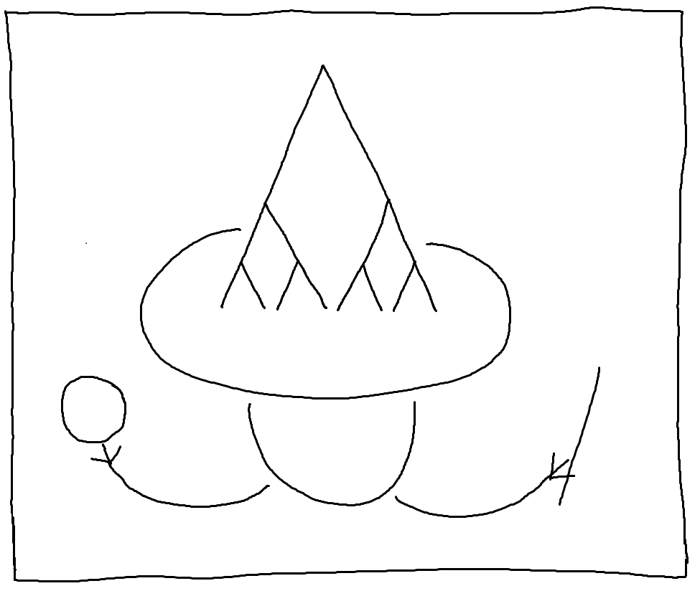
Treehehe
An interactive visualization of proof trees by Chelsea Battell

Slide 2


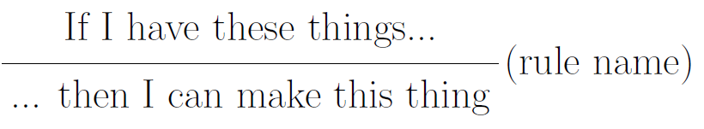
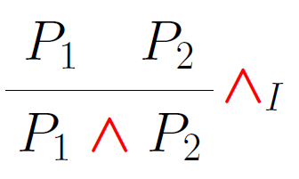
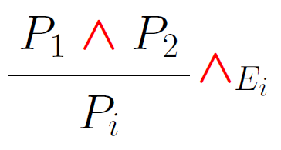
Application Domain
Goal: explore and gain insight on proofs and proof systems
          Super-fast logic introduction:
Formula – an expression we build that is true or false
Inference rule – how to build a thing or take it apart, giving meaning to connectives
Proof tree – stick rules together, filling in variables consistently, with assumptions as leaves and goal as root

Slide 3
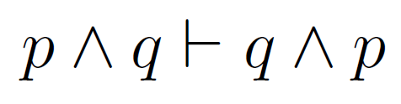


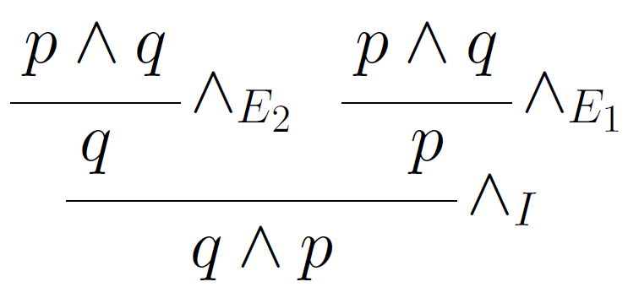
User Tasks
Choose an example judgment
Exploring a proof, optionally guided
Viewing supplementary info on selected node
Reviewing rule sets

Slide 4
InfoVis Elements
Tilford-Reingold-Walker algorithm for layout
Focus+context: children ← focus → parent
Interaction:
  Overview/explore: full tree view and navigation
  Abstract/elaborate: detail view vs structure view
  Select: display information on focused node
Colour
  To highlight a focused node and related nodes
  Categorizing nodes (e.g. children, visited)

Slide 5
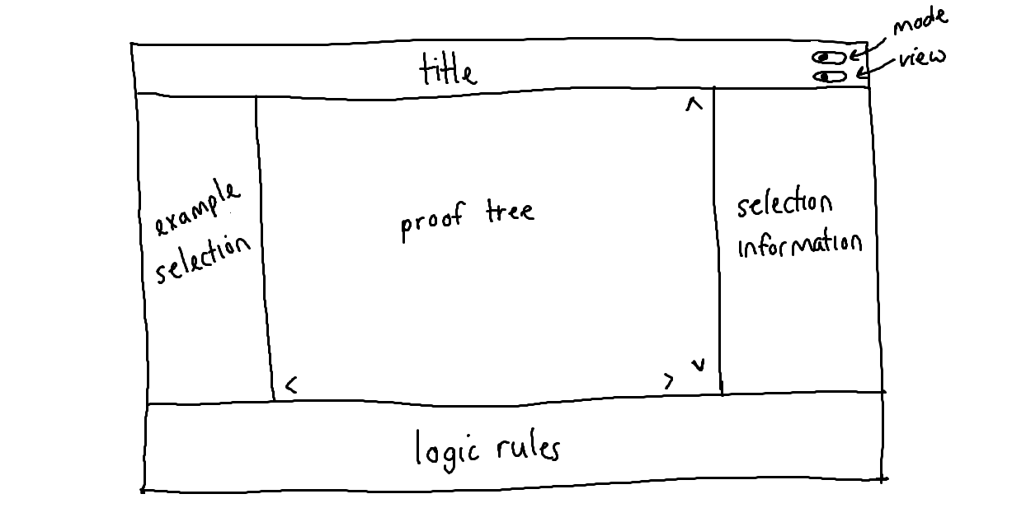
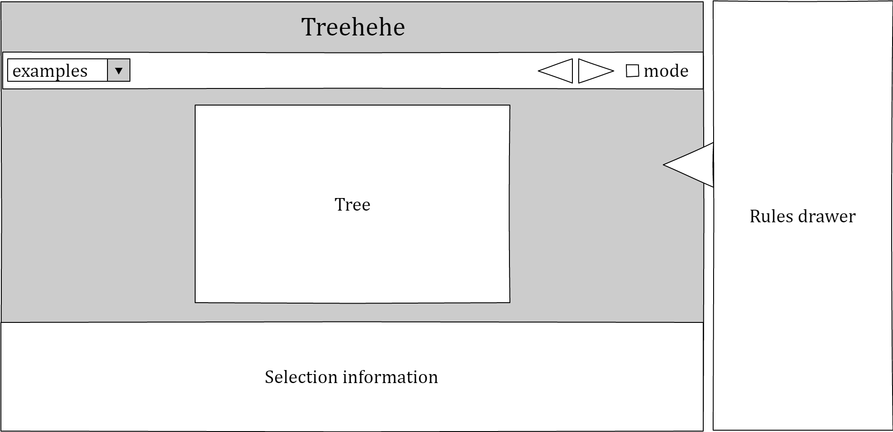
Design Sketches: Page

Slide 6
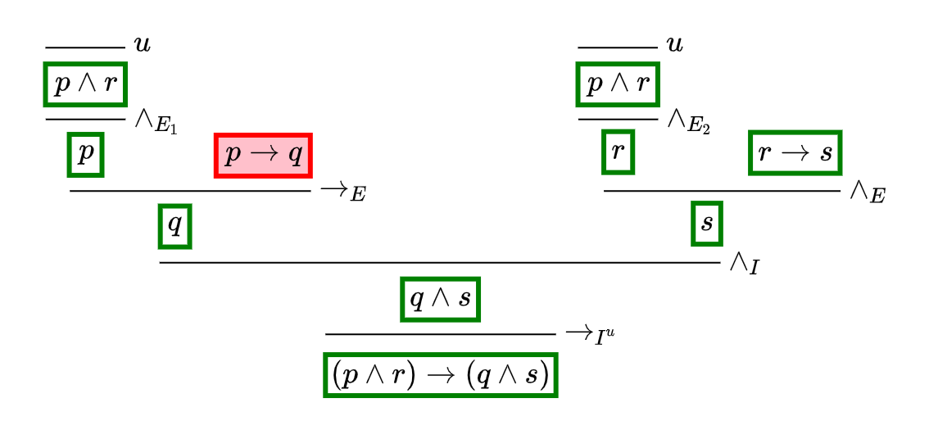
Design Sketches: Proof

Slide 7
Technology
Main languages: HTML, CSS, JavaScript
  Fast prototyping, easy sharing
Laying out math: MathJax
Tree structure: D3 trees
  Handles most of layout computation
  Modifications:
    Bottom rooted, no links, add inference lines & side content
  Challenges:
    Unconventional tree components
    Varied node widths
    Sequencing layout using LaTeX

Slide 8
Demo
Remaining tasks:
  Structure view
  Minimizing subtrees

Slide 9
Discussion
Consequences of logic choice
  Simpler logics see fewer benefits in documentation and insight, but are easier to understand
  Other visualizations may be better for natural deduction
Reasoning direction
  Forward (assumptions to goal) more natural
  Backward (goal to assumptions) more conducive to automatic reasoning
Impact of different traversals on cognition
Remaining tasks:
  Hiding subtrees
  Structure view

