Slide 1

Optimal Control of a Microgrid with Quantized Laxity Loads and significant Renewable Generation Via Smart Energy Analytic Disaggregation System(SEADS)
Presenter: Ali Adabi
Notes:
Hello Everyone My name is Ali Adabi
I will be talking about Optimal Control of a Microgrid with state dependent quantized laxity loads

Slide 2
Agenda
Microgrid Energy Management
Load and generation (+ storage ?)
Control of a Microgrid
Research Objective
How to monitor loads
Non-Intrusive Load Monitoring
Context and motivation
Research Issues
An embedded systems for load monitoring and control(SEADS)
Data Rates (sampling rate)
Accuracy
Training
Future Thesis Work
Research Contributions
Thesis Areas and Coursework
Notes:
Today I am going to talk about various subjects starting from Microgrid Energy management and Non Intrusive Load monitoring and SEADS and then I will talk about my current and future thesis work.

Slide 3














Microgrid
Grid
Fossil
Generation
Microgrid
Load
Wind Turbine
Solar
Generation
Storage
Notes:
Microgrids are islandable partitions of a larger power grid paired with an added layer of information technology and intelligence. Generally Microgrid
discussed in this presentation have significant generation from renewable
sources (Photovoltaic and wind), possibly augmented with
more conventional but limited generation and storage.
Theyalso have the ability to measure and control various sheddable loads through a dynamic demand response mechanism.

Slide 4


Microgrid: Generation Exceeds Loads (Island)
Generation
Solar Generation
Load
HVAC
Electric Car
Wind Generation
Solar Generation
Notes:
In a Sunny and/or windy day you can have generation exceeding the load
Sell back to the grid
Store the energy
Explain HVAC

Slide 5
Microgrid Control: Generation Exceeds Loads(Island)
Generation
Solar Generation
Wind Generation
Load
HVAC
Electric Car
Solar Generation
Storage as load
Notes:
Storage can be your water heater or actual battery or grid as storage But what if the generation is less than load!?

Slide 6
Microgrid : Load Exceeds Generation
Generation
Solar Generation
Wind Generation
Load
Washer & Dryer
Electric Car
HVAC
Notes:
What do you do when the the price of electricity is really high during the night???

Slide 7
Microgrid : Load Exceeds Generation(Grid Connected)
Generation
Solar Generation
Wind Generation
Load
Washer & Dryer
Electric Car
HVAC
Grid
Notes:
What do you do when the the price of electricity is really high during the evening???
You can either use grid or what if the electricity price is too high at evening

Slide 8

Microgrid : Load Exceeds Generation(Grid Connected)
Generation
Solar Generation
Wind Generation
Load
Washer & Dryer
Electric Car
HVAC
$$Grid $$
Notes:
What do you do when the the price of electricity is really high during the night??? Plus your carbon foot print will be increased!! And you have TOU time of use which means you are charged for peak hours differntly

Slide 9
Microgrid Control: Load Exceeds Generation(Island)
Generation
Solar Generation
Wind Generation
Load
Electric Car
HVAC
Notes:
We call loads like washer and dryer loads with laxity so we need some method of shedding loads and we have to do it quick to make our system resilient! We have to be able to measure and shed loads as quickly as possible otherwise we lose power.

Slide 10
Demand Response
“Demand-response” engages consumers to balance their consumption to match changes in available generation.
How does a utility company enable demand response?
Time Based pricing:
TOU: Time of use policy incentivizes consumers to use less power
Real time pricing (Dynamic pricing)
Critical Peak Pricing
Peak load reduction credits
Notes:
Federal Energy Regulatory Commission: “Changes in electric usage by end-use customers from their normal consumption patterns in response to changes in the price of electricity over time, or to incentive payments designed to induce lower electricity use at times of high wholesale market prices or when system reliability is jeopardized.”
Games that utility play
“Demand-response” engages consumers to balance their consumption to match changes in available generation. Automating this requires closed loop control. The most challenging demand-response is the operation of a micro-grid, with total dependence on local generation, predominately from renewable sources. Control of such a micro-grid requires instrumentation and control to balance generation and load. This requires identification, categorization and prioritization of loads. Loads with “laxity”, (e.g. electric water heater, pool pump, clothes dryer) can be economically equipped to be able to turn on or off in response to excess or deficient energy supply. Essential to this work is the determination of the cost-effective instrumentation and determining the variables, and the sampling rates necessary, to support closed-loop control
How is Demand response and micro grid are related? Because demand response trys to balance generation and load but what if we have more generation that load?

Slide 11
Microgrid
Grid
LM=Load Monitor
Fossil
Generation
Microgrid
Load
LM
Microgrid
Monitoring
And Control
Wind Turbine
LM
Solar
Generation
LM
Storage
Notes:
*So we have to monitor all sheddable loads or all load with so called laxity
Monitoring is essential for micro grid to keep the balance , We can put monitoring on every load or we can have central monitoring system! The question we ask here is how we can minimize the amount of load monitoring devices therefore reducing the cost while maintaining the resiliency of the microgrid and maintaining the balance. We need a microgrid central controller that keeps track of Generation and Load. If we can’t measure, it we can’t control it.
How can we centrally monitor loads?
We can do this through a system called NILM.

Slide 12
Microgrid
What is the challenge here?
We are trying to sense loads activities(bug bites) using the lowest amount of cost
Make low cost sensors and put them in every plug that communicate wirelessly with some base?
Train an intelligent system(like brain) learn loads behavior (bug bites)
Touch sensors = voltage, current, sonar sensors

Slide 13
Research Objective
To find optimum sampling rate and cost effective instrumentation for load detection:
Microgrid control
Demand Response
Study appliances’ training process (& Make it faster)
Autonomous signature detection based on the clustering results for unknown devices (unrecognized signatures) and develop generalized signatures
Notes:
Study of the appliance training process
from occupants point of view and proposing approaches which facilitates the training process for occupants
Thorough analysis of the appliance signatures in isolation for multiple categories of devices to study the possibility of developing generalized signatures using machine learning approaches for pre-installation autonomous training
If you add a new device we will be able to detect it

Slide 14
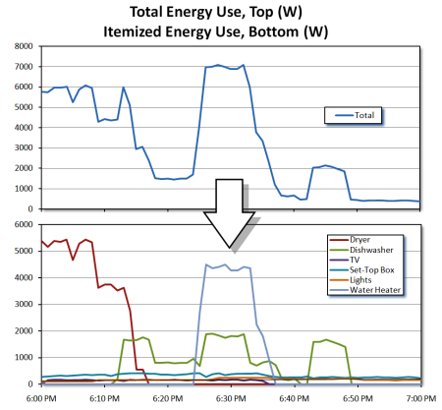
NILM(Non Intrusive Load Monitoring)
Notes:
What is NILM?
G. Hart wrote a paper in 1992 describing a method for disaggregating loads

Slide 15
NILM’s Motivation
Why NILM?
Lower cost
Easy installation
Automation
Where can it be used?
Microgrid(Island)
Grid connected
Residential
Businesses and Services
Utility
Why there isn’t any NILM device out there? (Bidgely, Energy Detective, Neurieo)/ (sampling rate)
Cost
Installation
Training
Accuracy and Performance
Notes:
Research in non-intrusive load monitoring (NILM) has exploded in recent years, enabling innovative and significant technological
advances. Few products are yet available, but development is underway at universities and a few corporations worldwide. In this
presentation I will discuss some of NILM benefits challenges and my vision of how these products will enable energy efficiency, improve comfort. Specifically, I am envisioning products that serve the greater systems – the energy management of a Microgrid, whole-house, and community energy systems. Feedback on energy consumption, with device-level breakdown, is a clear opportunity.
As built-in efficiency opportunities have been leveraged, energy consumption by lighting, electronics, and “other” end-uses – most
of which the designer/builder can neither control nor effectively predict – has surpassed every other category and now accounts for
roughly 40% of electricity costs in U.S. homes.
Homeowners do not know where their energy “goes” – i.e., how, when, and why their devices, lighting, and appliances are using
Energy3. They are similarly naïve about the savings potential and comfort enhancements available from usage and retrofit changes Homeowners struggle to maintain appliances, and have very limited tools to manage their energy use, costs, and comfort.
Services: Many small legacy audit and analysis businesses struggle to maintain high quality service with low resolution data and low profit margin.
Utilities: Because of regulatory environment and a highly diverse residential customer base, and low sampling rate smart meters(once every 15 min) utilities have limited tools to effectively report residential energy savings and reductions. Utilities are challenged to generate sufficient energy during peak consumption hours to maintain the grid stability.
Alternatively, NILM can be packaged as a standalone consumer product. Early market products have not been widely successful
Why there isn’t any NILM device out there?
For several reasons – primarily cost and installation requirements. Although market analysis would be necessary for a given product.

Slide 16


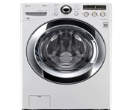
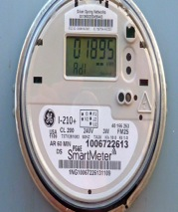
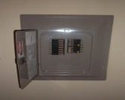
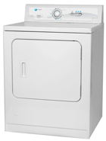

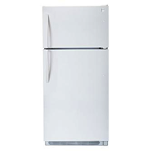

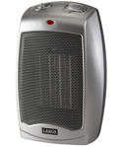

Smart Meters
Notes:
Smart meters application (what it does and what it doesn’t)
Smart meters are not made for a typical microgrid control and monitoring, they can deliver results to PG&E every 15min.

Slide 17
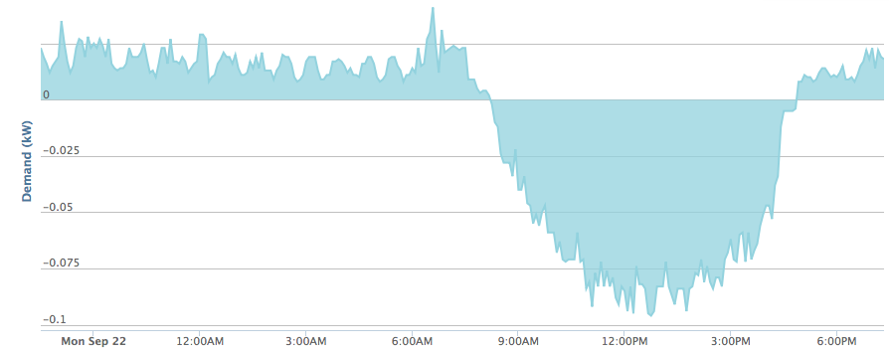
Bidgley

Slide 18
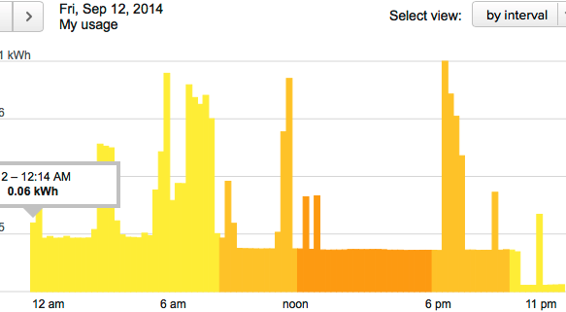
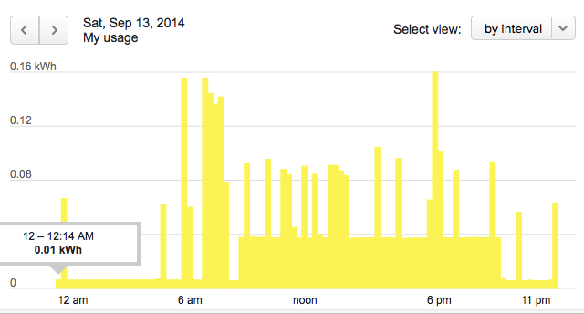
Smart Meters Application
Notes:
Smarter meters are installed on the pump

Slide 19
NILM Near Term Application
Deliver feedback and visualization
Demand Response (provided by utility incentives)
Dynamic pricing
Smart Energy Efficiency methods
Understand Occupancy
Usage Profiles
Notes:
near term: Many utilities provide incentives for demand response, a trend that will certainly grow.
If NILM allowed a thermostat to see that all the lights, the entertainment center, the oven, and the refrigerator turned on, the
air conditioner could turn on in advance of the temperature rising, and the system could direct cooling to occupied rooms, thus
delivering substantial savings and better comfort.
Advanced control:
Applications will then be able to forecast imminent problems, deliver maintenance
reminders, and identify when professional service is needed.
Continuous Home audit:
Applications will then be able to forecast imminent problems, deliver maintenance reminders, and identify when professional service is needed.
Applications using NILM to suggest cost-effective retrofits or consumer goods replacement, to enhance
utility rebate programs, and to monitor for significant building changes, are most likely to find a strong market.
Give recommendations to users when to use and not to use an equipment to save money!

Slide 20
NILM Long Term Application:
Advanced Microgrid controls
A toolkit for automating whole-house energy use, cost and comfort
Continuous home audit
Identifying poor preforming appliances
Fault detection and diagnostics and possible prognostics
Electric car charging detection(utilities current sub meter EVs and charge them at a different rate)
Notes:
Home audit : if you go out and come back you still can find out if there is a leak

Slide 21
Literature Review
10 order of Magnitude sampling rates
Accuracy Varies
Non Intrusive Load Disaggregation:
Low Frequency
High Frequency

Slide 22
Low Sampling Frequency
RealPower Based Algorithms | Description | Sampling Rate | Benefits | Drawbacks
Heuristic End-Use Load Profiler | Scans the whole home-level power draw profile and records the occurrence, timing, and magnitude of all large changes (or spikes) in power draw. | every 15 min | Inexpensive | 1. Not accurate 2. This method can’t be used to monitor consumer electronics devices.
Concordia University(CU) data disaggregation | This group constitutes a decision tree and uses pattern recognition to identify loads | every 16s | Accuracy of about 80% Detects water heaters and refrigerators | 1.Require excessive training (one week) during which each appliance individually monitored. 2. Need to create appliance specific rules limit
Extension to CU method | Using real power data, this time CU group applies signal filtering and smoothing as MIT group to find on off events | every 16s | Accuracy 90% Detect water Heater, Refrigerator, Clothes washer, Stove, Clothes Dryer, Dishwasher, Baseboard heater | 1.Every equipment needed to be monitored separately and continually for a week 2. Only monitors big appliance usages
Baranksi method | Inexpensive optical sensor on power meter that monitors overall real power. | 1 Hz | 1. No require Training 2. Simultaneous matching increases accuracy | Simulation method that may or may not provide the optimal solution.

Slide 23
High Sampling Frequency
Name | Description | Variable | Appliances | Sample rate | Training | Accuracy
Berges et al. (2010) | Machine learning classification based on signatures | power voltage | 17 | 10kHz | 5 days non real time | 86%
Kolter(2012) | Machine learning of temporal appliance models using factorial HMM | current | 9 | 15kHz compressed | 2 weeks | 83%
Inagaki(2011) | Appliance configuration distribution using integer programing | current voltage | 42 | 40kHz | not reported | 80%
Patel(2007) | Machine learning classification based on/off transient noise | current voltage | 40 | 100kHz | 150-350 events(train) 80-100 (test) | 85-95%
Gupta(2010) | Clustering Based on higher order harmonic components | voltage | 94 | 1MHz | 6 months | 94%
Notes:
Precision is the fraction of retrieved instances that are relevant, while recall(also known as sensitivity) is the fraction of relevant instances that are retrieved.

Slide 24
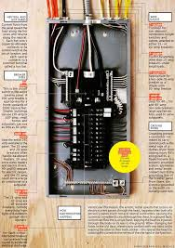
Why Metering on the Panel/Circuit?
Localization and disaggregation.
Easier identification.
Devices are inherently belong to certain circuits
Kitchen Circuit typically contains electric oven, refrigerator, microwave.
Living room Circuit contains TV, lights.
Garage typically contains garage door
opener and lamp.

Slide 25
SEADS
What is SEADS?
Smart Energy Analytic Disaggregation Systems
SEADS has Two Parts:
SEAD Plug collects signatures
SEAD Panel Analyzes and Disaggregates

Slide 26
SEAD System Architecture
SEAD Panel
Power Line
Query Generation
&
Compression
High Frequency Sampling
Real Time FFT
Transmission
SEAD Server
SEAD Panel
Feature
Extraction
KNN Classifier
Event Detection
Microgrid
Control

Slide 27
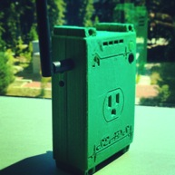
SEAD Plug Specs
Samples at 2.4KhZ
Based on Nyquist we can have valid 20th harmonic(1.2Khz)
5 seconds of interesting current data
Every 5 seconds wattage data are reported
Voltage will be reported every second if it is interesting
MSP430 with 16KByte of RAM
Accuracy of wattage reporting before calibration 4%

Slide 28
Signatures
Load signature is defined as the electrical behavior of an individual appliance when it is in operation.
Direct signatures are normally
Voltage
Current
Power
Sound(Equipment with motors )
EMI(TV)
Combinational
Current/Voltage etc. power spectrum density(Spectrogram))

Slide 29



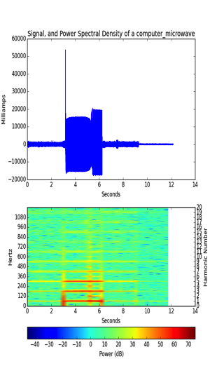
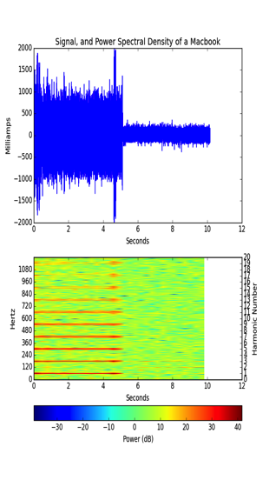
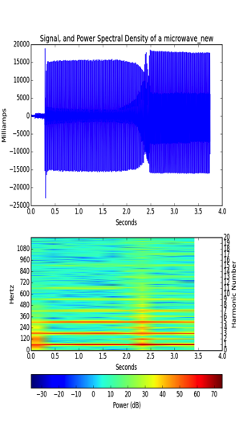
Computer + Microwave Current Harmonics Via SEAD Plug
Notes:
Specify when it is on and when it is off

Slide 30

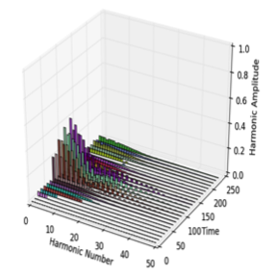
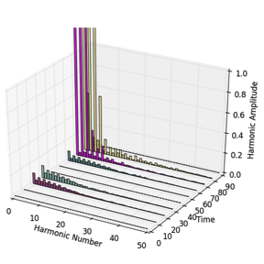
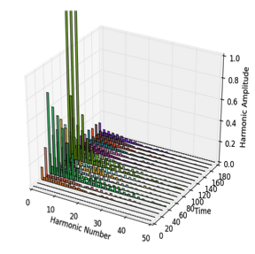

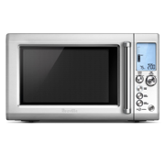
Computer + Microwave Current Harmonics Via Power Analyzer

Slide 31
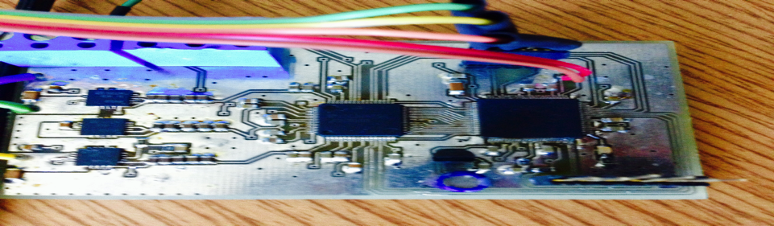
SEAD Panel
1)Measures Current and Voltage
2)Power and FFT calculation
3)Extracts signatures and report them to the base
DAQ Prototype version 2.0:

Slide 32
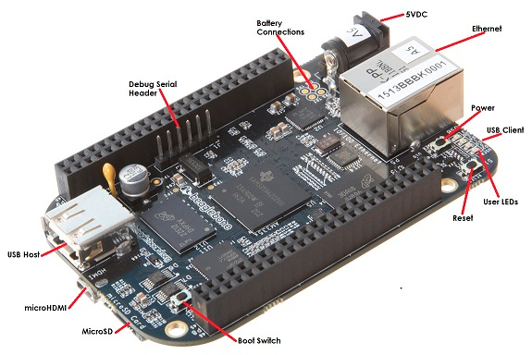
SEAD Panel
BeagleBoardBlack

Slide 33
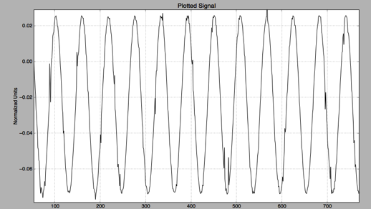
SEAD Panel
Current Prototype:
SPI Connection
Sampling at 3.0Khz
Noisy
3 input power supply
Future prototype:
UART
Capacitance matching on the IO pins
Integrating the transformers
Signature Detection
Wifi connectivity
Sampling 30Khz
Two input power supply
Notes:
Signals comes from a function generator

Slide 34
Theory of Operation
Switched electrical loads produce electrical noise in form of a transient or continuous noise.
Noise characteristics
Noise can be either due to the light switch itself
SMPS(switching mode power supply)
Signature
A signature should be similar to DNA of a device and should entail all unique characteristics of a device
Notes:
This needs some work
Also show a switching mode power supply circuit
Transient noise10KHz-100KHz
We have to consider both temporal(duration) and frequency component

Slide 35
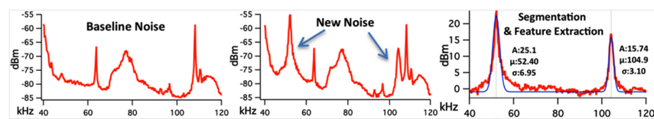
Noise Detection

Slide 36
Noise
Where does the noise come from?
Transmission lines
Switches
Devices
Resistive Load
Inductive Loads
Mechanical(fan motor)
Solid State Switching
(PC Power Supply)
FCC
Device generated noise between
150kHz-3MHz cannot exceed certain limits.
Notes:
Resistive noise devices like lamp don’t have a distinguishable harmonics in the frequency domain. But inductive loads have a distinguishable signatures.

Slide 37
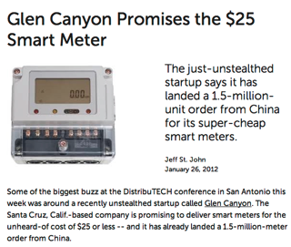
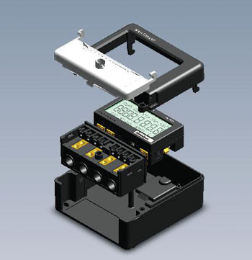
Other meters
We are investigating solid states meter from glen canyon which stores 1min data on the cloud and have been applied to over 30 million house holds in China.

Slide 38
Tasks
Capturing the device signature for range of devices and appliances (for maximum sampling rate, about 30kHz)
Choosing the lowest effective sample rate for acceptable accuracy and training time and cost based on simulation and signature analysis.
Create a methodology for choosing sampling rate and data requirement.
Find minimum variables that need to be measured.
Analysis of the capturing process from occupants' point of view.
Analysis of the captured signatures using machine learning(SVM, HMM, etc)

Slide 39
Tasks
Incorporating new sources of data including audio, motion sensors, light sensors, temperature etc…
Improving the event detection techniques based on new collected data
Incorporating Machine Learning to improve proposed NILM system detection rate
Improving the algorithm training process
Simulation and verification
Notes:
(Currently, the training process is completely supervised manual process which requires occupants complete cooperation)

Slide 40
Current and Future Thesis Work
Present
Studying signature variation and detection
Instrumentation and design of hardware of SEAD Panel
Software backend
SEAD PLUG
Matlab and Python Simulation
Machine learning classification algorithms(WEKA)
Future
Implementing a methodology for finding the right sampling rates and variables to be considered
Design an embedded system for detection
Collection of various signatures
Simulation and control system analysis
Microgrid deployment

Slide 41
Thesis Areas and Coursework
Computer Science Courses
Machine Learning
Data Structures
Mobile Computing
Web Programming
Electrical Engineering:
Feedback and Control Systems
Digital and Analog Circuits
US Denmak Summer workshop
Signal and Systems
Industry Experiences:
Intel: Design Automation
Tivo: Software Security
Playstation: Big Data Analytics System
Research Papers:
Recommendation Algorithms (2012)
Smart Glove for Stroke patients(submitted)
Competitions:
Dronezilla(2nd Angle Hack 2013)
Memsight(Launch 2014)
TA
EE101 3 times
CMPS100 1 time
EE 80J 1 time
EE80S 1 time

Slide 42



Acknowledgment
Research Advisor: Professor Pat Mantey
Professors: Mike Issacson, Joel Kubby, John Vesecky
CITRIS, CENSEPS,BELS
Undergraduate Students: Henry Crute, Micheal Sit, Pavlo Manovy, Brian Smith
Notes:
I am focusing on finding optimal method for finding the right sampling rates. In this road I might discover some methods that I have not described in this presentation.

