Slide 1
Parallel signing of pdf documents using blockchain

Slide 2
Problem Statement
In today’s world digital signatures are widely used to make documents trustworthy and to achieve integrity ,authenticity and non-repudiation of the document.
However this mechanism have several disadvantages :
Documents that need to be signed by different people can only be signed sequentially. In this sequential signing ,version of the document is changed .
Sometimes it's hard to know if you're signing the correct version of a document. During the tough negotiations, different versions of the agreement were sent back and forth. There's a risk that eventually the wrong version of an agreement is signed due to a confusingly high number of versions created by different people introducing confusing version numbers
If you want people to trust the signatures in your document, you need to involve some central authorities, such as CAs and TSAs. It would be great if we could think of a system that doesn't require any central authorities.
If we also want guarantees about the time of signing, we need to involve a time stamping authority; if we want the signature to be valid on the long term, we need extra long-term validation (LTV) functionality which is dependent heavily on central authority and may cause problem if the central authority goes down after a long time and we cant extend the validity of signature.

Slide 3
Detailed description of the problem statement
Documents are made trustworthy by applying digital signatures:
Signature is created by encrypting a hash of the bytes of the document using a private key.
The document is distributed along with this signature and the public certificate of the signer.
Whoever receives the document can create a new hash of the document using the same cryptographic hash function, resulting in hash1.
The public certificate of the signer consists of the identity of the signer and his public key. That public key can be used to decrypt the signed hash, resulting in hash2.
This mechanism guarantees us three things:
Integrity: If hash1 equals hash2, we know that the document hasn't been tampered with.
Authenticity: we know who signed the document, since this information is present in the public certificate of the signer.
Non-repudiation: the signer can't deny that he signed the document, because he's the only one who is supposed to have access to his private key

Slide 4
Disadvantages of digital signatures
Documents that need to be signed by different people can only be signed sequentially:
Person A will own a copy with a single signature, person B will own a copy with two signatures, and so on. If 12 people have to sign, person L will own a copy of the document with 12 signatures. It is then the responsibility of person L to send the document that contains all the signatures to all the previous signers. Unfortunately, this doesn't always happen. Often, people early in the chain only have copies that are missing one or more signatures .
Sometimes it's hard to know if you're signing the correct version of a document. Think of an agreement that was drafted in a process that involved tough negotiations. During the negotiations, different versions of the agreement were sent back and forth. There's a risk that eventually the wrong version of an agreement is signed due to a confusingly high number of versions created by different people introducing confusing version numbers. (As you may have guessed, this example is also based on a true story.)

Slide 5
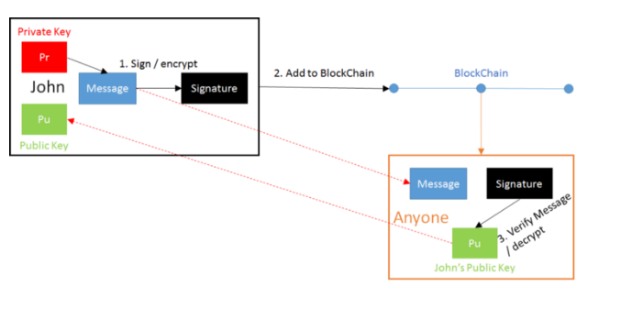
Digital Signatures and Blockchain

Slide 6
How Blockchain solves various problems associated with digital signatures
We use blockchain as a database for storing signatures (signed hash of the document with private key) along with corresponding public certificate.
Unique ID of the pdf is used as primary key for each record .
The address of the relevant blockchain could be stored in the metadata of the PDF. This address can be used to retrieve the record that correspond with the ID-pair of the document you want to verify.
That record will give you information on the signer or signers. With the hash, you'll be able to verify the document's integrity. If more than one record is retrieved, you'll have a historical overview of who registered the document when, and you can inspect the metadata that was added with each registration.

Slide 7
Advantages of using blockchain with digital signatures
Since the signatures are stored outside of the document, signatures can be applied in parallel without a predefined order. Every signer can add a signature to the blockchain at any moment in time, and
Everyone can check who signed a document, when, and in which order; this can be done without having to rely on a central service
We don't need to work with a TSA anymore; timestamping is inherent to blockchain; once a record is added to a block, its contents are immutable and can't be changed
We still meet the requirement of integrity, since we create the signature in exactly the same way. We only store the signature in a different place that is in blockchain;

Slide 8
Calculation of hash for given pdf file
Step1 :
Function : get_Documenthash:
Input stream:pdf file
Processing :SHA-256 algorithm is used to calculate the hash of the pdf file.
Return :hash of the input pdf file.
Step2:
Function :sign_Documenthash : sign the computed hash with private key .
Input: calculated hash( from function get_Documenthash) , private key
Encryption algorithm: RSA

Slide 9
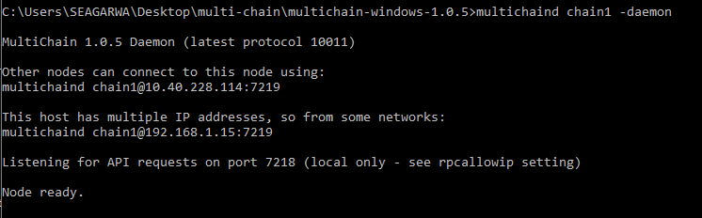
Tools used : Multi-chain Multichain -https://www.multichain.com/download-install
Step3 :First we will create a new blockchain named chain1 . On the first server run command : multichain-util create chain1
Step4 :Initialize the blockchain, including creating the genesis block:

Slide 10
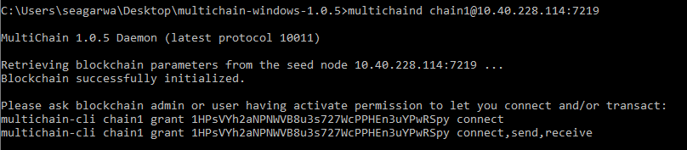
2. Connect to a blockchain from second server
3. On first server add connection permissions for this address:1HPsVYh2aNPNWVB8u3s727WcPPHEn3uYPwRSpy
multichain-cli chain1 grant 1HPsVYh2aNPNWVB8u3s727WcPPHEn3uYPwRSpy connect

Slide 11
Step 5 :Store key (unique id of PDF) and value(signature as well as public key ) in blockchain
function : put_Document_onBlockchain on
IP: 10.40.228.114
Port:7219
Chain name:chain1 , username , password .
Step6: Retrieving document information from blockchain
Function :Retrieve information from blockchain
Return :Private key of signer, public key
Pdf file
Hash information

Slide 12
Step7 :
BQL(Browsing query language):Select records from block having a particular unique id (for some pdf) to list all the transactions(signings of document ) in ascending /descending order.
Step8 :Verifying the signature
Information retrieved from block like public key is used to decrypt the signature Hashing information can be used to compute hash of the received document. compare both the hashes to check integrity ,authenticity of the document.

Slide 13
3D Printing and Blockchain
Challenges the 3D printing industry faces:
file IP protection
file integrity (tamper-proof)
ensure repeatable printability, tracking the digital data trail to ensure traceability.
3D digital manufacturing inherits several privacy and security-related challenges with multiple stake holders. Blockchain technology can be used for enabling data governance, data provenance, data auditability and data validation in 3D printing.

