Slide 1
Pearl Hunter: An Inspired Hyper-heuristic
16th January 2012, Paris
CY Chan, Fan Xue, WH Ip, CF Cheung
Department of Industrial & Systems Engineering
Hong Kong Polytechnic University

Slide 2
Outline
1
Pearl Hunting
2
The Pearl Hunter
3
Training and Validation on HyFlex
4
Conclusions

Slide 3

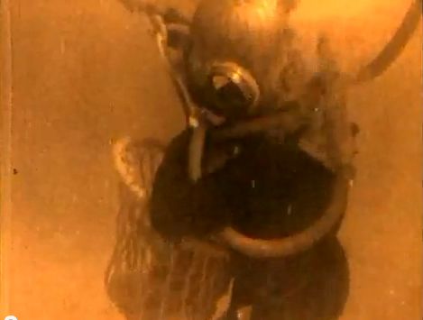
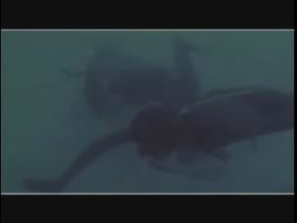
Pearl Diving
  Pearl diving is an out-of-date diving activity of retrieving pearls from oysters.
  Can still be found in:
    Some Asian tourist sites,
    Virtual games.
Pearl diver in Japan (from Wikimedia Commons, public copyright)
In Australia (screenshot of “Introduction to pearls and Australian Pearl Divers”, © by Australian Opal Cutter youtube.com/watch?v=V6vuBvglndw)
In Qatar (screenshot of “Pearling”, © Qatar Pavilion, World EXPO 2010)

Slide 4
Pearl Diving and Simulation
In a search perspective, pearl hunting consists of repeated
  diversification (surface and change target area)
  intensification (dive and find pearl oysters).
In the paradigm of Iterated Local Search (Lourenço et al, 2003).
Simulated operations
  move (diversification, 1 source or multiple sources)
  dive (intensification)
    snorkeling (quick, low level local search, stops after any improvements)
    deep dive (scuba; slow, high level local search, till no further improvements)

Slide 5
Correlations Between Snorkeling and Deep Dive
Table 1: Pearson correlations between improvements by snorkeling (10% maximum depth of search) and deep dive (maximum depth of search) in 3 domains of CHeSC
Correlations:
  Strong (*) or moderate (^) positive coefficient with a significant level 0.01
  1≤ N_{snorkeling}/N_{deepdive} ≤ 10, choose best of snorkeling in practice
Diversification by LLH |  | Max-SAT | Bin Packing | Flow Shop
Crossover | Pearson Cor. Sig. (2-tailed) N | 0.82* 0.00 466 | 0.47^ 0.00 143 | 0.88* 0.00 317
Mutation | Pearson Cor. Sig. (2-tailed) N | 0.61^ 0.00 112 | 0.11 0.00 1405 | 0.83* 0.00 752
Ruin-recreate (extra) | Pearson Cor. Sig. (2-tailed) N | 0.08 0.51 70 | 0.07 0.11 551 | 0.58^ 0.00 328

Slide 6
Pearl Hunter: A Hyper-heuristic Imitation
Obj
Value
“Environment”:
  Shallow water, where deep dive always returns the same as snorkeling
  Sea trench, where deep dives cost too much time at maximum depth-of-search
  Default, otherwise
Preparation of Low Level Heuristics(LLHs)
  Selective scheme (CHeSC2011)
    Choose {A, B} from {A, B, C}
  Constructive scheme
    Pre-trained
    Online trained
Trail
Time
Iterated move-snorkeling-dive
Perceiving the environment
and preparing LLHs

Slide 7
Pearl Hunter
  Pearl Hunter can drop a Buoy at the depth of first deep dive, to escape from local optimum by mutations (SIs).
  Four running modes (portfolios) of selected LLHs:
  A: all moves averagely, with a Buoy mark
  B: crossover with a Buoy mark (triggering a few mutations)
  C: crossover only, no mutation, no Buoy
  D: Sea trench mode, all surface moves averagely, no Buoy. Moves are subject to online pruning.
Other tricks:
  tabu lists (memory), “mission restarts” (go to new areas)
C | B | D | A
Crossover |  | Mutation
Anchors of the modes

Slide 8
HyFlex and CHeSC
HyFlex (Hyper-heuristics Flexible framework) is a java cross-domain platform (Burke et al, 2011)
  6 domains, 4 public (training domain) and 2 hidden
  “Black-box” low-level heuristics in 4 categories:
    Crossover, Mutation, Ruin-recreate, and Local search
  Parameters to control low-level heuristics :
    “Intensity" of mutations, and “depth of local search”
CHeSC 2011 is the first Cross-domain Heuristic Search Challenge on HyFlex. (http://www.asap.cs.nott.ac.uk/chesc2011/)
Pearl Hunter was ranked in CHeSC:
  4th out of 20 entries overall,
  1st out of 20 entries in the hidden domains.

Slide 9
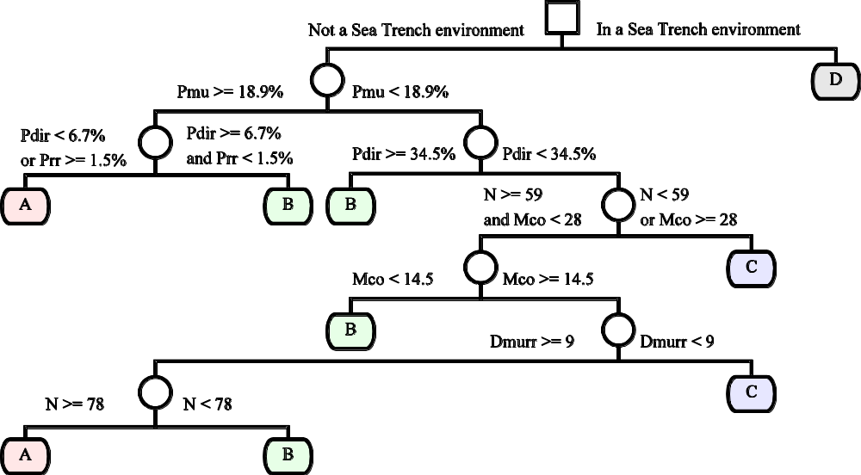
HyFlex and CHeSC: BF-Tree Obtained by Offline Learning (by Weka v3.5)
  D_{murr}: Depth of the mission in the Mutation and Ruin-recreate test,
  M_{co}: Number of missions completed in the Crossover test,
  N: Number of sub-optimal solutions found in total,
  P_{dir}: Percent of sub-optimal solutions found right after some moves (before any dive),
  P_{mu}: Percent of sub-optimal solutions found in iterations started with Mutation moves,
  P_{rr}: Percent of sub-optimal solutions found in iterations started with Ruin-recreate moves,

Slide 10
Tests on Personnel Scheduling: Beyond the 600s Time Limit of CHeSC
On large-scale personnel scheduling problems,
  Running time was increased to 10 hours (normalized to P4 3GHz),
  Same decision tree and algorithm codes
New best known solutions:
A possible reason
  A new “vertical” swap concept first implemented in low-level heuristics on HyFlex
Instance | Men | days | Time (h) | Result | Prev BK* | % improved
CHILD-2A | 41 | 42 | 10 | 1,095 | 1,111 | 1.4
ERRVH-A | 51 | 42 | 10 | 2,142 | 2,197 | 2.5
ERRVH-B | 51 | 42 | 10 | 3,121 | 6,859 | 54.5
* Best known values were collected from http://www.cs.nott.ac.uk/~tec/NRP/misc/NRP_Results.xls

Slide 11
Conclusion
We present a hyper-heuristic
  Imitates pearl hunting
  Perceives “environment” of search
  Determines a perturbation mode by offline learning
  Generates different modes of ILS
We find the results of tests encouraging
Possible future works
  Hunters can generate new LLHs besides a selection
    (Custom designed for TSP) Generated an association-rules-based weighting hyper-heuristic to determine candidate set, and facilitated branch-and-bound and local search (2-Opt, 5-Opt) (Xue et al, 2010, 2012).

Slide 12
References
  Burke E.K., Curtois T., Qu R., Vanden Berghe G. (2007) A Time Pre-defined Variable Depth Search for Nurse Rostering. Technical Report No. NOTTCS-TR-2007-6. University of Nottingham
  Burke, E. K., Hyde, M., Kendall, G., Ochoa, G., Ozcan, E., and Qu, R. (2010) Hyperheuristics: A Survey of the State of the Art, University of Nottingham. Technical Report No. NOTTCS-TR-SUB-0906241418-2747.
  Burke, E., Curtois, T., Hyde, M., Ochoa, G., Vazquez-Rodriguez J. A. (2011) HyFlex: A Benchmark Framework for Cross-domain Heuristic Search, ArXiv e-prints, arXiv:1107.5462v1
  Lourenço, H., Martin, O., Stützle, T. (2003) Iterated Local Search. In Glover, F., Kochenberger, G. (eds.) Handbook of Metaheuristics. Springer New York. 320-353.
  Xue F., Chan, C.Y., Ip, W.H., Cheung, C.F. (2010) Towards a learning-based heuristic searching reform scheme, XXIV European Conference on Operational Research (EURO), Lisbon, Portugal.
  Xue F., Chan, C.Y., Ip, W.H., Cheung, C.F. (2012) A learning-based variable assignment weighting scheme for heuristic and exact searching in Euclidean traveling salesman problems, NETNOMICS, (to appear).

Slide 13
Thank you for your attention!
E-mail addr.: mffxue@inet.polyu.edu.hk dewolf_matri_x@msn.com

