Slide 1
OOI Teaching with Data Workshop
Sunday May 22, 2016

Slide 2
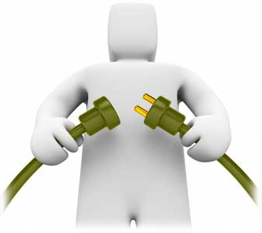
Sunday: Welcome Back!
Review agenda for today
Time to pull this all together
Provide Revisions
Implementation plans
NSF proposal – next steps
Stipends processing

Slide 3
Workshop Objectives
Crosswalk OOI Science themes presented in popular introductory textbooks used in oceanography courses. Compare themes and concepts in the OOI scientific themes document and popular published textbooks to triangulate where OOI data investigations/activities can be woven into existing courses.
Develop sample activities using OOI data/data viz tools and vet them with undergraduate professors.
Brainstorm how best to build a community of practice. Build long-term working relationships and collaborations on data investigation development.
Notes:
hands-on workshop focused on developing effective teaching with data practices using OOI

Slide 4
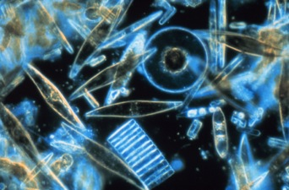
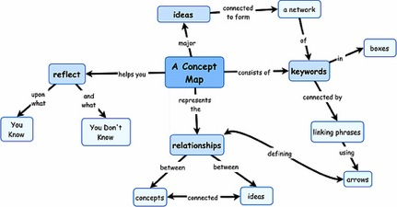
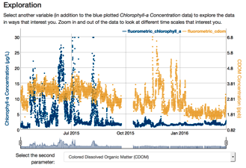
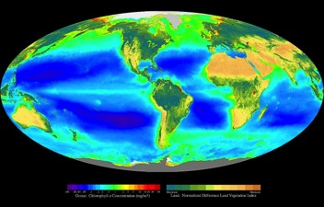
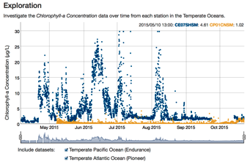
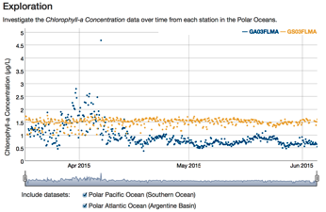
Exploring Primary Productivity with Data & Design Elements
Invitation Concept Map
Reflection Concept Map
Exploration Data Activity
Application Data Activity
Concept Invention Data Activity 1
Concept Invention Data Activity 2
Notes:
Sunday 8:15am
There was a method to the madness in how we designed the activities and what features we included to help the students engage with the data in a supported way…

Slide 5
Exploring Primary Productivity with Data & Design Elements
One data set is locked, user only needs to select another to compare data sets
List of data is prepopulated
The user can adjust the time frame, and the scale bar automatically adjusts
The data easily plot onto the same graph, no need to look between graphs
Invitation Concept Map
Reflection Concept Map
Exploration Data Activity
Application Data Activity
Concept Invention Data Activity 1
Concept Invention Data Activity 2
Notes:
Sunday 8:15am
… for example for the exploration data activity we incorporated aspects such as these to provide a scaffolded experience to the student to help them start to understand the data.

Slide 6
Exploring Primary Productivity with Data & Design Elements
Two data sets are provided to help user make observations across multiple locations
Able to only look at one location at a time
Same set-up of graph and variable that was looked at previously to minimize orientation needed
Invitation Concept Map
Reflection Concept Map
Exploration Data Activity
Application Data Activity
Concept Invention Data Activity 1
Concept Invention Data Activity 2
Notes:
Sunday 8:15am
… whereas for the concept invention we incorporated these aspects to help the students take their understanding to the next level…

Slide 7
Exploring Primary Productivity with Data & Design Elements
Multiple data sets provided, but user has to make decision of what to turn on and off for analysis
List of data is prepopulated
User has to look more among graphs to do data analysis
Invitation Concept Map
Reflection Concept Map
Exploration Data Activity
Application Data Activity
Concept Invention Data Activity 1
Concept Invention Data Activity 2
Notes:
Sunday 8:15am
… and finally for the application data activity we incorporated aspects such as these to provide opportunities for students to demonstrate their learned comfort with the data and to determine based on their interests which aspects of the concept they are interested in pursuing further.

Slide 8

Modifying Data Activities
Notes:
Sunday 8:15am
These data activities were designed to be flexible and adaptable for the needs of the users. Now we get to dive in and make suggestions of how to adjust the activities to make them enhanced/better versions for you to use with your students. We are going to work again in the small groups that we were in previously and here are paper copies of the activities to mark up and write your ideas on to make sure they are captured so we can make the changes next week. We will work until 3:45 or so and then after the break will come back together to share with one another how it went and what modifications were suggested (5 minutes per group).

Slide 9

Revised Activity Presentation
Notes:
Sunday 9:15am
Now that we have done great work on modifying the sample activities, while keeping in mind the scope of work with respect to data literacy and the myriad of components that go into our teaching with data it is time for us to share with one another what we have come up with. What we would like you to do is to take the next 10 minutes or so to sketch out your new activity on these sheets of paper (large enough for people to read). We will then share out with one another the layout of the activity and why you designed it the way that you did. Each group will have roughly 5 minutes to share with the whole group and then we will debrief at the end.

Slide 10
Data-enhanced learning experiences..
including activities in which students collect and interpret their own data and/or those in which they explore research databases to answer questions.
Data enhanced learning experiences can:
Prepare students to address real-world complex problems;
Develop students’ ability to use scientific methods, including consideration of the values and ethics of working with data;
Teach students how to critically evaluate the integrity and robustness of data or evidence and of their consequent interpretations or conclusions; and
Provide training in scientific, technical, quantitative, and communication skills.
Manduca and Mogk 2002. Using Data in Undergraduate Science Classrooms (Grant NSF-0127298)

Slide 11
Design of data activities
 | Questions to ask about the goals of the activity | Name of Data Activity – what did we do? Which phase does it match up with? How does it accomplish the goals of that phase?
Invitation | How does it get students interested in learning about the topic? How does it help them access their prior knowledge?
Exploration | How will learners have experiences that provide concrete observations and discoveries to help them make sense of the topic?
Concept Invention | How will learners be encouraged to struggle with their understanding and negotiate their ideas with others?
Application | How will learners authentically apply what they've learned to a new situation or context?
Reflection | How will learners think back on the learning process to help reinforce their understandings, and make them better learners in the future?
Notes:
First column provides more prompts to help us in the match-up. Quickly read each cell. Remind them to work with their group of 2-3p that engaged in the same data activity and to match the activities they did into the phase it best represents. In column 2 we’ll put the name of the activity and what they engaged in while doing the activity that accomplished the goal of that phase.
Elicit participant ideas before showing next slide. During debrief ask: Do you agree that the activity accomplishes the goals for the _________phase of learning? If not, why? Ask for reasoning, encourage participation in discussion, and probe for alternative ideas. Focus the discussion on their reasons.

Slide 12
Design of data activities
 | Questions to ask about the activity | Name of Data Activity – what did we do? Which phase does it match up with? How does it accomplish the goals of that phase?
Invitation | How does it access students prior knowledge and get them interested in learning about the topic? | Create a concept map of primary productivity to access and connect to prior knowledge.
Exploration | How will learners have experiences that provide concrete observations and discoveries to help them make sense of the topic? | Data figures of measurements of primary productivity. User changes time & four variables to make general observations & ask questions to try to make sense of the patterns.
Concept Invention | How will learners be encouraged to struggle with their understanding & negotiate their ideas with others? | Data figures of primary productivity at different latitudes (2 activities). Users are given two data sets to observe & are challenged to interpret patterns w/in a defined location & time (with other users).
Application | How will learners authentically apply what they've learned to a new situation or context? | Data figures of primary productivity from different regions. User provided choices & makes own determination about how to explore the data to understand differences in primary productivity.
Reflection | How will learners think back on the learning process to help reinforce their understandings, and make them better learners in the future? | Revise original concept map of primary productivity. Compare how ideas have changed and discuss what helped to deepen their understanding of how to teach/connect primary productivity concepts/topics.
Notes:
What did we do in the activities that reflects the goals of the phase?
Activities might include:
For exploration activity: learners explore a challenge question, a model and ideas with peers
For concept invention activity: Instructor provides directions for talking with peers, guides observations & provides reading. Volunteer explains & instructor probes for evidence and alternative ideas.
For application activity: where might this phenomena occur in the natural world? What did you learn about the concept of _______?

Slide 13
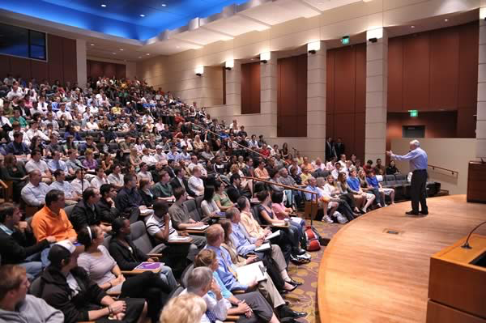

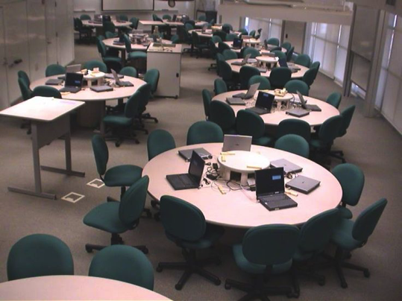
Where do we integrate data in teaching?
Course Syllabus
Lecture Online Active Learning

Slide 14
NSF IUSE
The Improving Undergraduate STEM Education (IUSE: EHR) program invites proposals that address immediate challenges and opportunities that are facing undergraduate STEM education, as well as those that anticipate new structures (e.g. organizational changes, new methods for certification or credentialing, course re-conception, cyberlearning, etc.) and new functions of the undergraduate learning and teaching enterprise.
Notes:
The IUSE: EHR program recognizes and respects the variety of discipline-specific challenges and opportunities facing STEM faculty as they strive to incorporate results from educational research into classroom practice and work with education research colleagues and social science learning scholars to advance our understanding of effective teaching and learning.

Slide 15
Goals
Improve STEM Learning & Learning Environments: Improve the knowledge base for defining, identifying, and innovating effective undergraduate STEM education teaching and learning for all NSF-supported disciplines, and foster widespread use of evidence-based resources and pedagogies in undergraduate STEM education.
Broaden Participation & Institutional Capacity for STEM Learning: Increase the number and diversity of undergraduate students recruited and retained in STEM education and career pathways through improving the evidence base for successful strategies to broaden participation and implementation of the results of this research.
Build the Professional STEM Workforce for Tomorrow: Improve the preparation of undergraduate students so they can succeed as productive members of the future STEM workforce, regardless of career path, and be engaged as members o

Slide 16
IUSE Tracks
Engaged Student Learning: proposals should clearly describe the steps they will take to design, develop, and implement promising teaching approaches, tools, resources, or models.
Institutional and Community Transformation: Exploration and Design projects should include a description of the participant team, the target audience, the institution(s) or community to be transformed and the actions to be taken to move toward broader implementation.

Slide 17
Applying for an IUSE grant:
Option #1: Data and Activity Development Center
Option #2: Design and Development of Desktop Version

Slide 18
What they are looking for:
projects that use innovative approaches to increase substantially the widespread use highly effective, evidence-based STEM teaching and learning, curricular, and co-curricular practices in institutions of higher education or across/within disciplinary communities.

Slide 19
NSF IUSE
Full Proposal Deadline Date: November 2, 2016
Exploration and Design Tier for Engaged Student Learning & Institution and Community Transformation
Full Proposal Deadline Date: January 11, 2017
Development and Implementation Tiers for Engaged Student Learning & Institution and Community Transformation

Slide 20

Incorporation planning
Choose which data activities AND learning aspects from this weekend to implement next year:
Why?
How?
What take out?
Notes:
Sunday 12:45pm
We have done a lot of great work on our journey together this weekend, now it is time for us to think about how we will incorporate aspects of this weekend into our teaching next year. Take some time to think through which data activities, as well as learning aspects that we have talked about, will you incorporate into your course. Why did you choose those activities/aspects? How will you incorporate them – as is, further modifications, as homework/in lecture/in lab, in person/online? And what part of your current teaching will need to come out so you can incorporate this new piece into the course?

Slide 21
Questions for You:
What phase(s) of the learning cycle can the activity(ies) address in your classroom? In what ways?
How will you incorporate learning science research (Foundational Ideas of Learning) in your classroom?
What supports will you provide for your students?

Slide 22
Evaluating our Success In Implementation:
Develop sample activities using OOI data/data viz tools and vet them with success with students.
Brainstorm how best to build a community of practice.
Notes:
hands-on workshop focused on developing effective teaching with data practices using OOI

Slide 23
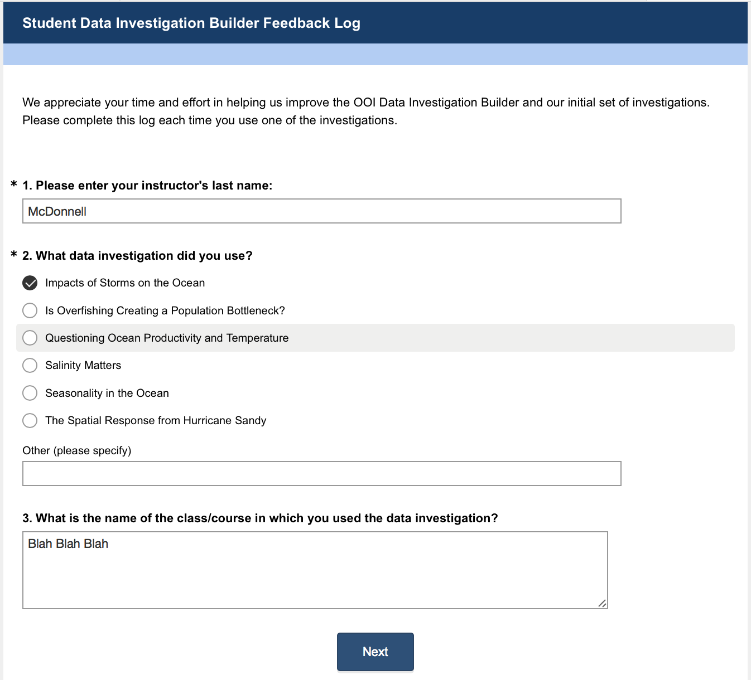

Slide 24
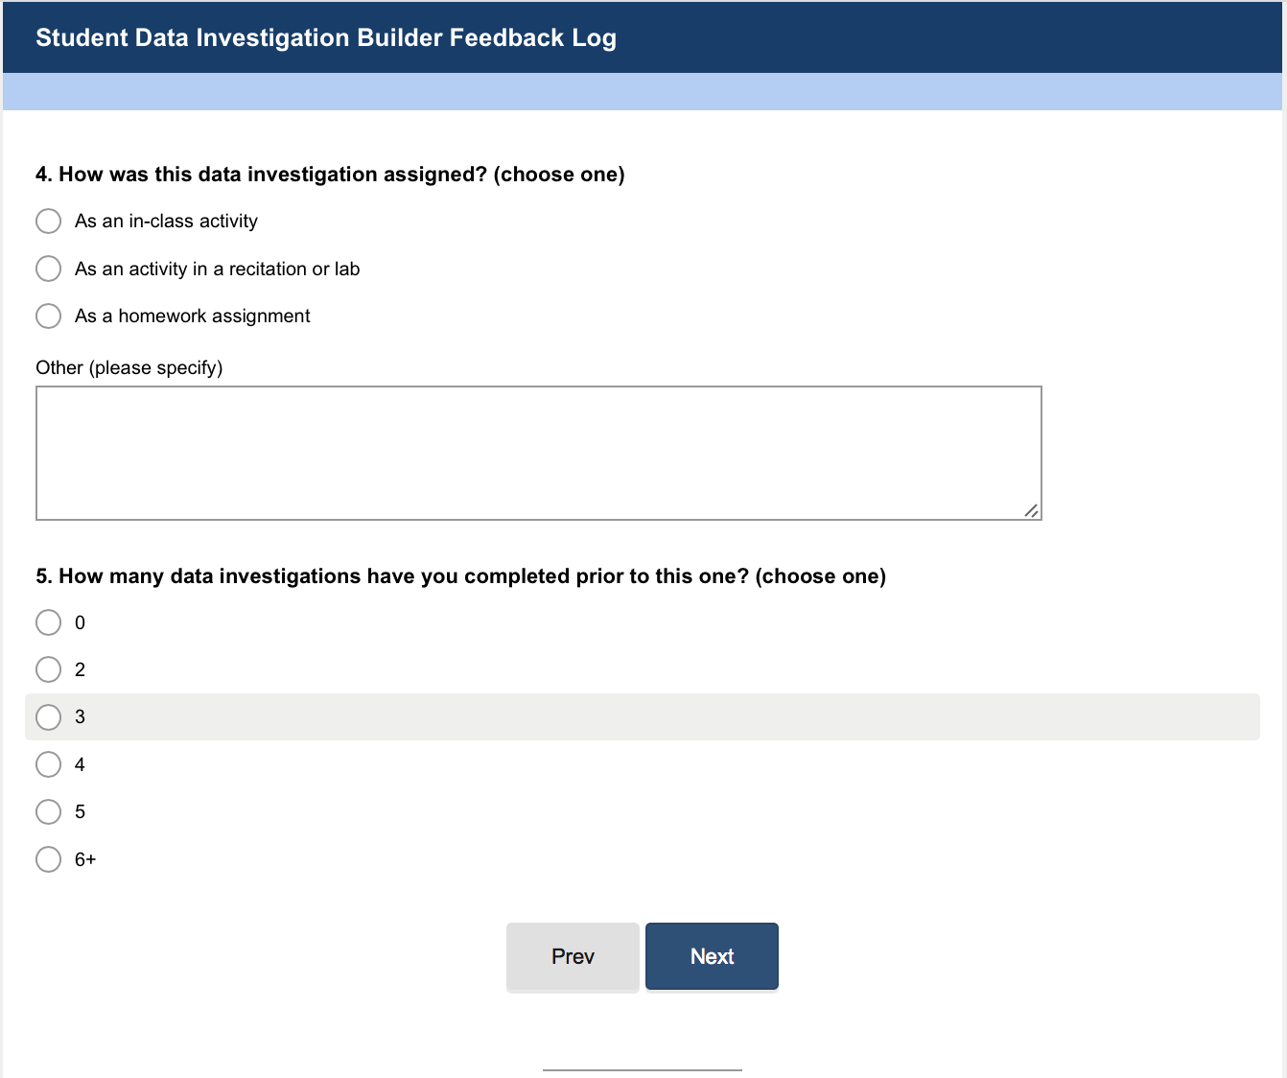

Slide 25
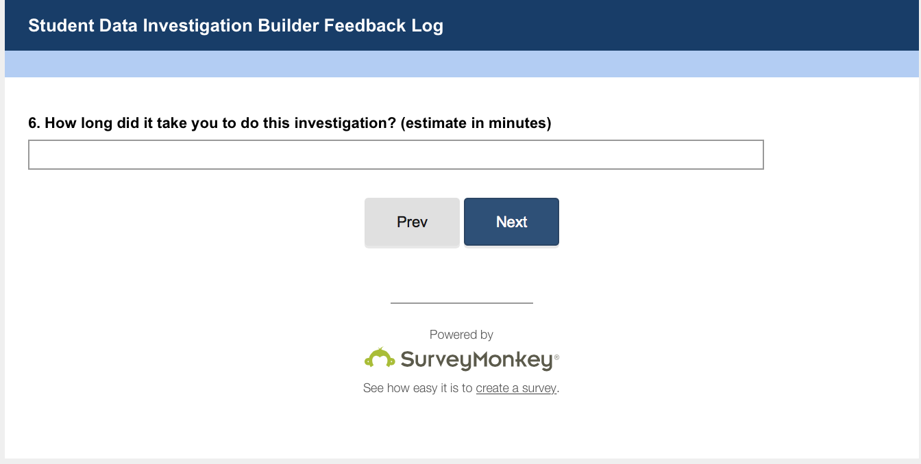

Slide 26
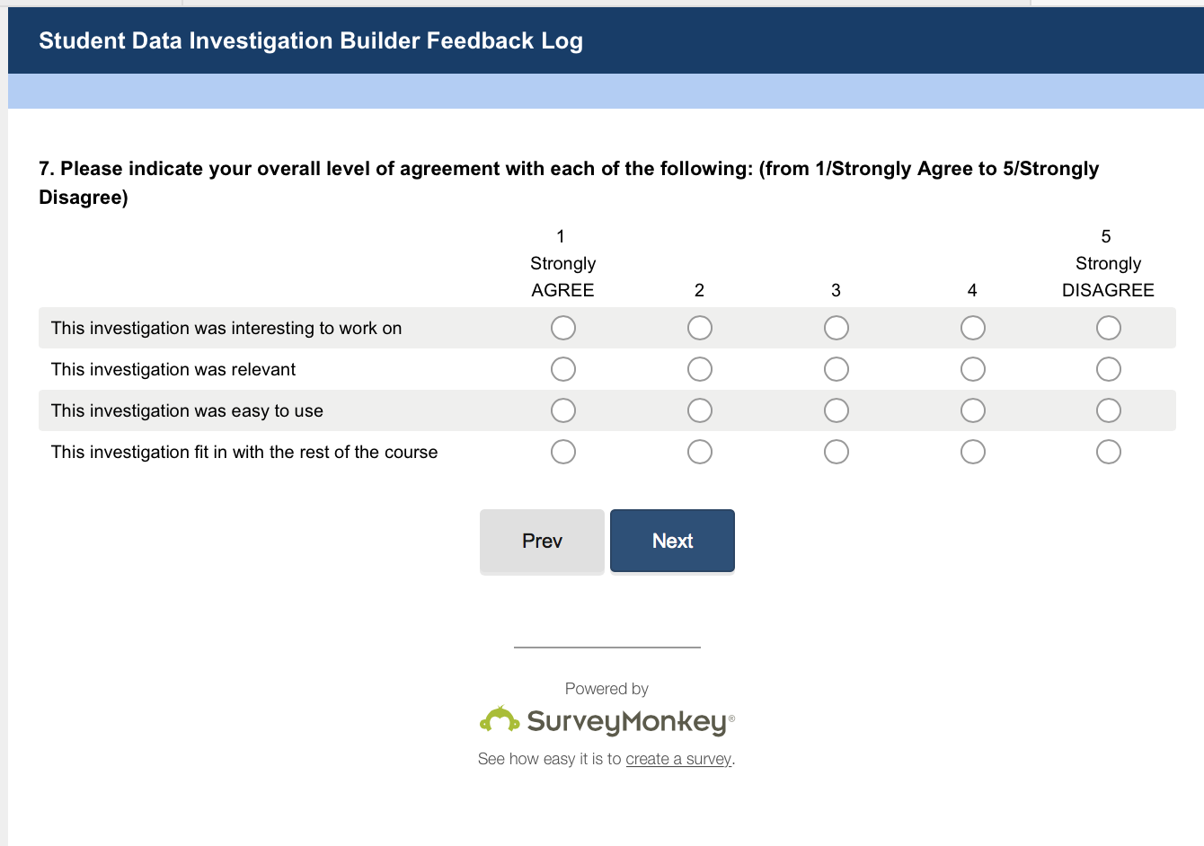

Slide 27
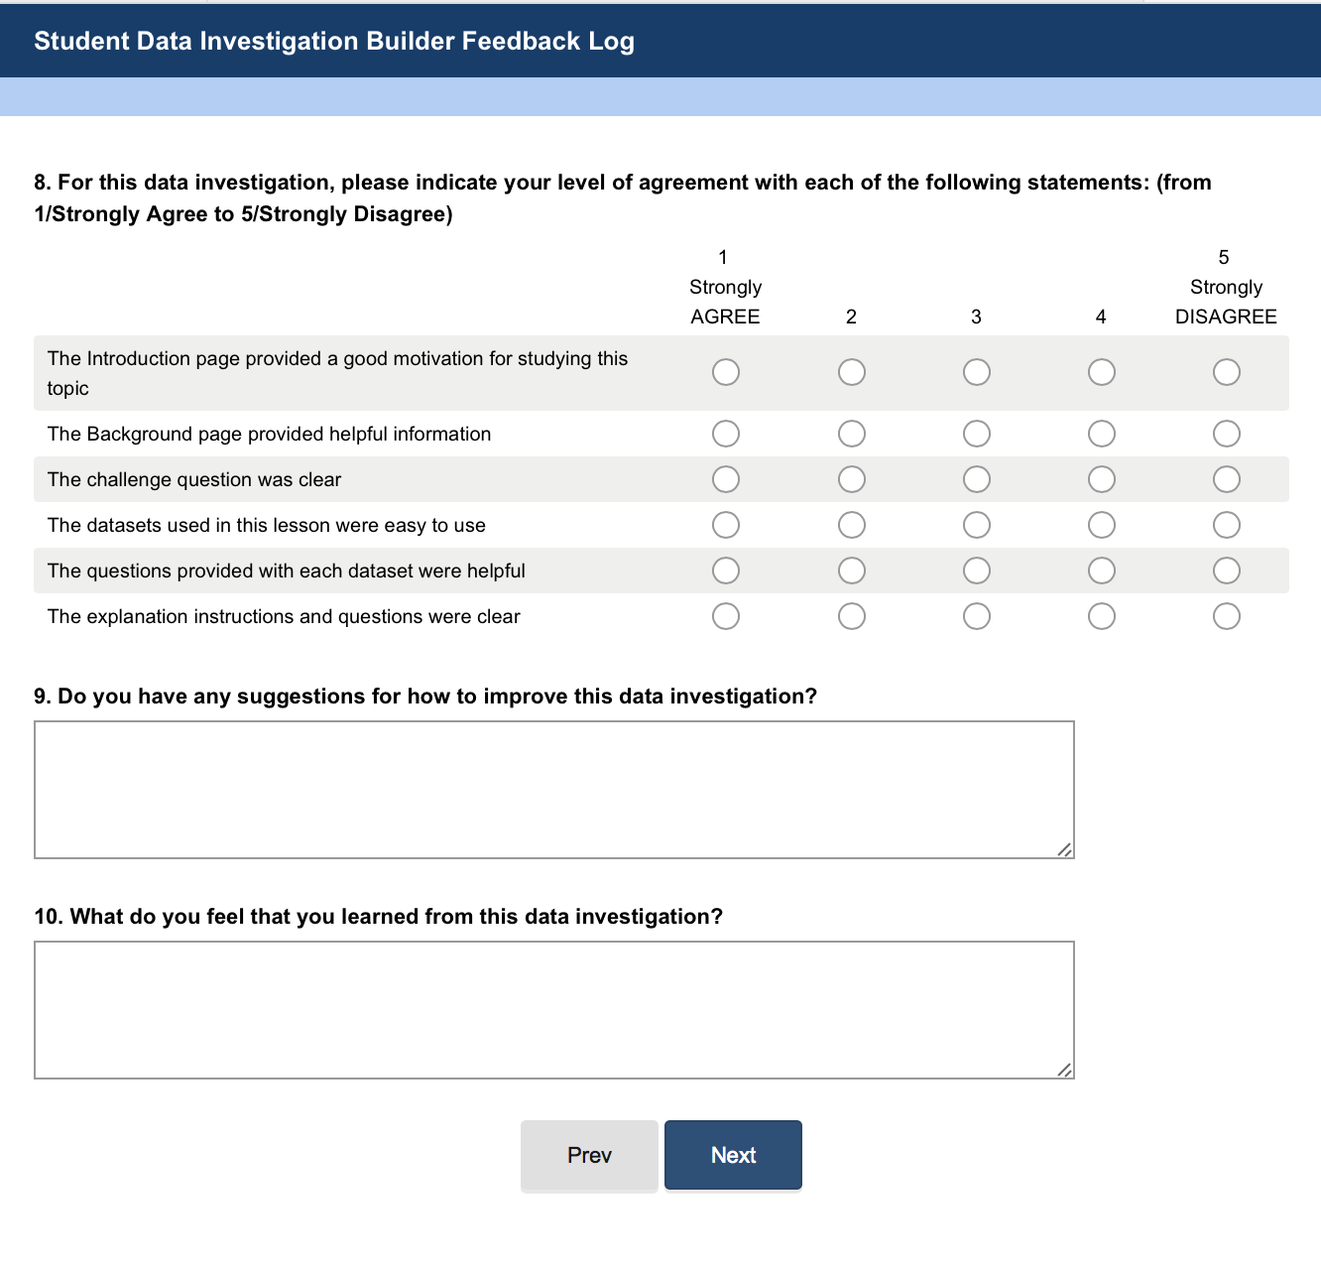

Slide 28
Questions for Professors
What were you expecting from the activities when you signed up?
What do you feel the activities offered?
How was what the activities offered different from what you were expecting?

Slide 29

Thank you! We are excited and grateful for your partnership

