Slide 1
0 : Nat
Klingon commander
up.
way
the
all
Turtles
What I wish I knew
learning ?anything
Layer by layer the fog lifts
The onion peels from its core
1, 2 infinity.
A meandering tour
of the past and future of
programming, math and logic
SeaHug 21 Jan 2016 short talk
Allan J. Cooper

Slide 2
Klingon Commander
In beta quadrant, not far from the star we know as Klingon, lies a small neutron star.
Unnamed until recently, the intelligence of Klingon Commander evolved from 01101110, better known here as Rule 110.

Slide 3
Humble origins
8 bits
1D + clock
Supports universal computation
Turing complete
Steven Wolfram, Matthew Cook (pdf)

Slide 4
Simulator
Game of Life: Conway and Martin Gardner 1970
Ulam and Von Neumann 1940
Golly

Slide 5
Back on earth
We call 01101110 rule 110 or λ-calculus or turing machines
λ from Church, 1936, to formalize “decidable”
TM from Turing, 1936 / 1937, to formalize “computable”
Same programming model: Program + Data → Output
Same class of computable functions

Slide 6
What will be the evolution of 01101110 / λ / TM?
Vocabulary
01101110 archaeologists use Cellular Automaton vocabulary
Imperative programming languages use turing vocabulary
Functional programming languages use λ vocabulary
Where are we going?
Fun facts, view of the countryside, history
Be able to read the papers (Haskell, Idris, Agda, Coq, HoTT..)
Curry → Howard → Lambek → … → Program

Slide 7
Fasten your seatbelts: warp speed into terminology
Don’t care much about λ but..
Do care about vocabulary, notation, terminology, technical detail, nuance
λ is the first layer in the core of typed functional languages
References
Barendregt ILC, Harper PFPL 2015, Pierce TAPL, Diehl Write you a Haskell
Here we go..

Slide 8
λ 스타일
0. Build terms
variable, abstraction, application
Application (binding), free, bound, open, closed, combinators
1. Convert / reduce terms
alpha, beta, xi, renaming, substitution, normal form, Church/Rosser
∞. Extra bonus: name predefined terms and shorthand notations
True/False, numerals, currying, turnstiles, combinators

Slide 9
build & reduce
(7 + 4) (8 + 5 * 3)
→ 11 * (8 + 5 * 3)
→ 11 * (8 + 15)
→ 11 * 23
→ 253 qed (“normal form”, no more rewrite rules apply)
first of (sort (append (“dog”, “rabbit”) (sort ((“mouse”, “cat”)))))
→ first of (sort (append (“dog”, “rabbit”) (“cat”, “mouse”)))
→ first of (sort (“dog”, “rabbit”, “cat”, “mouse”))
→ first of (“cat”, “dog”, “mouse”, “rabbit”)
→ “mouse” qed (“normal form”, no more rewrite rules apply)

Slide 10
λ terms, BNF style
t ::= terms
x variable
λx . t abstraction
t t application
Building terms BNF style
(parentheses for string representation, no parentheses for AST)

Slide 11
λ terms, set style
The set of λ-terms Λ is built up from an infinite set of variables V = {v, v’, v’’..} using application and abstraction
x in V ⇒ x in Λ
t and t’ in Λ ⇒ (M N) in Λ
t in Λ and x in V ⇒ (λx t) in Λ
All these are terms in Λ, parentheses style:
v’, (v’ v), (λv (v’ v)), ((λv (v’ v)) v’’), (((λv (λv’ (v’ v))) v’’) v’’’)

Slide 12
What do we do with terms?
Convert / reduce
Follow “axioms” aka rules:
β beta (what drives λ, abstraction meets application)
α alpha (equivalence by renaming)
ξ xi (actually a bunch of ξ, surface equality and compatibility)

Slide 13
β conversion: application meets abstraction
Abstraction is “binding” or “substitution”
Let M ≡ M[x] mean M is a term which contains x
(may be interpreted as an expression which depends on x)
“Axiom β” (Beta)
(λx.M[x]) N = M[N]
apply x-binding to M which depended on x to N, now M depends on N
(λx.M) N = M[x := N] substitution notation
λx.M[x] may be interpreted as the function x → M[x]

Slide 14
α equivalences bound variables
Integral calculus ∫ f(x, y) dx
x is bound
y is free
λ calculus λx.yx
x is bound
y is free

Slide 15
α conversion
Alpha says bound variables may be renamed
λx.M = λy.M[x := y] provided that y does not occur in M
Terms which differ only by the names of bound variables are identified
Avoid name collisions!!
how: DeBruijn indexes
how: Harper ABT abstract binding tree
(λx.xy)(λy.y)

Slide 16
ξ formalizes the “obvious”
Equality
M = M
M = N ⇒ N = M
M = N and N = L ⇒ M = L
Compatibility
M = N ⇒ M Z = N Z
M = N ⇒ Z M = Z N
M = N ⇒ λx.M = λx.N

Slide 17
Reduction and Church-Rosser
Rewrite rules: After “computation”, (λx.(x + 1)) 2 → 3
Not reversible
Normal form: no more reductions are possible
Not every term has a normal form
Not every “strategy” arrives at a normal form
Still, Church-Rosser (“just do it”)
Terms which are convertible
.. and can reduce
.. reduce to the same normal form

Slide 18
Types
JK, that’s for next time

Slide 19
Where are we going?
Usable language | Core
Haskell | System F
Coq | CIC
Agda | UTT
Idris | TT
Dependent Haskell | PICO
Notes:
http://blog.ezyang.com/2013/05/the-ast-typing-problem/

Slide 20
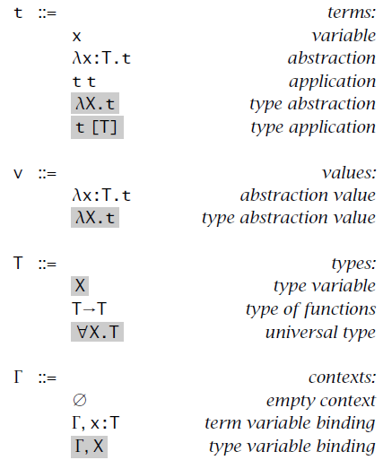
System F
Notes:
Figure 23-1: Polymorphic lambda-calculus (System F)

Slide 21
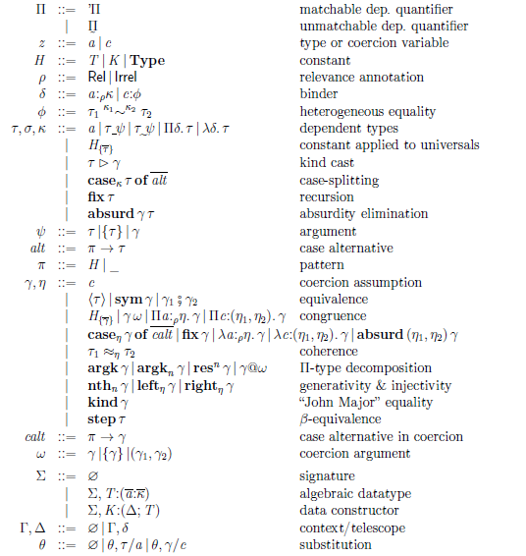
PICO

Slide 22
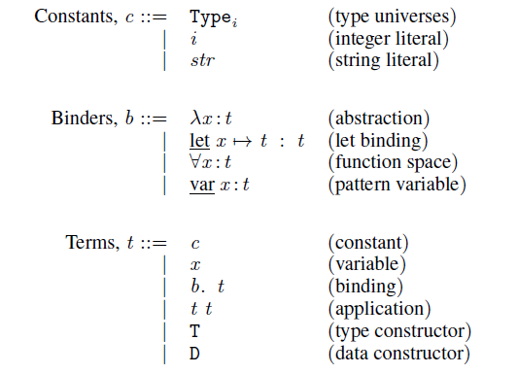
TT

Slide 23
Special thanks
All errors of fact and of presentation are mine.
Whether I understand them correctly or not, much of my inspiration is from
Bartosz Milewski
Conor McBride
Vladimir Voevodsky
Notes:
The Idris folks, particularly Edwin Brady and David Christiansen

Slide 24
Questions

Slide 26
1 : Nat
Type erasure
up.
way
the
all
Turtles
What I wish I knew
learning ?anything
Layer by layer the fog lifts
The onion peels from its core
1, 2 infinity.
A meandering tour
of the past and future of
programming, math and logic
SeaHug short talk
Allan J. Cooper
Notes:
Lambek 1973 might take 2 talks. I want to keep the talks to 30mins + 15mins discussion, or so.
Lots of vocabulary, needs patience or it glazes over.
Make haste slowly.

