Slide 1
3DCHESS – Preliminary Results for Scenario 2 (Reduced)
Alan Aguilar Jaramillo, Ben Gorr, Chrissi Erwin, Dr Daniel Selva Valero

Slide 2
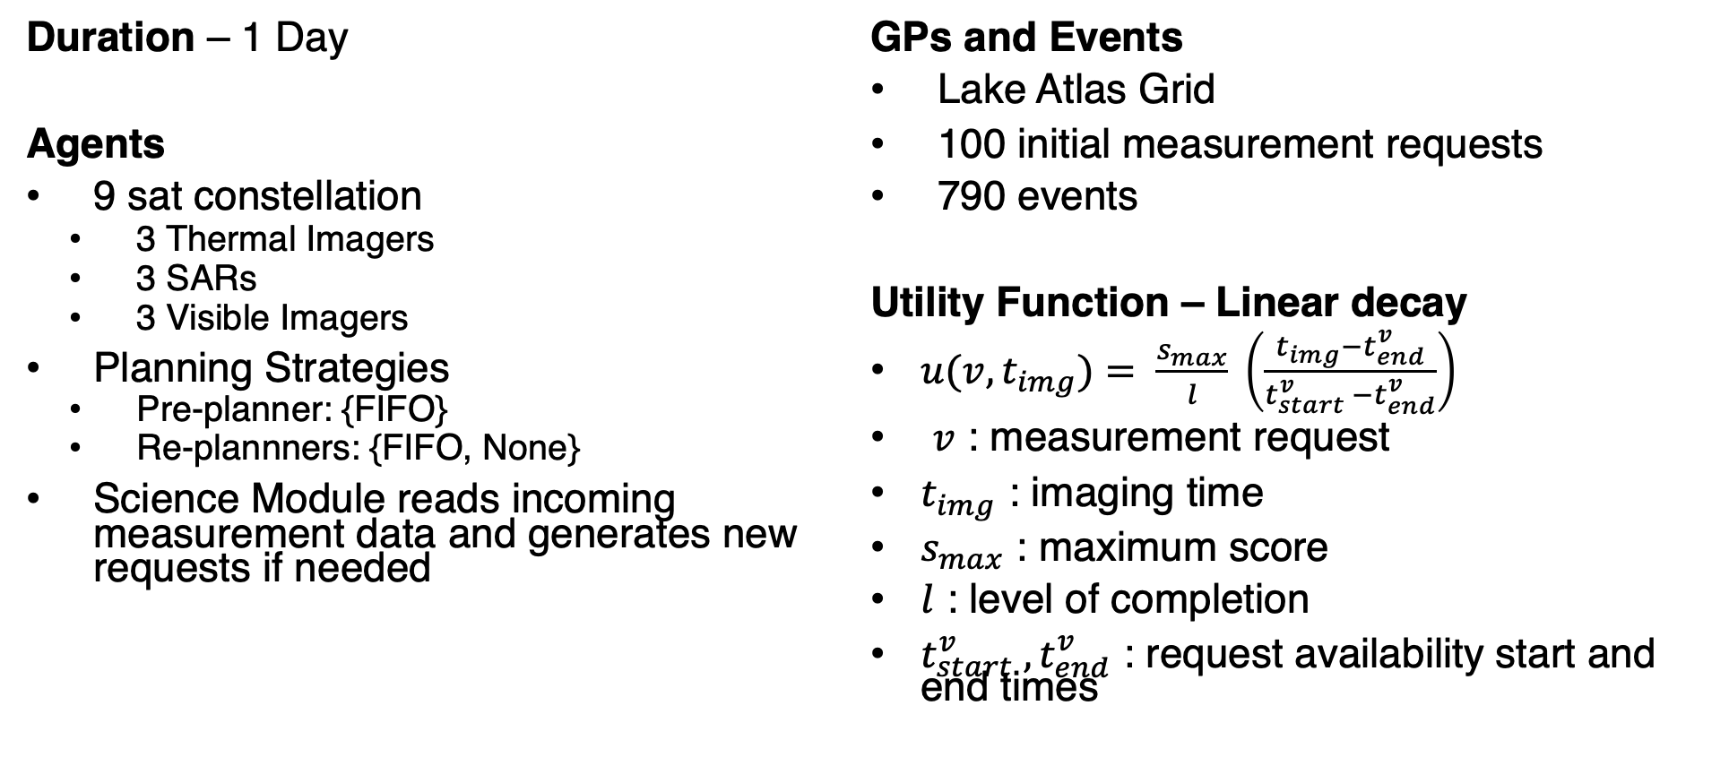
Scenario Description
Duration – 1 Day
Agents
9 sat constellation
3 Thermal Imagers
3 SARs
3 Visible Imagers
Planning Strategies
Pre-planner: {FIFO}
Re-plannners: {FIFO, None}
Science Module reads incoming measurement data and generates new requests if needed
GPs and Events
Lake Atlas Grid
100 initial measurement requests
790 events
Utility Function – Linear decay
$u(v, t_{img})= \frac{s_{max}}{l} \left(\frac{t_{img}−t_{end}^{v}}{t_{start}^{v} −t_{end}^{v}}\right)$
$v$ : measurement request
$t_{img}$ : imaging time
$s_{max}$ : maximum score
$l$ : level of completion
$t_{start}^{v} ,t_{end}^{v}$ : request availability start and end times

Slide 3
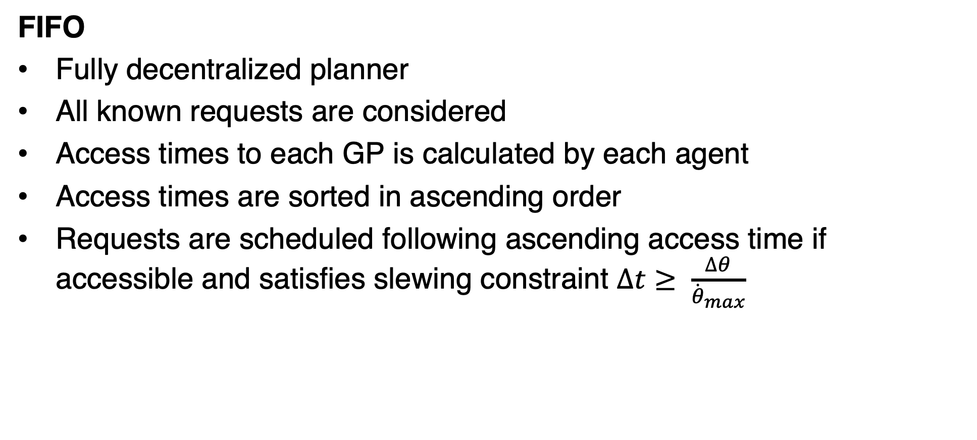
Planning Strategies
FIFO
Fully decentralized planner
All known requests are considered
Access times to each GP is calculated by each agent
Access times are sorted in ascending order
Requests are scheduled following ascending access time if accessible and satisfies slewing constraint $∆t≥ \frac{∆θ}{{\dot{θ}}_{max}}$

Slide 4
Preliminary Results

Slide 5
Questions?

Slide 6
Current Architecture Overview
Simulation Architecture
Environment
Server accessed by agents as clients
Tracks external agent state
Simulates Earth System
Controls simulation start and end
Agents
Simulation instructions received through dedicate SUB port
“Sense” environment via server requests through dedicated environment REQ port
Inter-agent communication via reconnecting REQ/REP TCP ports
Intra-agent communication modeled as asynchronous message queues (mimics internal data bus)
Agent
Simulation Module
Event Handler
-Simulation Events
Sim Start/End
-Scenario Events
-Simulation Events
SUB
-Scenario Events
Environment
REQ
Science Module
-GP access info
-GS access info
-Agent access info
-Agent state info
-Measurement observation metrics info
-Measurement Requests
-Information Requests
Engineering Module
REQ
Scheduler Module
-Scheduled Measurement Measurements
-Measurement Requests (out)
-Planner Results (out)
Other Agents
REP
-Measurement Request (out)
-Information Request (out)
-Measurement Results (out)
-Planner Results (out)
DMAS Agent Framework

Slide 7
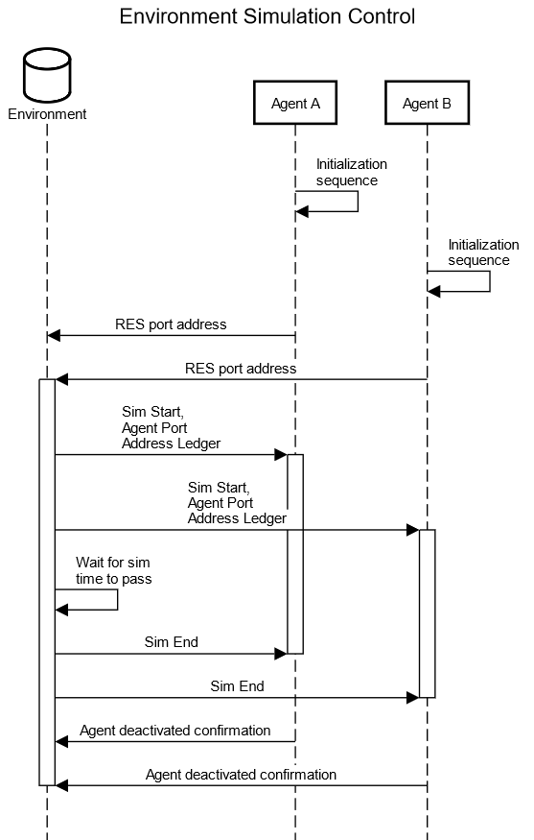
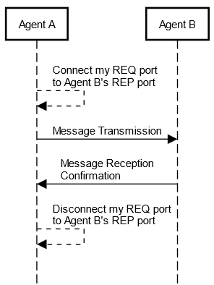
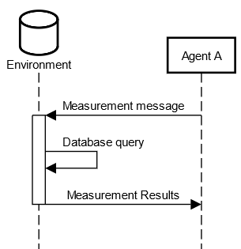
Current Architecture Overview
Simulation Sequences
Current Environment Sensing Sequence
Current Inter-Agent Communications Sequence
Current Environment Simulation Control Sequence

Slide 8
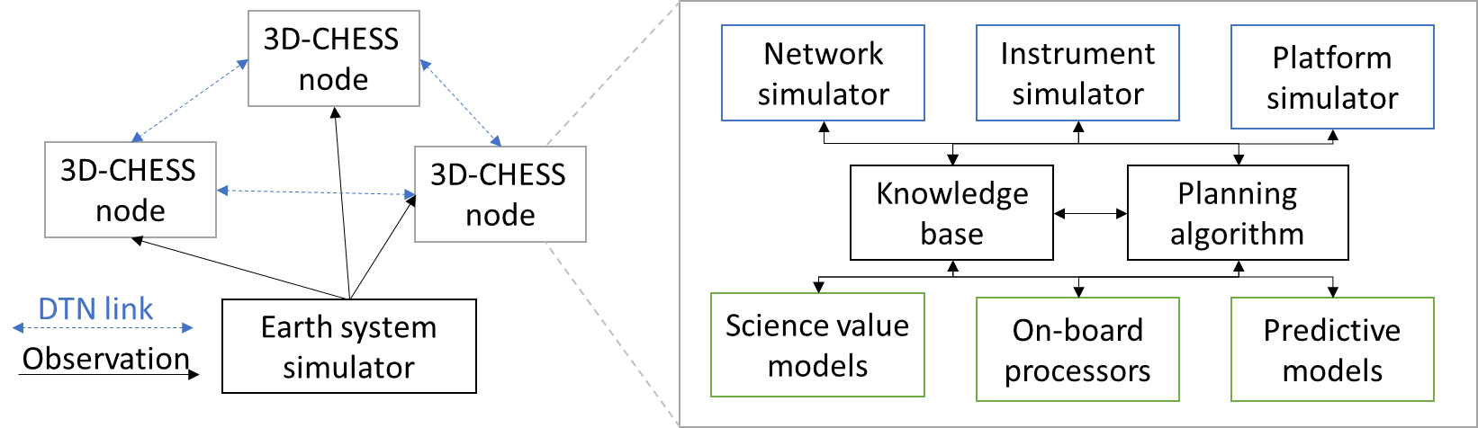




Current Architecture Overview
Limitations
Environment performs two distinct roles
Controls the simulation and propagates the state of the earth system and the agents
Centralized external agent state propagator only allows for agents with fixed trajectories
Ground Stations/Sensors and Satellites, but no UAVs
Agents have no explicit broadcast capabilities
Agents must copy and send a message n-times as to mimic a broadcast
Increases load in the network and runtime
No real-time user monitoring capabilities during the simulation
Results and logs are only printed after the simulation finalizes
Peer-to-peer
Data or Requests
Env-to-agent
Sensing Data
Satellite Node
Satellite Node
Simulation broadcast
Sim start, end, or time
Peer-to-peer
Data or Requests
Environment Server
Ground Station Node
Current DMAS Simulation Framework

Slide 9


New Architecture
Env-to-agent
Sensing Data
Peer-to-peer
Data or Requests
Satellite Node
Environment Server
Manager broadcast
Sim start, end, or time
Satellite Node
Peer broadcast
Data or Requests
Results Logger
Simulation Manager
Node Results
Node state, actions performed, events detected/measured, etc.
Satellite Node
Ground Station Node
Simulation Manager controls nodes
Simulation start and end times
Agent synchronization routine during initialization
Publishes network information to all nodes
Results Logger tracks agents during the simulation
Agents push their results to logger as the simulation runs
Logger tracks incoming results as they are received
Environment still modeled as a server accessed by nodes
Simulates Earth system and inter-agent connectivity
Nodes “sense” the environment by requesting simulated data

Slide 10
New Architecture
Agent Framework Architecture
Agent
-GP access info
-GS access info
-Agent access info
-Agent state info
-Measurement observation metrics info
Agent Node
Simulation Module
Event Handler
-Simulation Events
Sim Start/End
Simulation Module
-Scenario Events
-Simulation Events
SUB
-Scenario Events
Environment
-Simulation Events
Agent Sim Start/End
Environment
Simulation Manager
REQ
Science Module
-Measurement Results (from self or other agents)
-Information Request
-GP access info
-GS access info
-Agent access info
-Agent state info
-Measurement observation metrics info
Science Module
-Simulation Events
-Measurement Data (out)
REQ
-Measurement Requests
-Information Requests
Engineering Module
Other Agents
Engineering Module
-Measurement Requests
-Information Requests
-Measurement Results
-Planner Results
SUB
-Agent State
-Planner Results (in)
-Measurement Requests (in)
REQ
Scheduler Module
Scheduler Module
PUB
-Scheduled Measurement Measurements
-Measurement Requests (out)
-Planner Results (out)
Other Agents
PUSH
Results Logger
-Agent State
-Actions performed
-Events detected/measured
REP
-Measurement Request (out)
-Information Request (out)
-Measurement Results (out)
-Planner Results (out)
Redeveloped DMAS Agent Framework
Current DMAS Agent Framework

Slide 11
New Architecture
-GP access info
-GS access info
-Agent access info
-Agent state info
-Measurement observation metrics info
Agent Node
Agent Framework Architecture
New broadcast capabilities
Inter-Agent communication handled via PUB/SUB port
Agents subscribe to messages addressed directly to them or to ‘ALL’
Connection to other agent’s PUB ports dynamically controlled by the Environment
Simulation Module
Environment
-Simulation Events
Agent Sim Start/End
Simulation Manager
-Measurement Results (from self or other agents)
-Information Request
Science Module
-Simulation Events
-Measurement Data (out)
REQ
-Measurement Requests
-Information Requests
Other Agents
Engineering Module
-Measurement Requests
-Information Requests
-Measurement Results
-Planner Results
SUB
-Agent State
-Planner Results (in)
-Measurement Requests (in)
PUB
Scheduler Module
-Scheduled Measurement Measurements
-Measurement Requests (out)
-Planner Results (out)
-Agent State
-Actions performed
-Events detected/measured
PUSH
Results Logger
Redeveloped DMAS Agent Framework

Slide 12
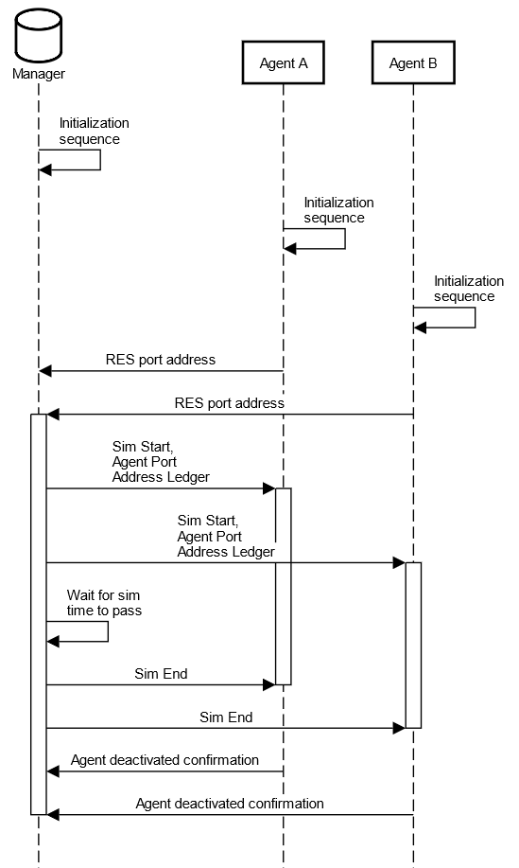
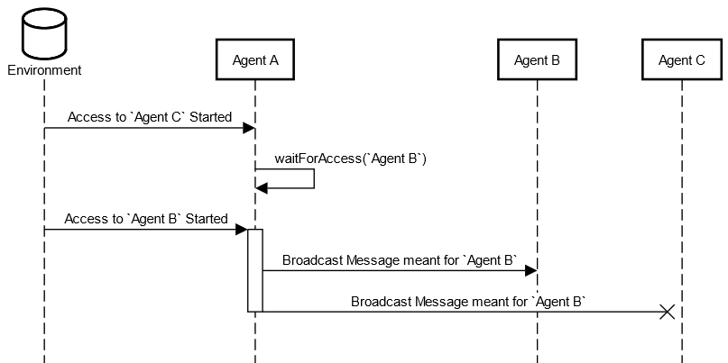
New Architecture
Simulation Sequences
Redeveloped Inter-Agent Communications Sequence
Redeveloped Environment Sensing Sequence
Redeveloped Simulation Manager Control Sequence

Slide 13
Discussion
Add external state propagating capabilities to agents?
Agents’ engineering module would be in charge of propagating external state
Position, velocity, ground coverage, etc.
Would allows for on-line position propagation
Useful for UAV path propagation and orbital maneuvers
Creates issues for the environment to track ground coverage and inter-agent access times
All satellites should inform the environment of their orbital parameters at the beginning of the simulation/whenever a maneuver is performed?
What about for coverage and access from satellites to UAVs?

