Slide 1
3DCHESS – Preliminary Results for Scenario 2 (Reduced)
Alan Aguilar Jaramillo, Ben Gorr, Chrissi Erwin, Dr Daniel Selva Valero

Slide 2
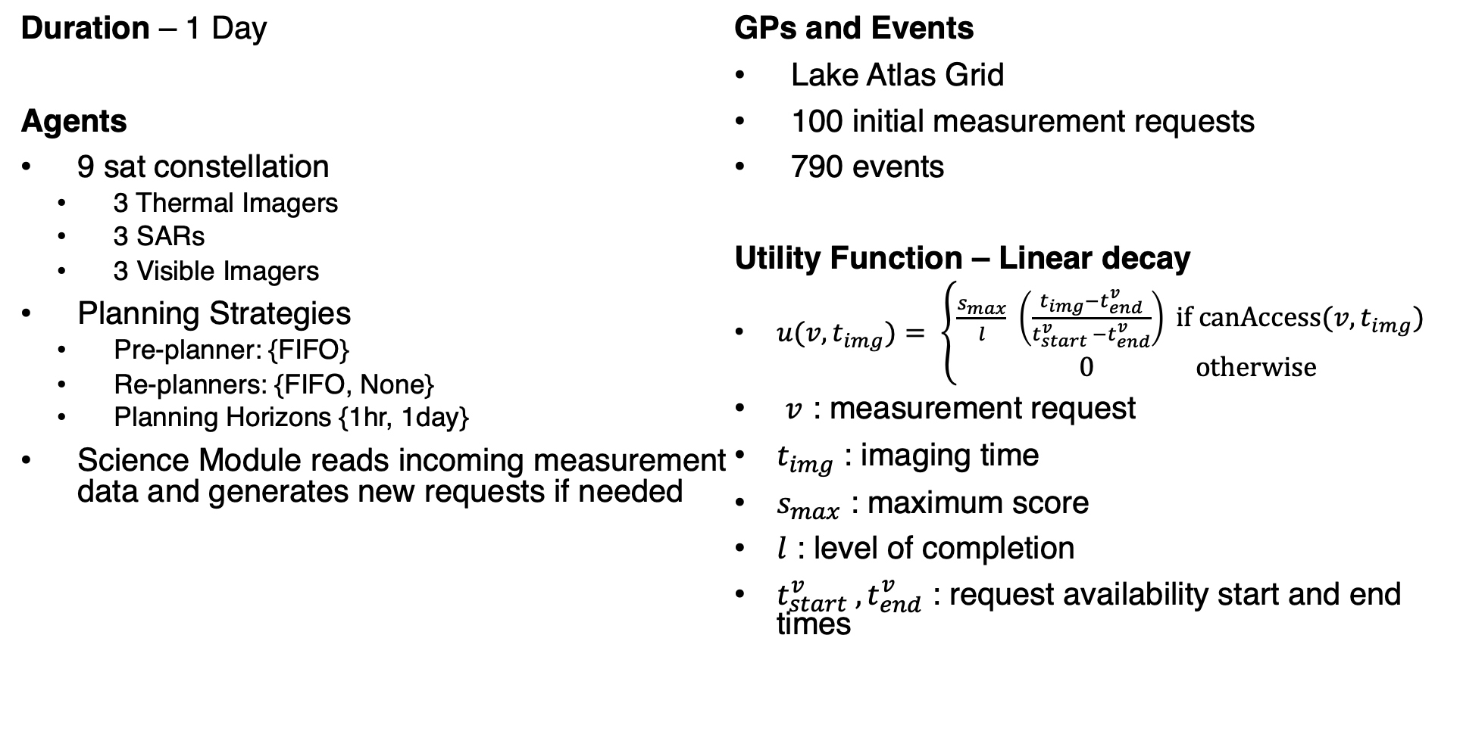
Reduced Scenario 2 Description
Duration – 1 Day
Agents
9 sat constellation
3 Thermal Imagers
3 SARs
3 Visible Imagers
Planning Strategies
Pre-planner: {FIFO}
Re-planners: {FIFO, None}
Planning Horizons {1hr, 1day}
Science Module reads incoming measurement data and generates new requests if needed
GPs and Events
Lake Atlas Grid
100 initial measurement requests
790 events
Utility Function – Linear decay
$u(v, t_{img})= \left\{\begin{aligned}\frac{s_{max}}{l} \left(\frac{t_{img}−t_{end}^{v}}{t_{start}^{v} −t_{end}^{v}}\right) if \text{canAccess}\text{(}v, t_{img}\text{) } \\ 0 otherwise\end{aligned}\right.$
$v$ : measurement request
$t_{img}$ : imaging time
$s_{max}$ : maximum score
$l$ : level of completion
$t_{start}^{v} ,t_{end}^{v}$ : request availability start and end times

Slide 3
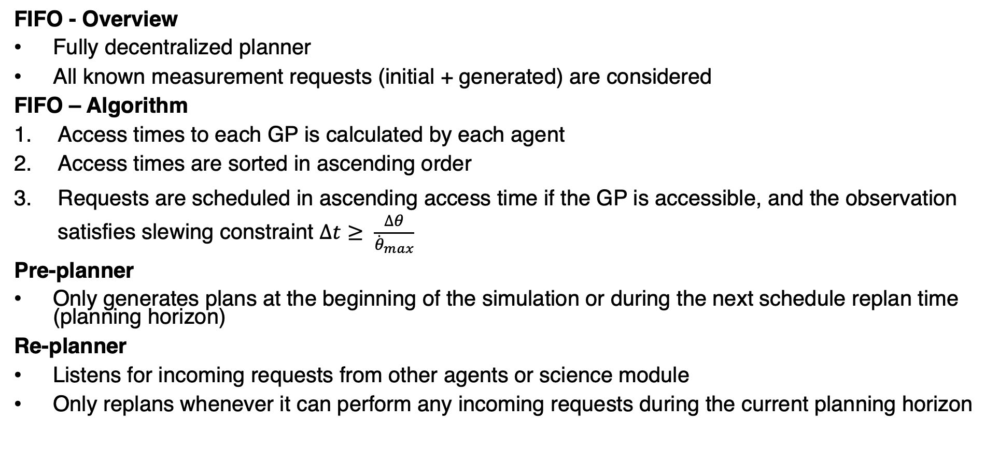
Planning Strategies
FIFO - Overview
Fully decentralized planner
All known measurement requests (initial + generated) are considered
FIFO – Algorithm
Access times to each GP is calculated by each agent
Access times are sorted in ascending order
Requests are scheduled in ascending access time if the GP is accessible, and the observation satisfies slewing constraint $∆t≥ \frac{∆θ}{{\dot{θ}}_{max}}$
Pre-planner
Only generates plans at the beginning of the simulation or during the next schedule replan time (planning horizon)
Re-planner
Listens for incoming requests from other agents or science module
Only replans whenever it can perform any incoming requests during the current planning horizon

Slide 4
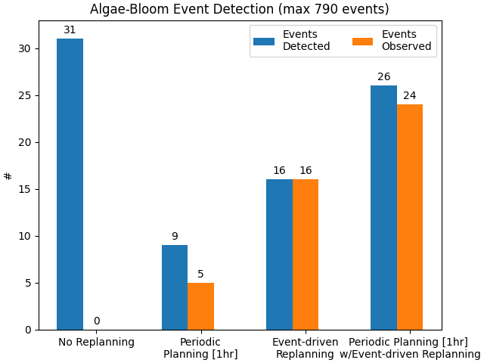
Preliminary Results
Definitions
Detected Event: an algae-bloom event GP was measured by an agent performing an unrelated measurement request. Results in a measurement request being generated
Observed Event: at least one agent performed a measurement request generated from an event detection
Planning Strategy | Replans when | Planning Horizon
No Replanning | Simulation starts | 1 day
Periodic Planning | The start of a new planning horizon is reached | 1 hr
Event-Driven Replanning | New doable measurement requests are received | 1 day
Periodic Planning w/Event-Driven Replanning | The start of a new planning horizon is reached or new doable measurement requests are received | Next 1 hr mark

Slide 5
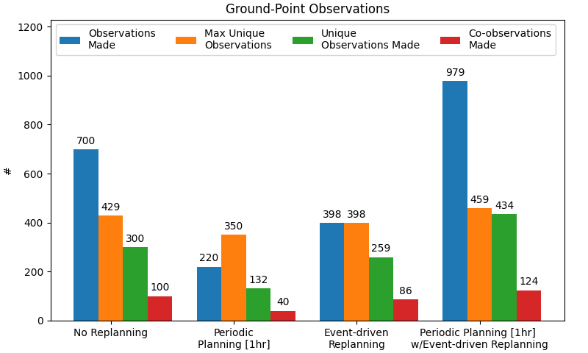
Preliminary Results
Definitions
Observations Made: single-instrument observations performed by all agents
Max Unique Observations: maximum number of unique observations possible due to coverage
Unique Observations Made: number of unique observations performed by all agents
Co-Observations Made: number of co-observations performed by all agents
All results include the initial 100 measurement requests + all event-generated measurement requests

Slide 6
Discussion
Trends match expected behavior, but number of events observed do not match Ben’s results yet
Mismatch might be due to different definitions of observed events
Very high number of repeating observations performed by agents on all cases
Utility Function was not considered during scheduling
Scenario highlighted previously unknown bugs within DMAS
Next Steps
Bug-fixing
Integration of existing CBBA in DMAS w/ new Preplanning/Replanning strategies and framework
Comparison of CBBA vs FIFO as replanning strategy

Slide 7
Questions?

