Slide 1
3DCHESS – Preliminary Results for Scenario 2 (Reduced)
Alan Aguilar Jaramillo, Ben Gorr, Chrissi Erwin, Dr Daniel Selva Valero

Slide 2
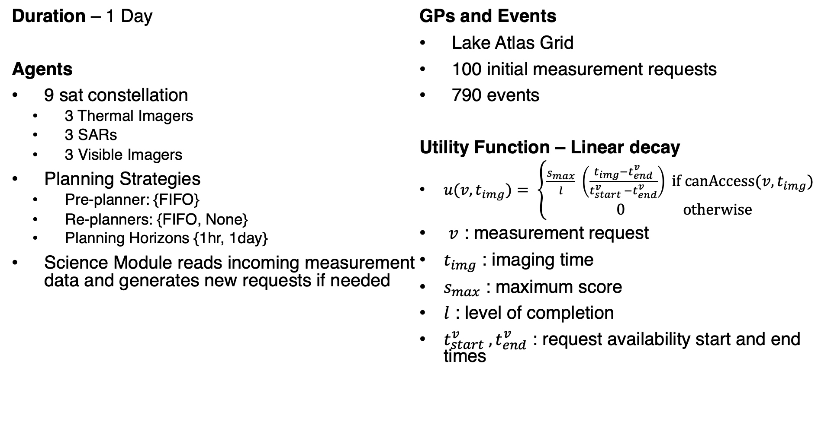
Reduced Scenario 2 Description
Duration – 1 Day
Agents
9 sat constellation
3 Thermal Imagers
3 SARs
3 Visible Imagers
Planning Strategies
Pre-planner: {FIFO}
Re-planners: {FIFO, None}
Planning Horizons {1hr, 1day}
Science Module reads incoming measurement data and generates new requests if needed
GPs and Events
Lake Atlas Grid
100 initial measurement requests
790 events
Utility Function – Linear decay
$u(v, t_{img})= \left\{\begin{aligned}\frac{s_{max}}{l} \left(\frac{t_{img}−t_{end}^{v}}{t_{start}^{v} −t_{end}^{v}}\right) if \text{canAccess}\text{(}v, t_{img}\text{) } \\ 0 otherwise\end{aligned}\right.$
$v$ : measurement request
$t_{img}$ : imaging time
$s_{max}$ : maximum score
$l$ : level of completion
$t_{start}^{v} ,t_{end}^{v}$ : request availability start and end times

Slide 3
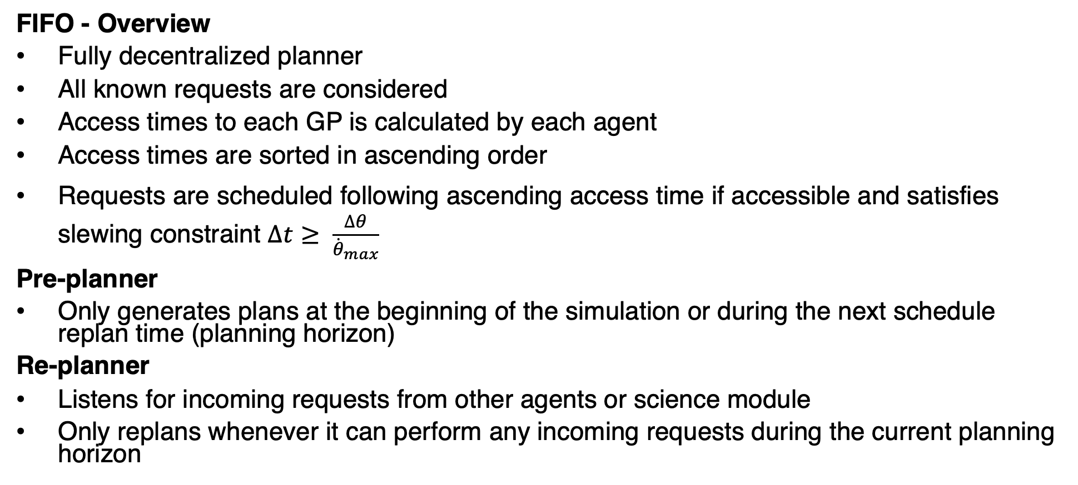
Planning Strategies
FIFO - Overview
Fully decentralized planner
All known requests are considered
Access times to each GP is calculated by each agent
Access times are sorted in ascending order
Requests are scheduled following ascending access time if accessible and satisfies slewing constraint $∆t≥ \frac{∆θ}{{\dot{θ}}_{max}}$
Pre-planner
Only generates plans at the beginning of the simulation or during the next schedule replan time (planning horizon)
Re-planner
Listens for incoming requests from other agents or science module
Only replans whenever it can perform any incoming requests during the current planning horizon

Slide 4
Preliminary Results

Slide 5
Questions?

