Slide 1
DMAS: Decentralized Multiagent Simulation Asynchronous Consensus Constraint-Based Bundle Algorithm (ACCBBA) for Measurement Task Assignment
Alan Aguilar Jaramillo, Ben Gorr, Chrissi Erwin, Dr Daniel Selva Valero

Slide 2

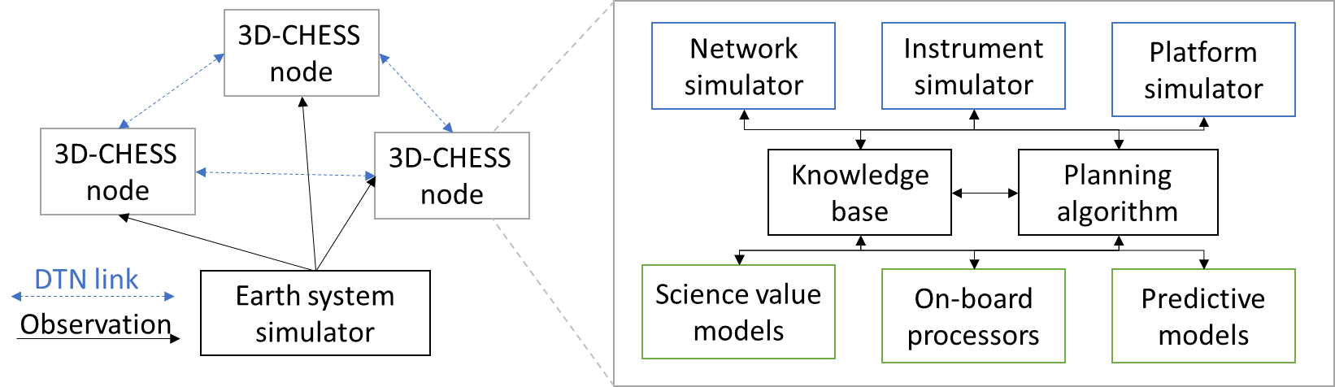






Overview - Simulation Architecture
Env-to-agent
Sensing Data
Peer-to-peer
Data or Requests
Satellite Node
Environment Server
Manager broadcast
Sim start, end, or time
Satellite Node
Peer broadcast
Data or Requests
Results Logger
Simulation Manager
Node Results
Node state, actions performed, events detected/measured, etc.
UAV Node
Ground Station Node
Simulation Manager controls nodes
Simulation start and end times
Agent synchronization routine during initialization
Publishes network information to all nodes
Results Logger tracks agents during the simulation
Agents push their results to logger as the simulation runs
Logger tracks incoming results as they are received
Environment modeled as a server accessed by nodes
Simulates Earth system and inter-agent connectivity
Nodes “sense” the environment by requesting simulated data
Agents modeled as network nodes
Can perform peer-to-peer messaging or broadcasts
Can request information from the environment

Slide 3
Overview - Agent Architecture
Agent Communication
Inter-Agent communication handled via PUB/SUB port
Agents subscribe to messages addressed directly to their name or to ‘ALL’
Connections and subscriptions between agents’ PUB ports is dynamically controlled by the Environment
Operated by Internal Modules
Engineering Module
Propagates internal state of the agent, senses the environment, and performs actions given by the scheduler/planner module
Science Module
Analyses incoming measurement information and proposes measurement or information requests to the scheduler/planner module
Scheduler/Planner Module
Assigns tasks to the engineering module to perform
Simulation Manager
Results Logger
-Network Sync Information
-Simulation Events
-Agent State
-Measurements Performed
-Planner Results
Agent Node
REQ
SUB
PUSH
-Measurement Results
-State Senses
-GP access info
-GS access info
-Agent access info
-Agent state info
-Measurement observation metrics info
-Simulation Events
Simulation Module
-Measurement Results (from self or other agents)
-Information Request
Environment
Science Module
REQ
-Measurement Data (out)
-Env Events
-Measurement Results
-Planner Results
-Agent Information
-Measurement Requests
SUB
-Measurement Requests
-Information Requests
Engineering Module
PUB
-Agent State
-Planner Results (in)
-Measurement Requests (in)
Other Agents
Scheduler Module
-Measurement Results
-Planner Results
-Agent Information
-Measurement Requests
-Information Requests
-Scheduled Measurement Measurements
-Measurement Requests (out)
-Planner Results (out)
Redeveloped DMAS Agent Framework

Slide 4
Engineering Module - Implementation
Sense
Performs State Sense Request to Environment
Reads incoming messages
Updates internal state (platform simulator)
Think
Waits for a plan from the Scheduler Module
Do
Receives high-level plan from planner
Decomposes plan into low-level instructions to perform
Performs instructions
Simulation Manager
Results Logger
-Network Sync Information
-Simulation Events
-Agent State
-Measurements Performed
-Planner Results
Agent Node
REQ
SUB
PUSH
-Measurement Results
-State Senses
-GP access info
-GS access info
-Agent access info
-Agent state info
-Measurement observation metrics info
-Simulation Events
Simulation Module
Engineering Module
-Measurement Results
-Information Request
Environment
Science Module
REQ
-Env Events
Sense
-Measurement Results
-Planner Results
-Agent Information
-Measurement Requests
SUB
-Agent State
-Planner Results
-Measurement Requests
-Measurement Requests
-Information Requests
PUB
Think
Other Agents
Scheduler Module
-Measurement Results
-Planner Results
-Agent Information
-Measurement Requests
-Information Requests
Do
-Scheduled Broadcasts/ Measurements
-Measurement Requests
-Planner Results
Engineering Module - DMAS Agent Framework

Slide 5
Consensus Constraint-Based Bundle Algorithm - CCBBA
Overview
Decentralized market-based approach
Agents bid on tasks based on their expected utility
Each agent looks to create a plan that maximizes their own utility
Allows for partial or total allocation of tasks
Agents can still perform a measurement if it does not have all required sensors for said tasks but for a smaller score
Allows for collaboration between satellites to fully allocate tasks
Enforces time constraints between measurements
Planning Phase
Consensus Phase
Greedy Plan
Broadcast own information
Receive information
Rule-based check
Outbid
Check Outbids
Update self-knowledge
Release Tasks
Not Outbid
Constraint violation
Check Constraint Fulfillment
Constraints met
Not Converged
Check Convergence
Start
Converged
End
Execute plan
Synchronous CCBBA
Limitation: Requires for all agents to broadcast and receive bid information from every agent before an iteration can proceed

Slide 6
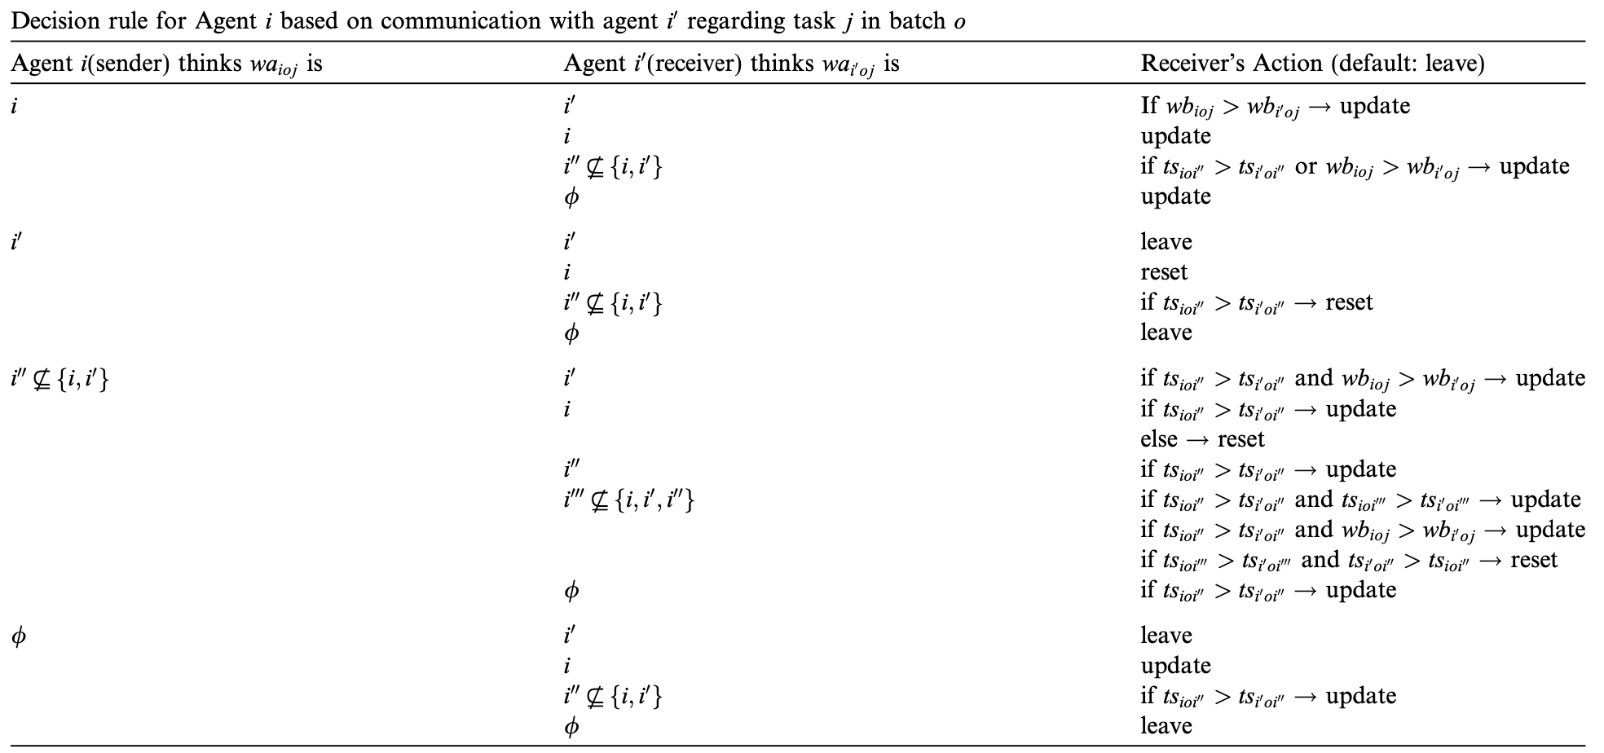
Consensus Constraint-Based Bundle Algorithm - CCBBA
Synchronous CCBBA Bid update decision table L. Johnson, “Decentralized Task Allocation for Dynamic Environments,” Master’s thesis, Massachusetts Institute of Technology, January 2012

Slide 7
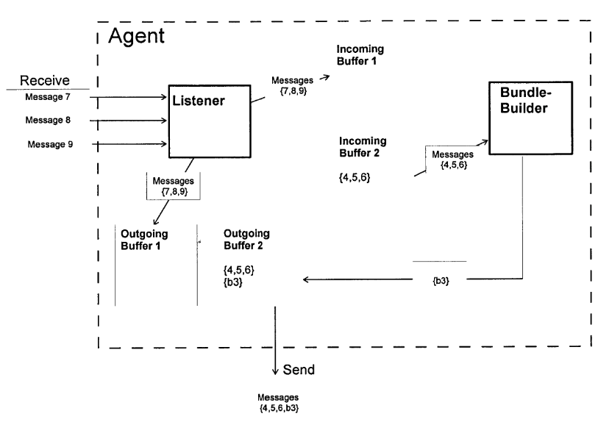
Asynchronous Consensus Constraint-based Bundle Algorithm - ACCBBA
Overview
Planning Phase and Consensus Phase performed simultaneously
Time of bid considered for information update instead of bid iteration
Depends on local consensus rather than global consensus
If a task’s bid is not updated after a certain time, it is assumed that no one is interested, can perform, or knows of said task
The current winner performs the task
Listener (Consensus Phase)
Receives incoming bids and updates information
Any changes deemed as ‘relevant’ are sent to the bundle-builder and broadcasted to all agents
Bundle Builder (Planning Phase)
Receives any ‘relevant’ changes to the known bids and creates a new bundle of tasks to perform
Broadcasts all changes to the bundle to all agents
Asynchronous CCBBA L. Johnson, “Decentralized Task Allocation for Dynamic Environments,” Master’s thesis, Massachusetts Institute of Technology, January 2012
Allows for decentralized planning in dynamic networks while minimizing network load. Does not guarantee double assignment of task.

Slide 8
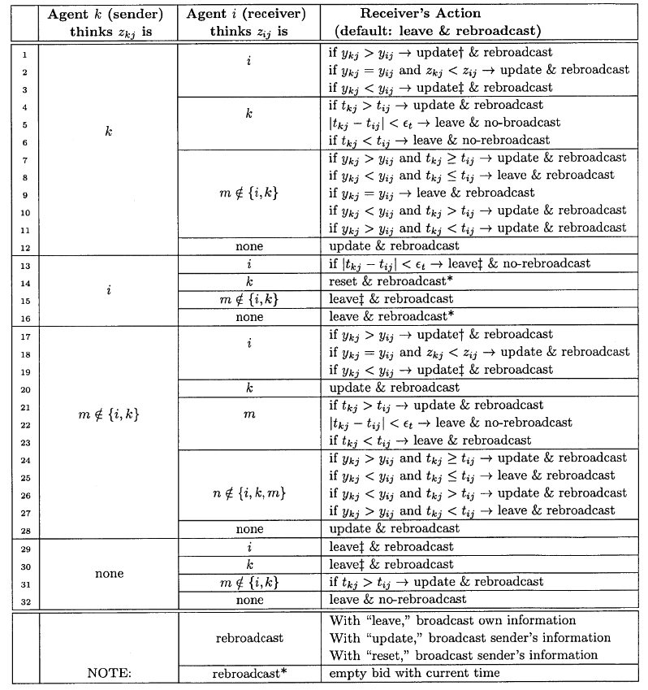
Asynchronous Consensus Constraint-Based Bundle Algorithm - ACCBBA
Asynchronous CCBBA Bid update decision table L. Johnson, “Decentralized Task Allocation for Dynamic Environments,” Master’s thesis, Massachusetts Institute of Technology, January 2012

Slide 9
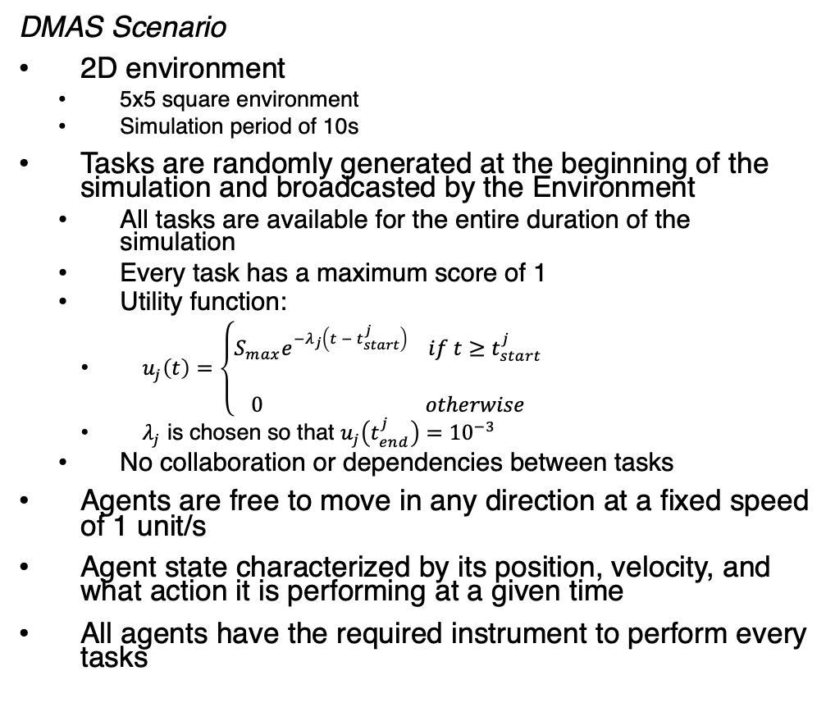
Preliminary ACCBBA Implementation
DMAS Scenario
2D environment
5x5 square environment
Simulation period of 10s
Tasks are randomly generated at the beginning of the simulation and broadcasted by the Environment
All tasks are available for the entire duration of the simulation
Every task has a maximum score of 1
Utility function:
$u_{j}\left(t\right)=\left\{\begin{aligned}S_{max}e^{−λ_{j}\left(t − t_{start}^{j}\right)} if t≥t_{start}^{j} \\ \\ 0 otherwise\end{aligned}\right.$
$λ_{j}$ is chosen so that $u_{j}\left(t_{end}^{j}\right)={10}^{−3}$
No collaboration or dependencies between tasks
Agents are free to move in any direction at a fixed speed of 1 unit/s
Agent state characterized by its position, velocity, and what action it is performing at a given time
All agents have the required instrument to perform every tasks
Engineering Module
Action space:
Move to a location
Idle for a predefined time
Broadcast Messages
Wait for Messages from another agent
Perform Measurements
Scheduler Module
Max bundle size of 3
Only decentralized planning considered
Asynchronous CCBBA Listener & Bundle-Builder
Assumes that the agents have enough resources to complete the simulation
Agents’ ability to perform tasks only considers if agent has the instruments explicitly defined in the task request
Science Module
Does not generate new tasks from measurements

Slide 10
Preliminary ACCBBA Implementation
DMAS Scenario
2D environment
5x5 square environment
Simulation period of 10s
Tasks are randomly generated at the beginning of the simulation and broadcasted by the Environment
All tasks are available for the entire duration of the simulation
Every task has a maximum score of 1
Utility function:
$u_{j}\left(t\right)=\left\{\begin{aligned}S_{max}e^{−λ_{j}\left(t − t_{start}^{j}\right)} if t≥t_{start}^{j} \\ \\ 0 otherwise\end{aligned}\right.$
$λ_{j}$ is chosen so that $u_{j}\left(t_{end}^{j}\right)={10}^{−3}$
No collaboration or dependencies between tasks
Agents are free to move in any direction at a fixed speed of 1 unit/s
Agent state characterized by its position, velocity, and what action it is performing at a given time
All agents have the required instrument to perform every tasks
ACCBBA Plan Execution for 2 agents and 7 tasks with a simulation period of T=10.0s

Slide 11
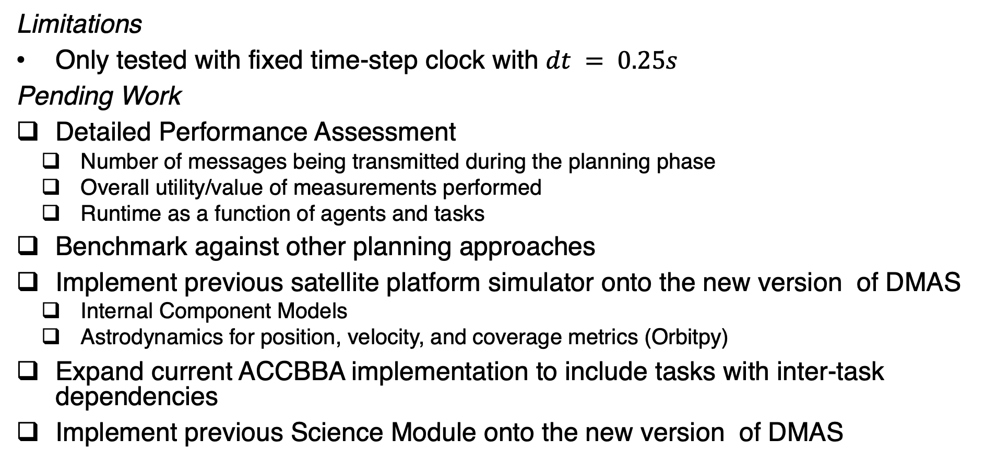
Discussion
Limitations
Only tested with fixed time-step clock with $dt = 0.25s$
Pending Work
Detailed Performance Assessment
Number of messages being transmitted during the planning phase
Overall utility/value of measurements performed
Runtime as a function of agents and tasks
Benchmark against other planning approaches
Implement previous satellite platform simulator onto the new version of DMAS
Internal Component Models
Astrodynamics for position, velocity, and coverage metrics (Orbitpy)
Expand current ACCBBA implementation to include tasks with inter-task dependencies
Implement previous Science Module onto the new version of DMAS

Slide 12
Questions?

Slide 13
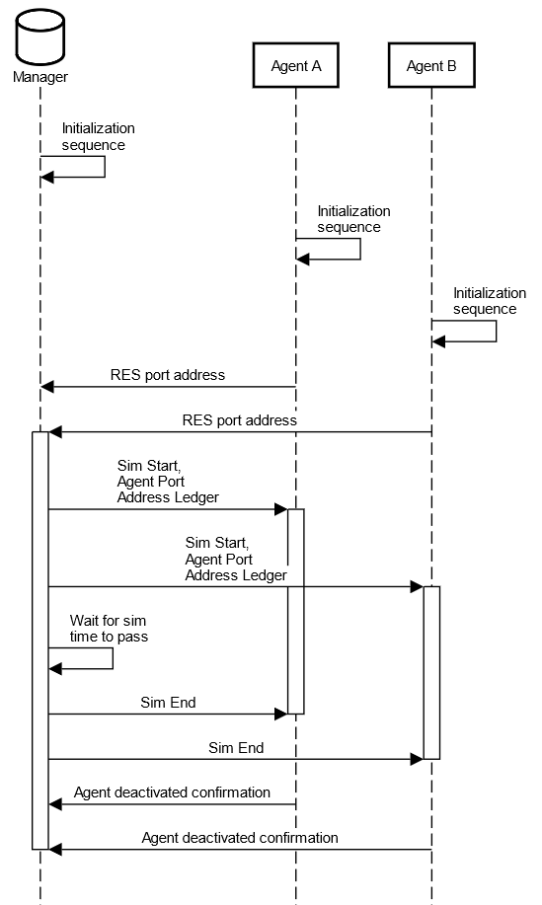
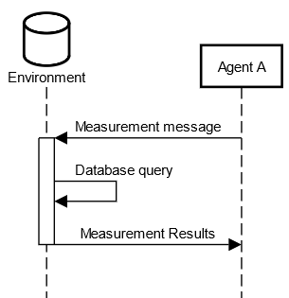
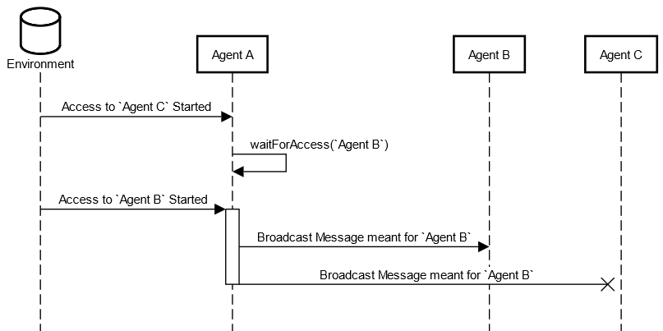
Simulation Sequences
Redeveloped Inter-Agent Communications Sequence
Redeveloped Environment Sensing Sequence
Redeveloped Simulation Manager Control Sequence

Slide 14
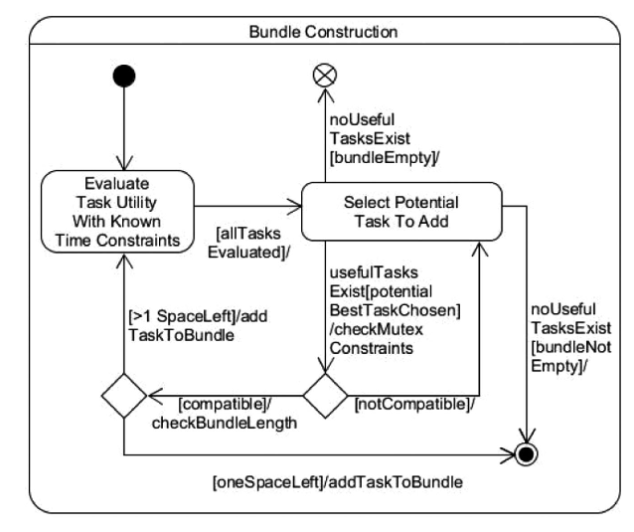
Consensus Constraint-Based Bundle Algorithm - CCBBA
Planning Phase
Agents develop plan locally and look to fill their bundle
All known sub-stasks are evaluated if an agent can perform them
The bundle gets constructed in a greedy fashion
A bundle is a container of a given size that stores all tasks that the agent is bidding on
Agents may adopt an optimistic bidding strategy for bidding on collaborative subtasks
Once the bundle is constructed, the bids are registered in the agent’s local bid ledger

Slide 15
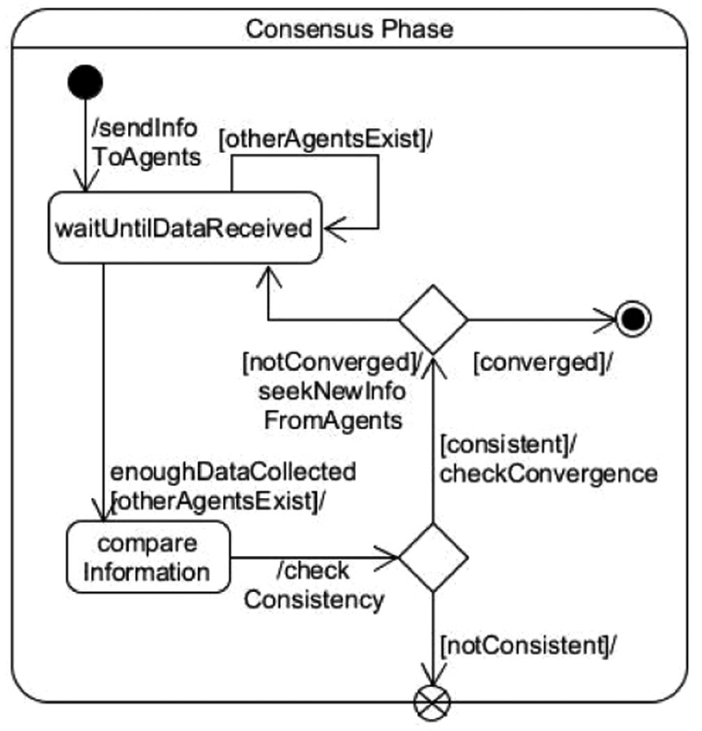
Consensus Constraint-Based Bundle Algorithm - CCBBA
Consensus Phase
Agents share their bid ledgers and compare their results
Rule-based check for determining winners
Individual subtask winners
Coalition winners
Time and collaboration constraint check
If a subtask is in violation of a constraint, its constraint counter goes up by one
If the constraint violation counter reaches a given limit, the winner of this task will be forced to release its bid and replan
Inconsistent ledgers lead to replanning

