Slide 1
DMAS: Decentralized Multiagent Simulation – TSS Example
Alan Aguilar Jaramillo, Ben Gorr, Chrissi Erwin, Dr Daniel Selva Valero

Slide 2
Simulation Summary
3 satellites:
All in 500 km, 45 deg inclination orbit, spaced in true anomaly by 5 degrees (essentially ~75 seconds apart)
CustomSat
TIR Camera
Jason-3
Poseidon-3B Altimeter
Suomi NPP
VIIRS
Iridium node to distribute measurement requests
Poseidon-3B Altimeter and VIIRS can detect “outliers” and generate measurement requests
Change this to only altimeter outliers

Slide 3
TSS example
Agent
Science Module
Engineering Module
On-board Processor
-Level 1-3 data products
Science “reasoning”
-Environment Events
-Simulation Events
SUB
Platform Emulator
-State
-Data (out)
-New data flag
Environment
CDH
-Level 0 data products from sensor
Science data-base
-Agent State
Memory Emulator
Reactive Planner
-TSS or altimetry outliers
REQ
-Emergency Task(s)
-Task(s)
-GP access req
-GS access req
-Agent access req
-Agent state req
-Observation sense req
--Itemized task instructions
Operations Executor
Science Value Model
Comms
-Received Data
Payload
-Measurement Requests
-Perceived Data
-Measurement Requests received from other agents
-Measurement Request
REQ
-Observation tasks and charge tasks
Scheduler/Planning Module
Iridium Node
Operations Planning (agent-level)
-Proposed observations
Observation Planning (Decentralized multiagent-level)
Knowledge-Base Instrument Capability Reasoning
REP
Planning Module
-Measurement Request
-Capable measurements

Slide 4
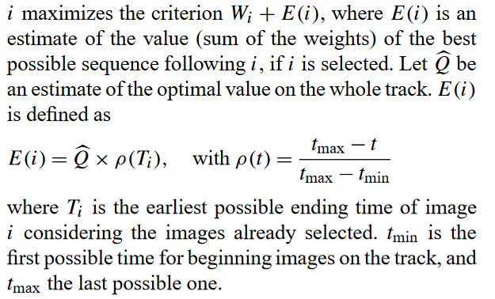
Planning Module – Observation Planner
Currently looks at access to lakes and rivers from HydroLAKES and GRWL, and uses a “greedy algorithm” from Lemaitre et. al. to schedule observations
All points weighted equally (W_{i} = 1.0) to begin simulation
Whenever a measurement request is received from either another agent or internally, completely replans with (W_{i} = measurement request science value)
Modifies science value by measurement performance multiplier based on Molly’s return function (NEW)
TODO: subtract measurement cost from value; try other algorithms

Slide 5
Planning Module – Operations Planner
Receives list of planned measurements and associated times
Puts charging actions in between the observation actions
Puts slewing actions between observation actions (NEW)
Sends to the engineering module
TODO: add downlink actions

Slide 6
Engineering Module - Observations
CDH receives ObservationTask from planning module, tasks the payload to complete it
Payload sends ObservationSense request to environment, which responds with reflectances (currently Landsat Collection 2 Surface Reflectance, same image)
ADCS slews spacecraft between observations
Payload sends image to CDH
CDH stores image and sends to science module
TODO: replace Landsat reflectance image with VIIRS “remote sensing reflectance from https://eastcoast.coastwatch.noaa.gov/cw_data_access.php”; add imager noise/distortion

Slide 7

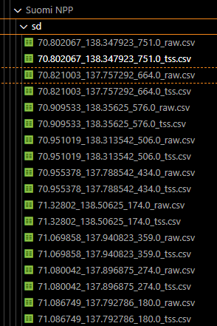
Science Module – Onboard processing
Upon receiving data from payload via the engineering module, stores the “raw/level 0” data product in the science database
If the submodule is capable, it processes the data into “level 1-3” data products
TSS: using algorithm from Nechad et. al.
Altimetry: currently generates a random reading
Sends flag notifying science reasoning module that a new data product has been added to the database
TODO: Implement Copernicus water level source for altimetry data; add more processing capabilities

Slide 8
Science Module – Science Reasoning
Upon receiving the updated flag from the onboard processing module, checks to see if the data product is an “outlier”
Currently the outlier check is just a 50% random yes/no
If the data product is an outlier, sends to the science value submodule
TODO: compare the data product to some threshold based on historical data for that ground point, or to existing measurements in science database

Slide 9
Science Module – Science Value
Receives outlier notification from science reasoning submodule
Currently checks HydroATLAS population density to determine the science value of observing that particular water body
Generates measurement request with the location and science value
Sends measurement request to planning module AND transmitter
Modified by the measurement performance quality indicator
TODO: Change science value source? Add measurement request expiration?

Slide 10
Engineering Module – Inter-agent Comms
Upon receiving measurement request from science value submodule, engineering module forwards to the transmitter submodule
Transmitter submodule sends the measurement request to the Iridium node that all satellites can contact at all times
Iridium node receives the measurement request and sends to all other agents
All agents receive via the receiver submodule and send the measurement request directly to the planning module
TODO: implement message timeouts, real communications constraints

Slide 11
Planning Module – Instrument Capability
Upon receiving a measurement request, checks if the agent can perform the request measurement
Queries the current knowledge graph (KG) based on the CEOS database
“Ocean chlorophyll concentration” is used for TSS at the moment
“Sea level” is used for altimetry at the moment
If the instrument can observe the observable according to the KG, passes the measurement request to the observation planning submodule
TODO: infer what sensors can observe “TSS” from KG, support custom instruments

Slide 12
TODOs summarized
Agent-level, centralized and decentralized planning algorithms (Alan/Ben)
Decentralized lit review to find CBBA alternatives
Add real reflectance/altimetry data sources (Ben)
Come up with method of determining “outlier” measurements from either historical or agent-generated time-series data (Molly/George/Huilin?)
Infer what sensors can observe “TSS” from KG, support custom instruments (UCLA team/Ben)
README!!! (Ben/Alan)
Consider science value as vector of covariances
Increase in flow results in increase in TSS/concentrations
Forecast-based measurement requests
Compare nadir altimeter to slewing altimeter
Start with delta in observations
Slides showing full simulation summary w/ visuals
Low-priority:
Add image noise/distortion (Ben/Molly?)
Add measurement request expiration (Ben/Alan)
Add real communication constraints (Ben/Alan)

Slide 13
Questions?

