Slide 1
Simulation Platform for Distributed Satellite Systems Mission Concepts
Alan Aguilar Jaramillo, Dr Daniel Selva Valero

Slide 2
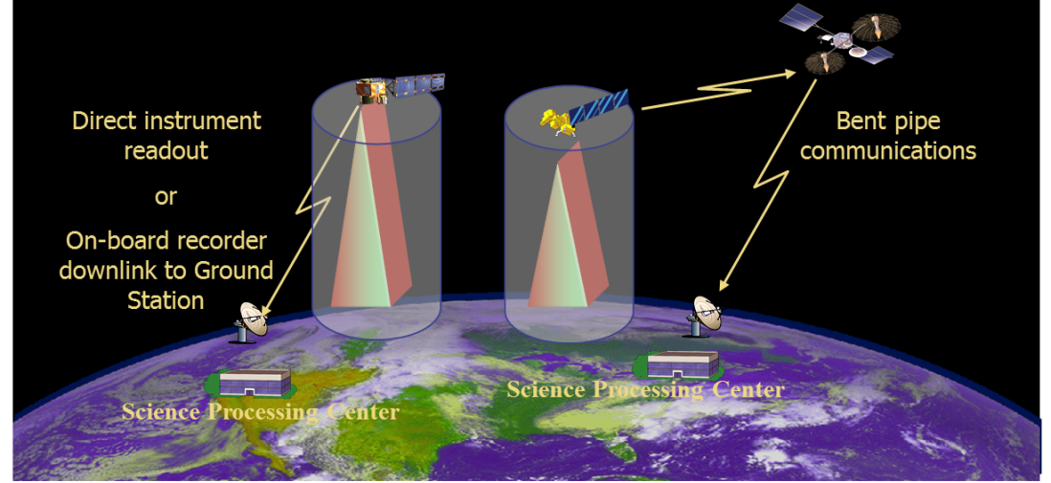
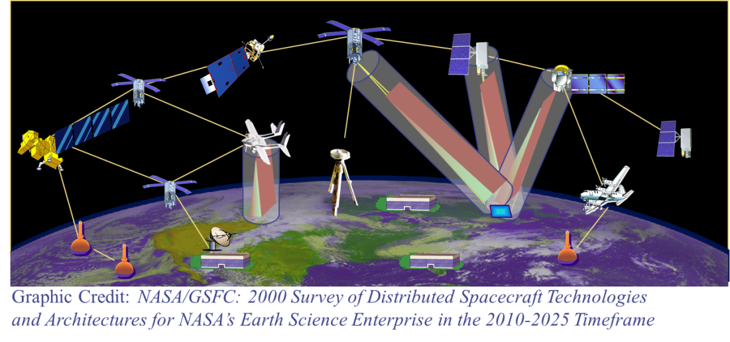
Motivation and Challenges
Space-based Earth observation is undergoing a paradigm change
Easier access to space
More affordable access to space
Higher grade commercial off-the shelf components
Increased computation power
Implementation of Distributed Architectures
Many smaller and heterogeneous satellites, w/ crosslinks
Federations (coordination among assets owned and operated by different organizations)
Onboard measurements processing
Starting to be implemented (e.g., TROPICS [1], CYGNSS [2])
Due to operations logistics, large constellations demand autonomous operations to maximize performance
NASA Sensor Web concept (image credit NASA GSFC)

Slide 3
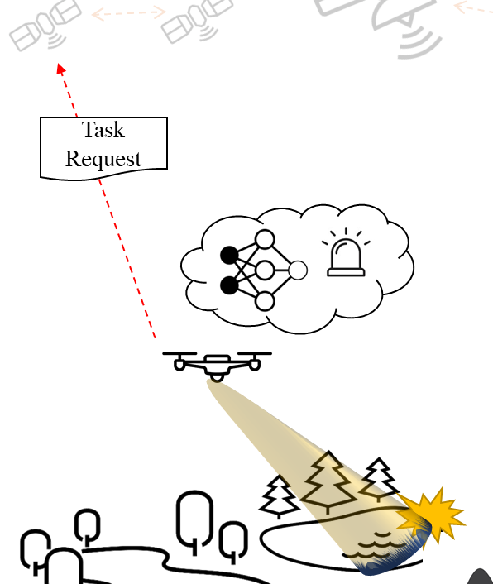
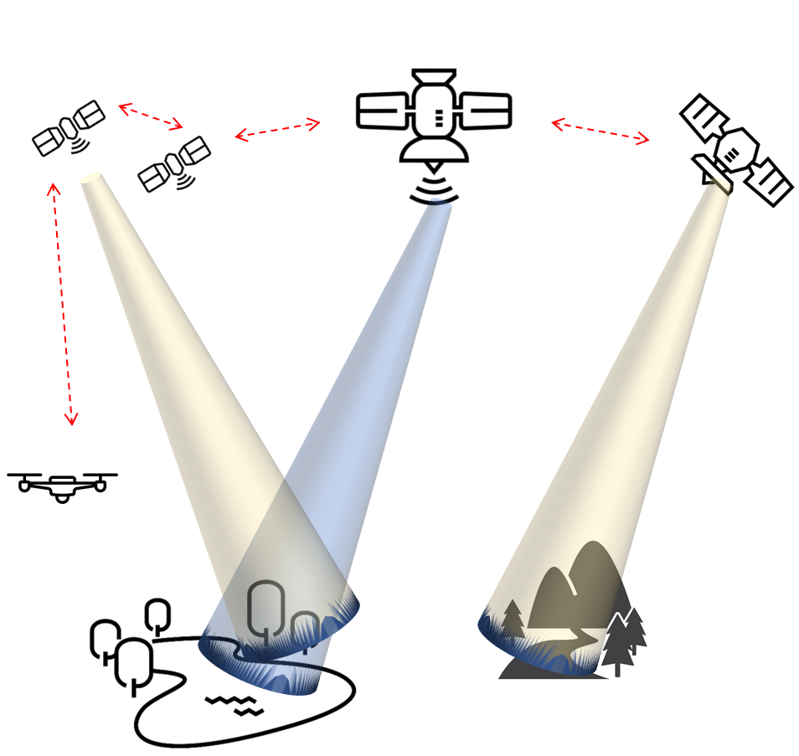
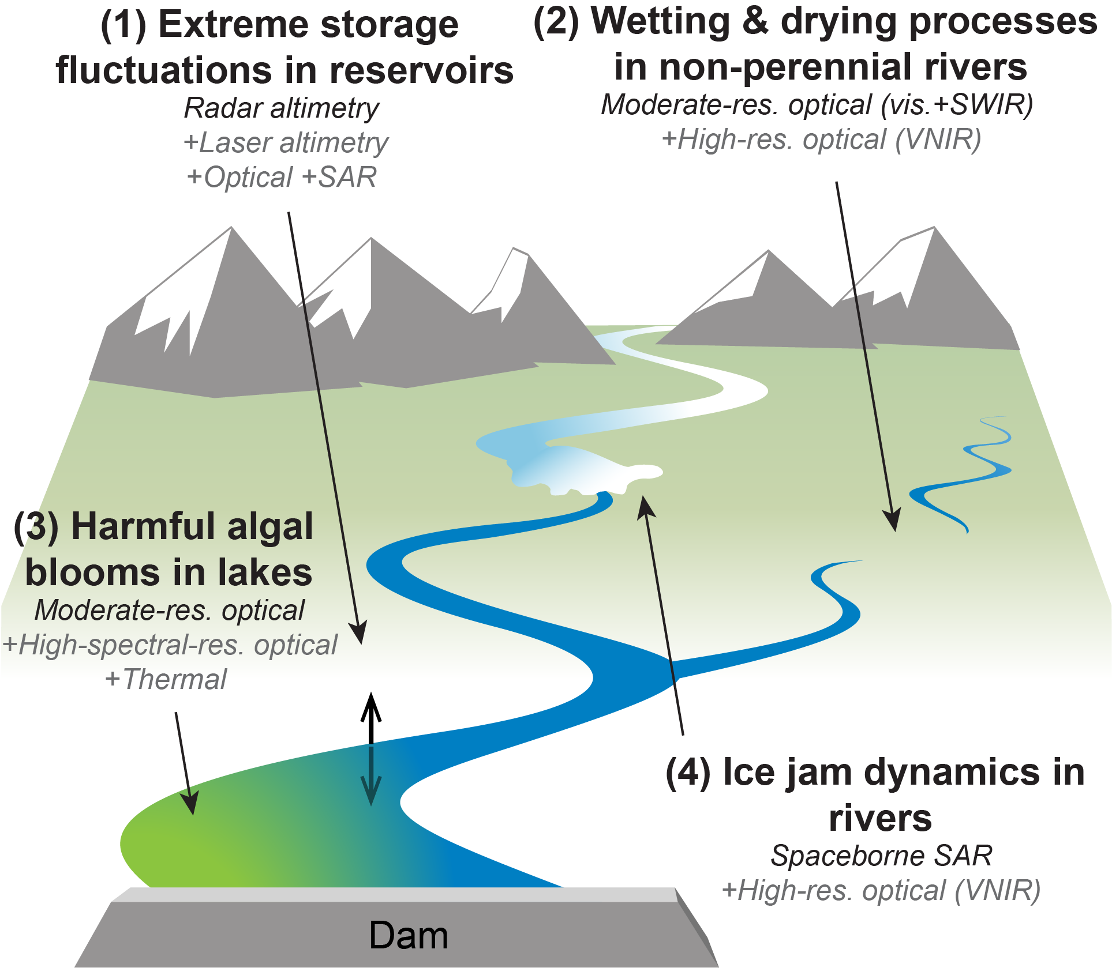
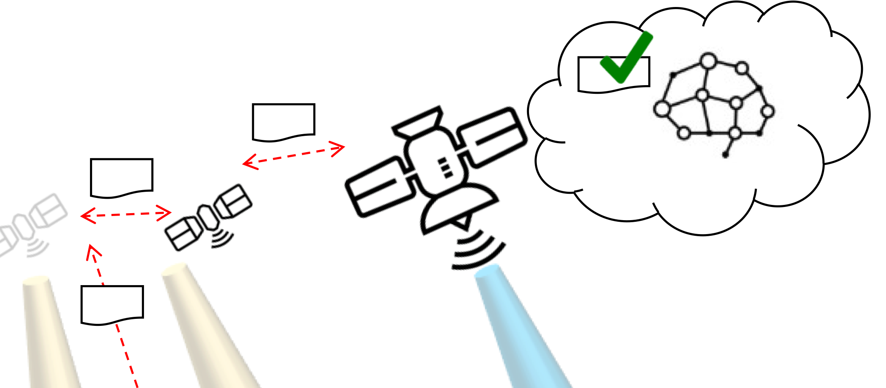
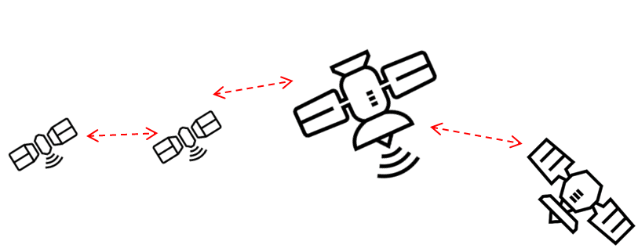
Mission Concept: 3D-CHESS
Goal: provide proof of concept for a context-aware network of heterogeneous sensors, in the context of an inland water ecosystem monitoring mission
1 – Default missions; data processing
2 – Event detected; task request sent
3 - Knowledge-based task filtering
4 – Decentralized planning
Notes:
To give you an idea of where we are today in terms of actual missions that have flown

Slide 4

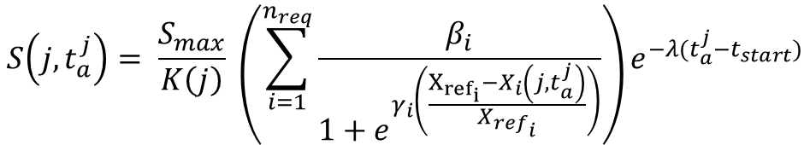
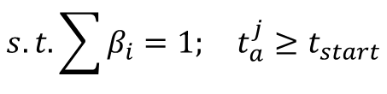

Requirement-Driven Utility Function
$$u_{a}\left(j\right)=S\left(j,t_{a}^{j}\right) −C_{man}−C(j)$$
$$S\left(j, t_{a}^{j}\right)= \frac{S_{max}}{K\left(j\right)} \left(\sum_{i=1}^{n_{req}}{\frac{β_{i}}{1+e^{γ_{i}\left(\frac{X_{{ref}_{i}}−X_{i}\left(j,t_{a}^{j}\right)}{{X_{ref}}_{i}}\right)}}}\right)e^{−λ(t_{a}^{j}−t_{start})}$$
$$s.t.\sum{β_{i}}=1; t_{a}^{j}≥t_{start}$$
Desired Dependencies
Temporal Constraints
Cross-registration with other satellites
Urgency
e.g., short-lived phenomena
Stakeholder Requirement Satisfaction
Spatial Resolution, Measurement Accuracy, etc…
Maneuvering Costs
Measurement Intrinsic Costs
$j$ : Measurement task j
$t_{a}^{j}$ : Time of Measurement of Task j
$S_{max}$ : Maximum Score
$K(j)$ : Level of Completion of Task j
$β_{i}$ : Weight of Requirement i
$γ_{i}$ : Urgency Factor
$X_{ref}$ : Reference performance metric
$X_{i}\left(j,t_{a}^{j}\right)$ : Estimated performance
$λ$ : Urgency Factor
$t_{start}$ : Task start time

Slide 5
Simulation Framework
Science Module
Predictive Model(s)
Science Value Models
Agent
Distributed Multi-Agent Satellite System Simulation (DMAS)
Onboard Processor
Science Knowledge Base
-Measurement Observation Metrics
-Estimated measurement data
-Task Requests
-Possible Measurement Observation Metrics
Satellites, Ground Stations, and Aircraft all treated as intelligent agents
-Measurement Observation Metrics
Actor
Perceives information from its environment or from other agents
Performs actions given by the planner (component actuation, message transmission and reception, performing measurements)
Scheduler
Processes information perceived by the agent
Maintains an internal knowledge base
Determine the next set of actions to be performed
Platform Simulator
Tracks current state of the agent (position, velocity, energy storage and consumption, and data storage, generation and transmission)
Can turn off agent if actions exceed capabilities (i.e., agent consumes more power than it can generate)
Scheduler
Network Simulator
-Incoming Msgs
Instrument Capability Reasoning
Actor
-Messages
-Actions taken
Environment / Other Agents
-Incoming Msgs
-Task Requests
-Task Responses
-Measurement Capabilities
-Possible Measurement to be performed
-Action(s)
Engineering Module
-Component Actuation
-Maneuver Instruction
-Incoming/Outgoing Mgs
-Outgoing Msgs
-Measurement performed
-Task Requests
-Task Response
Routing Planner
Measurement Allocation Planner
InstruPy
-Agent State
-Critical State Warnings
Knowledge Base + Predictive State model
Platform Simulator
OrbitPy
Modular agent structure creates a generic platform to test different planners without tailoring the simulator to a particular planner
Operations Planner

Slide 6
Simulation Framework
Agent
Simulation Maintenance Module
Event Handler
-Simulation Events
Sim Start/End
-Environment Events
-Simulation Events
SUB
-Environment Events
Environment
Nomenclature:
Communications Port
Agent Module/Submodule
Process
Inter-process/module
communication link
Inter-agent
communication link
Process Sequence
-Measurement Requests
-Information Request
-Measurement Results (from self or other agents)
SUB
REQ
Science Module
-GP access req
-Agent access req
-Agent position req
-Agent eclipse req
-GP measurement observation metrics req
Module
-Measurement Requests
-Proposed measurements’ estimated Science Benefit
-Proposed measurements
-Proposed measurements’ estimated observation metrics
Sim Start/End
-Measurement Request
-Information Request
-Measurement Results
-Planner Results
Engineering Module
-Agent State
-Planner Results (in)
REP
Science Scheduler
-Scheduled Measurement Measurements
-Planner Results (out)
Other Agents
REQ
-Measurement Request
-Information Request
-Measurement Results
-Planner Results

Slide 7
Simulation Framework
Agent
Simulation Maintenance Module
Event Handler
-Simulation Events
Sim Start/End
-Environment Events
-Simulation Events
SUB
Environment
Engineering Module
-Measurement Results (from self)
REQ
Science Module
-GP access req
-Agent access req
-Agent position req
-Agent eclipse req
-GP measurement observation metrics req
-Measurement Request
-Information Request
-Measurement Results (from other agents)
-GP access req
-GP measurement observation metrics req
Instrument Simulator
-Agent access req
-Environment Events
-Agent State Events
-Agent State
-Measurement Requests
-Proposed measurements’ estimated Science Benefit
-Proposed measurements
-Proposed measurements’ estimated observation metrics
-Measurement Request
-Information Request
-Measurement Results
-Planner Results
-Environment Events
Operations Planner
Platform Sim
-Agent position req
-Agent eclipse req
-Maintenance actions
-Planner Results
REP
-Agent comms capabilities
-Changes to buffers
Science Scheduler
Other Agents
-Scheduled Measurement Actions
Network Sim
-Measurement Request
-Information Request
-Measurement Results
-Planner Results
REQ
-Latest Agent State
-Measurement Request
-Information Request
-Measurement Results
-Planner Results
Knowledge-Base and Predictive Models
-Next predicted critical state

Slide 8
Simulation Framework
Agent
Simulation Maintenance Module
Event Handler
-Simulation Events
Sim Start/End
-Environment Events
-Simulation Events
SUB
Environment
Engineering Module
REQ
Platform Sim
-GP access req
-Agent access req
-Agent position req
-Agent eclipse req
-GP measurement observation metrics req
periodic_update():
---------------------------------------------------------------
Wait 1 time-step
Update state
Repeat forever
update_state():
---------------------------------------------------------------
dt = current time – previous update time
Update power and data for dt
Check if in eclipse
Check for pos and vel
Update component status
Trigger updated event
Internal_message_handler():
---------------------------------------------------------------
Await message
If message not meant for this module, forward to destination
If environment event, update state
If maintenance action, perform measurement
If measurement action,
If buffer allocation action,
If state request, send latest state
If critical state flag, request actions to operations planner. If no response and still critical, set platform state to false, else do actions and exit process
-Measurement Request
-Information Request
-Measurement Results
-Planner Results
critical_state_timer():
---------------------------------------------------------------
Get current state
If critical, send critical state flag and return
Predict next critical state
Await next critical state or updated event
If updated event, repeat from 1
Else, send critical state flag
perform_measurement():
---------------------------------------------------------------
asd
REP
Other Agents
REQ
-Measurement Request
-Information Request
-Measurement Results
-Planner Results
run():
---------------------------------------------------------------
Wait for all to end: internal_message_handler(), critical_state_timer()

Slide 9
Simulation Framework
Agent
Simulation Maintenance Module
Event Handler
-Simulation Events
Sim Start/End
-Environment Events
-Simulation Events
SUB
Environment
Engineering Module
REQ
Network Sim
-GP access req
-Agent access req
-Agent position req
-Agent eclipse req
-GP measurement observation metrics req
send_transmission():
---------------------------------------------------------------
Receive Transmission Request
Await self buffer allocation
Create Routing Plan
Await Access Start
Establish link
Await receiver’s buffer allocation
Start transmission
Await transmission completion
Simulate remaining time Delay
Delete message from buffer
-Measurement Request
-Information Request
-Measurement Results
-Planner Results
REP
Other Agents
receive_transmission():
---------------------------------------------------------------
Await reception request
Await to allocate transmission in buffer
Send allocation confirmation
Await transmission completion
Simulate remaining time delay
Delete message from buffer
Send transmission message to destined module for processing
REQ
-Measurement Request
-Information Request
-Measurement Results
-Planner Results

Slide 10
ToDo’s
Engineering Model Integration
Alan: Power and Data Tracking Model
Ben: Attitude Model
Science Value Module
Ben: Spatial Res + Look Angle-based Chlorophyll + TSS
Federated Systems
Define federation in simpy
Use Case
Define federation in simpy

Slide 11
Types of Requests
Past Information Request
“I want soil moisture at (X,Y), does anyone know about this?”
“I am measuring SM at (X,Y) in 5 mins but need temperature measurements, does anyone know about this recently?”
“I an optical measurement from (X,Y), can you tell me if there is Algae here?”
New/Future Measurement Request
“Can someone measure SM at (X,Y) and tell me what the value is?”
Force Measurement Request
“You are measuring SM at (X,Y) because we told you to.”
Publish and subscribe protocol?
Sat X performs periodic measurements and list of Sats X_i receive the periodical data
Request protocol?
Only request the information you need

Slide 12
End Users
Initial Focus: Data collection of the network
Later Focus: Data downlink and information quality
Use case-specific metrics
i.e., How many times were algae blooms detected in single sat mission vs distributed mission
Evaluated information is obtained from GS performing information requests

Slide 13
Validation
Value of context-awareness
Fixed plan vs reactive plan
Importance of different information
No state info, no information requests

Slide 14
Questions?

Slide 15
References
WJ, Blackwell, Braun, S, Bennartz, R, et al. An overview of the TROPICS NASA Earth Venture Mission. Q J R Meteorol Soc. 2018; 144 ( Suppl. 1): 16– 26
M. P. Clarizia and C. S. Ruf, "Wind Speed Retrieval Algorithm for the Cyclone Global Navigation Satellite System (CYGNSS) Mission," in IEEE Transactions on Geoscience and Remote Sensing, vol. 54, no. 8, pp. 4419-4432, Aug. 2016, doi: 10.1109/TGRS.2016.2541343.
Marinan, A., Cahoy, K. L., Byrne, J., Cordeiro, T., Decker, Z., Marlow, W., ... & Osaretin, I. (2015). Automated Resource-Constrained Science Planning for the MiRaTA Mission.
W. J. W. J. Wolfe and S. E. S. E. Sorensen, “Three Scheduling Algorithms Applied to the Earth Observing Systems Domain,” Manage. Sci., pp. 148–166, 2000.
Duncan, Eddy, and Kochenderfer, Mykel. “Markov Decision Processes For Multi-Objective Satellite Task Planning”,
Cidoncha, X. G., and Selva, D., “Agent-based simulation framework and consensus algorithm for observing systems withadaptive modularity,”Syst. Eng., Vol. 21, no. 5, 2018, pp. 432–545.
Nag, Sreeja, et al. "Autonomous scheduling of agile spacecraft constellations with delay tolerant networking for reactive imaging." (2019).
H. Wang, X. Li, and Y. Liu, “Summary of intelligent algorithms in planning & amp; scheduling of Earth observation satellite,” in IEEE International Conference on Intelligent Computing and Intelligent Systems, 2010, pp. 480–483.
Kennedy, Andrew K., and Kerri L. Cahoy. "Performance analysis of algorithms for coordination of earth observation by cubesat constellations." Journal of Aerospace Information Systems 14.8 (2017): 451-471.
Li, G. 2020. Online scheduling of distributed Earth observation satellite system under rigid communication constraints. Advances in Space Research. 65 (11), 2475-2496.
Gallud,X.,andSelva,D.,“Agent-basedsimulationframeworkandconsensusalgorithmforobservingsystemswithadaptive modularity,” Syst. Eng., 2018, pp. 432, 454.
S. Nag et al., "D-SHIELD: DISTRIBUTED SPACECRAFT WITH HEURISTIC INTELLIGENCE TO ENABLE LOGISTICAL DECISIONS," IGARSS 2020 - 2020 IEEE International Geoscience and Remote Sensing Symposium, 2020, pp. 3841-3844, doi: 10.1109/IGARSS39084.2020.9323248.

