Slide 1

Data Ingestion, Management, Wrangling, Cleaning, from Predictit.org
closed
market
data
Jeremy Gerdes
https://github.com/seakintruth/rpredictit_dataset

Slide 2
Leveraging Previous Work
Dataset comes from scripts 01 - 04 and database created over several weeks of free time at home 9 months ago...
All work for this practicum is in script 05_explore_data.R

Slide 3
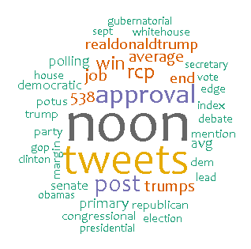
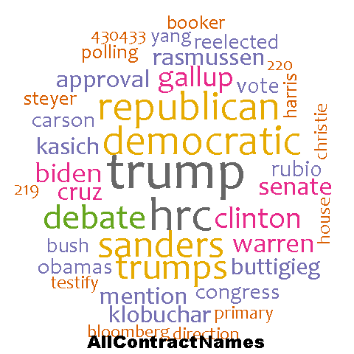
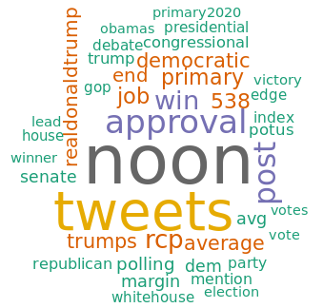
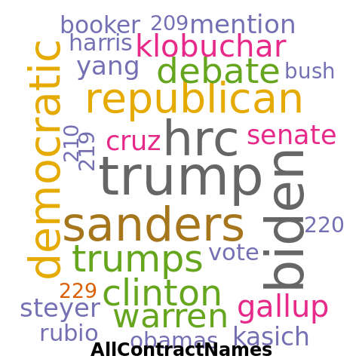
Word Cloud Comparison Z1_getImagesForFun.R Z2_analyzeImages.R
Market Titles 2014-2019
2014-2019
Market Titles 2014-2020
2014-2020

Slide 4
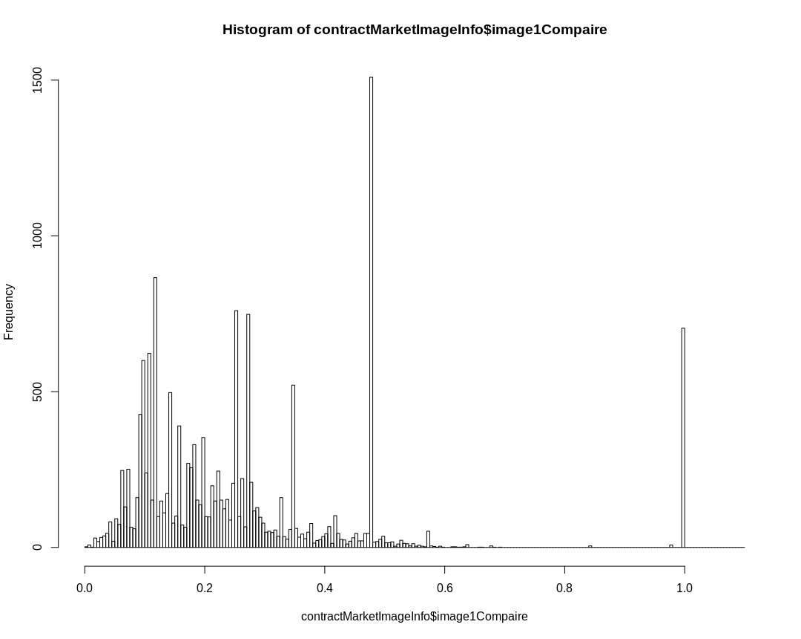
Image Comparison using 'ImageMagick': this should allow for grouping on similar images
Install.packages("magick")
(Each contract has an ICON)

Slide 5
Practicum Demonstration
Series of weekly markets

Slide 6
Reading on the Legality of predictit.org (Federal)
U.S. COMMODITY FUTURES TRADING COMMISSION no action letter for predictit
https://www.cftc.gov/csl/14-130/download
https://www.predictit.org/Home/TermsAndConditions
https://github.com/seakintruth/rpredictit_dataset

