Slide 1

FIND ME
Course: CS 382 - Search Engines and Information Retrieval PROF : Chamroeun Khim

Slide 2
CORE MEMBERS
Bunnarith Heang
Monespiseth Ly
Seakmeng Chheang

Slide 3
Content
Motivation
Objective
Modeling
Demo
Conclusion

Slide 4
Motivation

Slide 5
Motivation
To learn how search engine works under the hood
To apply the knowledge been learned in Information Retrieval course
To make sense of the vast world of the internet on how it is connected to each others

Slide 6
Objective

Slide 7
Objective
Want to build a basic search engine which user can search with keywords that extracted from metadata in each webpage.
Want to target only stackoverflow (hardware constraint).

Slide 8
Modeling

Slide 9
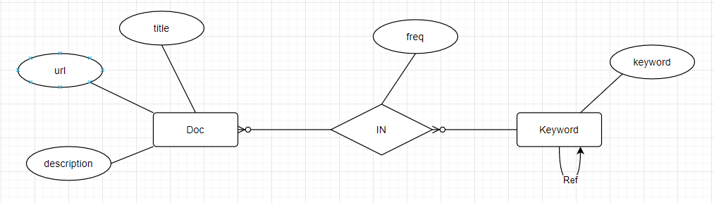
Modeling - Model
Notes:
https://app.diagrams.net/#G17DjBDN78j0e-FsorBzU61J3DlUEmU9Wt

Slide 10
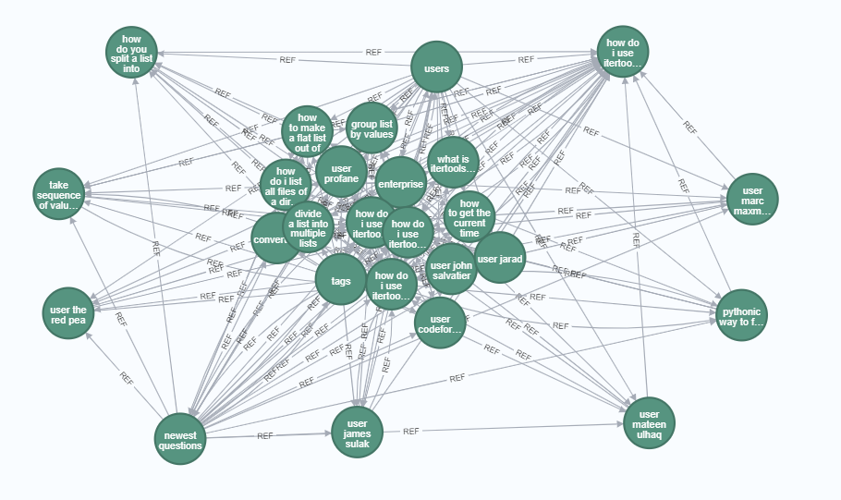
Modeling - DOc Model
Notes:
find_me_model.drawio - diagrams.net

Slide 11
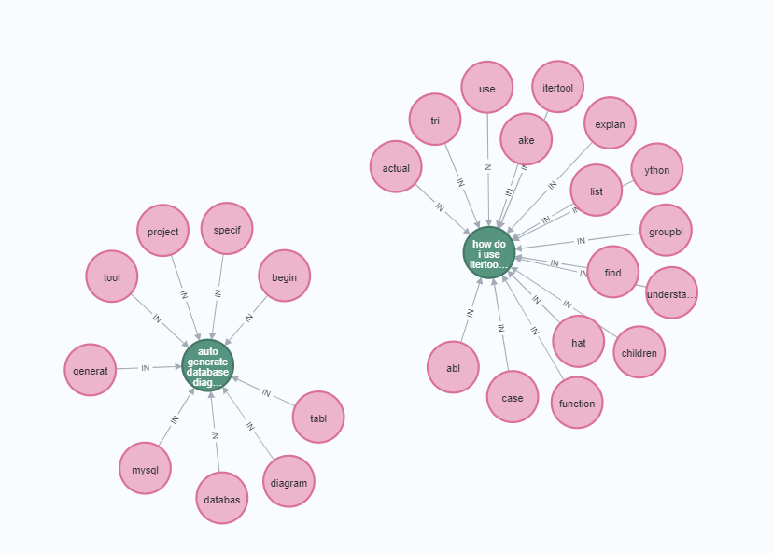
Modeling - KEYWORD Model
Notes:
find_me_model.drawio - diagrams.net

Slide 12
Modeling - Tools
Flask (API)
Neo4J (Datastore)
Flutter (UI)

Slide 13
MODELING - components
Crawling
Indexing
Ranking

Slide 14
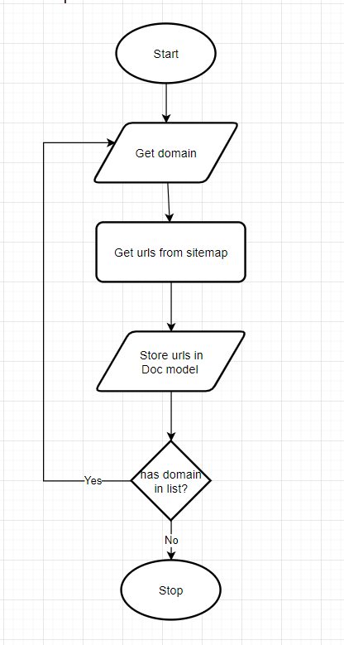
Modeling – Crawling (explore Sitemap)
Notes:
find_me_model.drawio - diagrams.net

Slide 15
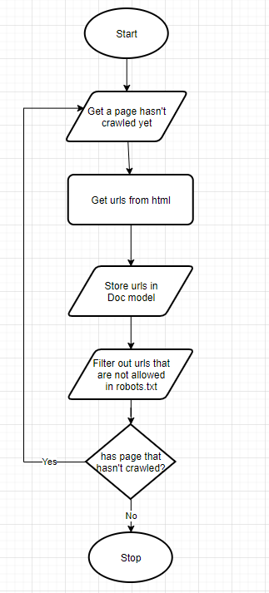
Modeling - Crawling (explore BY FOLLOWING)
Notes:
find_me_model.drawio - diagrams.net

Slide 16
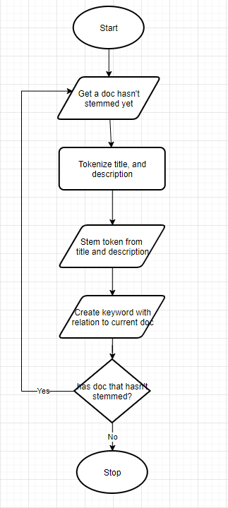
Modeling - INDExing
Notes:
find_me_model.drawio - diagrams.net

Slide 17
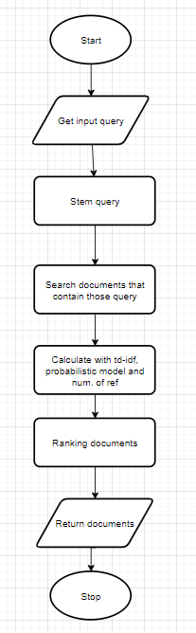
Modeling - RANKING
Notes:
find_me_model.drawio - diagrams.net

Slide 18

Demo

Slide 19
Conclusion

Slide 20
Conclusion
Most of the time, users are not reliable source of truth
To make a good search engine, time and resources are needed to produce a good algorithm with computational power to make querying consumes less time.
Search engine algorithms should change after a period of time

Slide 21

Thank You
NOTICE:
All GRAPHICS WERE Taken from the internet. We do not own any of those.

