Slide 1

FIND ME
Team 2

Slide 2
CORE MEMBERS
Bunnarith Heang
Monespiseth Ly
Seakmeng Chheang

Slide 3
Content
System Architecture
Model
Processes
Demo

Slide 4
SYSTEM Architecture

Slide 5
SYSTEM Architecture - Tools
Flask Framework
Graph Database (Neo4J)

Slide 6
SYSTEM Architecture - components
Crawling
Indexing
Ranking

Slide 7
Model

Slide 8
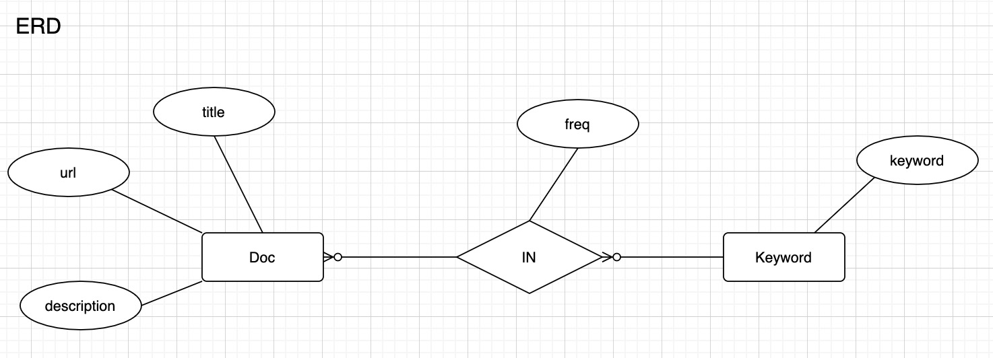
Model

Slide 9
processes
Notes:
https://drive.google.com/file/d/17DjBDN78j0e-FsorBzU61J3DlUEmU9Wt/view?usp=sharing

Slide 10
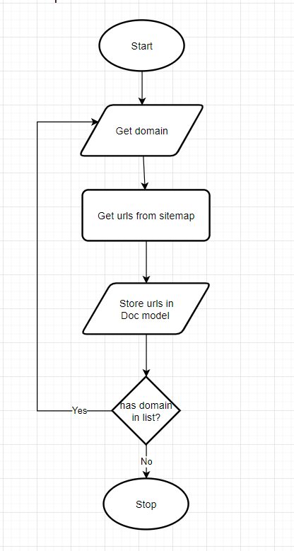
Crawling – explore Sitemap

Slide 11
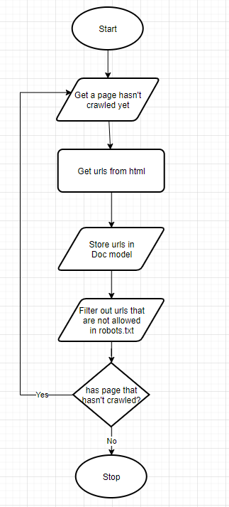
Crawling – explore BY FOLLOWING

Slide 12
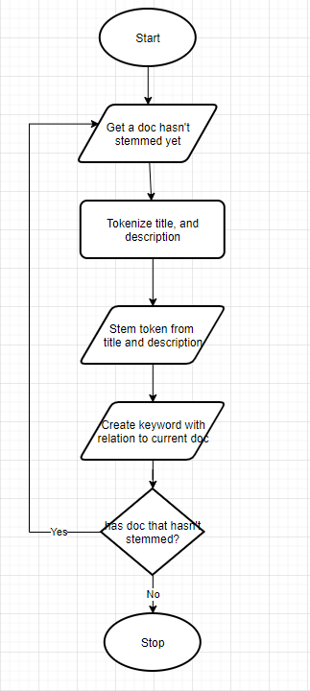
INDExing

Slide 13

Demo

Slide 14

Thank You
NOTICE:
All GRAPHICS WERE Taken from the internet. We do not own any of those.

Slide 17

Digital Communications
Cloud
Local
Hybrid

