Slide 1

FIND ME
Team 2

Slide 2
SYSTEM Architecture

Slide 3
SYSTEM Architecture - Tools
Flask Framework
Graph Database (Neo4J)

Slide 4
SYSTEM Architecture - components
Crawling
Indexing
Ranking

Slide 5
Model

Slide 6
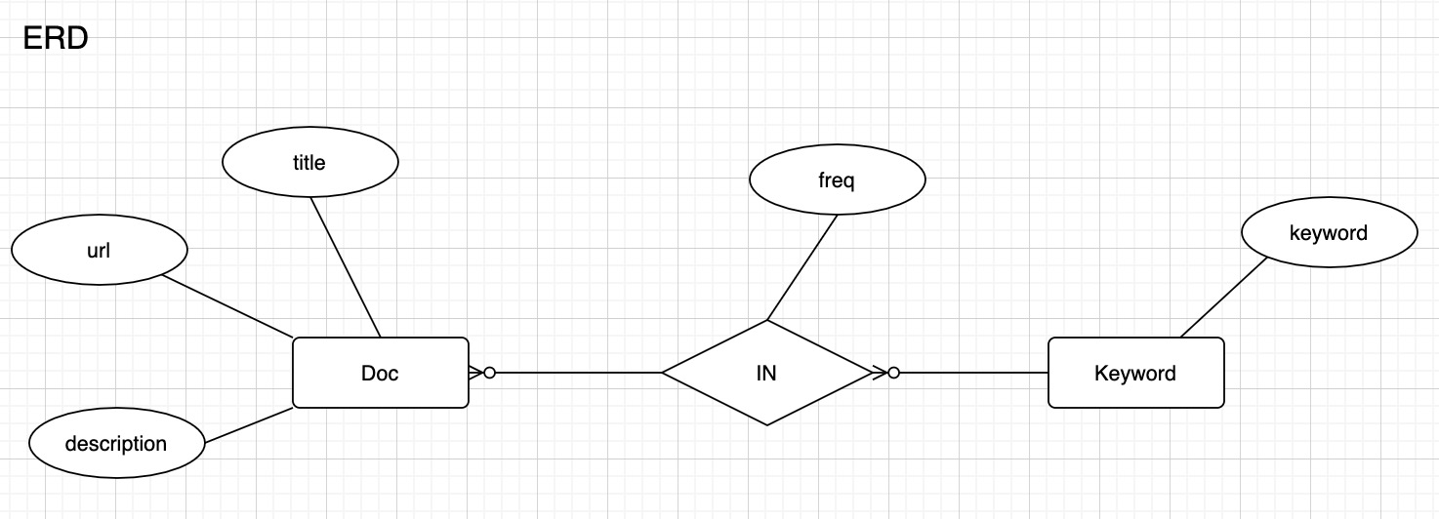
Model

Slide 7
processes
Notes:
https://drive.google.com/file/d/17DjBDN78j0e-FsorBzU61J3DlUEmU9Wt/view?usp=sharing

Slide 8
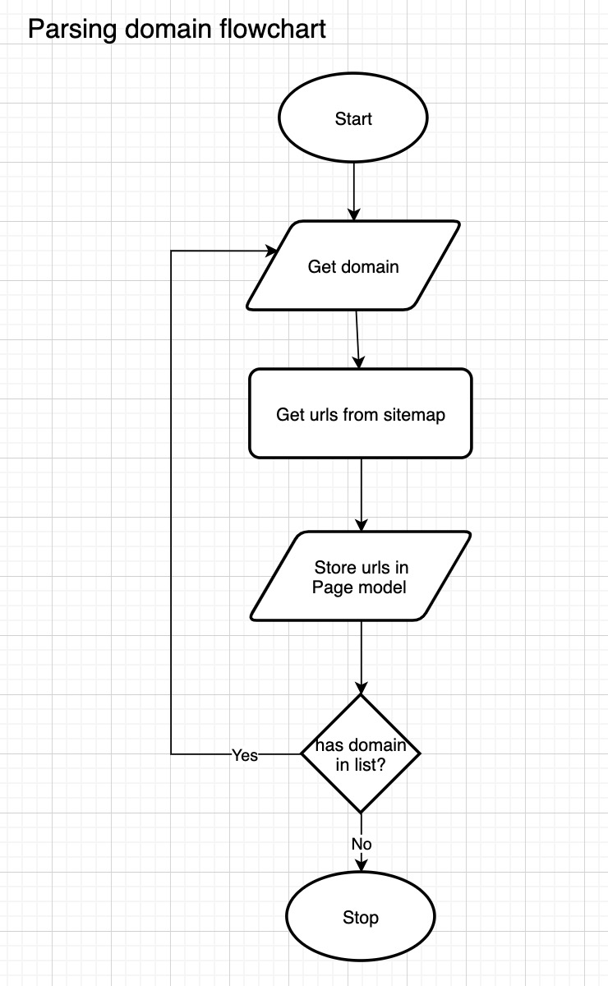
Crawling – explore Sitemap

Slide 9
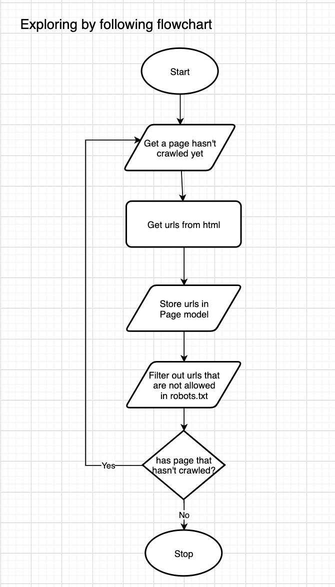
Crawling – explore BY FOLLOWING

Slide 10
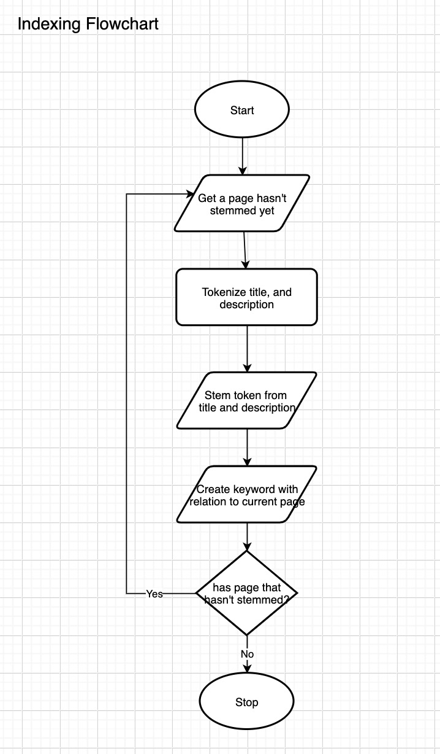
INDExing

Slide 11

Demo

Slide 12

Thank You
NOTICE:
All GRAPHICS WERE Taken from the internet. We do not own any of those.

Slide 15

Digital Communications
Cloud
Local
Hybrid

