Slide 1

FIND ME
Team 2

Slide 2
CORE MEMBERS
Bunnarith Heang
Monespiseth Ly
Seakmeng Chheang

Slide 3
Content
Motivation
Objective
Modeling
Demo
Conclusion

Slide 4
Motivation

Slide 5
Motivation
To learn how search engine works under the hood
To apply the knowledge been learned in Information Retrieval course
To make sense of the vast world of the internet on how it is connected to each others

Slide 6
Objective

Slide 7
Objective
Want to build a basic search engine which user can search with keywords that extracted from metadata in each webpage.
Want to target only stackoverflow (hardware constraint).

Slide 8
SYSTEM Architecture - Tools
Flask Framework
Graph Database (Neo4J)

Slide 9
SYSTEM Architecture - components
Crawling
Indexing
Ranking

Slide 10
Modeling

Slide 11
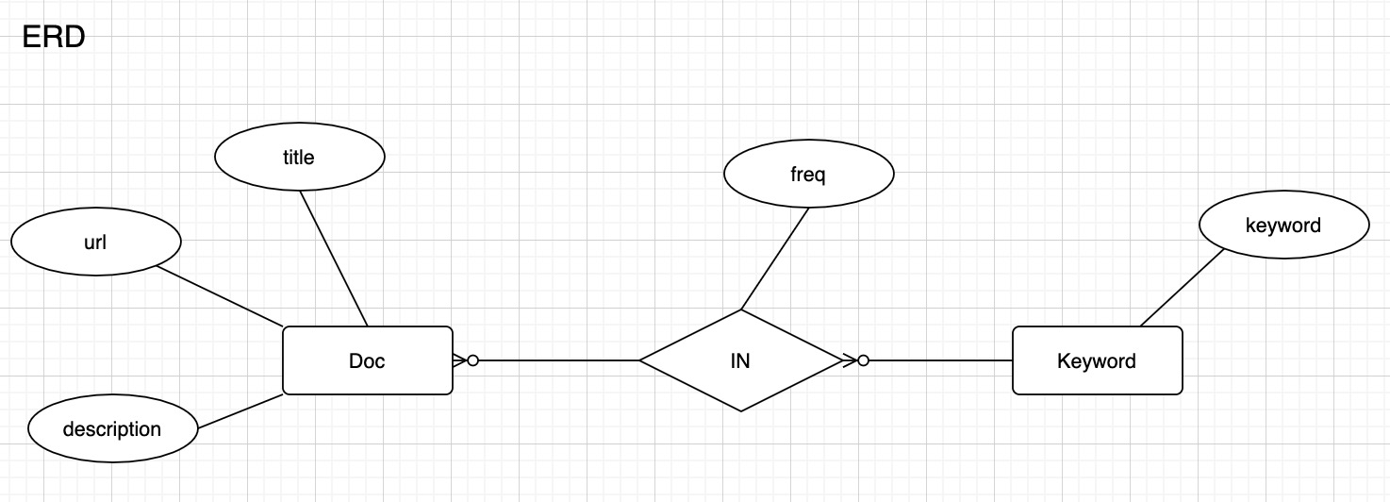
Modeling - Model

Slide 12
Modeling - Tools
Flask Framework
Graph Database (Neo4J)

Slide 13
Modeling - components
Crawling
Indexing
Ranking

Slide 14
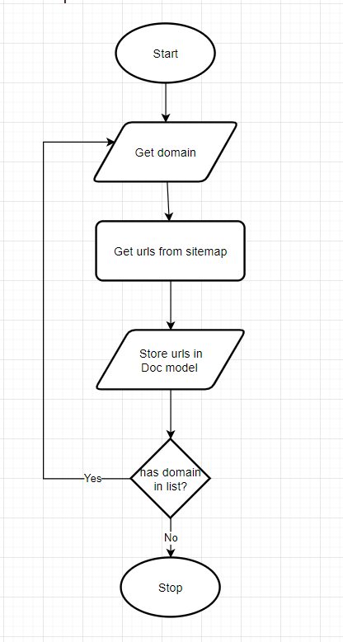
Modeling – Crawling (explore Sitemap)

Slide 15
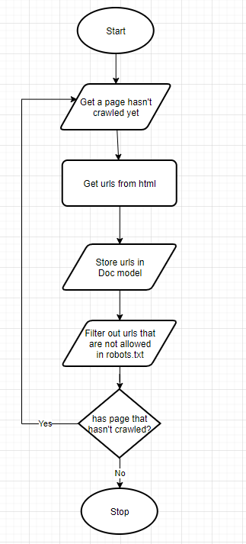
Modeling - Crawling (explore BY FOLLOWING)

Slide 16
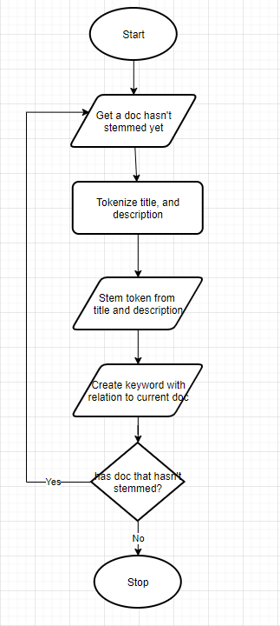
Modeling - INDExing

Slide 17
Modeling - QUERYING

Slide 18

Demo

Slide 19
Conclusion

Slide 20
Conclusion

Slide 21

Thank You
NOTICE:
All GRAPHICS WERE Taken from the internet. We do not own any of those.

Slide 24

Digital Communications
Cloud
Local
Hybrid

