Slide 1

FIND ME
Course: CS 382 - Search Engines and Information Retrieval PROF : Chamroeun Khim

Slide 2
CORE MEMBERS
Bunnarith Heang
Monespiseth Ly
Seakmeng Chheang

Slide 3
Content
Motivation
Objective
Modeling
Demo
Conclusion

Slide 4
Motivation

Slide 5
Motivation
To learn how search engine works under the hood
To apply the knowledge been learned in Information Retrieval course
To make sense of the vast world of the internet on how it is connected to each others

Slide 6
Objective

Slide 7
Objective
Want to build a basic search engine which user can search with keywords that extracted from metadata in each webpage.
Want to target only stackoverflow (hardware constraint).

Slide 8
SYSTEM Architecture - Tools
Flask (API)
Neo4J (Datastore)
Flutter (UI)

Slide 9
SYSTEM Architecture - components
Crawling
Indexing
Ranking

Slide 10
Modeling

Slide 11
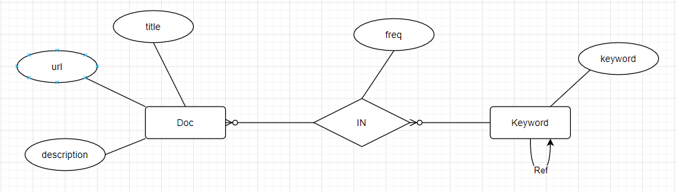
Modeling - Model
Notes:
find_me_model.drawio - diagrams.net

Slide 12
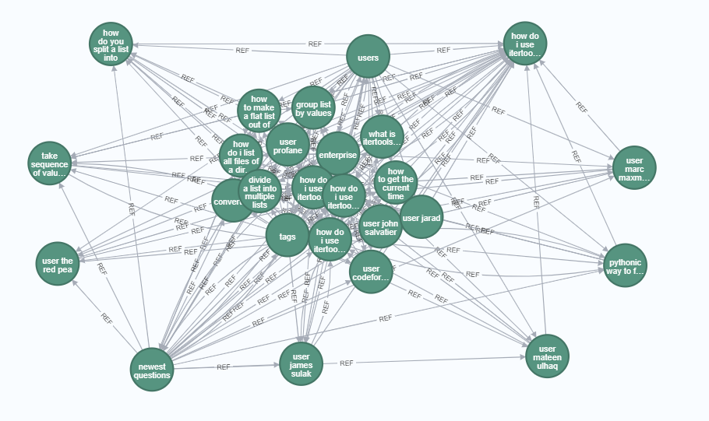
Modeling - DOc Model
Notes:
find_me_model.drawio - diagrams.net

Slide 13
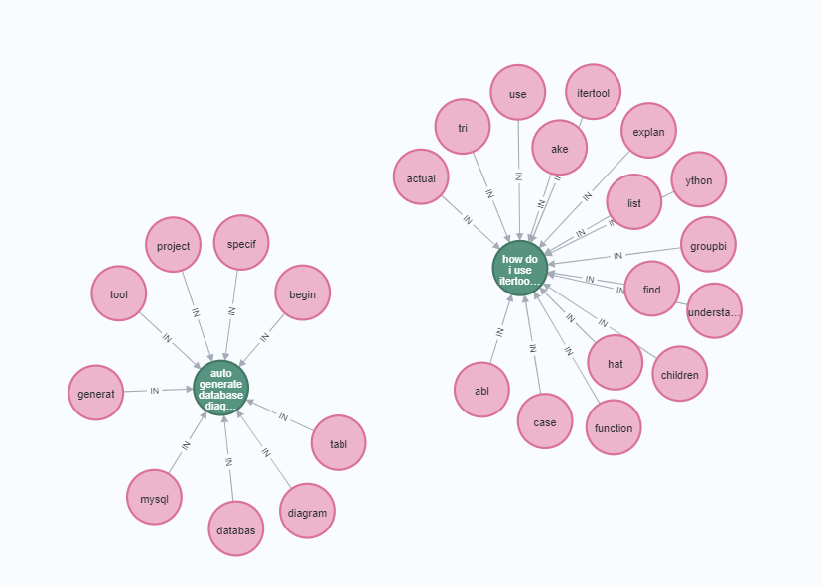
Modeling - KEYWORD Model
Notes:
find_me_model.drawio - diagrams.net

Slide 14
Modeling - Tools
Flask Framework
Graph Database (Neo4J)

Slide 15
Modeling - components
Crawling
Indexing
Ranking

Slide 16
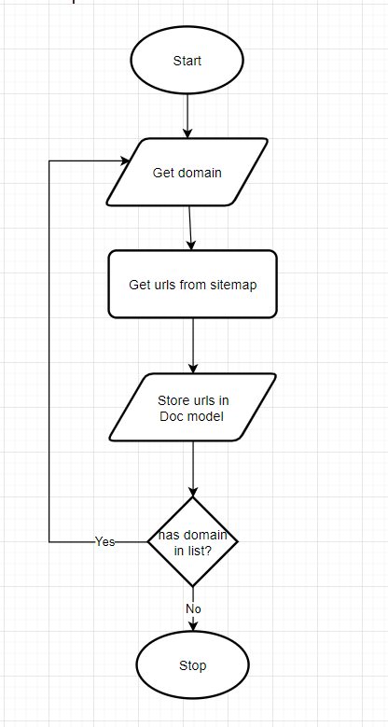
Modeling – Crawling (explore Sitemap)
Notes:
find_me_model.drawio - diagrams.net

Slide 17
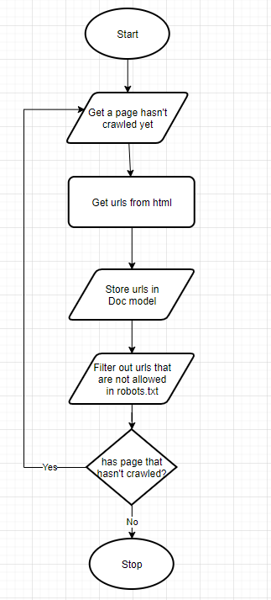
Modeling - Crawling (explore BY FOLLOWING)
Notes:
find_me_model.drawio - diagrams.net

Slide 18
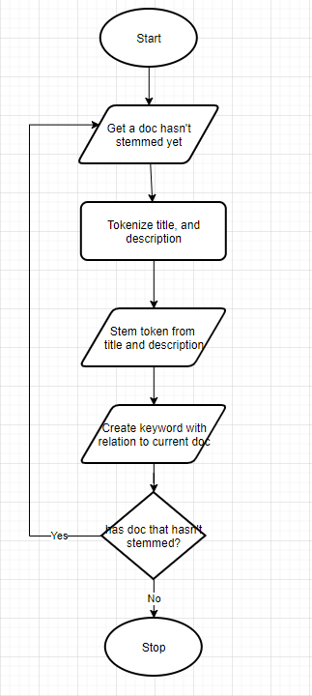
Modeling - INDExing
Notes:
find_me_model.drawio - diagrams.net

Slide 19
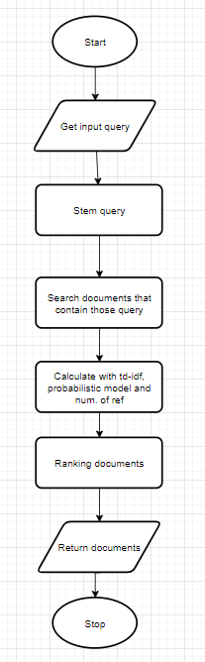
Modeling - QUERYING
Notes:
find_me_model.drawio - diagrams.net

Slide 20

Demo

Slide 21
Conclusion

Slide 22
Conclusion
Most of the time, users are not reliable source of truth
To make a good search engine, time and resources are needed to produce a good algorithm with computational power to make querying consumes less time.
Search engine algorithms should change after a period of time

Slide 23

Thank You
NOTICE:
All GRAPHICS WERE Taken from the internet. We do not own any of those.

