Slide 1
Capstone
Shayne Nguyen

Slide 2
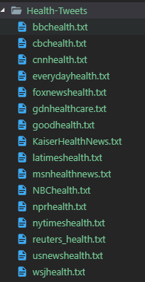
Topic 1
Problem Statement:
How social network as Twitter can impact healthcare.
Can I implement the advance of social network?
Potential Audience:
Small healthcare start-up
Researcher
Goals:
Accurately predict category.
Automation .
Data Source(s)
http://archive.ics.uci.edu/ml/datasets/Health+News+in+Twitter#

Slide 3
Topic 2
Problem Statement:
How social network as Twitter can impact healthcare.
Can I implement the advance of social network?
Potential Audience:
Small healthcare start-up
Researcher
Goals:
Accurately predict category.
Identify the relevant keyword, hashtag.
Data Source(s)
http://archive.ics.uci.edu/ml/datasets/Health+News+in+Twitter#

Slide 4
THANK YOU

