Slide 1

Intune Alerting: Dream or Reality?
Sebastiaan de Wolf

Slide 2

Thank you to the sponsors
PLATINUM SPONSOR

Slide 3








Thank you to the sponsors
GOLD SPONSORS
SILVER SPONSORS
BRONZE SPONSORS

Slide 4
About Me
Sebastiaan de Wolf
M365 & Azure background
Automation Engineer @ Arxus
Graph Enthusiast
LinkedIn
Github

Slide 5
Agenda
What is available?
What does a possible finished flow look like?
What is possible?
Example demo
What do you need?
Q&A

Slide 6
What is available?

Slide 7
Intune
What does it have?
Devices
Applications
Policies
Built-in reports
...
What is missing?
User-built reports
Custom alerts
Notes:
Individual data that can’t be linked manually in a meaningful way
Any useful information only exists in the built-in reports, but those need to be run & downloaded manually
“Many nice-to-have things are missing from Intune, but we will focus today on these 2”

Slide 8
Nice-to-have examples
Noncompliant devices with offending rules in compliance policies
Not up-to-date devices
Empty configuration policies that haven’t been touched for a while
Historical device performance based on model
...
Notes:
even outside of Intune
- app registration secrets/certificates that will expire soon

Slide 9

Since the tools on Intune are very limited...
We’ll do it ourselves!

Slide 10
What is possible?

Slide 11
Get data from Intune using the Graph API
All data on the Intune portal ➔ comes from the Graph API
You can access this API yourself...
Today!
For free!
Find documentation for this API here
Notes:
Intune portal uses the Graph API itself
This API is accessible, so this means anything on Intune, is accessible to you as raw data
An API also means AUTOMATION
We will use this to gather data & then process it ourselves

Slide 12

WATCH OUT!
Data quality...

Slide 13
Data Timeline
Intune is aware of any changes with some delay
The data you pull later is already delayed
→ You are not up to date with the actual state of a device
1
Device data changes
2
Intune pulls in data
3
4
Process data & fire alerts
You pull in data
Notes:
As a general rule!
Intune is not constantly monitoring enrolled devices (that would cost too many local resources)
Intune is already behind on the current state of a device
which means YOU are too
This is not a dealbreaker, but something to be aware of

Slide 14
What do you need?

Slide 15
What do you need?
An app registration to access the Graph API
Somewhere to store & process the data we pull in
A way to manage our custom alerts & reports

Slide 16
App Registration
Create or reuse
Which Graph API permissions are needed?
documentation
v1.0 >< beta
Authentication method?
Notes:
Creating an app registration isn’t too difficult, but the challenge is knowing which accesses are needed
Graph API permissions are listed in Entra ID, but aren’t always clear what they mean
documented Graph API calls show which permissions are needed
also Graph SDK has a command for looking up access using endpoints (runs similar to the documentation)
Quick explanation of difference between ‘v1.0’ & ‘beta’
need to think about Authentication methods:
client secret (probably easiest)
delegated (not desirable for automation)
using certificates

Slide 17
Gather & Process Data
Use a script
Some platform to recurrently run these scripts
Automation Account on Azure
Functions on Azure
Ansible
...
Notes:
Python or PowerShell
Personally I use PowerShell a lot
Works very well for complex objects and has the Microsoft.Graph.Authentication module for easy authentication & built-in error handling
(I don’t use it in my actual scripts, but it does good. Instead I use custom methods with manual HTTP requests)
automation account will run into memory issues very fast
only has limited memory for scripts and no easy way to increase it
Azure Functions can be scheduled + options for better memory
Something like Ansible is probably overkill for this
For low scale, quick fix solutions → the task scheduler on a server can also work (not recommended for business critical stuff)

Slide 18
Alerts & Reports
Store processed data somewhere
Log Analytics Workspace on Azure
CosmosDB on Azure
...
Set up rules & reports
Alert Rules on Azure (Monitor)
Workbooks on Azure
...
Notes:
Alert rules work well with the Log Analytics Workspace
You can set up a query on the LAW for the alert rule and fire alerts based on the results
Workbooks provide the option for custom reports that can pull straight from a Log Analytics Workspace

Slide 19
What does a possible finished flow look like?

Slide 20
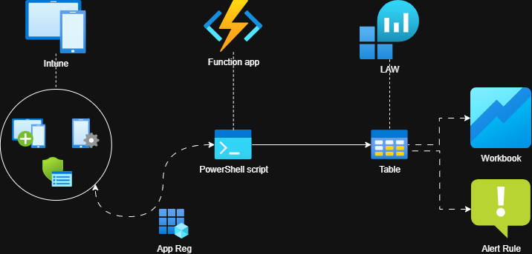
Data Flow
Gather Intune data using a Function app & PowerShell
Process data & store in a Log Analytics Workspace
Report on the data with Workbooks
Alert on the data with Alert Rules

Slide 21
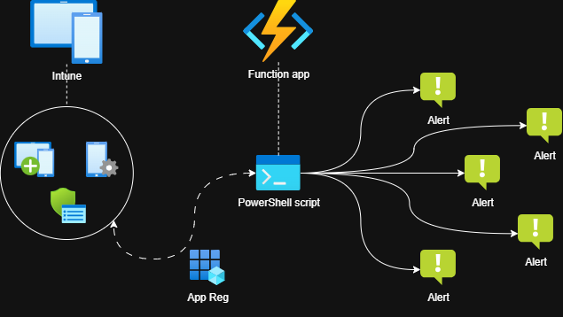
Data Flow (alternate)
Perform alert logic in the script itself
Less infrastructure, more simplicity
Gets complicated with extensive alerting, no easy reporting
Notes:
No storing the data
Quicker to set up
Less scalable because all logic happens in script which can get unorganized fast!

Slide 22
Now the theory is done...
Let’s build it!

Slide 23
What are we making?
Data collection with PowerShell
Storing data in Log Analytics Workspace
Dashboard in Azure Workbook

Slide 24
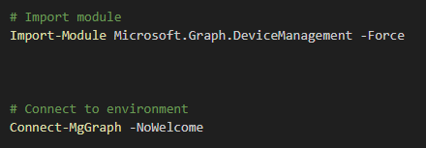
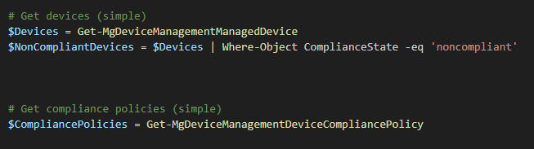
Data Collection
Notes:
We’ll only look at how to set up getting all devices, compliance policies, failed settings because of time
Gather devices
Gather broken compliance policies per device
Specific settings not being met
USE THE Graph SDK for simplicity
Very easy to use and understand
here
authentication
gather devices & compliance policies

Slide 25
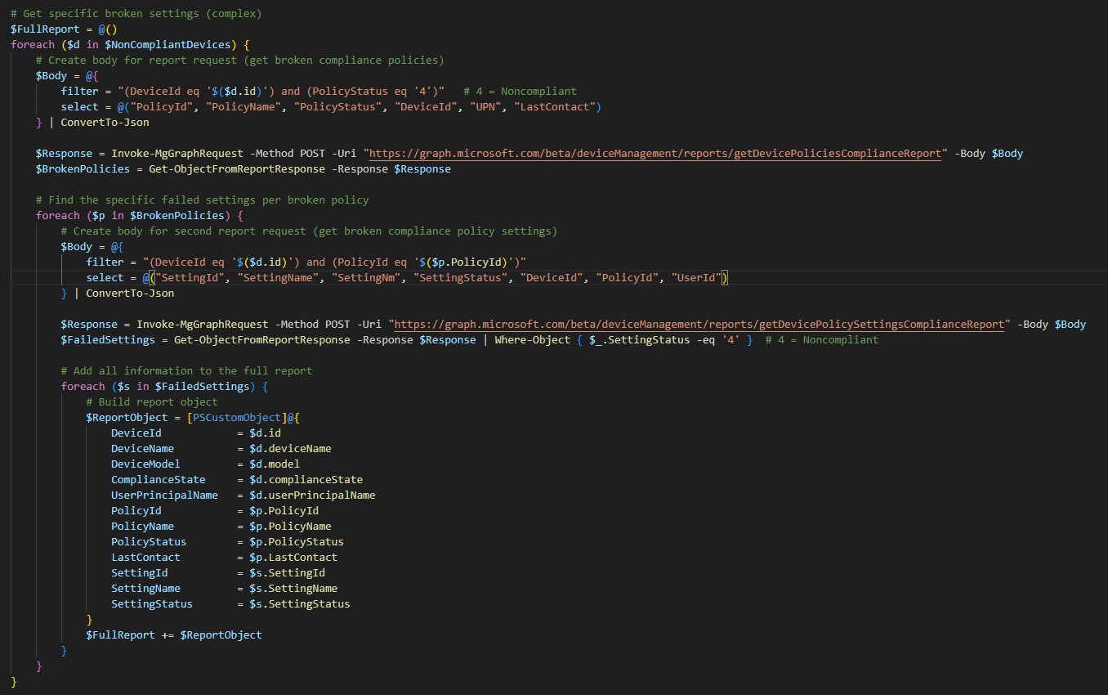
Data Collection
Notes:
Graph SDK is not really ‘simple’ if you want to do more complex stuff
Gathering broken settings for compliance policies is one of those
-> quick overview of the code

Slide 26
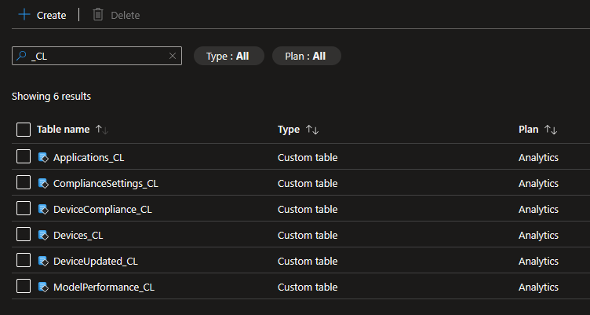
Storing the data
Notes:
LAW for storage
define tables on Azure
sort of like a basic database
tables can only contain ‘simple’ lines (no json objects for example with more depth than 1)
Analytics type is important if we want to use a Workbook dashboard later

Slide 27
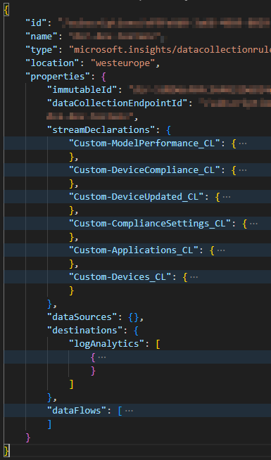
Storing the data
Notes:
LAW for storage
How do you upload to the tables of an LAW?
use a data collection rule (defines the data structure in advance)
see logs ingestion api documentation how this exactly works (convoluted enough to do a separate session on this)
https://learn.microsoft.com/en-us/azure/azure-monitor/logs/logs-ingestion-api-overview
basic flow: dce > dcr > law

Slide 28
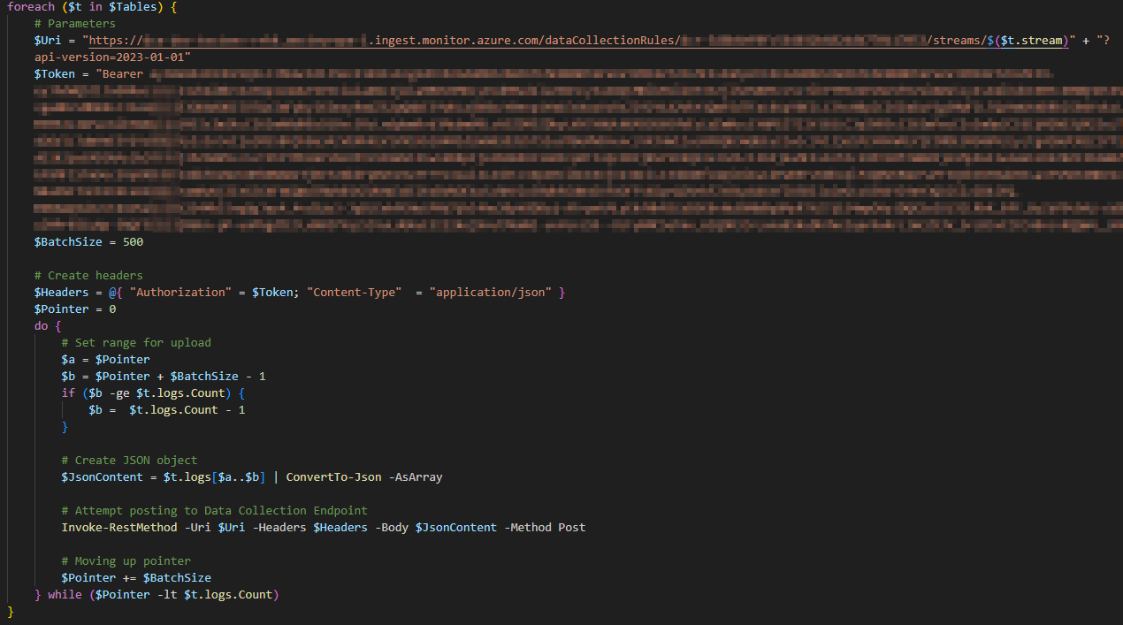
Storing the data
Notes:
Example upload method to push stuff to the DCR
again see logs ingestion api documentation how this exactly works (convoluted enough to do a separate session on this)
https://learn.microsoft.com/en-us/azure/azure-monitor/logs/logs-ingestion-api-overview

Slide 29
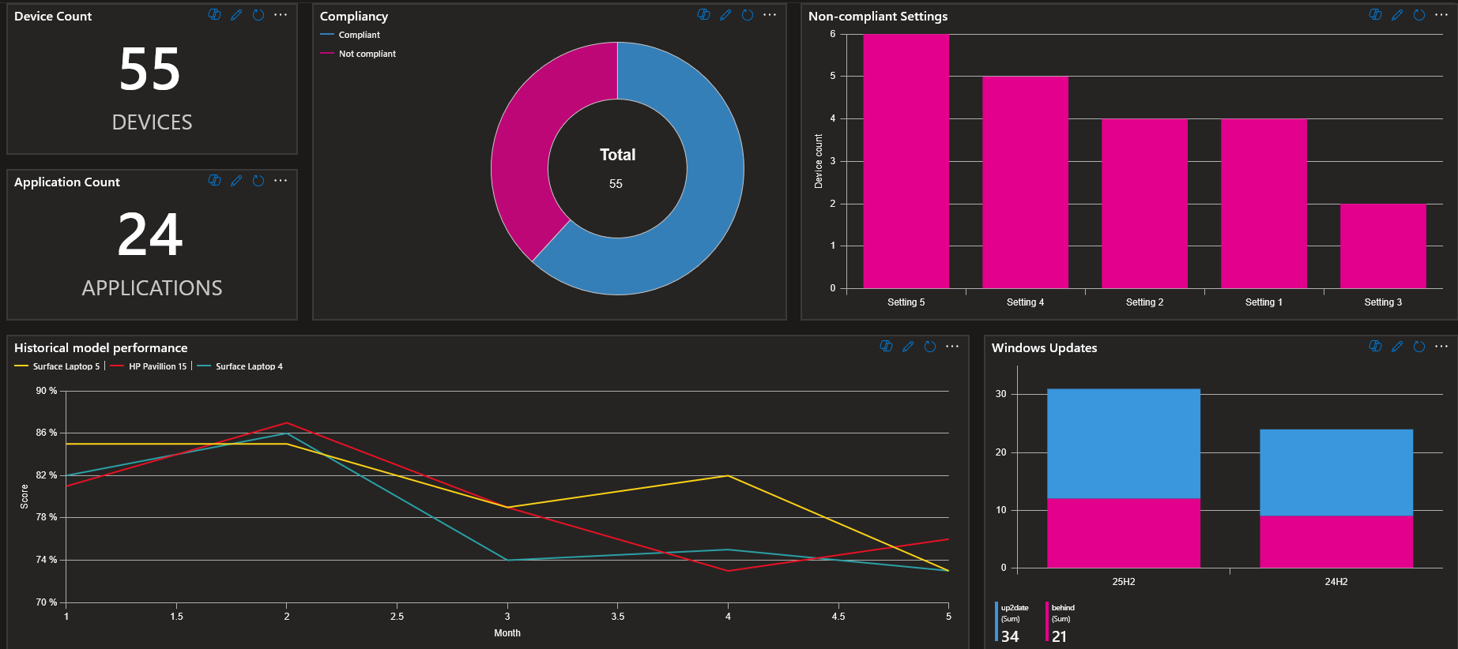
Showing the data
Notes:
example Azure workbook
compliancy of the tenant devices
offending settings sorted by amount
are your devices updated with the lates windows updates (grouped per channel)
historical performance per specific model in your tenant
these are generated by querying the LAW we created using the Kusto Query Language

Slide 30

Showing the data
Notes:
Kusto query for the pie chart
very simple to set up (if you structure the data in advance)
No the iif is not incorrect

Slide 31
Any Questions?

Slide 32

THANK YOU
SLIDES & FILES
on my GitHub
Notes:
Slides & support files will be available on my GitHub

