Slide 1

Intune Alerting: dream or reality?
by Sebastiaan de Wolf
2026

Slide 2

Who am I?
Sebastiaan de Wolf
Automation Engineer @ Arxus
M365 & Azure background
2

Slide 3
Agenda
What is available?
What is possible?
What do you need?
What does a possible finished flow look like?

Slide 4

What is available?

Slide 5
Intune
What does it have?
Devices
Applications
Policies
Built-in reports
...
What is missing?
User-built reports
Custom alerts
5
Notes:
Individual data that can’t be linked manually in a meaningful way
Any useful information only exists in the built-in reports, but those need to be run & downloaded manually
“Many nice-to-have things are missing from Intune, but we will focus today on these 2”

Slide 6
Nice-to-have Examples
Noncompliant devices with offending rules in compliance policies
Not up-to-date devices
Empty configuration policies that haven’t been touched for a while
Historical device performance based on model
...
6
Notes:
even outside of Intune
- app registration secrets/certificates that will expire soon

Slide 7
What is possible?

Slide 8

We’ll do it ourselves
Since the tools on Intune are very limited...

Slide 9
Get data from Intune using the Graph API
All data on the Intune portal ➔ comes from the Graph API
You can access this API yourself...
Today!
For free!
Find documentation for this API here
9
Notes:
Intune portal uses the Graph API itself
This API is accessible, so this means anything on Intune, is accessible to you as raw data
An API also means AUTOMATION
We will use this to gather data & then process it ourselves

Slide 10
WATCH OUT !
Data quality...

Slide 11
Data timeline
Intune is aware of any changes with some delay
The data you pull later is already delayed
→ You are not up to date with the actual state of a device
1
Device data changes
2
Intune pulls in data
3
4
Process data & fire alerts
You pull in data
11
Notes:
As a general rule!
Intune is not constantly monitoring enrolled devices (that would cost too many local resources)
Intune is already behind on the current state of a device
which means YOU are too
This is not a dealbreaker, but something to be aware of

Slide 12
What do you need?

Slide 13
Get data from Intune using the Graph API
An app registration to access the Graph API
Somewhere to store & process the data we pull in
A way to manage our custom alerts & reports
13
Notes:
Intune portal uses the Graph API itself
This API is accessible, so this means anything on Intune, is accessible to you as raw data
An API also means AUTOMATION
We will use this to gather data & then process it ourselves

Slide 14
App Registration
Create or reuse
Which Graph API permissions?
documentation
v1.0 >< beta
Authentication method?
Notes:
Creating an app registration isn’t too difficult, but the challenge is knowing which accesses are needed
Graph API permissions are listed in Entra ID, but aren’t always clear what they mean
documented Graph API calls show which permissions are needed
Quick explanation of difference between ‘v1.0’ & ‘beta’
need to think about Authentication methods:
client secret (probably easiest)
delegated (not desirable for automation)
using certificates

Slide 15
Gather & Process Data
Use a script
Some platform to recurrently run these scripts
e.g. Automation Account on Azure
e.g. Functions on Azure
e.g. Ansible
...
15
Notes:
Python or PowerShell
Personally I use PowerShell a lot
Works very well for complex objects and has the Microsoft.Graph.Authentication module for easy authentication & built-in error handling
(I don’t use it in my actual scripts, but it does good. Instead I use custom methods with manual HTTP requests)
automation account will run into memory issues very fast
only has limited memory for scripts and no easy way to increase it
Azure Functions can be scheduled + options for better memory
Something like Ansible is probably overkill for this
For low scale, quick fix solutions → the task scheduler on a server can also work (not recommended for business critical stuff)

Slide 16
Alert & Reports
Store processed data somewhere
e.g. Log Analytics Workspace on Azure
e.g. CosmosDB on Azure
Set up rules & reports
e.g. Alert Rules on Azure (Monitor)
e.g. Workbooks on Azure
Notes:
Alert rules work well with the Log Analytics Workspace
You can set up a query on the LAW for the alert rule and fire alerts based on the results
Workbooks provide the option for custom reports that can pull straight from a Log Analytics Workspace

Slide 17
What does a possible finished flow look like?

Slide 18
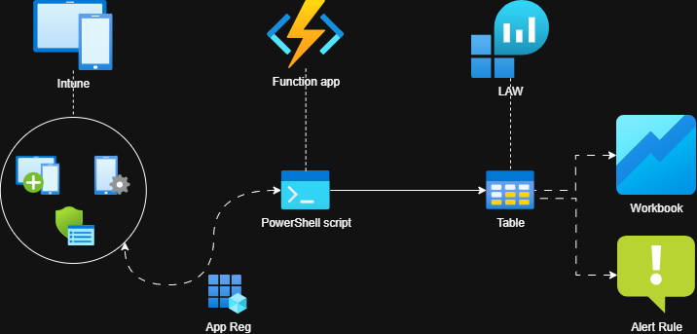
Data Flow
Gather Intune data using a Function app & PowerShell
Process data & store in a Log Analytics Workspace
Report on the data with Workbooks
Alert on the data with Alert Rules

Slide 19
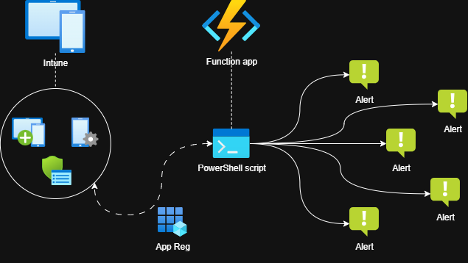
Data Flow (alternate)
Perform alert logic in the script itself
Less infrastructure, more simplicity
Gets complicated with extensive alerting, no easy reporting
Notes:
No storing the data
Quicker to set up
Less scalable because all logic happens in script which can get unorganized fast!

Slide 20
Thank you
Sebastiaan de Wolf
linkedin.com/in/sebastiaan-de-wolf
github.com/sealionforever/sessions
Notes:
These slides & some resources are available on my GitHub

