Slide 1
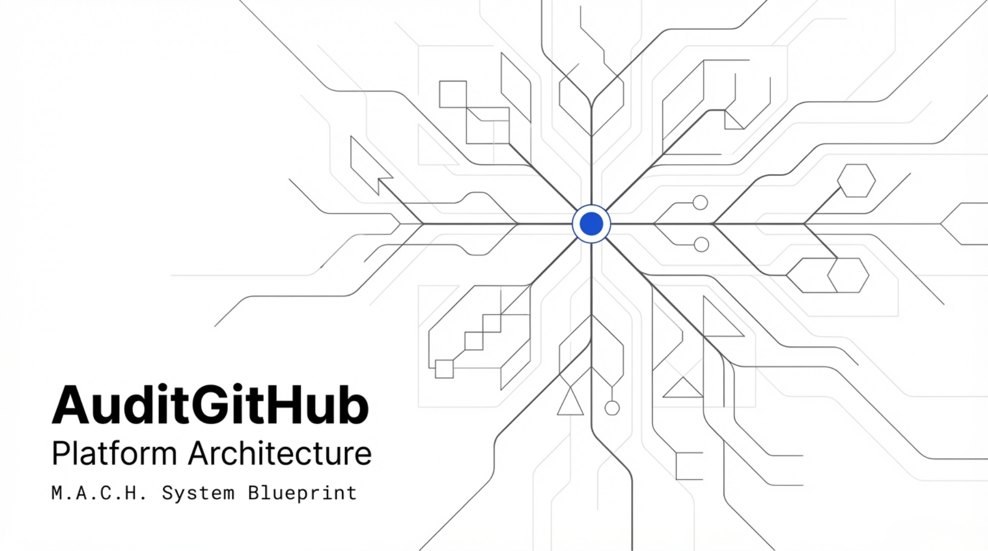

Slide 2
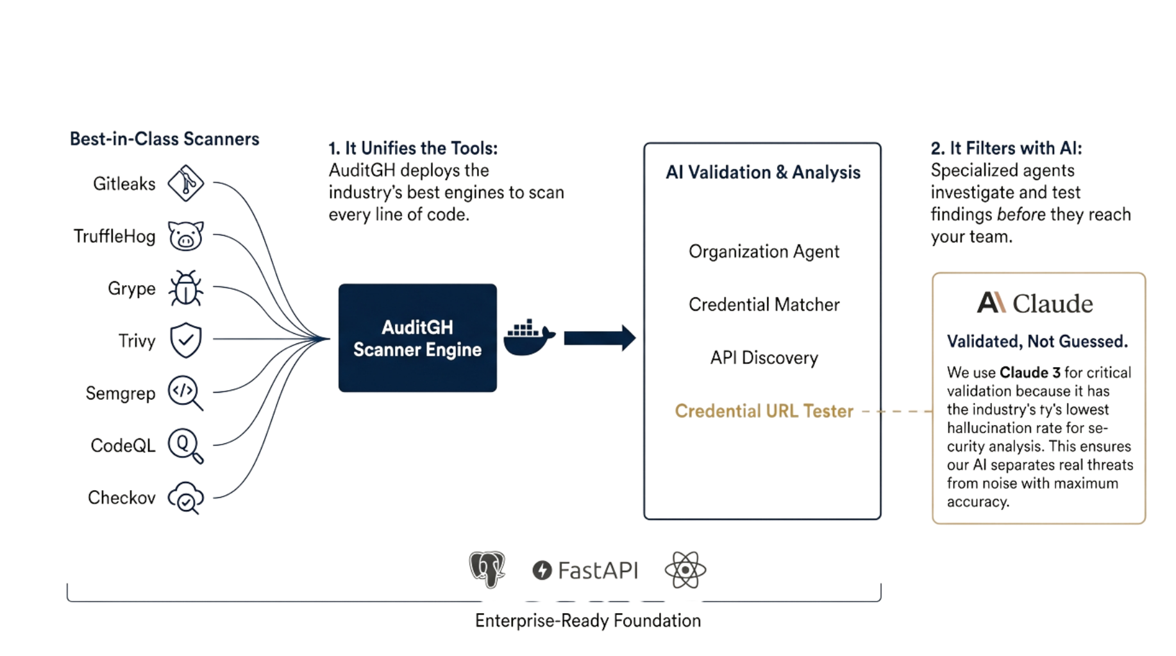
Overall

Slide 3
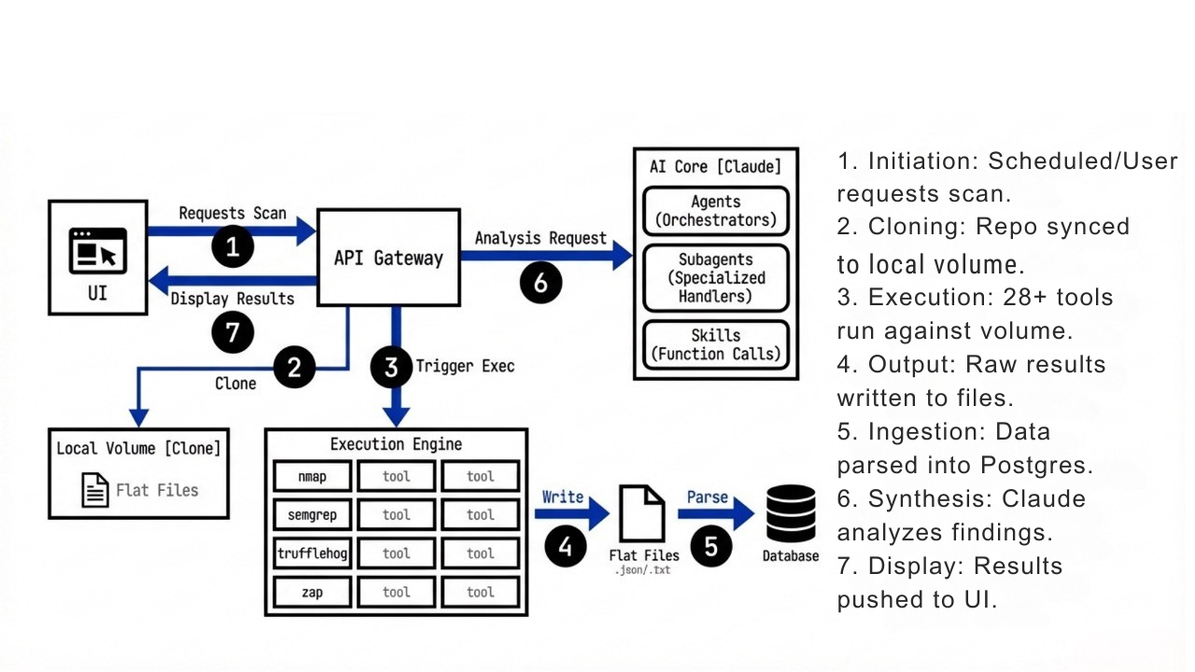
Process Flow

Slide 4
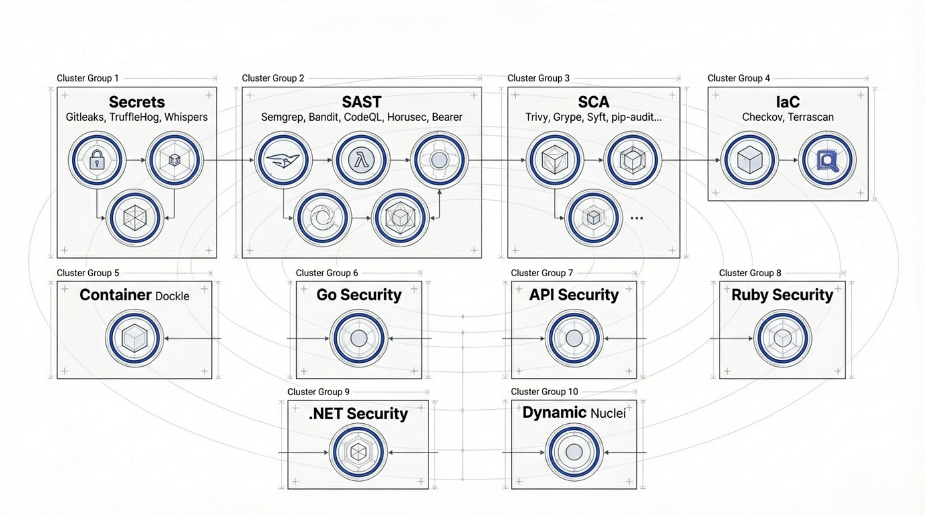
Scanners
Notes:
Total: 28 tools across 10 categories, orchestrated from scripts/scanning/scan_repos.py with category-specific execution modules in execution/. All tools output JSON Secrets Detection (3 tools)
│ Tool │ Purpose │ Invocation │
│ Gitleaks │ Detects API keys, passwords, tokens, and hardcoded credentials in the working tree and full Git history. Findings classified │ CLI (gitleaks │
│ │ as CWE-798. │ detect) │
│ TruffleHog │ Scans repository history and current state for high-entropy strings and known secret patterns (AWS keys, Slack tokens, etc.). │ CLI │
│ Whispers │ Specialized for secrets embedded in configuration files (YAML, JSON, XML, .env, .properties). Runs in an isolated Python │ CLI (isolated venv) │
SAST - Static Application Security Testing (3 tools)
│ Tool │ Purpose │ Invocation │
│ Semgrep │ Pattern-based code analysis using 10+ rule packs (security-audit, OWASP Top 10, command-injection, SQL-injection, XSS, JWT, │ CLI (semgrep scan) │
│ │ Docker, etc.) plus custom rules in semgrep-rules/. Supports taint-mode data flow analysis. │ │
│ Bandit │ Python-specific SAST. Detects hardcoded passwords, insecure function calls, SQL injection risks, and unsafe deserialization. │ CLI (bandit -r) │
│ │ Only runs when .py files are present. │ │
│ CodeQL │ Semantic code analysis with database-driven data flow tracking. Supports Python, JavaScript/TypeScript, Go, and Java. Finds │ CLI (codeql database │
│ │ deeper vulnerabilities that pattern matching misses. │ create + analyze) │
SCA - Software Composition Analysis / Dependency Scanning (8 tools)
│ Tool │ Purpose │ Invocation │
│ Grype │ Scans repository filesystem or Docker images for known vulnerabilities in packages. Supports VEX │ CLI (grype) │
│ │ (Vulnerability Exploitability eXchange) for false-positive suppression. │ │
│ Trivy │ Multi-scanner covering vulnerabilities, misconfigurations, secrets, and license issues across filesystem and │ CLI (trivy fs) │
│ │ container images. │ │
│ Syft │ Generates Software Bill of Materials (SBOM) in CycloneDX and SPDX formats. Inventories all │ CLI │
│ │ packages/dependencies for compliance and auditing. │ │
│ OWASP │ Cross-language dependency scanner (Java, .NET, Python, Ruby, Node.js) using the National Vulnerability │ CLI (dependency-check.sh) │
│ Dependency-Check │ Database (NVD). │ │
│ pip-audit │ Python-specific. Audits requirements.txt, Pipfile, pyproject.toml, and setup.py against the PyPI advisory │ CLI (pip-audit --format │
│ │ database. │ json) │
│ Safety │ Python-specific. Checks installed packages against the Safety vulnerability database. │ CLI (safety check --json) │
│ npm audit │ Node.js/JavaScript. Scans package-lock.json for known vulnerabilities in npm dependencies. │ CLI (npm audit --json) │
│ retire.js │ JavaScript-specific. Identifies JavaScript libraries with known CVEs, including client-side libraries. │ CLI │
Infrastructure as Code Security (2 tools)
│ Tool │ Purpose │ Invocation │
│ Checkov │ Scans Terraform, CloudFormation, Docker, Kubernetes, and Helm charts for security misconfigurations and policy violations. │ CLI (checkov -d) │
│ Terrascan │ Policy-as-code engine for Terraform, Kubernetes, Docker, and CloudFormation. Validates against 500+ security policies. │ CLI │
Container Security (1 tool)
│ Tool │ Purpose │ Invocation │
│ Dockle │ Audits Docker images and Dockerfiles against CIS benchmarks and best practices (no root user, minimal layers, no secrets in image). │ CLI │
Go Security (3 tools)
│ Tool │ Purpose │ Invocation │
│ gosec │ Go-specific SAST. Detects SQL injection, hardcoded credentials, weak crypto, file path traversal, and unsafe exec calls in Go source. │ CLI │
│ govulncheck │ Go-specific SCA. Checks Go modules against the Go vulnerability database with call graph analysis (only flags vulns in reachable │ CLI │
│ │ code). │ │
│ GolangCI-Lint │ Go linter aggregator that includes security-focused linters (gosec, staticcheck, etc.) for comprehensive Go code quality and │ CLI │
│ │ security. │ │
Multi-Language SAST (2 tools)
│ Tool │ Purpose │ Invocation │
│ Horusec │ Multi-language SAST covering 15+ languages. Orchestrates multiple internal engines for broad vulnerability detection. │ CLI │
│ Bearer │ Data flow analysis tool. Tracks sensitive data (PII, credentials) through application code and flags exposure risks and compliance │ CLI │
│ │ violations. │ │
Ruby Security (1 tool) │ Tool │ Purpose │ Invocation │
│ bundle-audit │ Ruby-specific. Audits Gemfile.lock for gems with known CVEs against the Ruby Advisory Database. │ CLI (Ruby gem) │
Dynamic / Template-Based Scanning (1 tool)
│ Tool │ Purpose │ Invocation │
│ Nuclei │ Template-based vulnerability scanner. Uses a community-maintained library of detection templates for known CVEs, misconfigurations, and │ CLI │
.NET Security (1 tool)
│ Tool │ Purpose │ Invocation │
│ OSSGadget │ .NET/C# tool for detecting malware, backdoors, and suspicious code patterns in open-source packages. Outputs SARIF format. │ dotnet tool CLI │
API Security (2 custom tools)
│ Tool │ Purpose │ Invocation │
│ API Scanner │ AI-powered 4-phase API discovery and security assessment: Discovery, Extraction, Synthesis, Security. Fingerprints │ Python │
│ (custom) │ frameworks (FastAPI, Flask, Django, Express, Spring, etc.) and builds threat matrices. │ (built-in) │
│ OpenAPI Spider │ Crawls OpenAPI/Swagger specifications to discover and document API endpoints, authentication schemes, and data models. │ Python │
│ (custom) │ │ (built-in) │
Code Metrics (1 tool)
│ Tool │ Purpose │ Invocation │
│ cloc │ Counts lines of code by language. Provides codebase composition metrics used for risk-weighting and scan coverage analysis. │ CLI │

Slide 5
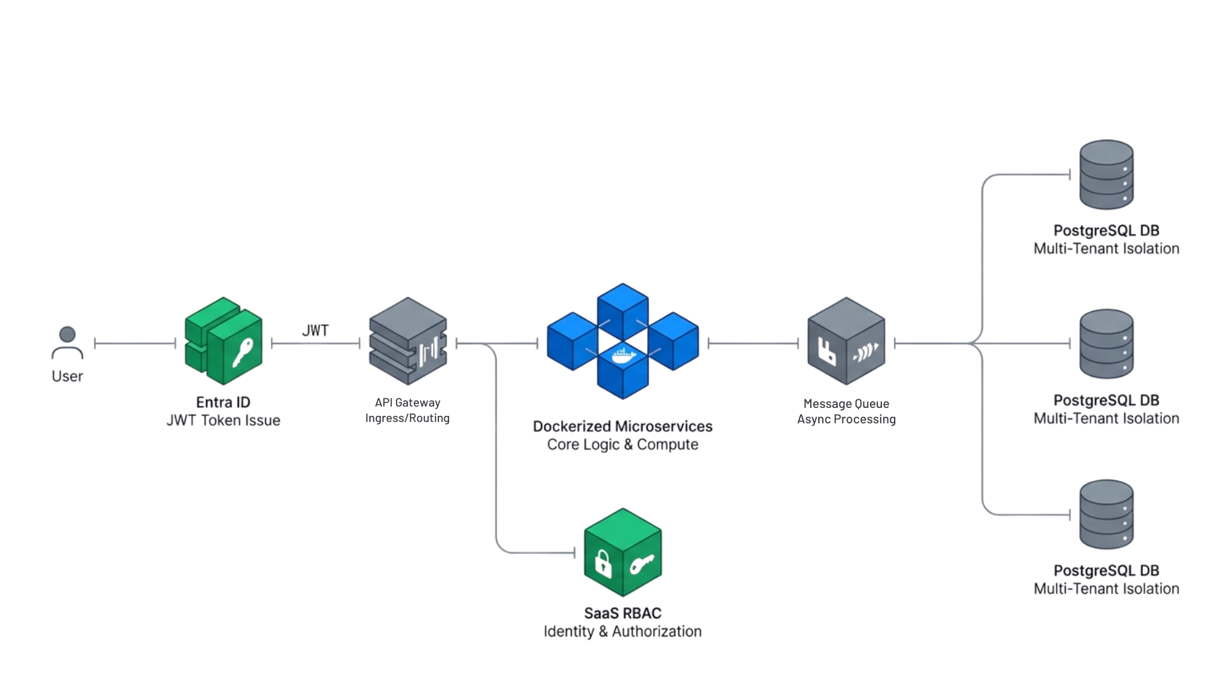
MACH/SaaS + RBAC
Notes:
MACH + SaaS

Slide 6
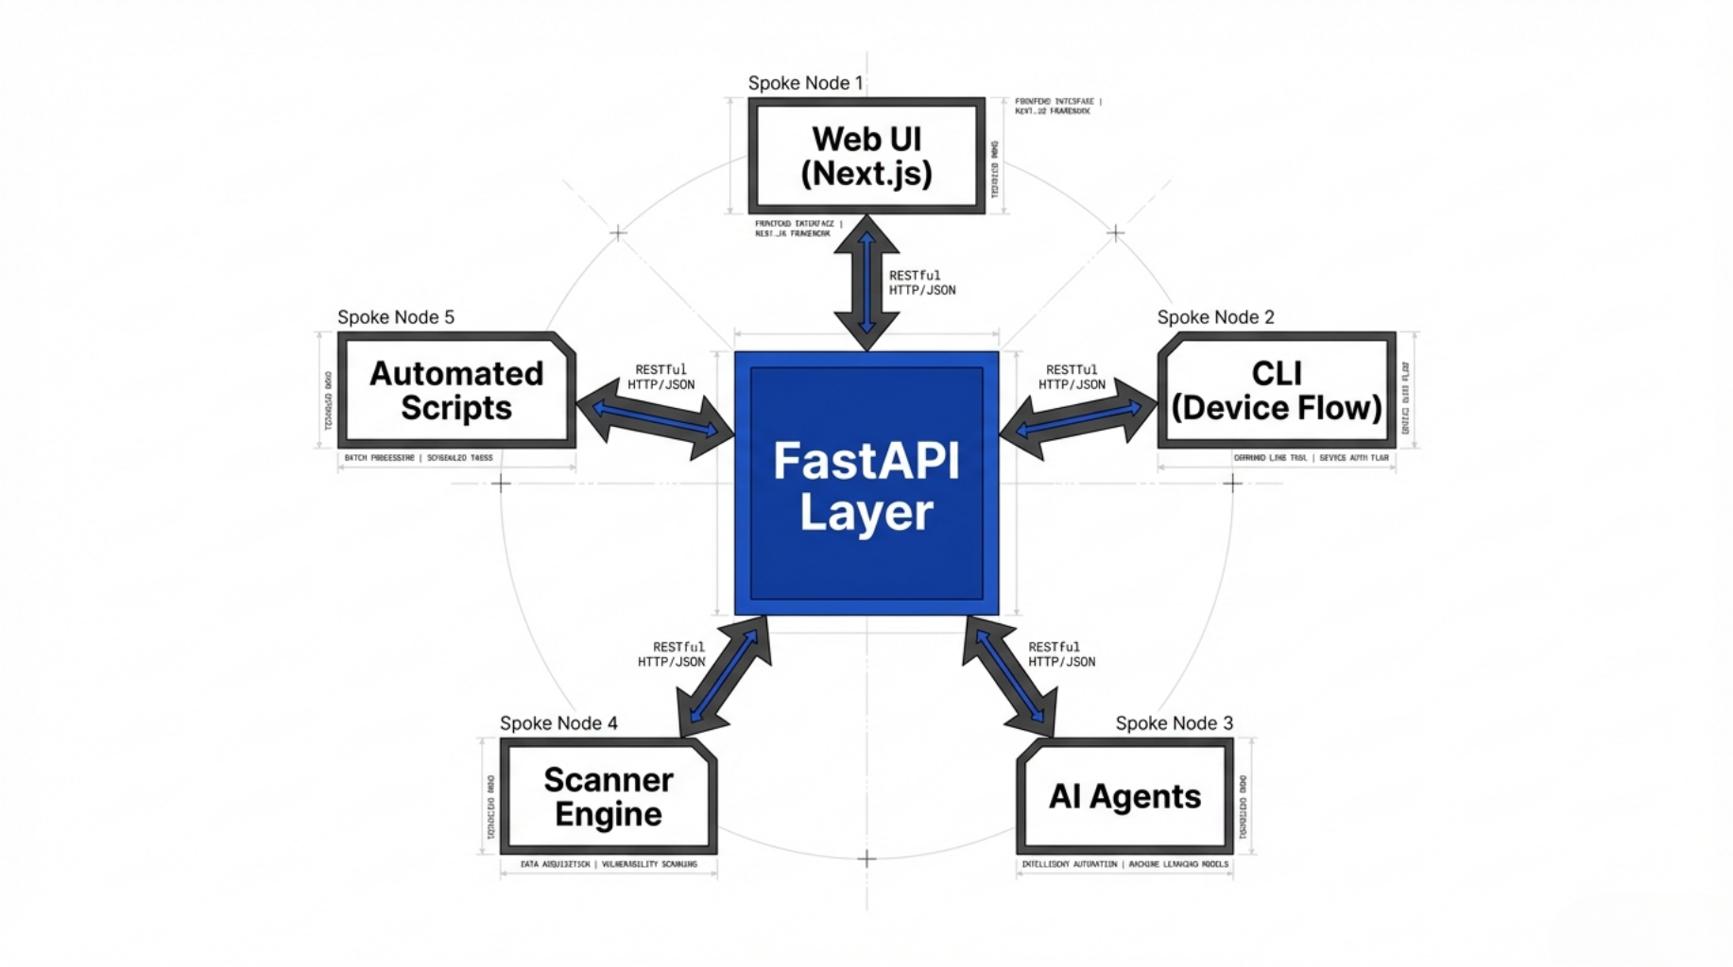
API First
Notes:
MACH

Slide 7
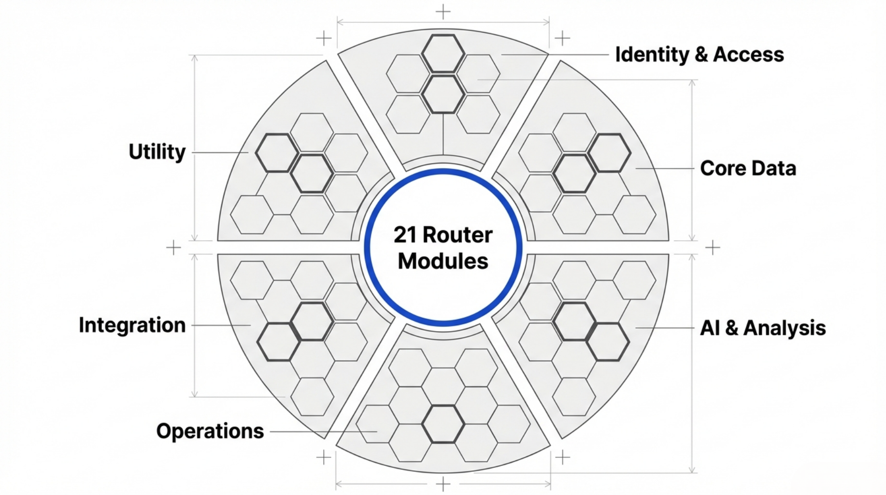
Next.JS
Notes:
Why Next.JS

Slide 8
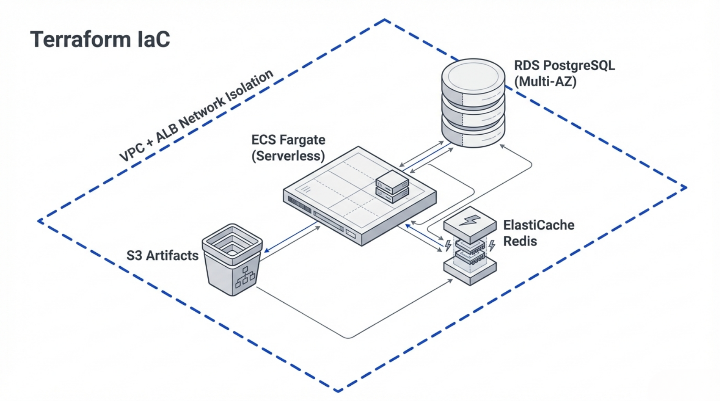
Notes:
AWS IaC

Slide 9
Why not AGH?
The Honest Framing
The gap isn't in detection — it's in everything that happens after detection.
MegaLinter is a better scanner orchestrator. Wider tool coverage, zero setup, runs anywhere Docker runs.
AGH is a security findings management platform. The scanners are just the input. The value is what happens to those findings after they're detected — triage, risk scoring, AI analysis, investigation workflows, compliance tracking, and reporting.
Why AGH
If your team's workflow is "run scanners in CI, look at the output, fix things" — MegaLinter is simpler and has more scanners.
If your team needs to answer "which findings actually matter, who's working on them, are we meeting our SLAs, and can we prove it to auditors?" — that's what AGH does. MegaLinter doesn't try to.
They're complementary. MegaLinter could even feed findings into AGH via SARIF import.

Slide 10
Next
Shift Left
Make it accessible via the IDE
Enhance API
Audit API services such as testing the discovered secrets against Dev and Prod
PR
Have a version where the tool scans local
Policy Base
PR and Global Policy (exception)

