Slide 1
PCA in High Dimensions
Iain M. Johnstone and Debashis Paul
Paper link: https://tinyurl.com/3u2pwyrc
PPT link: https://github.com/sealx017/High-dimensional-PCA
Presented by Souvik Seal

Slide 2
PCA in High Dimensions
Recap of simple PCA
Spiked Covariance Model
Matrix distributions
Spreading of eigenvalues
Estimation in spiked models
Inferential questions under the spiked model framework
Conclusion

Slide 3






Recap of simple PCA
Observed data,
Assume that they are IID with
Denote the full data matrix as,
Denote the sample covariance matrix as,
The matrix is symmetric and hence, can be diagonalized as,
and are the matrices of eigen-vectors and eigen-values.

Slide 4



Recap of simple PCA
Eigen-vectors, ’s are called the principal directions of the data.
Projections of the data on the principal directions are called principal components.
The j-th principal component is given by the j-th column of the matrix,
PCA and singular value decomposition (SVD) are related, https://tinyurl.com/yuuu6jcn.
A low-rank approximation,

Slide 5






Recap of simple PCA
For the population covariance matrix,
Using law of large numbers (LLN),
is traditionally taken as fixed and asymptotic behavior is evaluated for large and it can be shown that,
and for
The paper focuses on the “boundary” case, where and grow proportionately, i.e.,

Slide 6



Spiked Covariance Model
Focus on the population covariance and its eigen-decomposition.
A base covariance matrix + a low rank perturbation,
The signal strengths, or spikes as well the orthonormal eigenvectors
are unknown.
The rank K is small, (and stays fixed in asymptotic models as p and n grow).
It is usually assumed that .
Regarding eigenvectors, two assumptions are considered,
a) it makes no assumptions about them,
b) it assumes that they are sparse in some known orthonormal basis.

Slide 7

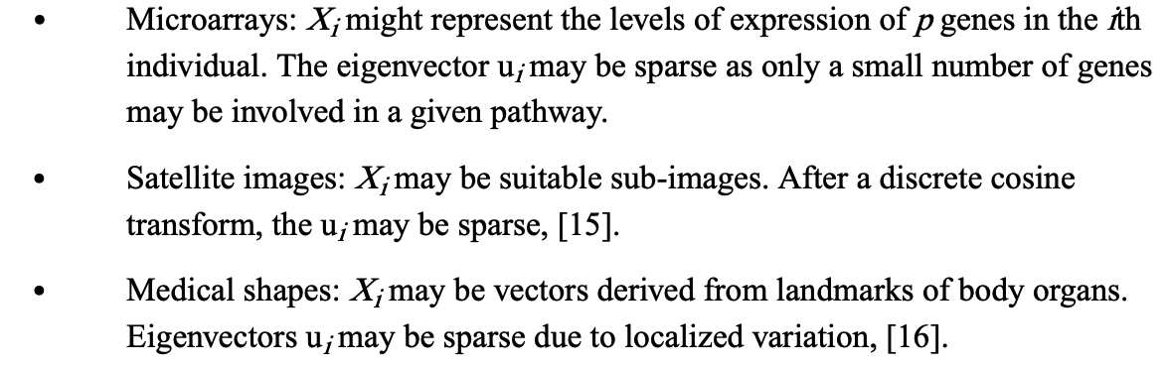
Spiked Covariance Model
In electrocardiogram (ECG) traces, the signal measured in the i-th beat,
The periodic beats vary about the mean beat according to a small number of modes with random Gaussian amplitudes, the k-th mode having variance.

Slide 8








Matrix Distributions
Define, . Assuming Wishart showed that
Properties: Suppose is a matrix of rank ,
Suppose, is a constant vector, ,
where, .
Wishart distribution will be singular if

Slide 9




Matrix Distributions
James derived the joint density of the eigen-values,
of the sample covariance matrix,
is a hypergeometric function with two symmetric
matrix arguments and , https://tinyurl.com/2xpd96uy.

Slide 10
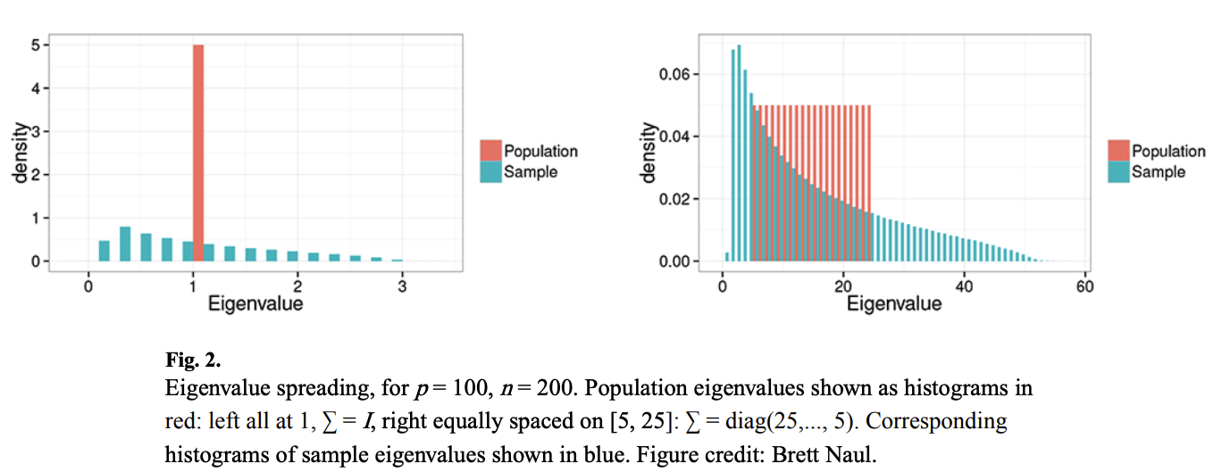
Spreading of eigenvalues
The sample eigenvalues are more spread out, or dispersed, than the population eigenvalues.

Slide 11








Spreading of eigenvalues
Marchenko and Pastur derived a celebrated approximation of the eigenvalue distribution when
When
Let the empirical distribution function of the p sample eigenvalues of
be,
If with the limit distribution having a density
function of the quarter-circle form,
where,
For

Slide 12


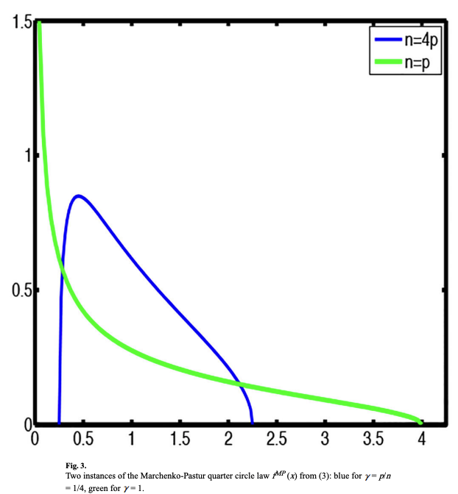
Spreading of eigenvalues
Example: suppose and
Out of 10 eigenvalues, only the values higher than 1.5 would be considered significant.
The larger the ratio and hence , the larger the interval, in other words, the larger is the spreading of sample eigenvalues.

Slide 13

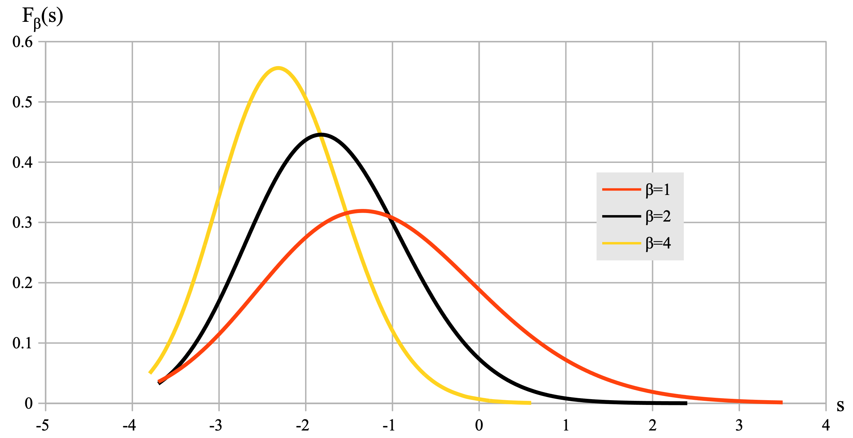

Spreading of eigenvalues
Tracy–Widom distribution: it is the probability distribution of the normalized largest eigenvalue of a random Hermitian matrix.
The largest sample eigenvalue in our context can be approximated as,
https://arxiv.org/pdf/1712.07903.pdf

Slide 14





Spreading of eigenvalues
For the limiting bulk distribution of all sample eigenvalues is unchanged, essentially since it is unaffected by a single value.
For the largest sample eigenvalue has the same limiting Tracy-Widom distribution – the (small) spike in the top population eigenvalue has no limiting effect on the distribution of the sample top eigenvalue.
Asymptotically the largest sample eigenvalue is of no use in detecting a subcritical spike in the largest population eigenvalue.
A phase transition occurs at the largest sample eigenvalue now has a limiting Gaussian distribution, with scale on the usual order of

Slide 15
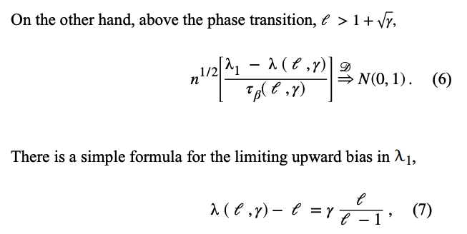
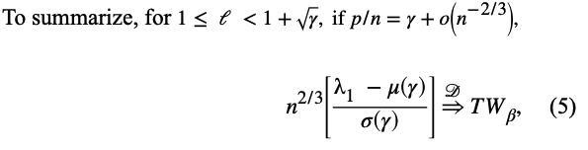
Spreading of eigenvalues

Slide 16
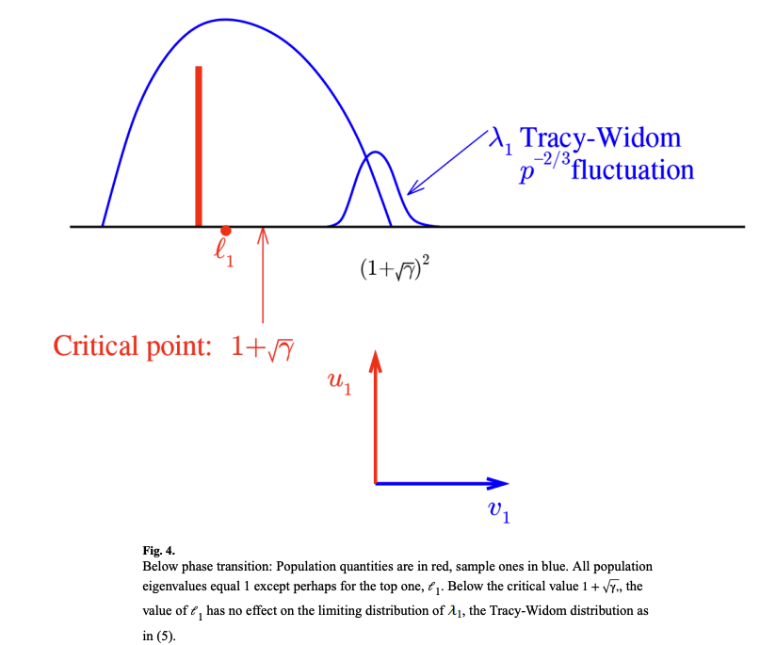
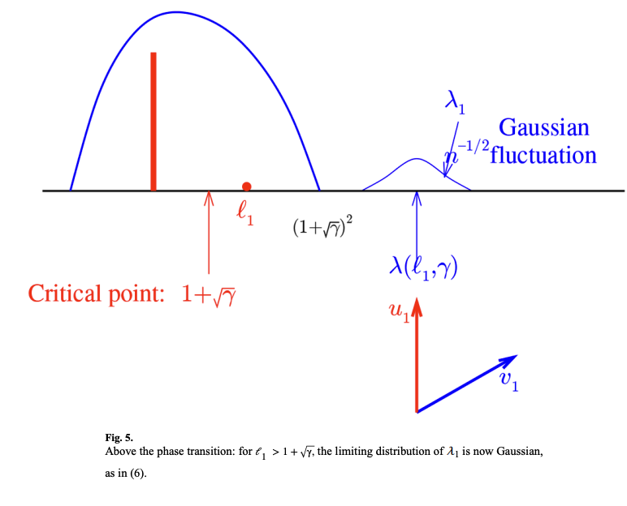
Spreading of eigenvalues

Slide 17


Estimation in spiked models
Estimation of leading eigenvectors under sparsity:
Assume eigenvectors have only a few co-ordinates significantly different from 0.
A two-stage approach is proposed in https://tinyurl.com/3vddf5z7.
The first stage involves selection of coordinates based on thresholding the sample variances, which is then followed by a PCA of the selected submatrix of the sample covariance matrix.
Under the assumed model, the eigenvector estimators can also be utilized to obtain consistent estimates of

Slide 18

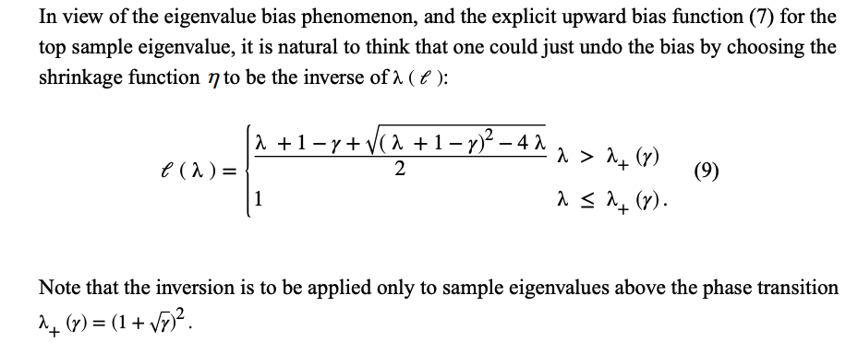
Estimation in spiked models
Estimation of the covariance matrix:
interesting covariance estimation procedures have been developed by making use of the eigenvalue and eigenvector phase transition phenomena in the “boundary case”
The sample eigenvalues are shrinked through a single univariate function

Slide 19
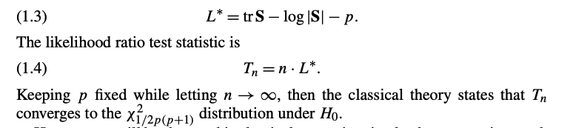


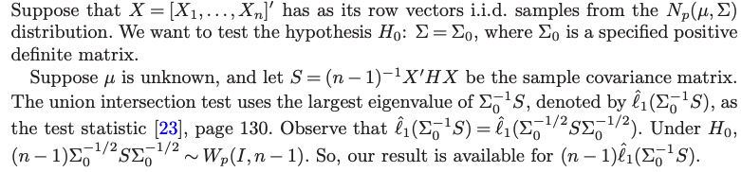
Inferential questions under the spiked model framework
John’s Likelihood ratio test:
The Tracy-Widom law for the largest sample eigenvalue under the null Wishart case i.e., allows a precise determination of the cut-off value for the largest root test.

Slide 20
Inferential questions under the spiked model framework
In the context of spiked model, Tracy-Widom law for the largest eigenvalue has been extensively used for signal detection.
Many of these approaches use a sequential hypothesis testing framework whereby the Tracy-Widom law is used to determine the null distribution for testing the presence of an additional signal direction.
Test,
1.
2.
3.
4. And so on.
https://arxiv.org/pdf/0910.0827.pdf

Slide 21
Conclusion
We learned about “Spiked Covariance” model.
Several matrix/eigenvalue distributional properties.
Difference between the population and sample eigenvalues.
How to infer about the population eigenvalues and spiked model from the sample ones.
This PPT is available at
https://github.com/sealx017/High-dimensional-PCA.

