Slide 1
Ellipse
An ellipse is a flattened circle, a plane curve, which results from the intersection of a cone by a plane in a way that produces a closed curve. It has two points called foci. It’s defined as the set of all points in a plane such that the sum of the distances from two fixed points (called foci) to each point on the ellipse is constant. we can also state that an ellipse is the image of a circle under parallel or perspective projection.

Slide 2
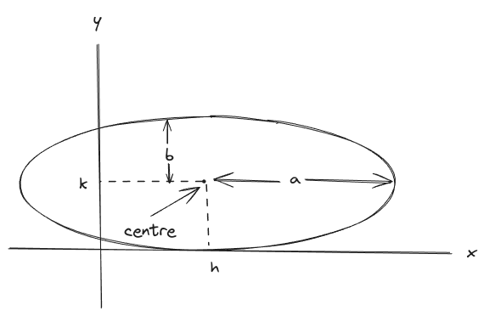
Scan converting an Ellipse
The ellipse is also a symmetric figure like a circle but is four-way symmetry rather than eight-way.

Slide 3

Polynomial method of defining an Ellipse
The ellipse has a major and minor axis. If a1 and b1are major and minor axis respectively. The centre of ellipse is (i, j). The value of x will be incremented from i to a1and value of y will be calculated using the following formula

Slide 4
Trigonometric method of defining and Ellipse
x = a * cos (θ) +h and
y = b * sin (θ)+k
where (x, y) = the current coordinates
a = length of major axis
b = length of minor axis
θ= current angle
(h, k) = ellipse center
In this method, the value of θ is varied from 0 to radians. The remaining points are found by symmetry.

Slide 5
Midpoint Ellipse Algorithm
This is an incremental method for scan converting an ellipse that is centered at the origin in standard position i.e., with the major and minor axis parallel to coordinate system axis. It is very similar to the midpoint circle algorithm. Because of the four-way symmetry property we need to consider the entire elliptical curve in the first quadrant.

Slide 6


Let's first rewrite the ellipse equation and define the function f that can be used to decide if the midpoint between two candidate pixels is inside or outside the ellipse:
There are two regions in an ellipse. Region 1 and Region 2 need to be calculated each of them having two conditions P < = 0 and P > 0.Po = b² - a²b + a²/4
The Decision Parameters
&

Slide 7









Expressions
If
If
Region 1
Region 2
Else
Else

Slide 8

Calculation
The ellipse is calculated in 2 regions namely:
Region 1 & Region 2
Region 2: (using the last x0 and y0 from the region 1)
Region 1:

Slide 9
Midpoint Algorithm
Take input radius along x axis and y axis and obtain center of ellipse.

Slide 10
Midpoint Algorithm
Take input radius along x axis and y axis and obtain center of ellipse.
Initially, we assume ellipse to be centered at origin and the first point as : (x, y₀)= (0, b).

Slide 11
Midpoint Algorithm
Take input radius along x axis and y axis and obtain center of ellipse.
Initially, we assume ellipse to be centered at origin and the first point as : (x, y₀)= (0, b).
Obtain the initial decision parameter for region 1 as:

Slide 12



Midpoint Algorithm
Take input radius along x axis and y axis and obtain center of ellipse.
Initially, we assume ellipse to be centered at origin and the first point as : (x, y₀)= (0, b) .
Obtain the initial decision parameter for region 1 as:
For every x_{k,} position in region 1 :
  If p1k<0 then the next point along the is (x_{k+1} , y_{k}) and
  Else, the next point is (x_{k}+1,y_{k} -1 ) and

Slide 13
Midpoint Algorithm
V. Obtain the initial value in region 2 using the last point (x0, y0) of region 1 as:

Slide 14

Midpoint Algorithm
V. Obtain the initial value in region 2 using the last point (x0, y0) of region 1 as:
VI. At each y_{k} in region 2 starting at k =0 perform the following task.
    If p2k>0 the next point is (x_{k}, y_{k}-1) and
    Else, the next point is (x_{k}+1, y_{k}-1) and

Slide 15
Midpoint Algorithm
V. Obtain the initial value in region 2 using the last point (x0, y0) of region 1 as:
VI. At each y_{k} in region 2 starting at k =0 perform the following task.
    If p2k>0 the next point is (x_{k}, y_{k}-1) and
    Else, the next point is (x_{k}+1, y_{k}-1) and
VII. Now obtain the symmetric points in remaining quadrants.

Slide 16
Example 1:
Let’s assume we need to draw an ellipse having a semi-major axis of 8, a semi-mirror axis of 6, and a center at the origin.

Slide 17
Example 1:
Let’s assume we need to draw an ellipse having a semi-major axis of 8, a semi-mirror axis of 6, and a center at the origin.
For Region 1:
Po = -332
k | Pk | Xk, Yk | Xk+1, Yk+1
0 | -332 | 0, 6 | 1, 6
1 | -224 | 1, 6 | 2, 6
2 | -44 | 2, 6 | 3, 6
3 | 208 | 3, 6 | 4, 5
4 | -108 | 4, 5 | 5, 5
5 | 288 | 5, 5 | 6, 4
6 | 244 | 6, 4 | 7, 3

Slide 18
Example 1:
Let’s assume we need to draw an ellipse having a semi-major axis of 8, a semi-mirror axis of 6, and a center at the origin.
For Region 2:
Po = -332
k | Pk | Xk, Yk | Xk+1, Yk+1
0 | -23 | 0, 6 | 8, 2
1 | 361 | 8, 2 | 8, 1
2 | 297 | 8, 1 | 8, 0

