Slide 1
Exploiting Pearl’s Theorems for Graphical Model Structure Discovery
Dimitris Margaritis
(joint work with Facundo Bromberg and Vasant Honavar)
Department of Computer Science
Iowa State University

Slide 2
The problem
General problem:
  Learn probabilistic graphical models from data
Specific problem:
  Learn the structure of probabilistic graphical models

Slide 3
Why graphical probabilistic models?
Tools for reasoning under uncertainty
  can use them to calculate the probability of any propositional formula (probabilistic inference) given the facts (known values of some variables)
Efficient representation of the joint probability using conditional independences
Most popular graphical models:
  Markov networks (undirected)
  Bayesian networks (directed acyclic)

Slide 4

Markov Networks
Define neighborhood structure among variables (i, j):
MNs’ assumption: S_{i} conditionally independent of all but its neighbors:
Intuitively: variable X is conditionally independent (CI) of variable Y given set of variables Z if Z “shields” any influence between X to Y
Notation:
Implies decomposition:

Slide 5
Markov Network Example
Target random variable: crop yield X
Observable random variables:
  Soil acidity Y1
  Soil humidity Y2
  Concentration of potassium Y3
  Concentration of sodium Y4

Slide 6
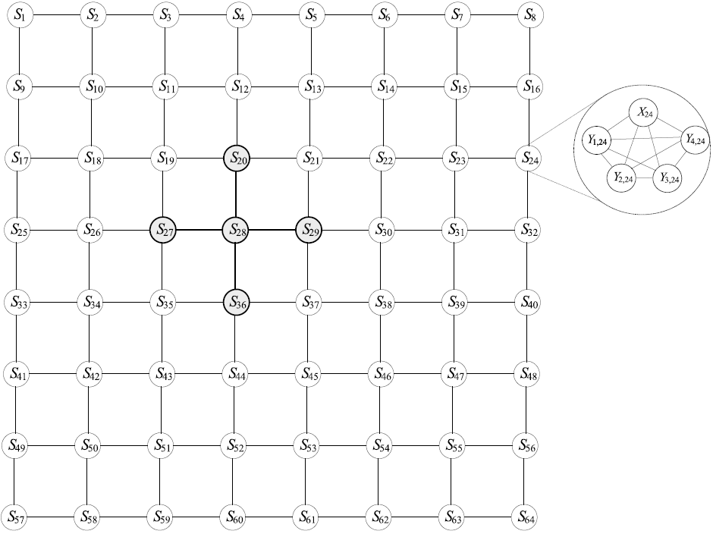
Example: Markov network for crop field
The crop field is organized spatially as a regular grid
Defines a dependency structure that matches spatial structure

Slide 7
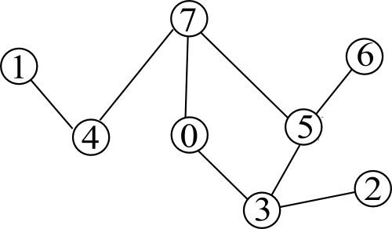
Markov Networks (MN)
We can represent structure graphically using Markov network G=(V, E):
V: nodes represent random variables,
E: undirected edges represent structure i.e.,
(
i
j
)
2
E
(
)
(
i
j
)
2
N
;
;
Example MN for:
N
=
f
(
1
4
)
(
4
7
)
(
7
0
)
(
7
5
)
;
;
;
;
;
;
;
;
(
6
5
)
(
0
3
)
(
5
3
)
(
3
2
)
g
;
;
;
;
;
;
;
V
=
f
0
1
2
3
4
5
6
7
g
,
,
,
,
,
,
,

Slide 8
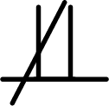
Markov network semantics
The CIs of probability distribution P are be encoded in a MN G by vertex-separation:
Denoting conditional dependence by ,
=
j
f
g
?
3
?
7
0
?
j
f
g
3
?
7
0
5
;
(Pearl 88’) If the CIs in the graph match exactly those
of distribution P, P is said to be graph-isomorph.
Notes:
* Mention what is the symbol

Slide 9
The problem revisited
Learn structure of Markov networks from data
True probability distribution:
Unknown
Data sampled from distribution:
Known!
P
r
(
1
2
¢
¢
¢
7
)
»
,
,
;
Learning
algorithm
True network
Learned network

Slide 10
Structure Learning of Graphical Models
Approaches to
Structure Learning:
Score-based
Independence
based
Other isolated approaches
Search for graph with optimal score (Likelihood, MDL)
Score computation intractable in Markov networks
Infer graph using
information of independences that hold in underlying model

Slide 11
Independence-based approach
Assumes existence of independence-query oracle that answers the CIs that hold in the true probability distribution
Proceeds iteratively:
  Query independence query oracle for CI value h in true model
  Discard structures that violate CI h
  Repeat until a single structure is left (uniqueness under assumptions)
Is variable 7 independent of
variable 3 given variables {0,5}?
independence query oracle
Oracle says NO:
so this structure (e.g.) is inconsistent!
=
j
f
g
but this, instead, is consistent!
?
3
?
7
0
5
;

Slide 12
But an oracle does not exist!
Can be approximated by a statistical independence test (SIT) e.g. Pearson’s χ² or Wilk’s G²
Given as input:
  a data set D (sampled from the true distribution), and
  a triplet (X,Y | Z)
The SIT computes the p-value: probability of error in assuming dependence when in fact variables are independent
and decides:

Slide 13
Outline
Introductory Remarks
The GSMN and GSIMN algorithms
The Argumentative Independence Test
Conclusions

Slide 14
GSMN and GSIMN Algorithms

Slide 15
GSMN algorithm
We introduce (the first) two independence-based algorithms for MN structure learning: GSMN and GSIMN
GSMN (Grow-Shrink Markov Network structure inference algorithm) is a direct adaptation of the grow-shrink (GS) algorithm (Margaritis, 2000) for learning a variable’s Markov blanket using independence tests
D
e
¯
n
i
t
i
o
n
:
A
M
a
r
k
o
v
b
l
a
n
k
e
t
B
L
(
X
)
o
f
X
2
V
i
s
a
n
y
s
u
b
s
e
t
S
o
f
v
a
r
i
a
b
l
e
s
h
h
l
d
f
l
l
h
b
l
h
(
?
f
g
j
)
t
a
t
s
i
e
X
r
o
m
a
o
t
e
r
s
v
a
r
i
a
e
s
,
t
a
t
i
s
,
X
?
V
¡
S
¡
X
S
.

Slide 16
GSMN (cont’d)
Markov blanket is the set of neighbors in the structure (Pearl and Paz ’85).
Therefore, we can learn the structure by learning the Markov blankets:
N
1
:
f
o
r
e
v
e
r
y
X
2
V
2
:
B
L
(
X
)
Ã
¡
g
e
t
M
a
r
k
o
v
b
l
a
n
k
e
t
o
f
X
u
s
i
n
g
G
S
a
l
g
o
r
i
t
h
m
.
3
:
f
o
r
e
v
e
r
y
Y
2
B
L
(
X
)
4
:
a
d
d
e
d
g
e
(
X
;
Y
)
t
o
E
(
G
)
:
GSMN extends above algorithm with heuristic ordering for grow and shrink phases of GS

Slide 17
Initially No Arcs
F
G
B
C
A
D
E
K
L

Slide 18
Growing phase
2. F dependent of A
given {B}?
3. G dependent of A
given {B}?
G
F
G
F
1. B dependent of A
given {}?
4. C dependent of A
given {B,G}?
B
B
C
C
A
6. D dependent of A
given {B,G,C,K}?
7. E dependent of A
given {B,G,C,K,D}?
E
D
E
D
5. K dependent of A
given {B,G,C}?
8. L dependent of A
given {B,G,C,K,D,E}?
L
K
L
K
Markov blanket of A = {B,G,C,K,D,E}
Markov blanket of A = {B,G,C,K}
Markov blanket of A = {B,G,C,K,D}
Markov blanket of A = {B,G}
Markov blanket of A = {B,G,C}
Markov blanket of A = {}
Markov blanket of A = {B}

Slide 19
Shrinking phase
Minimum
Markov Blanket
9. G dependent of A
given {B,C,K,D,E}? (i.e. the set-{G})
F
G
B
C
A
D
E
10. K dependent of A
given {B,C,D,E}?
K
L
Markov blanket of A = {B,C,D,E}
Markov blanket of A = {B,C,K,D,E}
Markov blanket of A = {B,G,C,K,D,E}

Slide 20
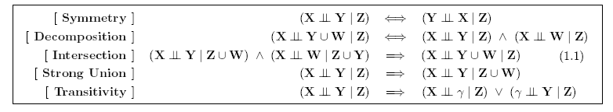
GSIMN
GSIMN (Grow-Shrink Inference Markov Network) uses properties of CIs as inference rules to infer novel tests, avoiding costly SITs.
Pearl (88’) introduced properties satisfied by the CIs of distributions isomorphic to Markov networks:
Undirected axioms (Pearl ’88)
GSIMN modifies GSMN by exploiting these axioms to infer novel tests

Slide 21
Axioms as inference rules
[
]
(
?
j
)
(
j
)
(
j
)
?
6
?
?
?
T
r
a
n
s
i
t
i
v
i
t
y
X
W
Z
^
W
Y
Z
=
)
X
?
Y
Z
(
?
j
f
g
)
(
=
j
f
g
)
(
j
f
g
)
?
?
?
?
1
7
4
^
7
3
4
=
)
1
?
3
4

Slide 22
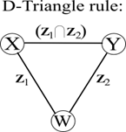
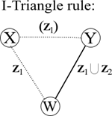
Triangle theorems
GSIMN actually uses the Triangle Theorem rules, derived from (only): Strong Union and Transitivity:
(
6
j
)
(
j
)
(
j
)
(
j
)
?
?
6
?
?
?
?
6
?
X
W
Z
1
^
W
Y
Z
2
X
W
Z
1
^
W
?
Y
Z
1
[
Z
2
(
6
j
)
(
j
)
?
?
?
=
)
X
Y
Z
1
\
Z
2
=
)
X
?
Y
Z
1
:
Rearranges GSMN visit order to maximize benefits
Applies these rules only once (as opposed to computing the closure)
Despite these simplifications, GSIMN infers >95% of inferable tests (shown experimentally)

Slide 23
Experiments
Our goal: Demonstrate GSIMN requires fewer tests than GSMN, without significantly affecting accuracy

Slide 24
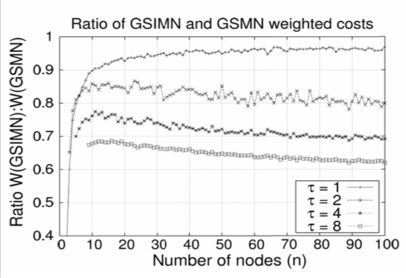
Results for exact learning
We assume independence query oracle, so
  tests are 100% accurate
  output network = true network (proof omitted)

Slide 25
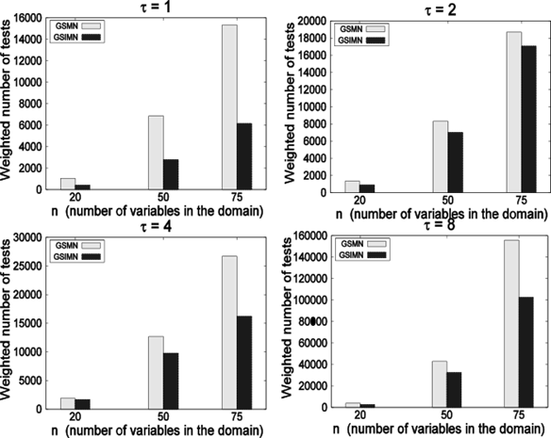
Sampled data: weighted number of tests

Slide 26
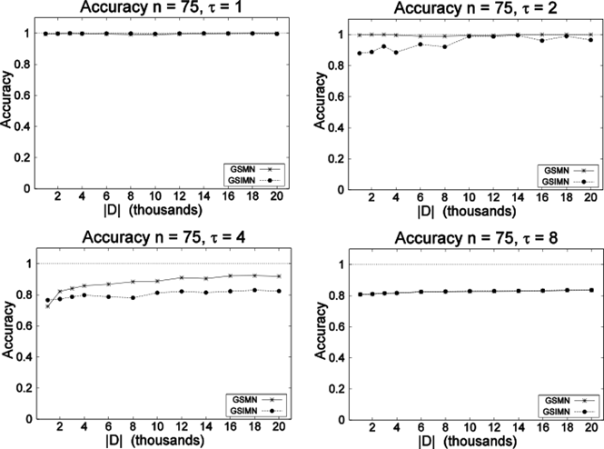
Sampled data: Accuracy

Slide 27
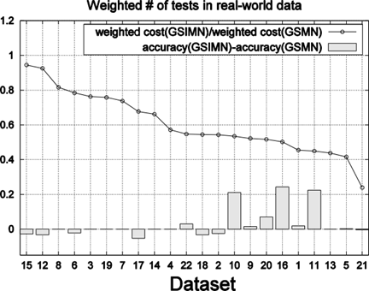
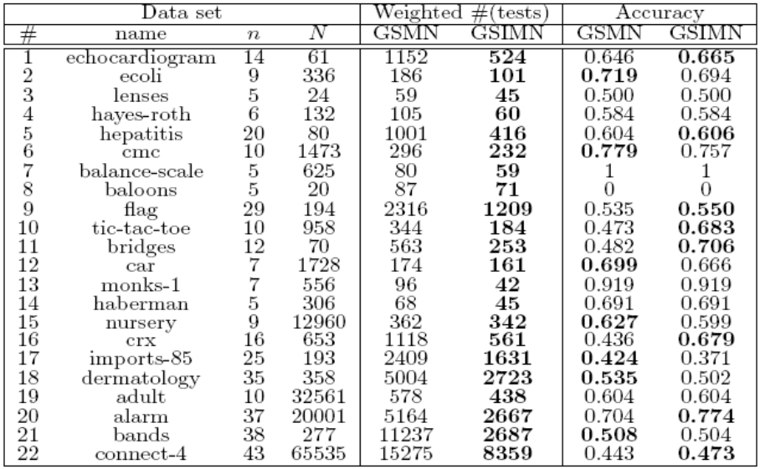
Real-world data
More challenging because:
  Non-random topologies (e.g. regular lattices, small world, chains, etc.)
  Underlying distribution may not be graph-isomorph

Slide 28
Outline
Introductory Remarks
The GSMN and GSIMN algorithms
The Argumentative Independence Test
Conclusions

Slide 29
The Argumentative Independence Test
(AIT)

Slide 30
The Problem
Statistical Independence tests (SITs) unreliable for small data sets
Produce erroneous networks when used by independence-based algorithms
This problem is one of the most important criticisms of independence-based approach
Our contribution
A new general purpose independence test: the argumentative independence test or AIT that improves reliability for small data sets

Slide 31
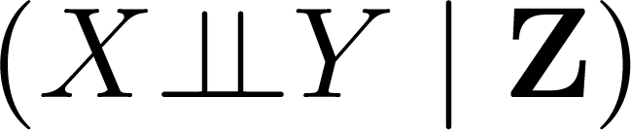
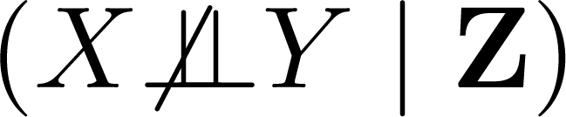
Main Idea
The new independence test (AIT) improves accuracy by “correcting” outcomes of a statistical independence test (SIT):
  Incorrect SITs may produce CIs inconsistent with Pearl’s properties of conditional independences
  Thus, resolving inconsistencies among SITs may correct the errors
Propositional knowledge base (KB)
  propositions are CIs (i.e., for (X, Y | Z), or )
  inference rules are Pearl’s conditional independence axioms

Slide 32
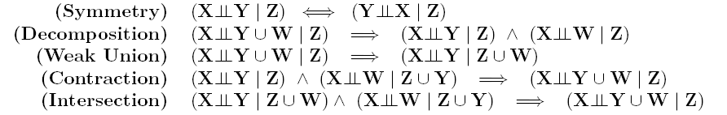
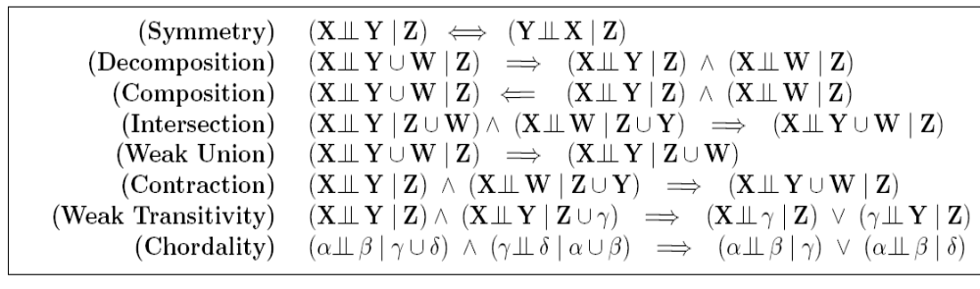
Pearl’s axioms
We presented above the undirected axioms
Pearl (1988) also introduced, for any distribution:
general axioms
For distributions isomorphic to directed graphs:
Directed axioms
Notes:
* For clarity, we use numbers as variables names.

Slide 33


Example
Consider the following KB of CIs, constructed using a SIT.
A.
B.
C.
(
?
j
f
g
)
0
?
1
2
3
;
(
?
j
f
g
)
0
?
4
2
3
;
(
6
f
g
j
f
g
)
?
0
?
1
4
2
3
;
;
Assume C is wrong (SIT’s mistake).
Assuming the Composition axiom holds, then
D.
(
?
j
f
g
)
(
j
f
g
)
(
f
g
j
f
g
)
?
?
?
?
0
1
2
3
^
0
4
2
3
=
)
0
?
1
4
2
3
;
;
;
;
Inconsistency: D and C contradict each other

Slide 34
Example (cont’d)
At least two ways to resolve inconsistency: rejecting D or rejecting C
If we can resolve inconsistency in favor of D, error could be corrected
The argumentation framework presented next provides a principled approach for resolving inconsistencies
A.
B.
C.
(
?
j
f
g
)
Consistent and
correct KB:
0
?
1
2
3
Inconsistent and
Incorrect KB:
Consistent but
Incorrect KB:
;
(
?
j
f
g
)
0
?
4
2
3
;
(
6
f
g
j
f
g
)
?
0
?
1
4
2
3
;
;
D.
(
?
j
f
g
)
(
j
f
g
)
(
f
g
j
f
g
)
?
?
?
?
0
1
2
3
^
0
4
2
3
=
)
0
?
1
4
2
3
;
;
;
;

Slide 35
Preference-based Argumentation Framework
Instance of defeasible (non-monotonic) logics
Main contributors: Dung ’95 (basic framework), Amgoud and Cayrol ’02 (added preferences)
The framework consists on three elements:
P
A
F
=
h
A
R
¼
i
;
;
Set of arguments
Attack relation among arguments
Preference order over arguments
A
:
R
:
¼
:

Slide 36

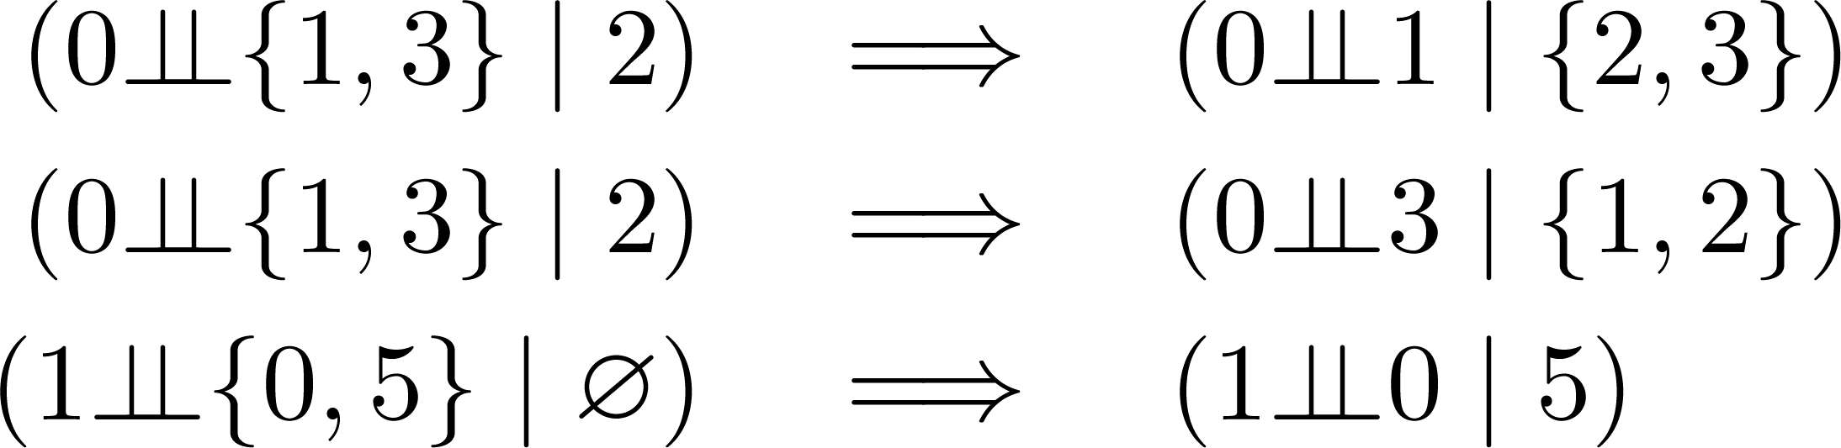
Arguments
Argument (H, h) is an “if-then” rule (if H then h)
  Support H is a set of consistent propositions
  Head h
In independence KBs if-then rules are instances (propositionalizations) of Pearl’s universally quantified rules. For example these
are instances of Weak Union:
Propositional arguments: arguments ({h}, h) for individual CI proposition h

Slide 37
Example
The set of arguments corresponding to KB of previous example is:
Name (H, h) Correct?
A.
B.
C.
(
f
(
?
j
f
g
)
g
(
j
f
g
)
)
?
?
0
1
2
3
0
?
1
2
3
;
;
;
(
f
(
?
j
f
g
)
g
(
j
f
g
)
)
?
?
0
4
2
3
0
?
4
2
3
;
;
;
(
f
(
6
f
g
j
f
g
)
g
(
f
g
j
f
g
)
)
?
?
6
?
0
1
4
2
3
0
?
1
4
2
3
D.
;
;
;
;
;
¡
f
(
?
j
f
g
)
(
j
f
g
)
g
(
f
g
j
f
g
)
¢
?
?
?
?
0
1
2
;
3
;
0
4
2
;
3
;
0
?
1
;
4
2
;
3

Slide 38
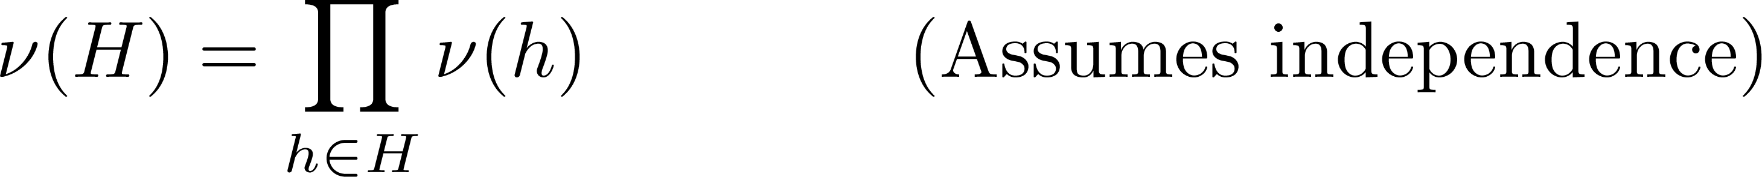
Preferences
Preference over arguments obtained from preferences over CI propositions
We say argument (H, h) preferred over argument (H’, h’) iff it is more likely for all propositions in H to be correct:
The probability ν(h) that h is correct is obtained from p-value of h, computed using a statistical test (SIT) on data

Slide 39
Example
Let’s extend the arguments with preferences:
Name (H,h) Correct? ν(H)
A.
B.
C.
0.8
0.7
0.5
0.8x0.7=0.56
(
f
(
?
j
f
g
)
g
(
j
f
g
)
)
?
?
0
1
2
3
0
?
1
2
3
;
;
;
(
f
(
?
j
f
g
)
g
(
j
f
g
)
)
?
?
0
4
2
3
0
?
4
2
3
;
;
;
(
f
(
6
f
g
j
f
g
)
g
(
f
g
j
f
g
)
)
?
?
6
?
0
1
4
2
3
0
?
1
4
2
3
D.
;
;
;
;
;
¡
f
(
?
j
f
g
)
(
j
f
g
)
g
(
f
g
j
f
g
)
¢
?
?
?
?
0
1
2
;
3
;
0
4
2
;
3
;
0
?
1
;
4
2
;
3

Slide 40
Attack relation
R
The attack relation formalizes and extends the notion of logical contradiction:
Definition: Argument b attacks argument a iff b logically
contradicts a and a is not preferred over b
Since argument (H₁,h₁) models if H then h rules, it can be logically contradicted by (H₂,h₂) if:
  (H₁,h₁) rebuts (H₂,h₂) iff h₁ ≡ ¬h₂
  (H₁,h₁) undercuts (H₂,h₂) iff ∃h∈H₂ such that h ≡ ¬h₁

Slide 41
Example
Name (H, h) Correct? ν(H)
A.
B.
C.
0.8
0.7
0.5
0.8x0.7=0.56
(
f
(
?
j
f
g
)
g
(
j
f
g
)
)
?
?
0
1
2
3
0
?
1
2
3
;
;
;
(
f
(
?
j
f
g
)
g
(
j
f
g
)
)
?
?
0
4
2
3
0
?
4
2
3
;
;
;
(
f
(
6
f
g
j
f
g
)
g
(
f
g
j
f
g
)
)
?
?
6
?
0
1
4
2
3
0
?
1
4
2
3
D.
;
;
;
;
;
¡
f
(
?
j
f
g
)
(
j
f
g
)
g
(
f
g
j
f
g
)
¢
?
?
?
?
0
1
2
;
3
;
0
4
2
;
3
;
0
?
1
;
4
2
;
3
C and D rebut each other, and
C is not preferred over D, so
D attacks C

Slide 42
Inference = Acceptability
Inference modeled in argumentation frameworks by acceptability
An argument r is:
  “inferred” iff it is accepted
  “not inferred” iff rejected, or
  in abeyance if neither
Dung-Amgoud’s idea: accept argument r if
  r is not attacked, or
  r is attacked, but its attackers are also attacked

Slide 43
Example
Name (H, h) Correct? ν(H)
A.
B.
C.
0.8
0.7
0.5
0.8x0.7=0.56
(
f
(
?
j
f
g
)
g
(
j
f
g
)
)
?
?
0
1
2
3
0
?
1
2
3
;
;
;
(
f
(
?
j
f
g
)
g
(
j
f
g
)
)
?
?
0
4
2
3
0
?
4
2
3
;
;
;
(
f
(
6
f
g
j
f
g
)
g
(
f
g
j
f
g
)
)
?
?
6
?
0
1
4
2
3
0
?
1
4
2
3
D.
;
;
;
;
;
¡
f
(
?
j
f
g
)
(
j
f
g
)
g
(
f
g
j
f
g
)
¢
?
?
?
?
0
1
2
;
3
;
0
4
2
;
3
;
0
?
1
;
4
2
;
3
We had that D attacks C (and no other attack).
Since nothing attacks D, D is accepted.
C is attacked by an accepted argument, so C is rejected.
Argumentation resolved the inconsistency in favor of correct proposition D!
In practice, we have thousands of arguments. How to compute acceptability status of all of them?

Slide 44
Computing Acceptability Bottom-up
accept if not attacked, or if all attackers attacked.

Slide 45
Computing Acceptability Bottom-up
accept if not attacked, or if all attackers attacked.

Slide 46
Computing Acceptability Bottom-up
accept if not attacked, or if all attackers attacked.

Slide 47
Computing Acceptability Bottom-up
accept if not attacked, or if all attackers attacked.

Slide 48
Computing Acceptability Bottom-up
accept if not attacked, or if all attackers attacked.

Slide 49
Top-down algorithm
Bottom-up algorithm highly inefficient
  Computes acceptability of all possible arguments
Top-down is an alternative
Given argument r, it responds whether r accepted or rejected
  accept if all attackers are rejected, and
  reject if at least one attacker is accepted
We illustrate this with an example

Slide 50
Computing Acceptability Top-down
7
Target node
1
2
9
12
6
11
4
3
8
13
5
10
7
accept if all attackers rejected, reject if at least one accepted.

Slide 51
Computing Acceptability Top-down
7
Target node
1
2
9
12
3
6
11
attackers
6
11
4
3
8
13
5
10
7
accept if all attackers rejected, reject if at least one accepted.

Slide 52
Computing Acceptability Top-down
7
Target node
1
2
9
12
3
6
11
attackers
6
11
4
3
8
4
5
12
13
5
10
7
accept if all attackers rejected, reject if at least one accepted.

Slide 53
Computing Acceptability Top-down
7
Target node
1
2
9
12
3
6
11
6
11
4
3
8
4
5
12
13
5
leaf
10
7
accept if all attackers rejected, reject if at least one accepted.

Slide 54
Computing Acceptability Top-down
7
Target node
1
2
9
12
3
6
11
6
11
4
3
8
4
5
12
13
5
leaf
10
7
2
1
13
leaf
leaf
leaf
accept if all attackers rejected, reject if at least one accepted.

Slide 55
Computing Acceptability Top-down
7
Target node
1
2
9
12
3
6
11
6
11
4
3
8
4
5
12
13
5
10
7
2
1
13
accept if all attackers rejected, reject if at least one accepted.

Slide 56
Computing Acceptability Top-down
7
Target node
1
2
9
12
3
6
11
6
11
4
3
8
4
5
12
13
5
10
7
2
1
13
accept if all attackers rejected, reject if at least one accepted.

Slide 57
Computing Acceptability Top-down
7
Target node
1
2
9
12
3
6
11
6
11
4
3
8
4
5
12
13
5
10
7
2
1
13
We didn’t evaluate arguments 8, 9 and 10!
accept if all attackers rejected, reject if at least one accepted.

Slide 58
Approximate top-down algorithm
It is a tree-traversal, we chose iterative deepening
Time complexity: O(b^{d})
Difficulties:
Exponential in depth d.
By nature of Pearl rules, # attackers of some nodes (branching factor b) may be exponential
Approximation:
To solve (1), we limit d to 3.
To solve (2), we consider an alternative propositionalization of Pearl’s rules that bounds b to polynomial size (details omitted here)
b=3
d=3

Slide 59
Experiments
We considered 3 variations of each AIT, one per set of Pearl axioms: general, directed, and undirected
Experiments on data sampled from Markov and Bayesian networks (directed graphical models)

Slide 60
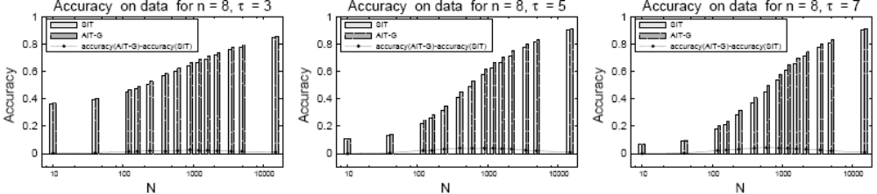
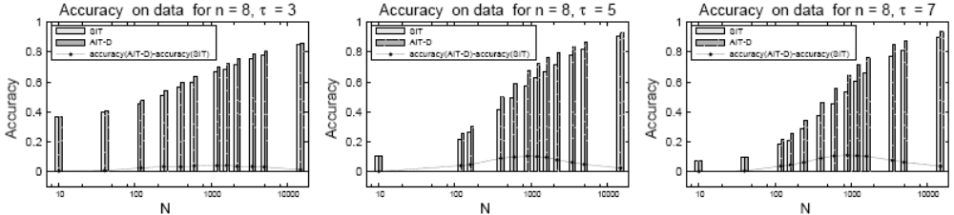
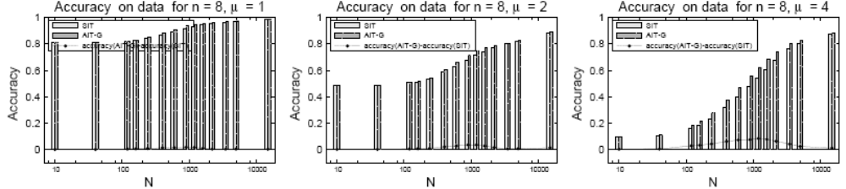
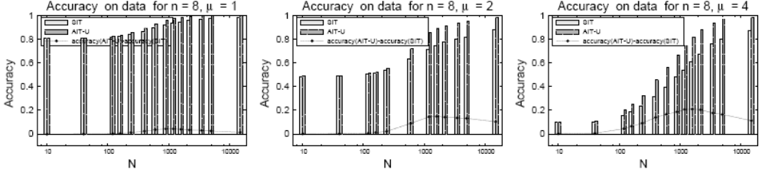
Approximate top-down algorithm:
accuracy on data
Axioms: general
True model: BN
Axioms: directed
True model: BN
Axioms: general
True model: MN
Axioms: undirected
True model: MN

Slide 61
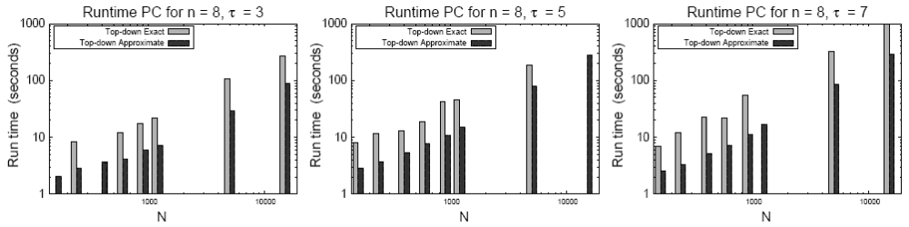
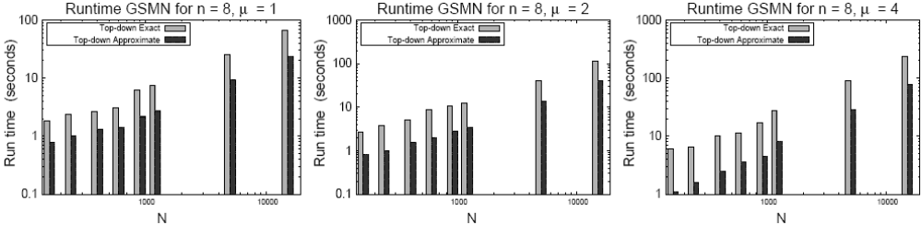
Top-down runtime: approximate vs. exact
We show results only for specific axioms
PC algorithm
GSMN
algorithm

Slide 62
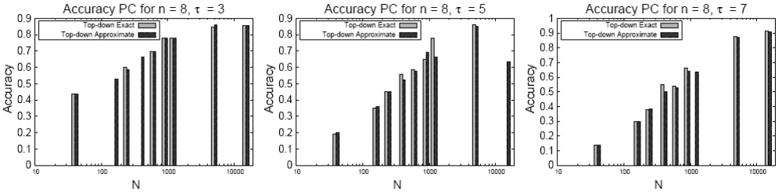
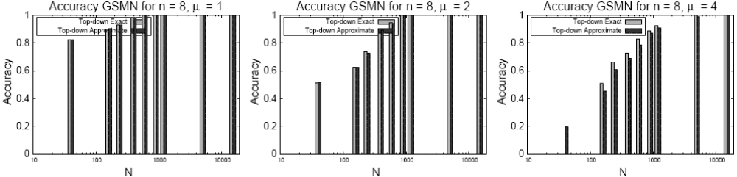
Top-down accuracy: approx vs. exact
Experiments show accuracies of both match in all but few cases: (only specific axioms)

Slide 63
Conclusions

Slide 64
Summary
I presented two uses of Pearl’s independence axioms/theorems:
  the GSIMN algorithm
    Uses axioms to infer independence test results from known ones when learning the domain Markov network
    ➔ faster execution
  The AIT general-purpose independence test
    Uses multiple tests on data and the axioms as integrity constraints to return the most reliable value
    ➔ more reliable tests on small data sets

Slide 65
Further Research
Explore other methods of resolving inconsistencies in KB of known independences
Use such constraints to improve Bayesian network and Markov network structure learning from small data sets (instead of just improving individual tests)
Develop faster methods of inferring independences using Pearl’s axioms—Prolog tricks?

Slide 66
Thank you!
Questions?

Slide 67
Auxiliary slides

Slide 68
Conditional independence (CI)
Definition:
G
i
v
e
n
p
r
o
b
a
b
i
l
i
t
y
d
i
s
t
r
i
b
u
t
i
o
n
P
o
v
e
r
V
a
n
d
t
h
r
e
e
d
i
s
j
o
i
n
t
s
e
t
s
X
Y
Z
½
,
;
;
V
X
a
n
d
Y
a
r
e
s
a
i
d
t
o
b
e
c
o
n
d
i
t
i
o
n
a
l
l
y
i
n
d
e
p
e
n
d
e
n
t
g
i
v
e
n
Z
d
e
n
o
t
e
d
,
,
(
?
j
)
X
?
Y
Z
P
i
f
f
o
r
e
v
e
r
y
a
s
s
i
g
n
m
e
n
t
x
y
a
n
d
z
o
f
v
a
r
i
a
b
l
e
s
X
Y
a
n
d
Z
r
e
s
p
e
c
t
i
v
e
l
y
i
t
i
s
t
h
e
,
,
,
,
c
a
s
e
t
h
a
t
P
(
x
j
y
z
)
=
P
(
x
j
z
)
w
h
e
n
e
v
e
r
P
(
y
z
)
>
0
;
;
:
Intuitively: Learning the value of Y does not provide additional information about X, once we know the value of Z.
Notes:
* For clarity, we use numbers as variables names.

Slide 69
Graphoids
Pearl noted striking similarities between general axioms and vertex separation.
He thus wondered: could graphs encode CIs? Of which distributions?
  Graph-isomorph
  distributions: CIs
  can be encoded
  by undirected graphs.
  Causal distributions:
  CIs can be encoded
  by directed graphs (called Bayesian networks).
Graph-
isomorph
Causal
Space of all
Probability distributions
Notes:
* For clarity, we use numbers as variables names.

Slide 70
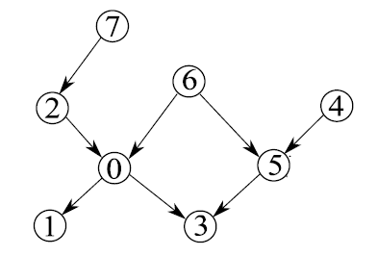
Bayesian Networks
Bayesian networks are another type of graphical models consisting on directed edges.
Example Bayesian network
for domain variables
V
=
f
0
1
2
3
4
5
6
7
g
,
,
,
,
,
,
,
Bayesian networks use more complex separability criterion: d-separation (definition omitted)

Slide 71
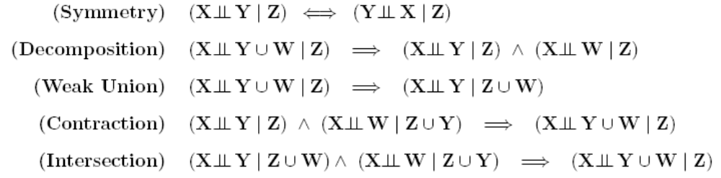
General axioms of CI
The conditional independence relation satisfies the following properties (Pearl 88):
?
j
X
?
Y
Z
Follow from definition of CI and axioms of probability.
Intersection only satisfied in positive distributions.
Notes:
* For clarity, we use numbers as variables names.

Slide 72
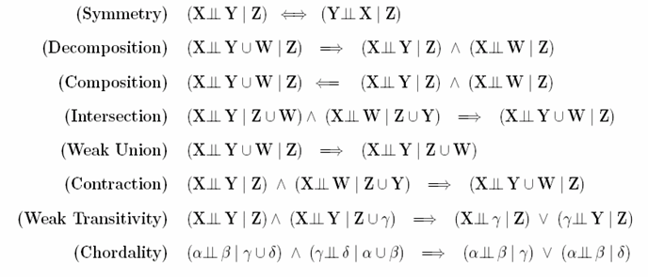
Specific axioms
CIs of a graph-isomorph probability distribution satisfy:
Undirected axioms
CIs of a causal probability distribution satisfy:
Directed axioms
(
?
j
)
X
?
Y
Z
P
(
)
Z
i
n
t
e
r
c
e
p
t
s
a
l
l
p
a
t
h
s
f
r
o
m
X
t
o
Y
P is called graph-isomorph and its CIs satisfy:
We assume underlying distribution is graph-isomorph (faithfulness assumption).

Slide 73
Directed specific axioms
Given a probability distribution P, if exists a directed graph G such that CIs correspond with d-separation:
(
?
j
)
X
?
Y
Z
P
(
)
Z
d
-
s
e
p
a
r
a
t
e
s
X
f
r
o
m
Y
P is called causal and its CIs satisfy:

Slide 74
Known Model Experiments
Allows better assessment of accuracy since true model is known.
Uses randomly generated true model (G,ϕ)
  Network: random networks G=(V,E) of different number of variables n=|V| and edge densities τ.
  Parameters (ϕ): randomly with log-odds ratio θ=2.
Two types:
    Exact Learning: tests conducted directly on true network G through vertex-separation.
    Sampled data experiments: Tests conducted on D~_{Gibbs}(G,ϕ), data sampled from true model.

Slide 75
Accuracy
Accuracy of network output by algorithm
alg ∈ {GSMN, GSIMN} was measured as follows:
  Sample set T of 10,000 triplets (X,Y | Z)
  For each test t in T, compare its outcome I_{true}(t) on true model, and its outcome I_{alg}(t) on network.
  Report the ratio that matched, i.e.
t
¯
n
o
¯
a
c
\
r
u
e
1
¯
t
2
T
j
I
(
t
)
I
(
t
)
¯
c
u
r
a
c
y
a
l
g
=
j
T
j
¯
a
l
g
=
t
r
u
e
¯
:
¯
¯
Replace I_{true}(t) with I_{data}(t) if true model is unknown.

Slide 76
Resolving inconsistent KBs
Two approaches for resolving inconsistencies.
Belief revision:
  Resolves inconsistencies by removing subsets of propositions until resulting KB is consistent.
  Shortcomings:
    Discards valuable information.
    Inconsistencies may reappear upon insertion of new propositions.
Defeasible logics:
  Allows inconsistencies,
  Proposes novel proof procedure for deducing the preferred truth-value of inconsistent propositions.

Slide 77
Argumentation in independence KBs
We must define: set of arguments, defeat/attack relation,
and the preference ordering.
Arguments: For each possible match of Pearl’s universally
quantified rules, add the corresponding argument (as
antecedents, consequent pairs).
Defeat/attack: Identical to general case.
Preferences of:
Proposition h: defined as probability ν(h) that independence proposition h is correct (based on p-value of SITs)
Support H: Probability that all propositions in H are correct:
  ν(H) = Π_{h∈H} ν(H) (assumes independence)
Argument (H, h): Follows preference of its support H.

Slide 78
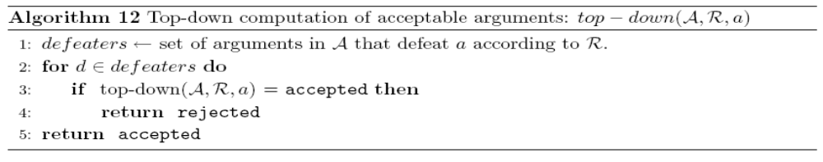
Top-down algorithm
Bottom-up is highly inefficient, Alternative: top-down.
Given argument r, top-down algorithm responds whether
r accepted or rejected (or may not terminate).
It uses the fact that an argument r is: (proof omitted)
  accepted if all its attackers are rejected, and
  rejected if at least one attacker is accepted.
a
t
t
a
c
k
e
r
s
a
t
t
a
c
k
e
r
s
Top-down algorithm
Algorithm is a tree-traversal, we chose iterative
Deepening. So time complexity is O(b^{d}).

Slide 79
Computing Acceptability Bottom-up
Acceptability rule: accept if not attacked, or if attackers themselves attacked.
Based on this rule, Dung (1995) proposed bottom-up recursive procedure for computing the set of acceptable arguments Acc:
Start by those arguments that are not attacked:
A
c
c
(
0
)
f
a
2
A
j
a
i
s
n
o
t
a
t
t
a
c
k
e
d
g
=
Continue recursively as follows:
R
e
j
(
i
)
f
a
2
A
j
a
i
s
a
t
t
a
c
k
e
d
b
y
a
n
e
l
e
m
e
n
t
i
n
A
c
c
(
i
)
g
=
A
c
c
(
i
)
f
a
2
A
j
a
i
s
a
t
t
a
c
k
e
d
b
y
a
n
e
l
e
m
e
n
t
i
n
R
e
j
(
i
¡
1
)
g
=
Until Acc^{(i+1)} = Acc^{(i)}.

Slide 80
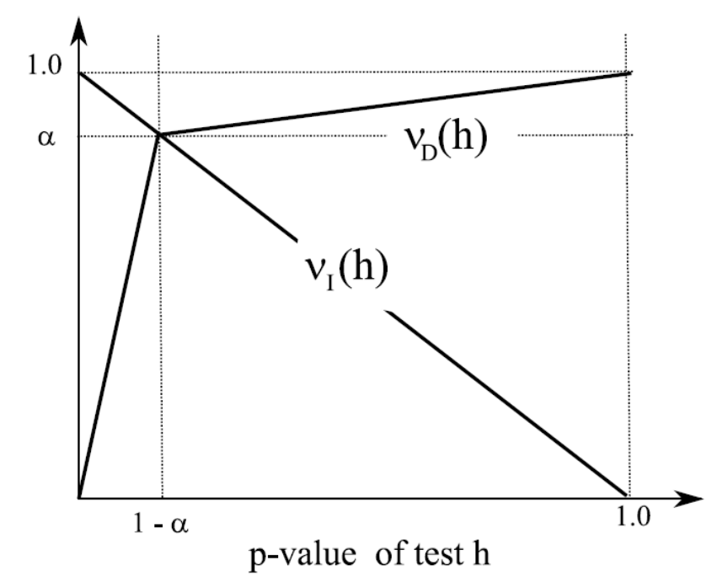
Probability of correctness ν(h)
The p-value p(X,Y|Z) returned by a SIT (e.g., G² or χ²) was
defined as the probability of error in assuming X and Y
dependent when in fact they are not. Therefore,
ν_{D}( ) = 1−p(X,Y|Z)
(
6
j
)
?
X
?
Y
Z
Probability of error in assuming
independence incorrectly is
β-value β(X,Y|Z), so
ν_{I}( ) = 1−β(X,Y|Z)
(
?
j
)
X
?
Y
Z
But β-value cannot be compute
so approximated from p-value:
h
(
?
j
)
=
X
?
Y
Z
h
(
6
j
)
?
=
X
?
Y
Z

Slide 81
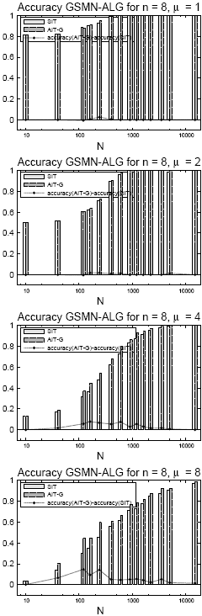
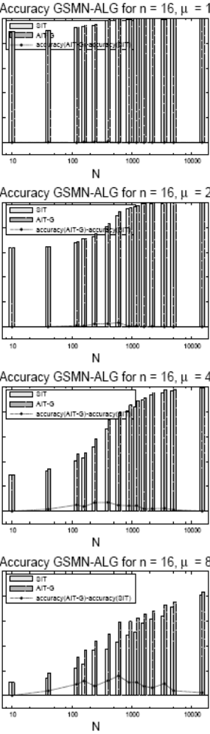
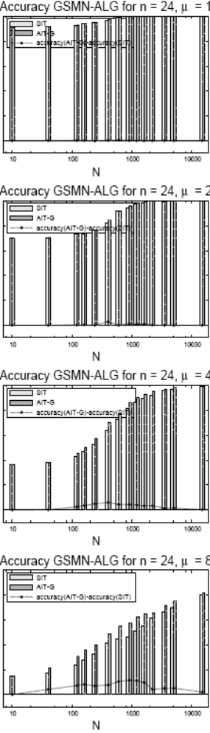
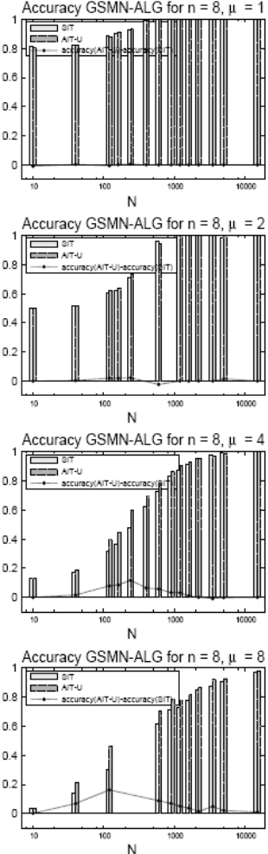
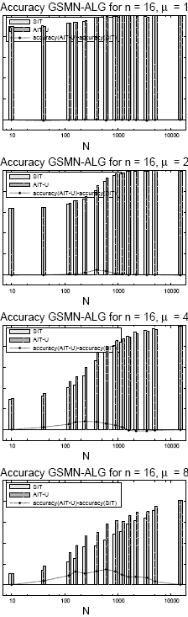
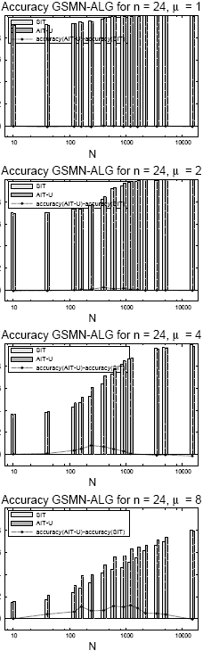
Approx. top-down accuracy on GSMN
general axioms
undirected axioms
PC G and D on BN data(4.13 and 4.14)
GSMN G and D on MN data (4.17 and 4.18)

Slide 82
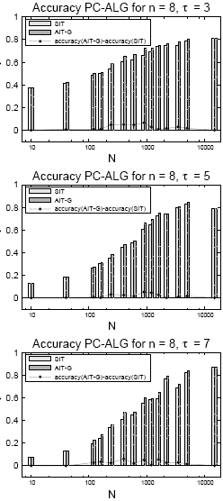
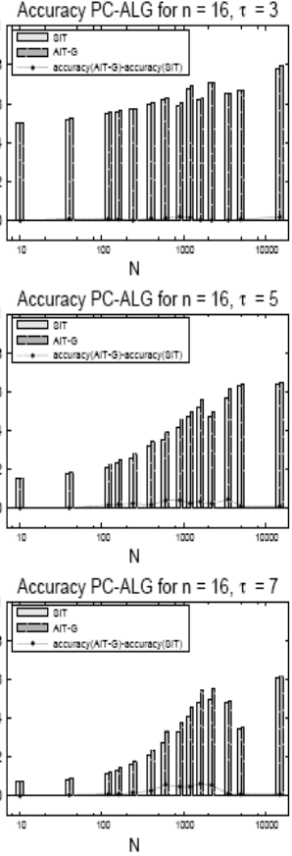
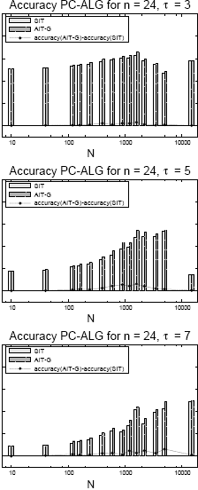
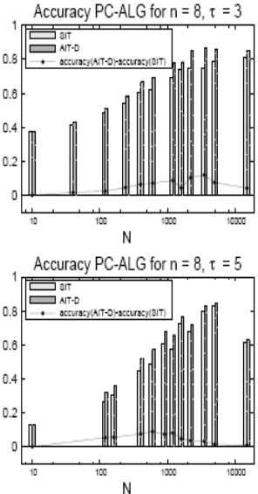
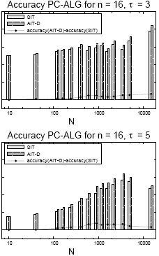
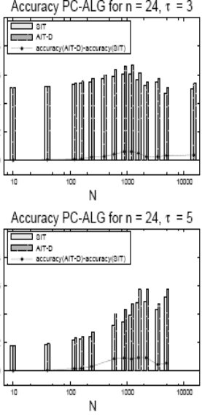
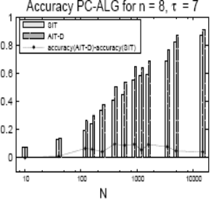
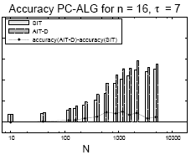
Approx. top-down accuracy on PC
general axioms
directed axioms

Slide 83
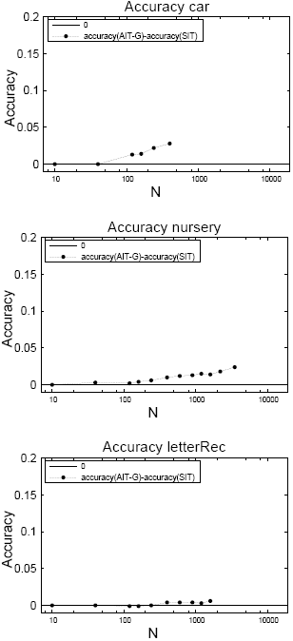
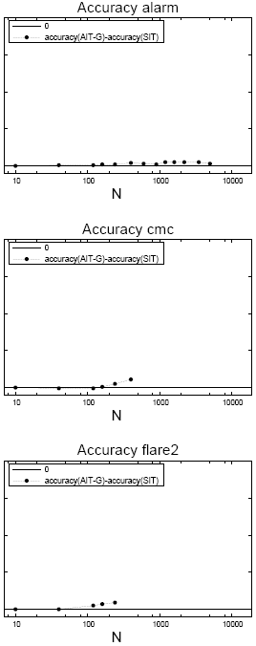
Approximate top-down algo. on real data
Don’t know if underlying models are graph-isomorph or not, so we used only the general axioms

Slide 84
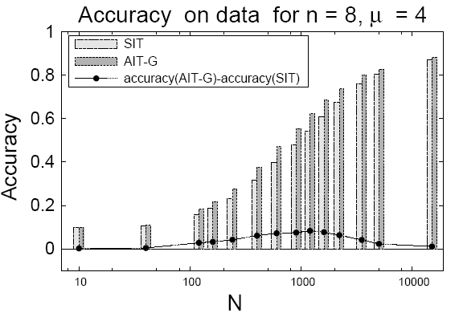
Approx. top-down accuracy on data
Axioms: general
True model: MN

Slide 85
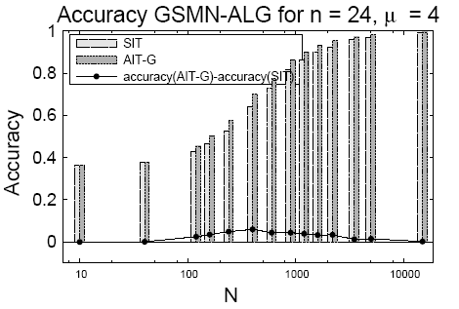
Approx. top-down accuracy on GSMN
general axioms
PC G and D on BN data(4.13 and 4.14)
GSMN G and D on MN data (4.17 and 4.18)

Slide 86
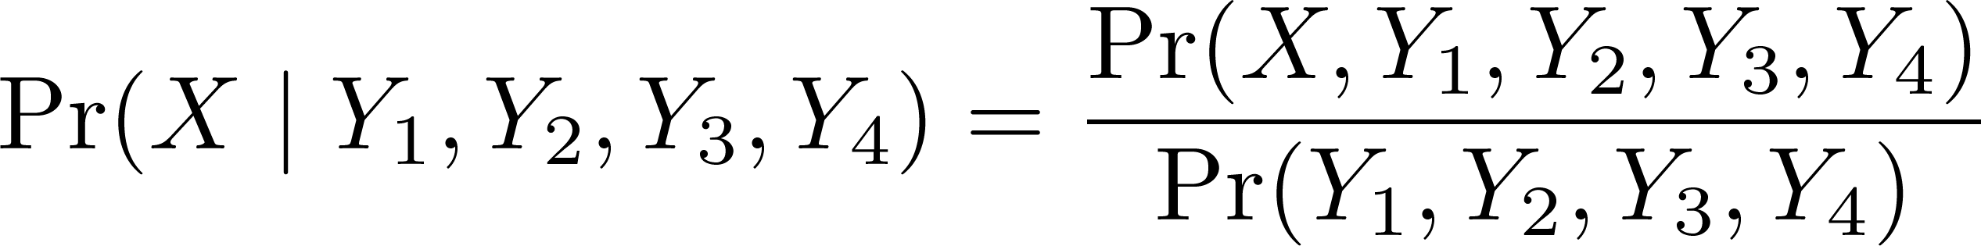
Tabular Model Example
Target random variable: crop yield X
Observable random variables:
  Soil acidity Y1
  Soil humidity Y2
  Concentration of potassium Y3
  Concentration of sodium Y4
All domains binary: { high, low }
Goal: Probability of target, given observables

Slide 87
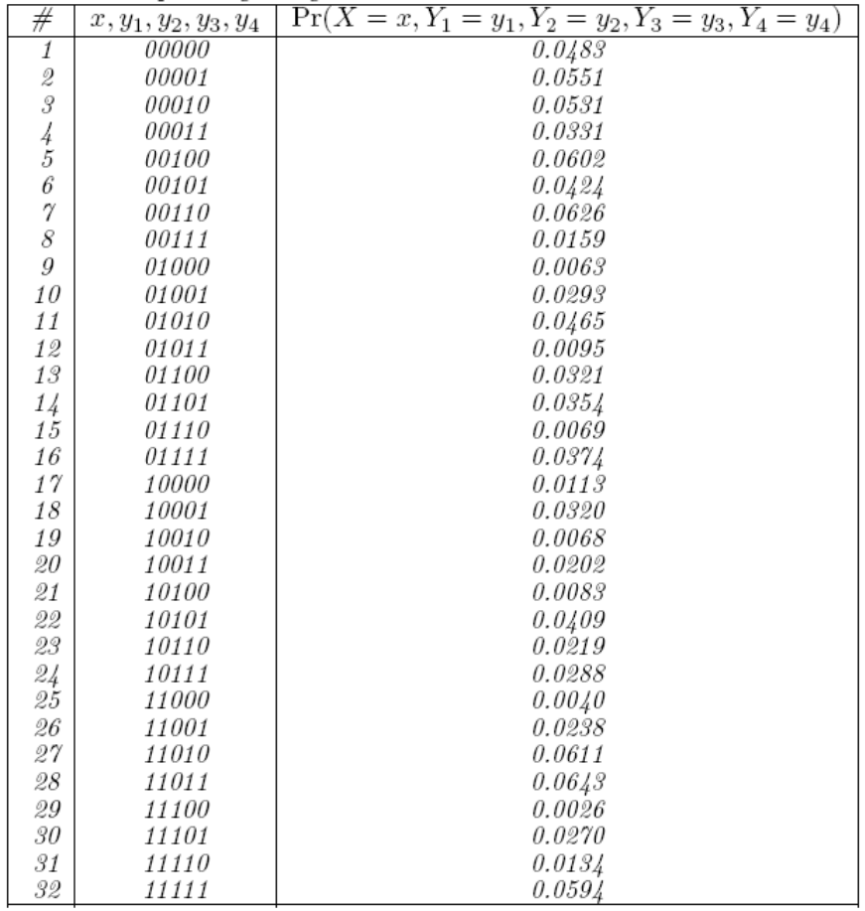


Example (cont’d)
Tabular model
For Y₁=1, Y₂=0, Y₃=0, Y₄=1
and therefore
i.e., inference says that crop yield is more likely to be low than high

Slide 88

Tabular Model Efficiency Problems
Supposed we have an agricultural field with 64 locations, organized in a regular lattice of 8x8
Variables are
Tabular model:
Number of entries: 2³²⁰
Storage: 10⁸⁵ terabytes
Computation: 584 years
Data: several times 2³²⁰
Prohibitive requirements!

Slide 89


If Regions Were Independent
If locations are mutually independent (no interaction), i.e.,
Then:
Tabular model for S_{i}
Tabular model:
64 tabular models, one per variable
  Entries: 64 x 2⁵
  Storage: ~40 kilobytes
  Disadvantage: too simplistic

Slide 90
An alternative: graphical models
Exploit independencies to efficiently represent the distribution
Are probabilistic models, and as such can be used for probabilistic inference
Can model some interactions
  Captured by the structure of the graphical model

Slide 91



Example (cont’d)
Decomposition:
MRF model: From decomposition, 64 tabular models, (one per location i), with entries each:
Assuming
Entries:
Storage: 44 megabytes

Slide 92
Why structure discovery from data?
Structure may be provided by an expert, but may be based on incorrect knowledge, or not available
In general, data is more readily available, and can be used to automate the process

Slide 93

Argumentative independence test
AIT must decide on propositions based on acceptability of arguments.
Given triplet (X, Y | Z), AIT decides as follows:
(
f
(
?
j
)
g
(
j
)
)
(
j
)
?
?
?
d
?
X
Y
Z
X
Y
Z
a
c
c
e
p
t
e
=
)
X
?
Y
Z
(C.4)
;
(
f
(
6
j
)
g
(
j
)
)
(
j
)
?
?
6
?
?
d
6
?
X
Y
Z
X
Y
Z
a
c
c
e
p
t
e
=
)
X
?
Y
Z
;
But what if both are accepted (or neither)?
Solution:

Slide 94
Computing Acceptability Bottom-up
Based on the acceptability rule, Dung (1995) proposed bottom-up recursive procedure for computing the set of acceptable arguments Acc
Let us illustrate this with an example

