Slide 1
Castle Escape
Game Designed By: Sean Francis, Erinn Fecteau, Ashley Robinson, Ryan DiBlasi and Austin Koh
Notes:
*Introduce Selves* And this is our game: Castle Escape.

Slide 2
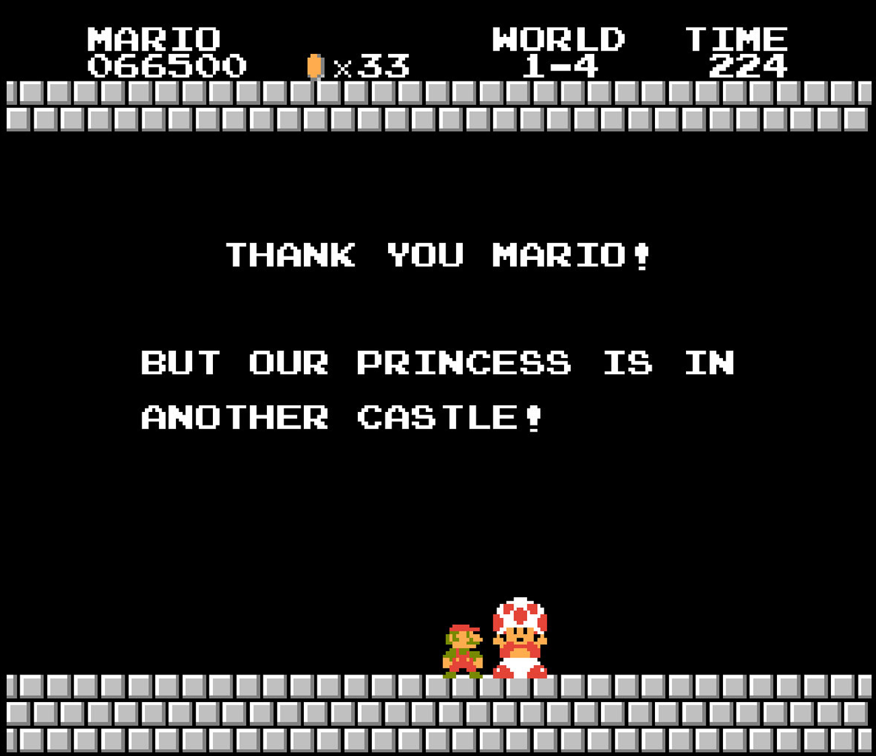
Remember This?
Notes:
Remember this line? Or the various story themes of “... the princess has been kidnapped and YOU are her only hope!” We’ve seen this cliche many times and, if you’re like us, then you’re sick of it.

Slide 3

That’s Not Us
Notes:
Thankfully, we took a stand and decided to flip the book on its head. Sure, the princess has been kidnapped, but this time there is no hero to save her. This time, she will save herself.

Slide 4
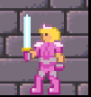
Meet the Princess
Notes:
And here she is, the hero of the tale. Taking her one and only shot for freedom, she killed the monster king and stole his blade. Now, she must descend the castle, fighting off the guards, and escape.

Slide 5
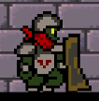
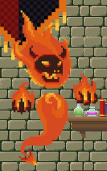

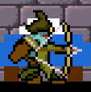
The Opposition
Notes:
These are the four kinds of foes that stand in her way. The shield enemy, who can only be attacked from behind, the ranged enemy who will make sure to keep out of range to attack her, the fighter who only comes in as reinforcements and the Fire Elemental, the second command of the castle and the last line of defense between the princess and her freedom.

Slide 6
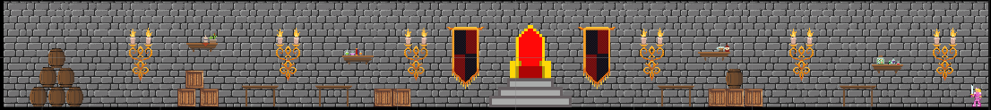
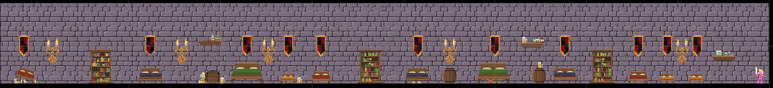
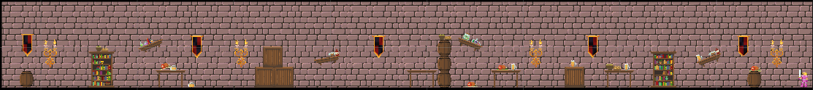
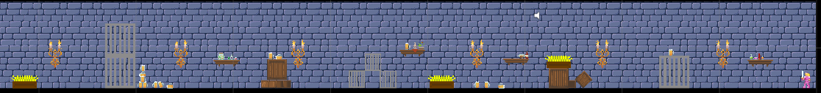
Six Unique Levels
Notes:
Battle your way through the different floors of the castle. Watch your footing in the dinning hall and dont look under the beds in the sleeping chambers. If there is anything that you can learn from these rooms it's that these baddies are messy and like to drink.

Slide 7








Time is Not on Your Side
Notes:
Along with our change of story, we also have a rarely seen mechanic with our timer. This timer does not count down until the Princess is captured again. Instead, it counts down until the full might of the Castle comes barreling down upon the Princess. Each interval spawns an increasing amount of enemies until the timer reaches zero, where a massive amount of enemies spawn at once. The Princess can still kill all the enemies in the room, but it gets harder and harder for her to do so the longer she remains.

Slide 8
Gameplay
Notes:
Of course, we cannot just stand here and show you nothing of the gameplay. So, we have a video of a full run of the game to show and help explain what we have mentioned.

Slide 9
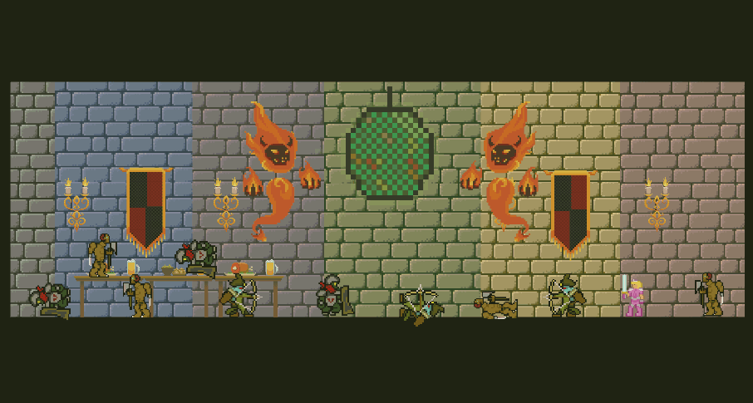
Any Questions?
Notes:
Are there any questions?

