Slide 1
Detection of Distortion and Movement
CEC 495a
Sean Lamorena & Jesse Rodriguez

Slide 2
Objectives
Find differences in a time lapse feed.
Alert user for substrate or distortion.
To detect interference with camera feed

Slide 3
Getting the Pictures
Time Lapse Photos
Tested Different Camera Options:
- GoPro
- Fixed Phone Camera

Slide 4
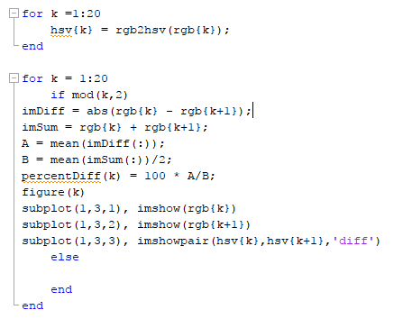
Detection Code

Slide 5
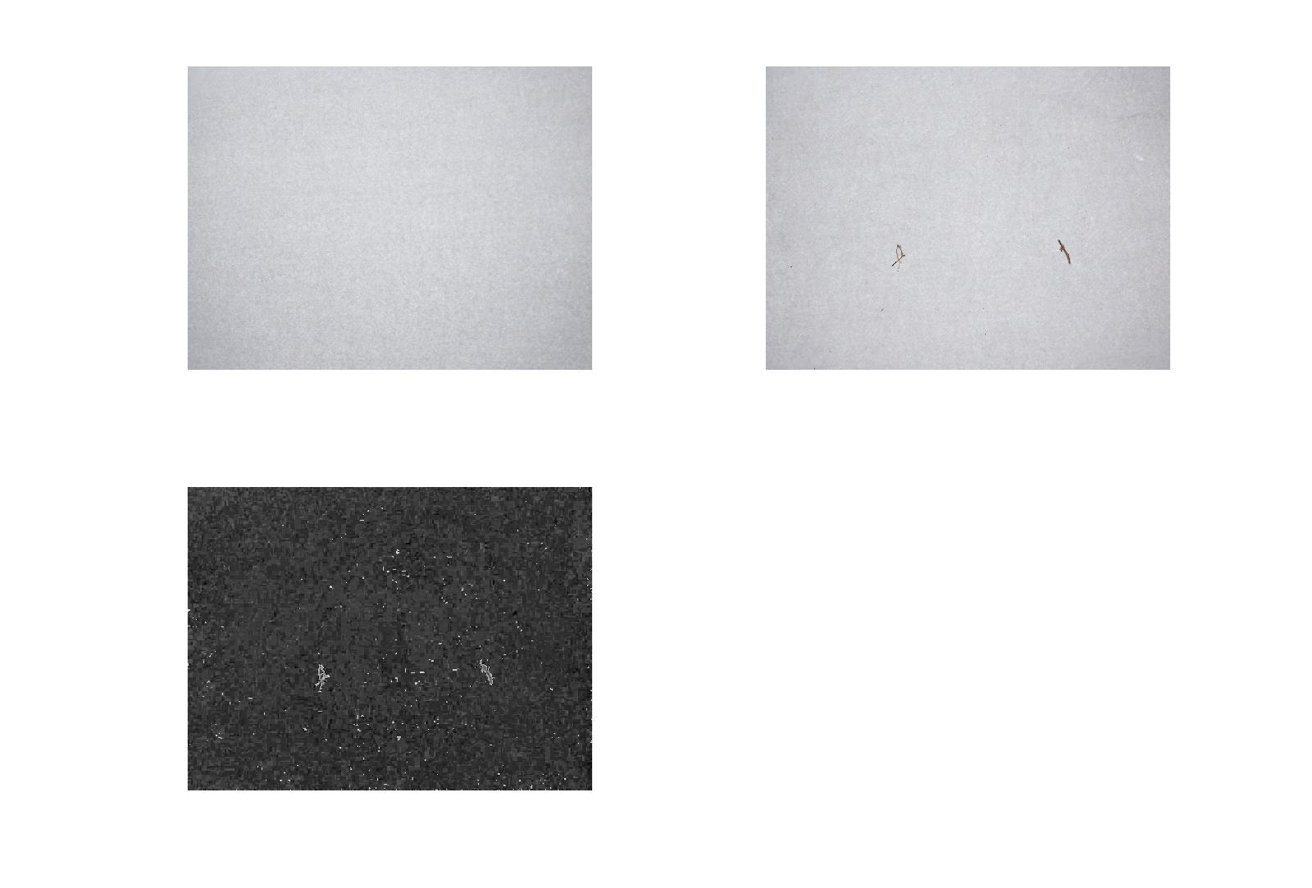
Results: Substrate on Image
Percent Difference: 2.35%

Slide 6
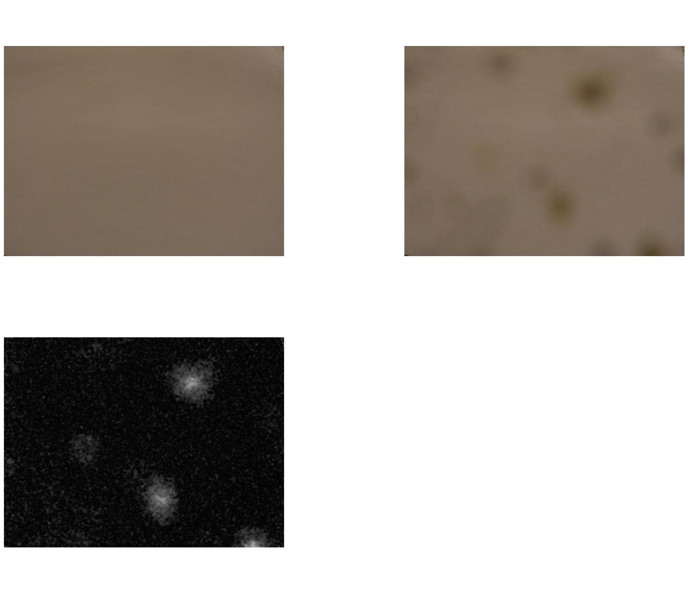
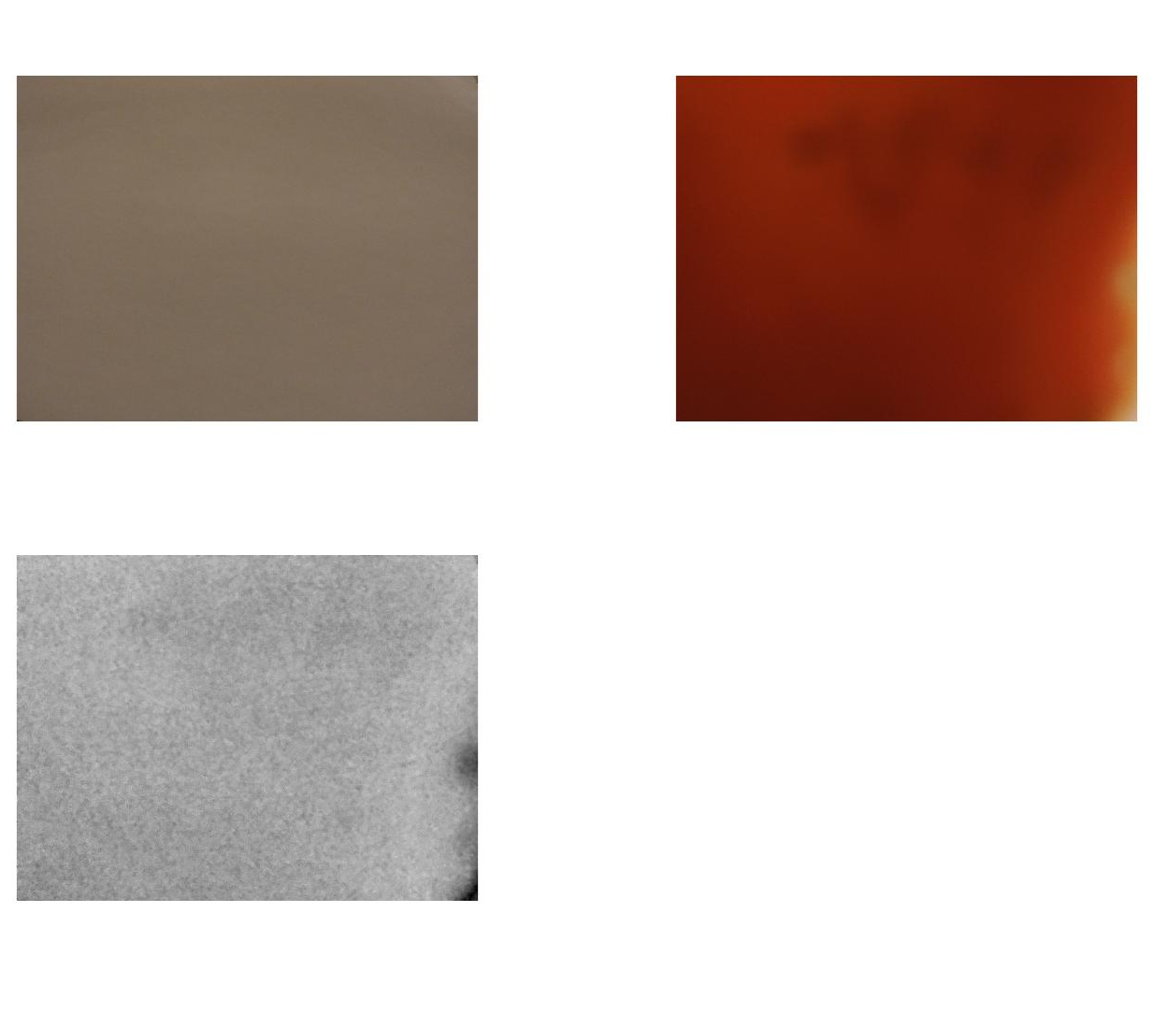
Results: Substrate on Camera
Percent Difference: 1.82%
Percent Difference: 67.89%

Slide 7
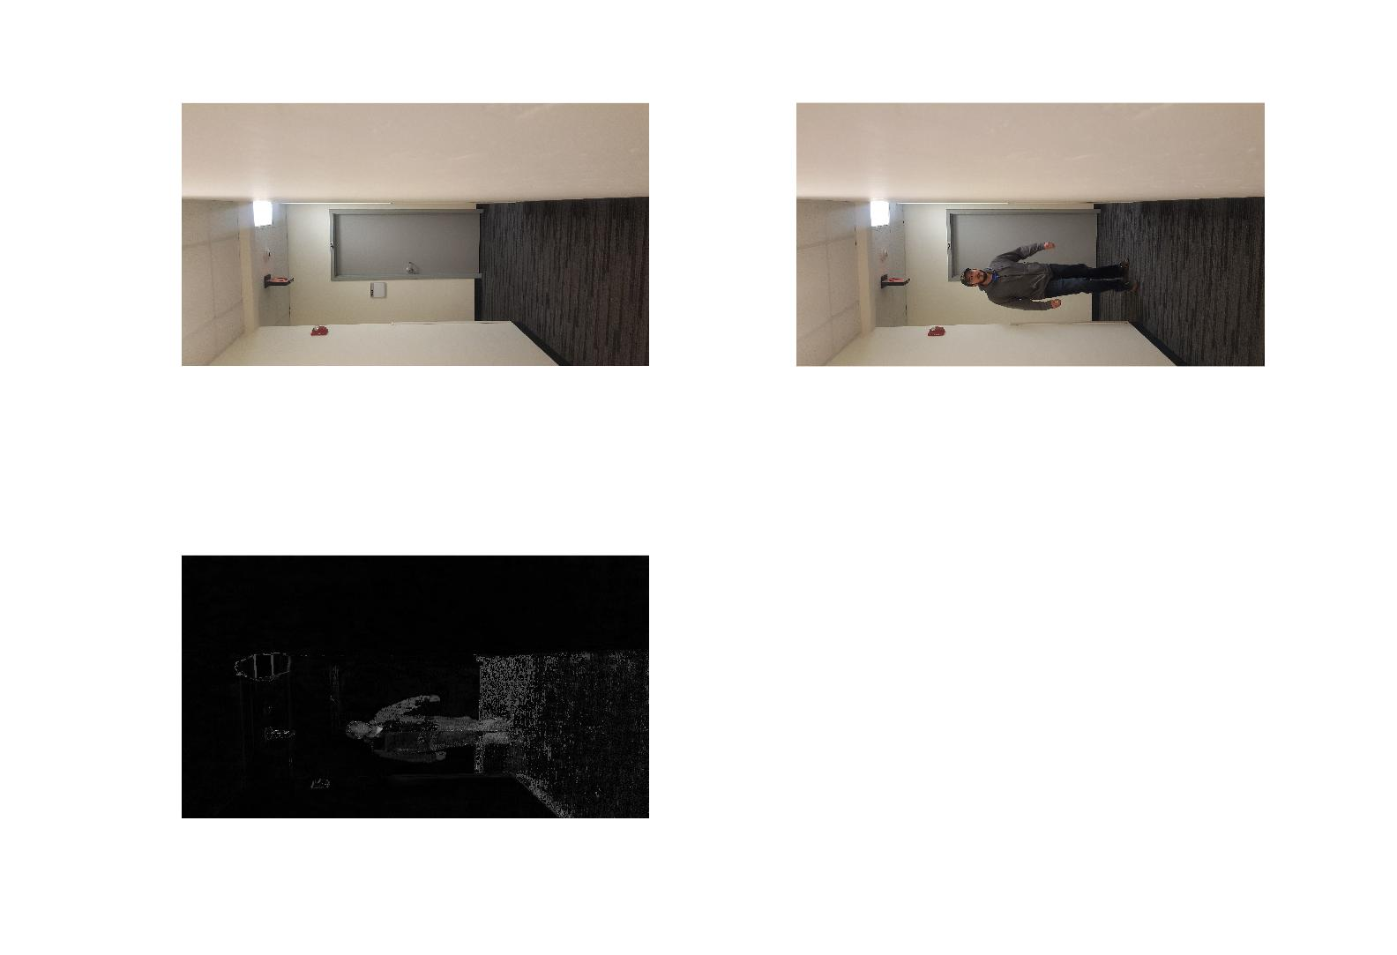
Results: People passing
Percent Difference: 6.50%

Slide 8
Issues Faced
Camera Size: Needed to be the same size picture
Lighting: Counted as a difference
Movement of Camera: Counted as a difference
Color: Not counted as a complete difference

Slide 9
QUESTIONS?

