Slide 1



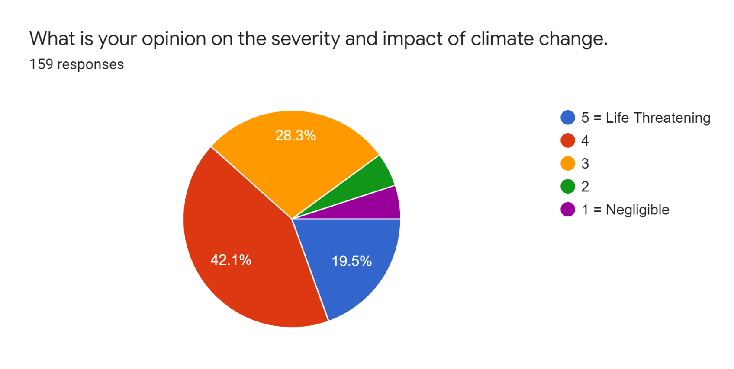
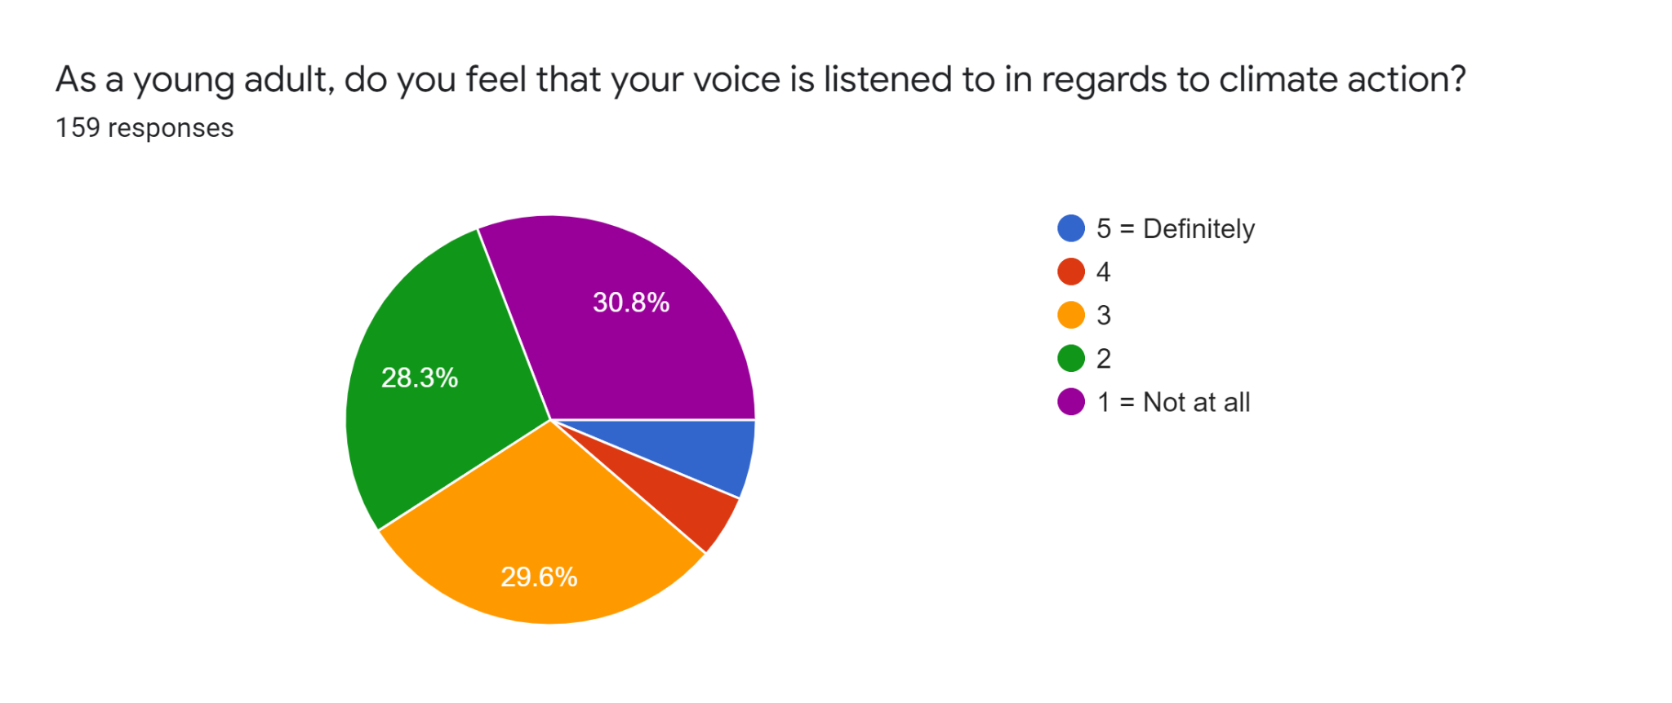
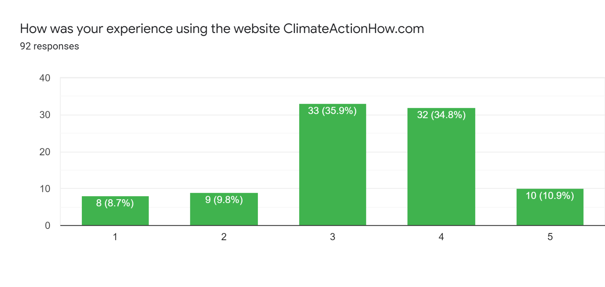
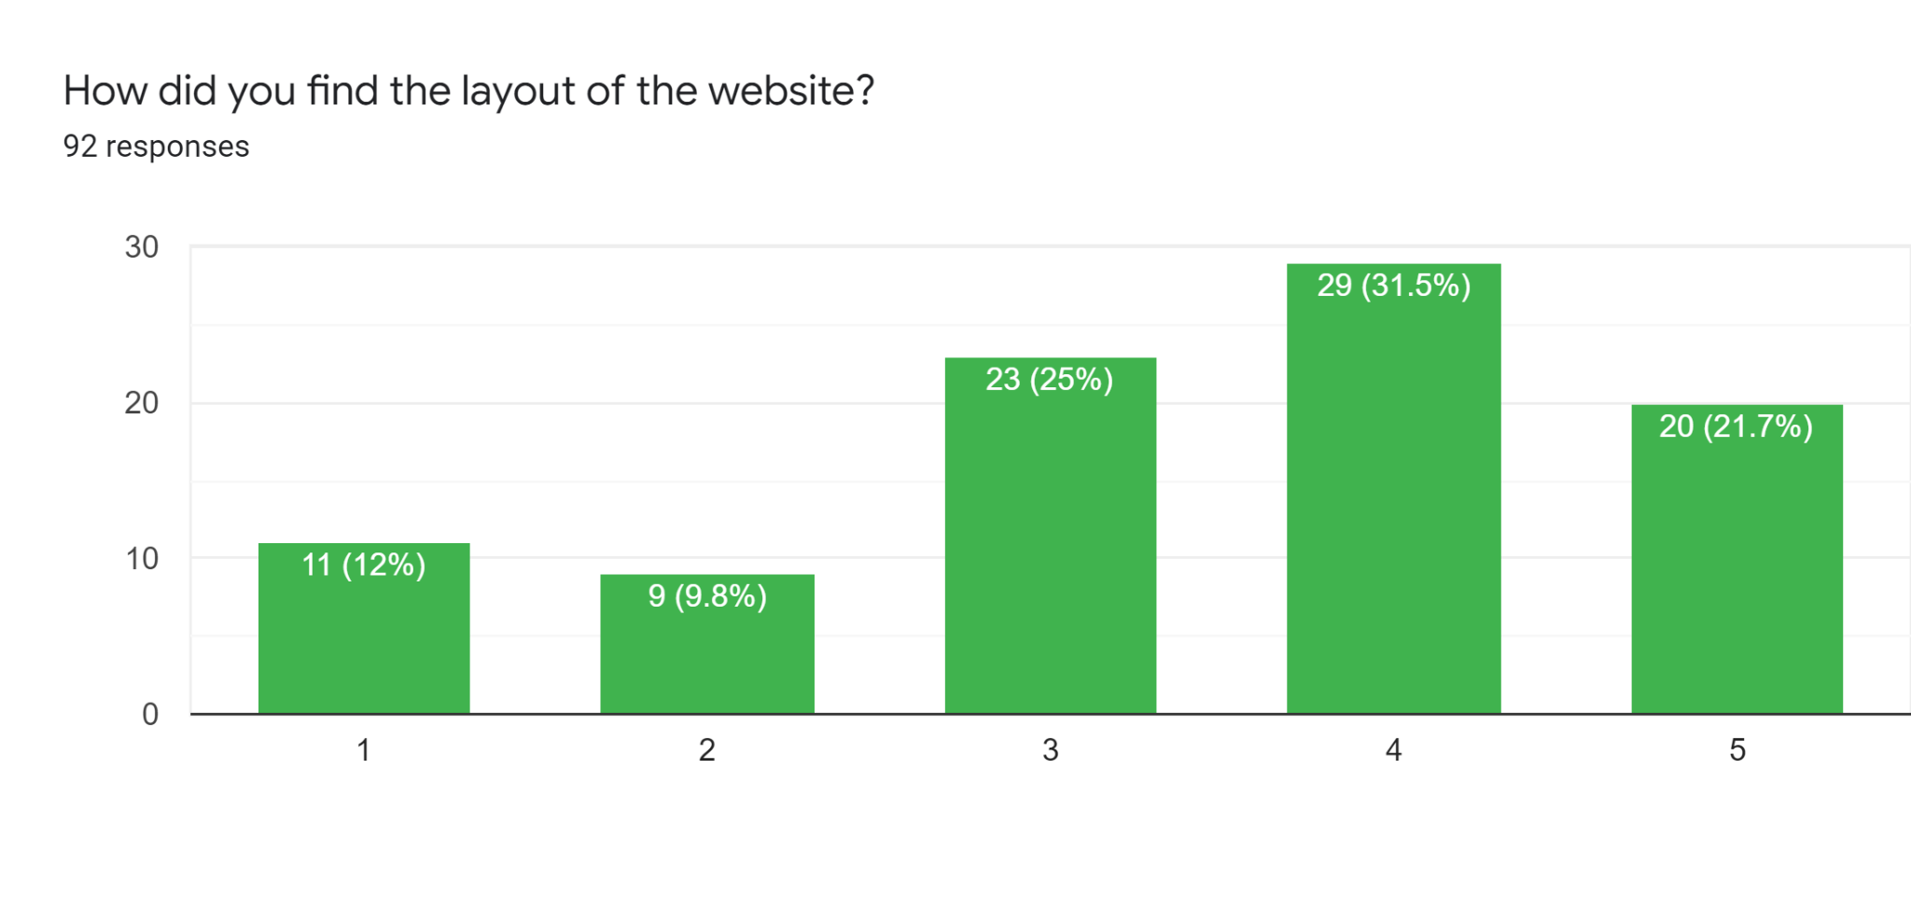
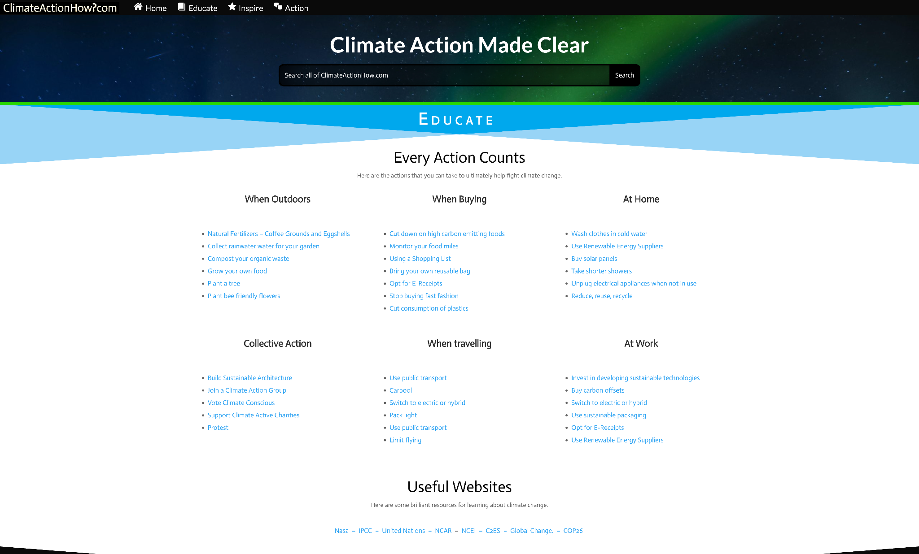
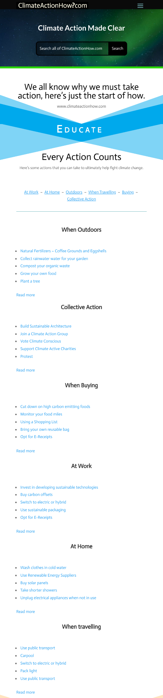
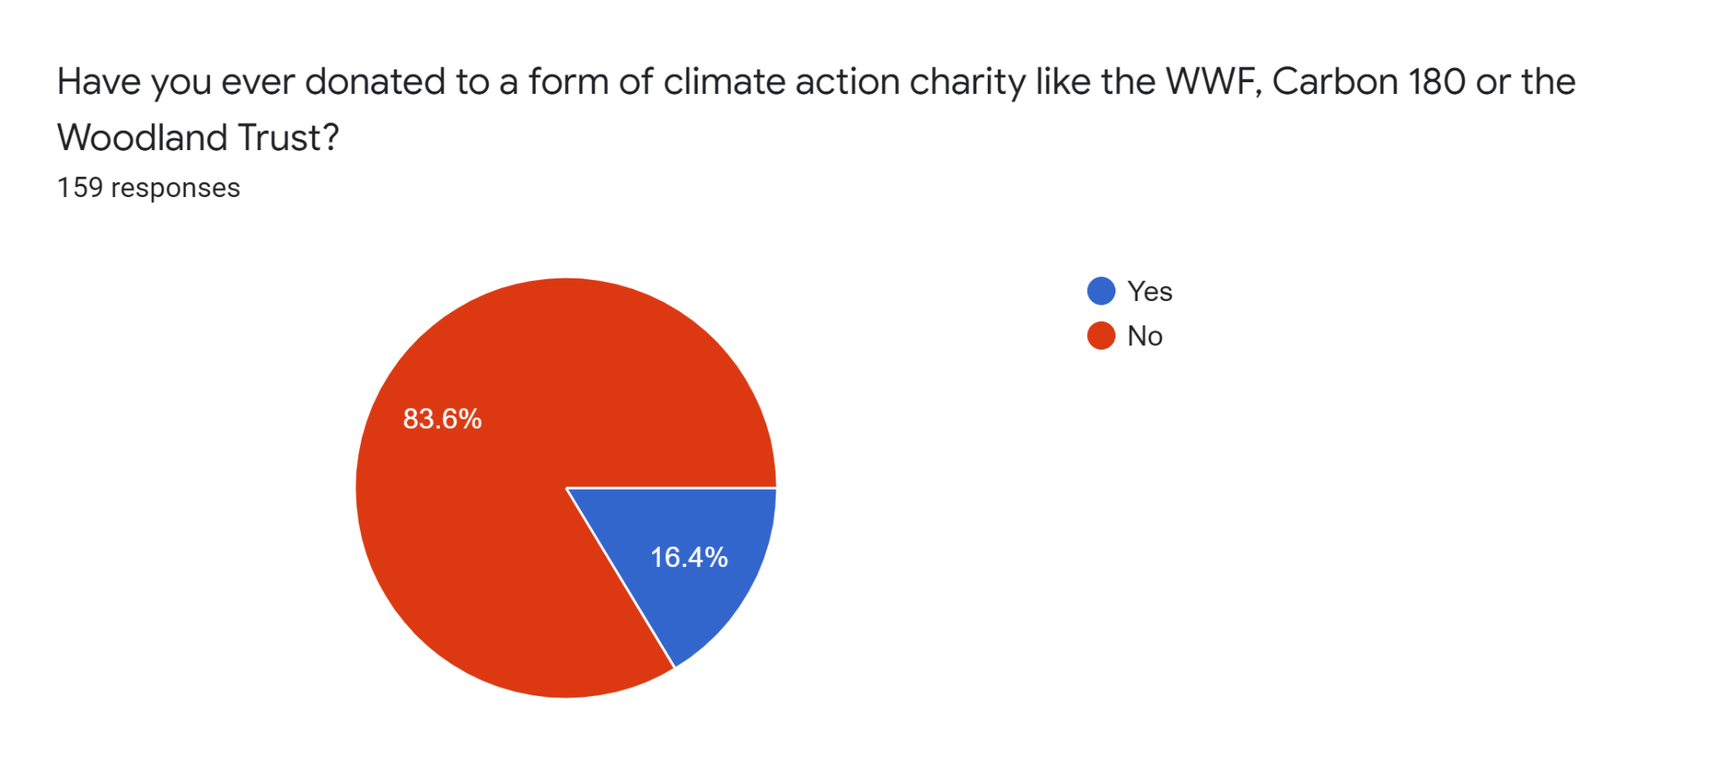
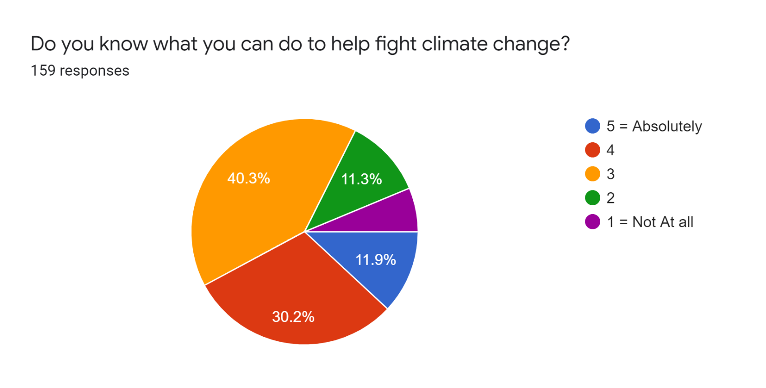
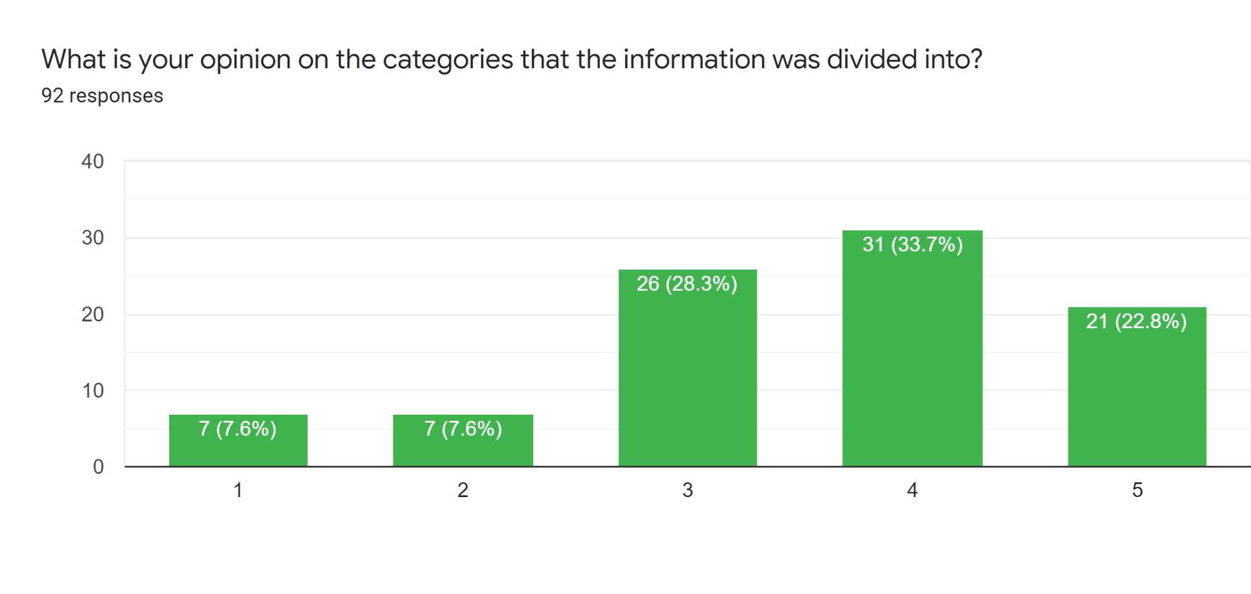
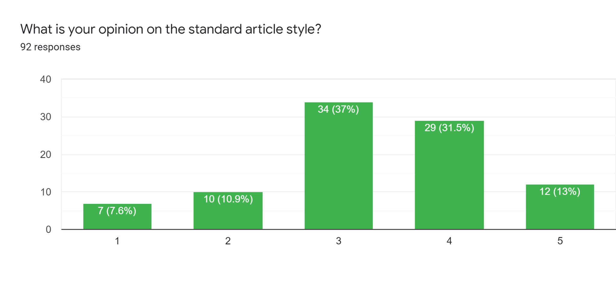
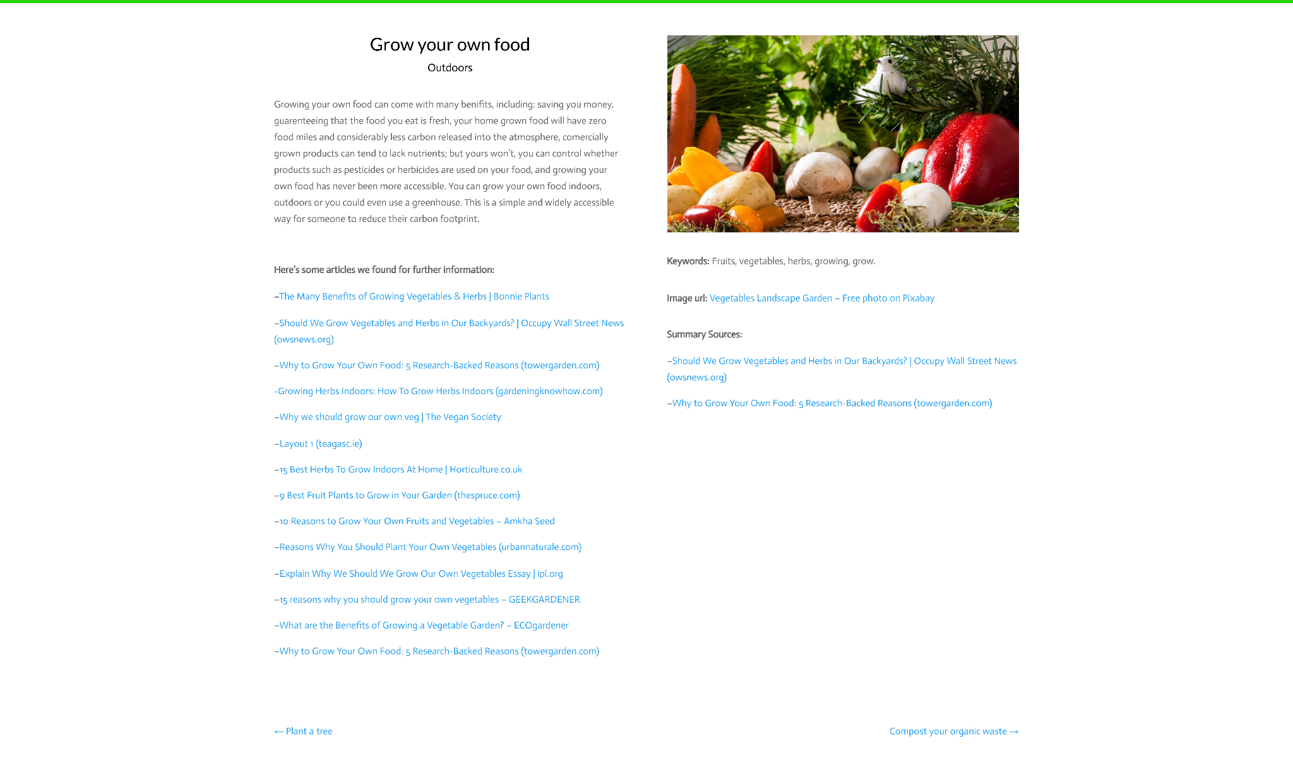
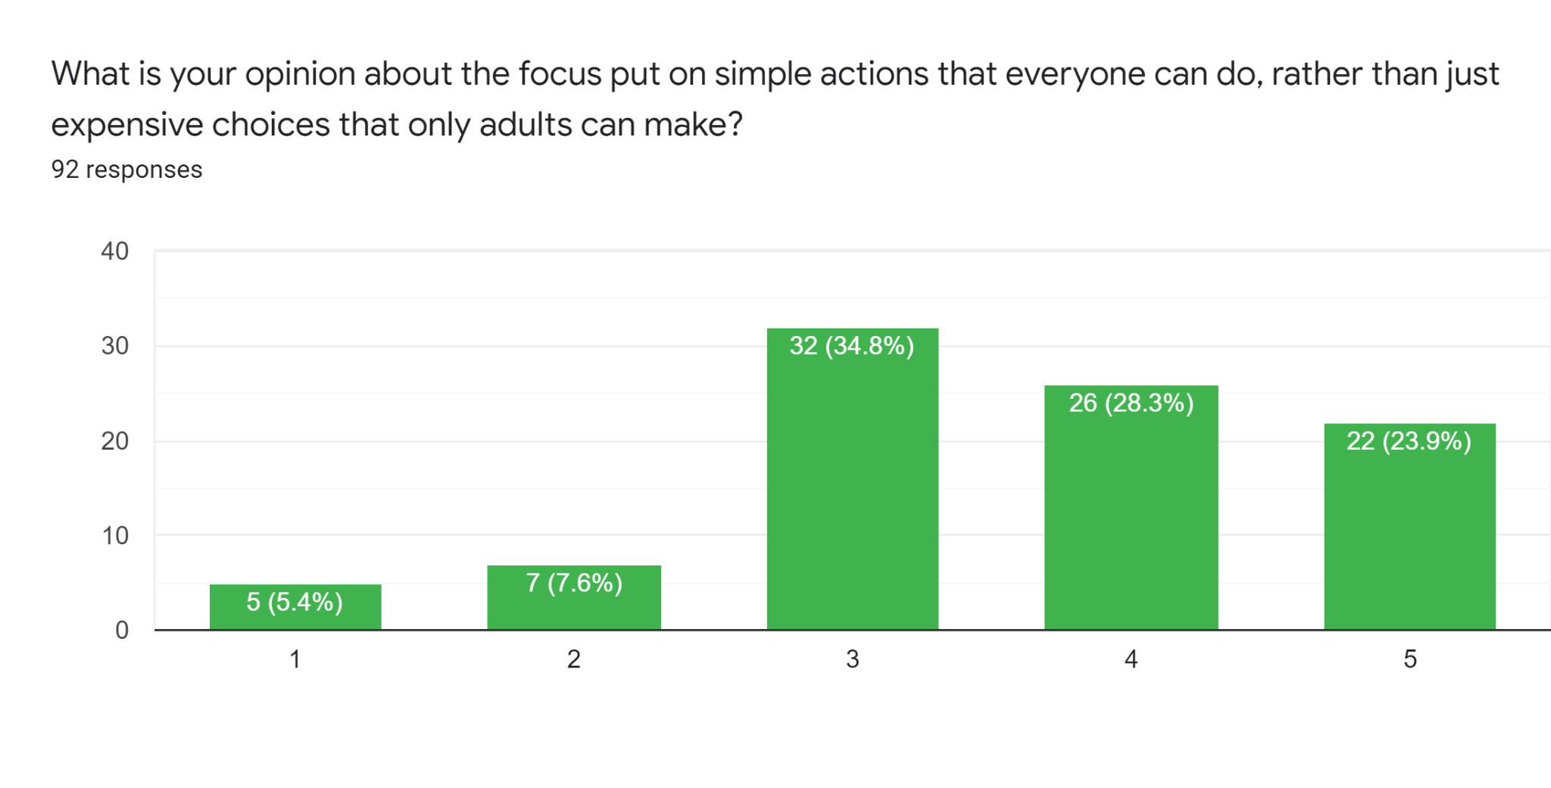
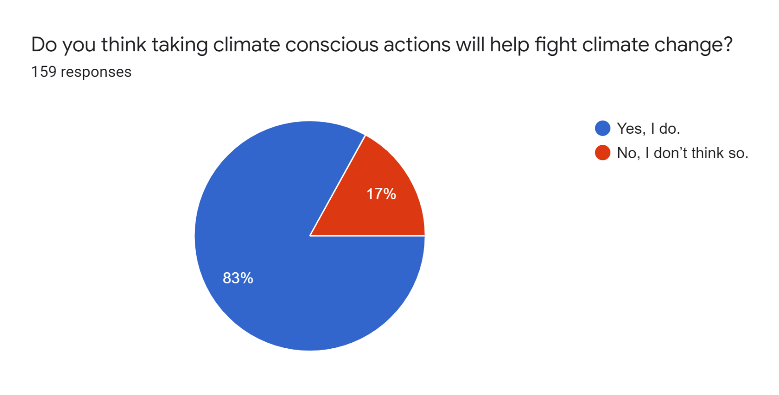
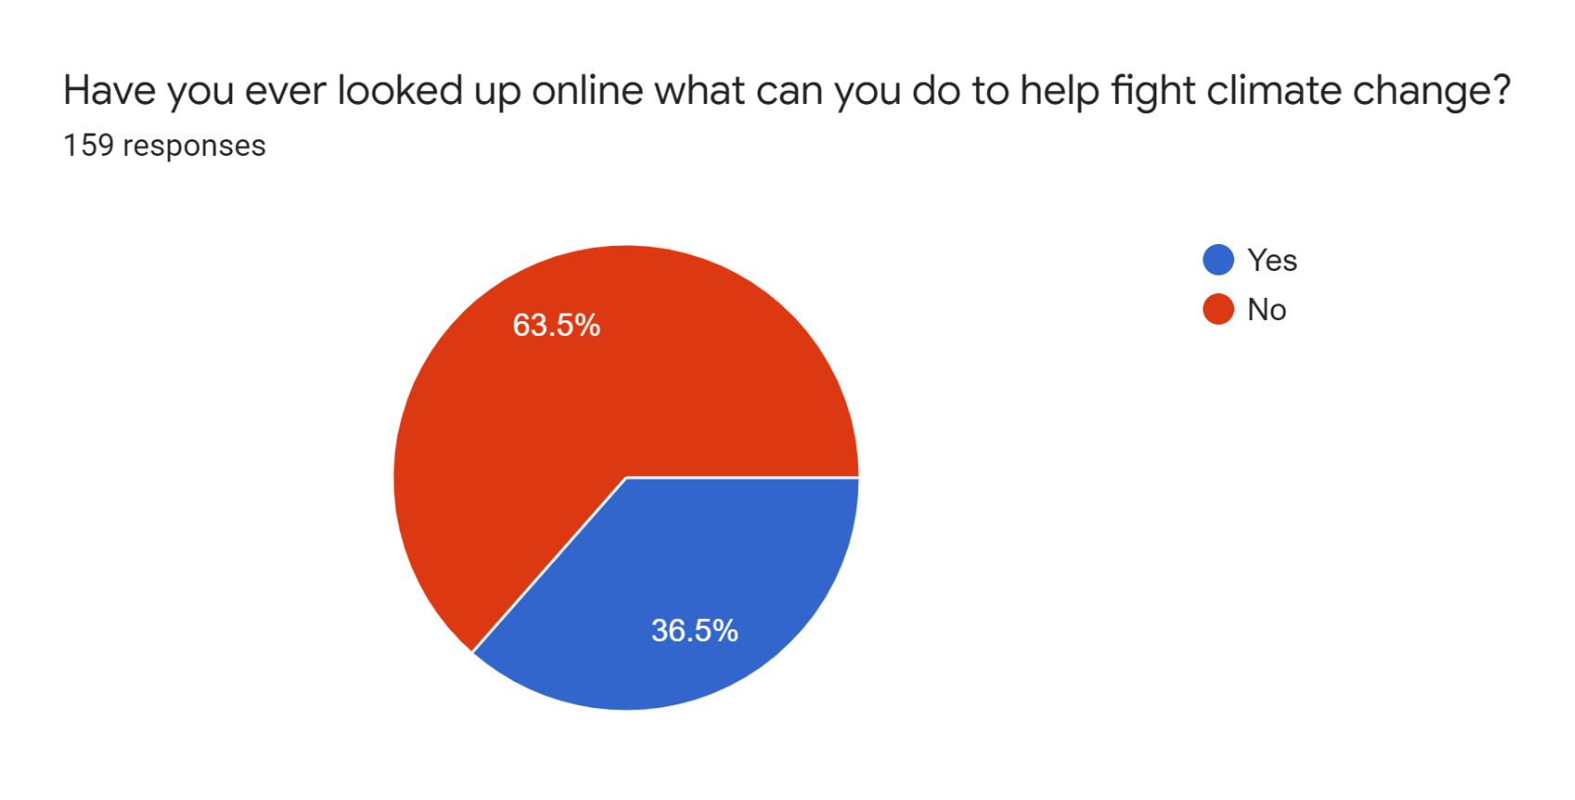
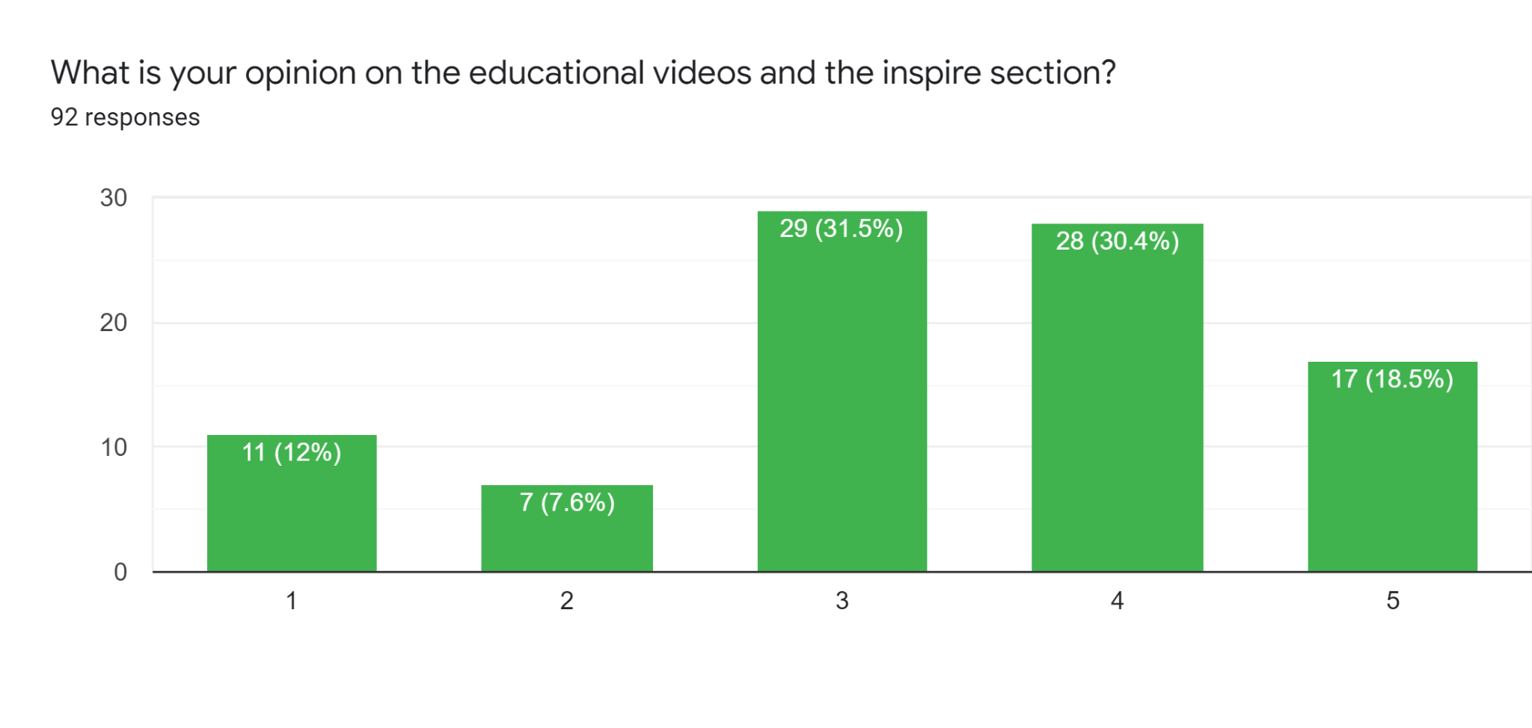
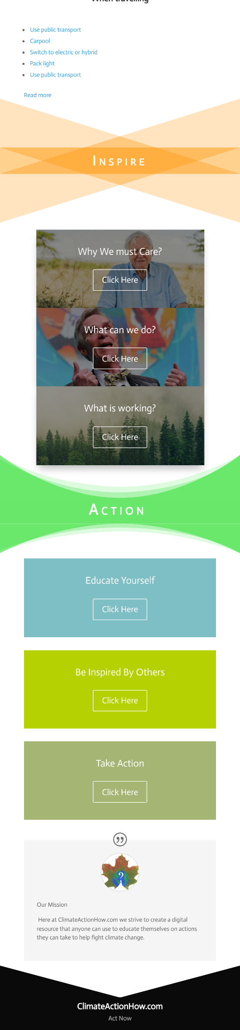
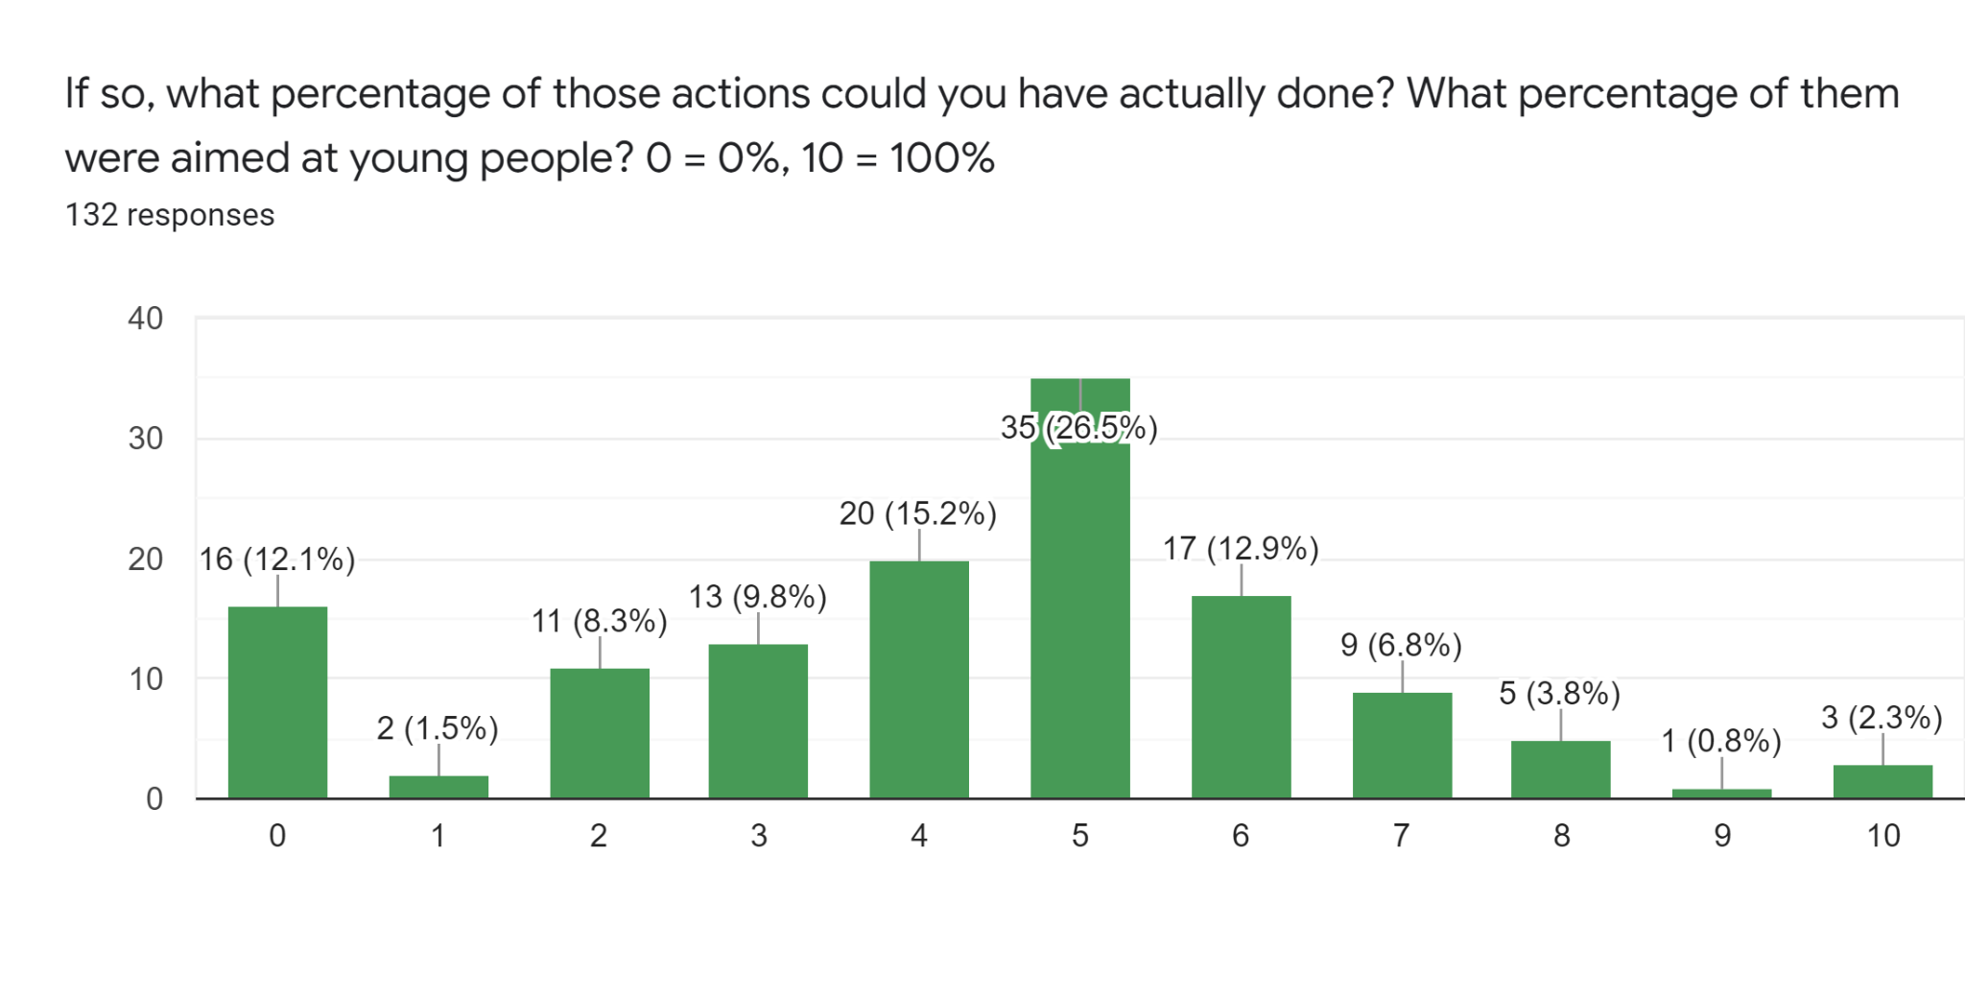
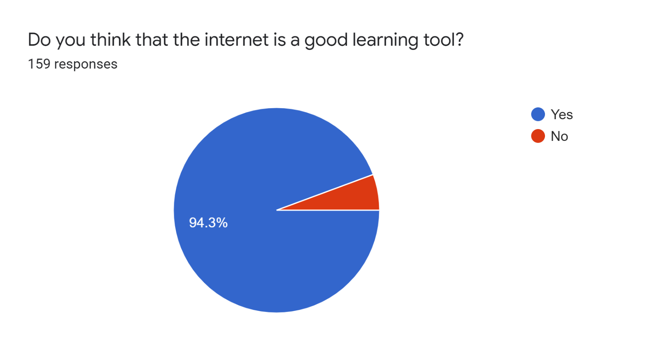
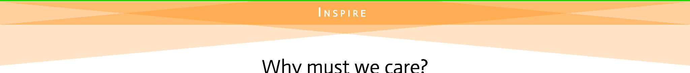
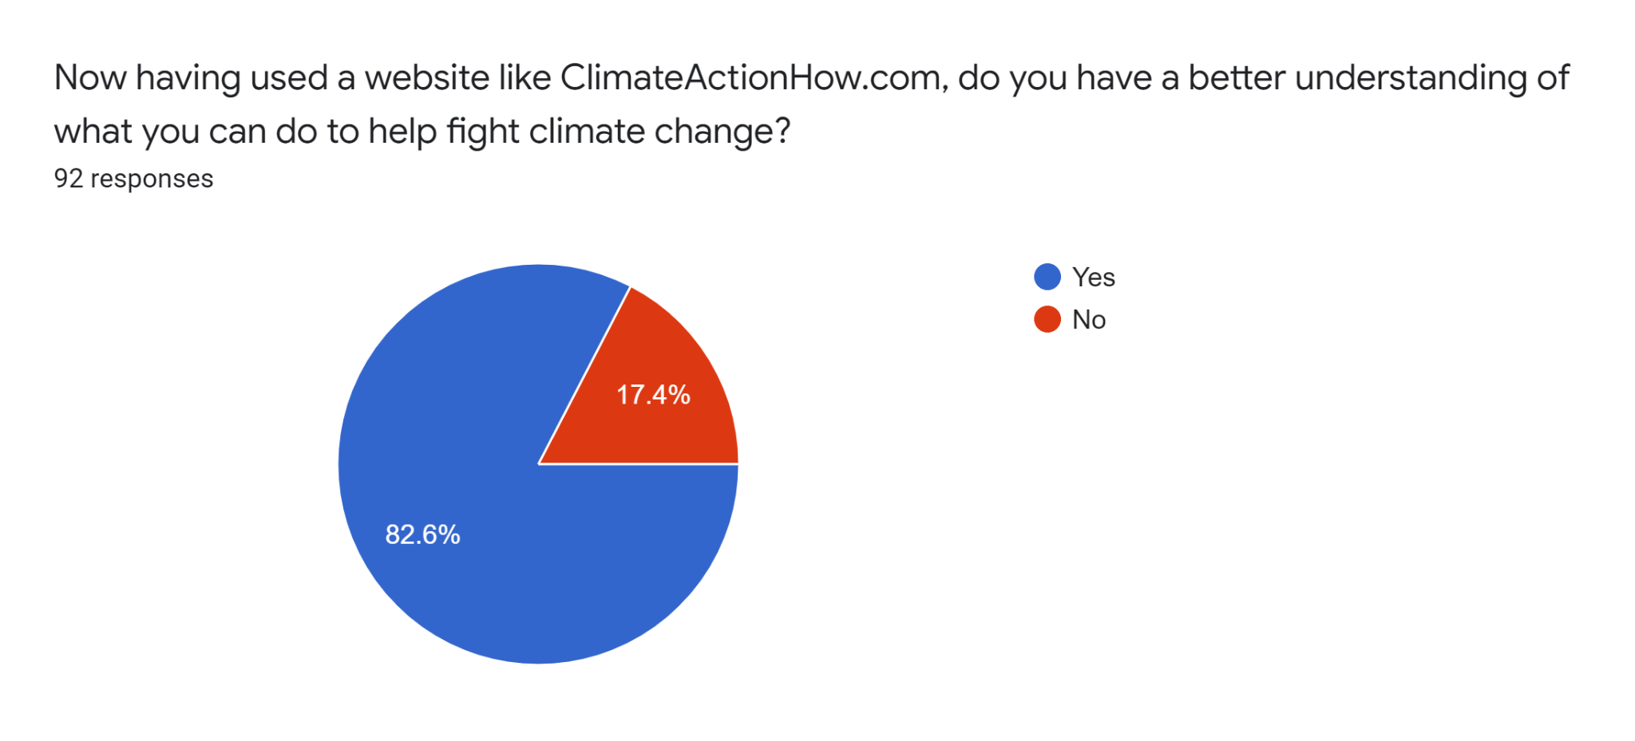
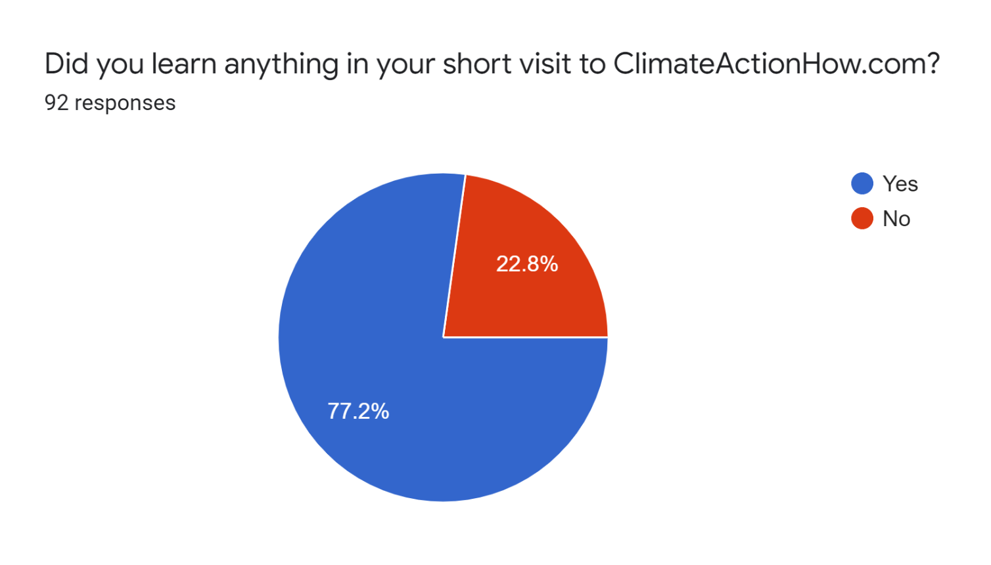
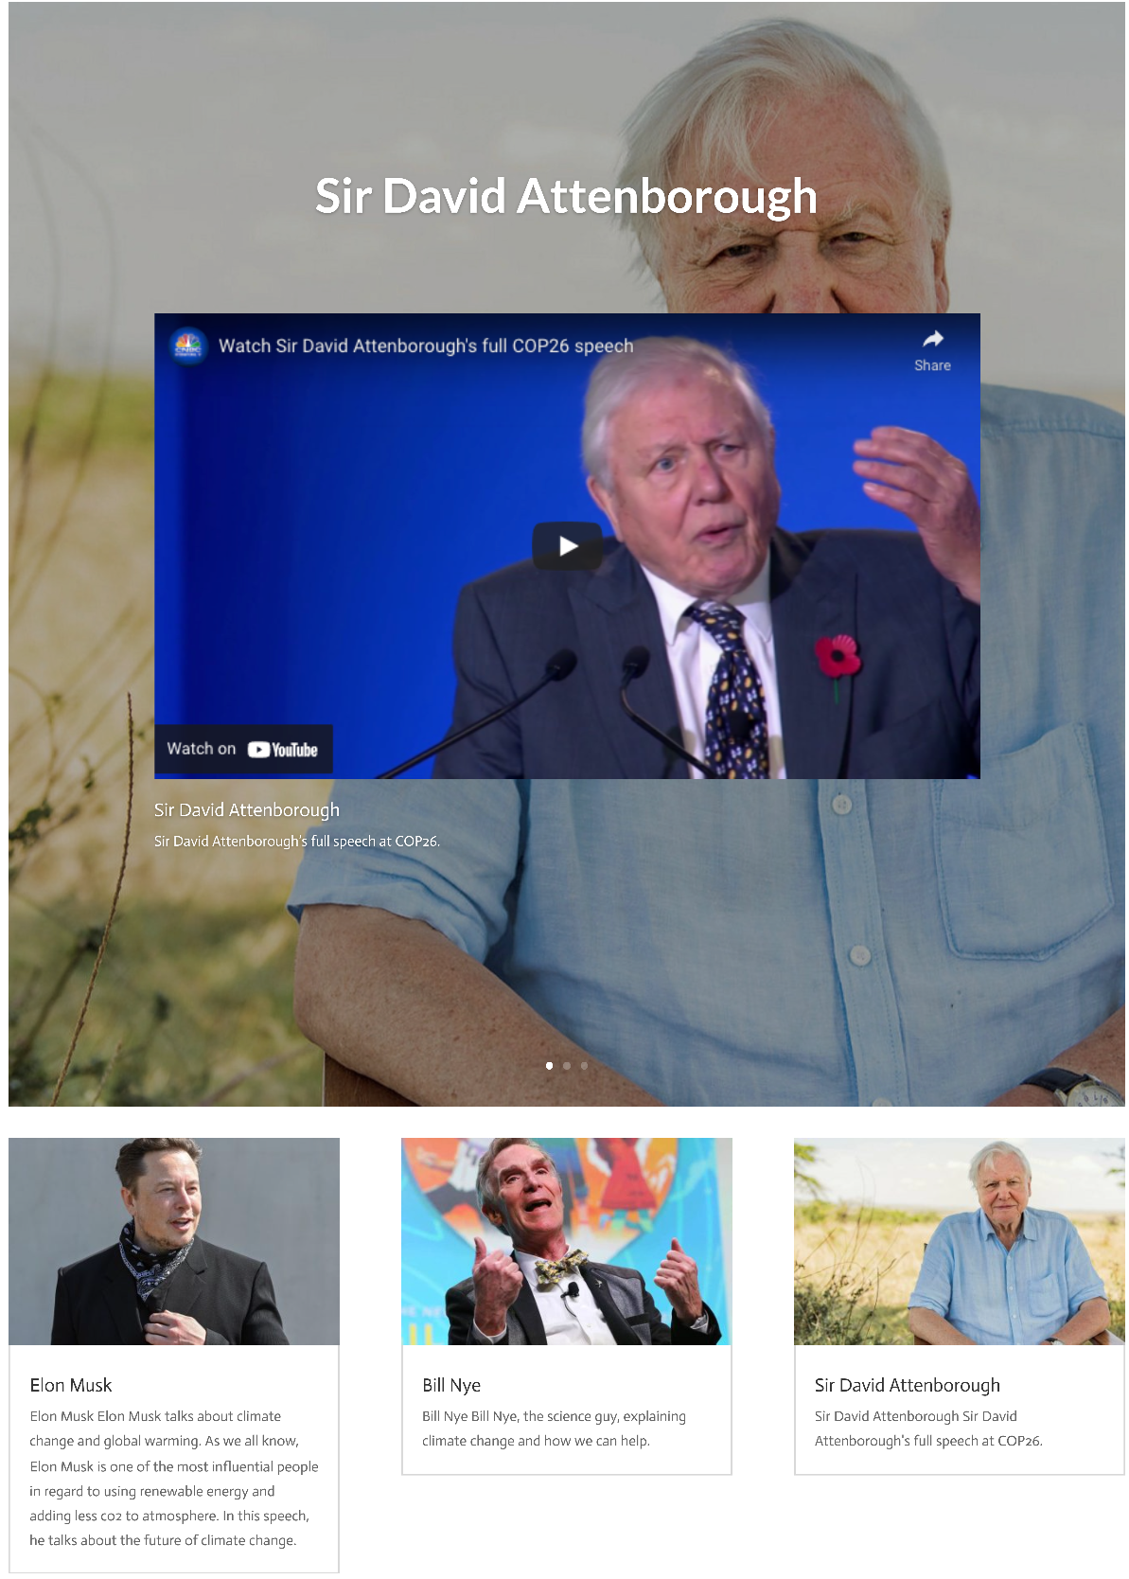
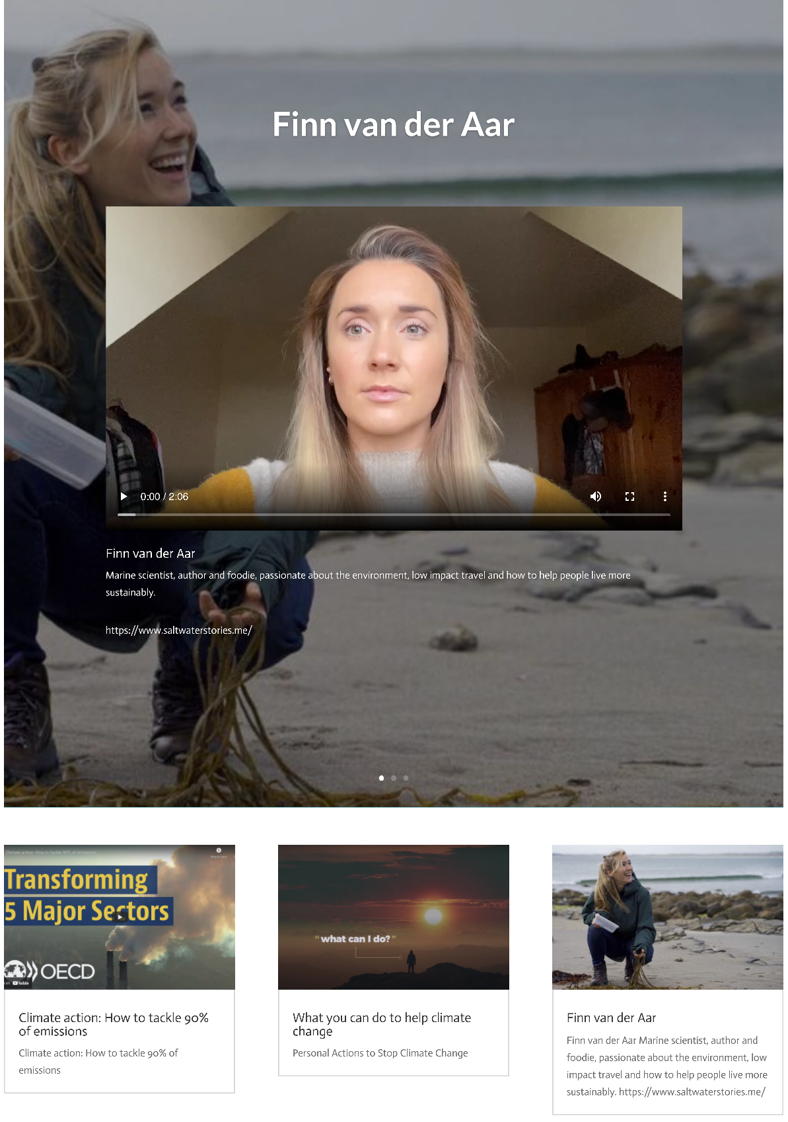
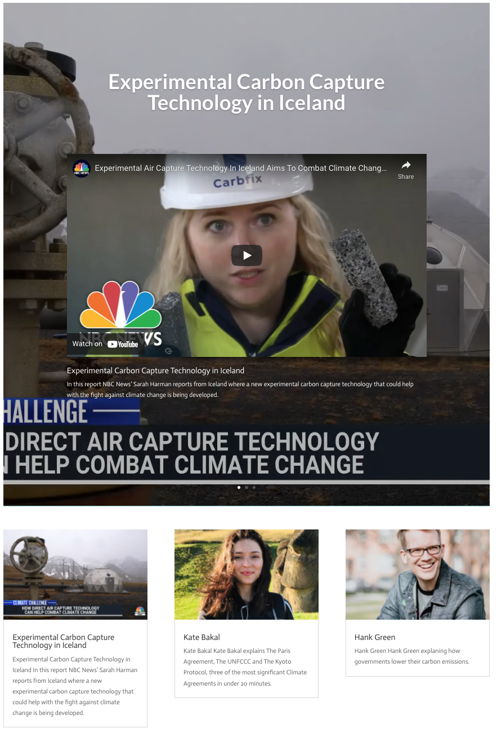
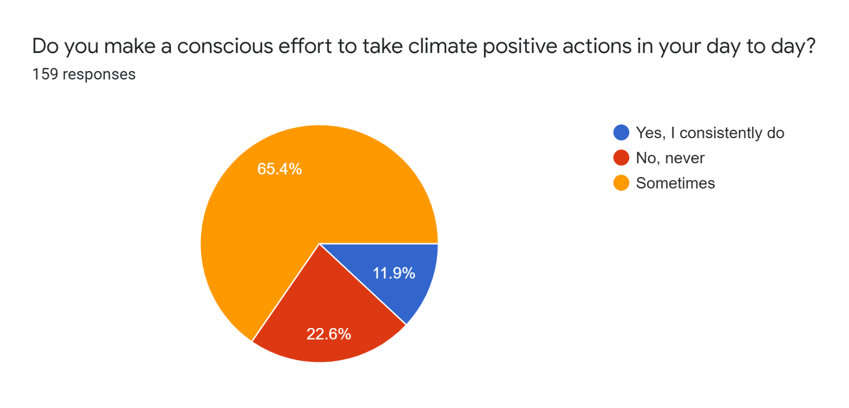

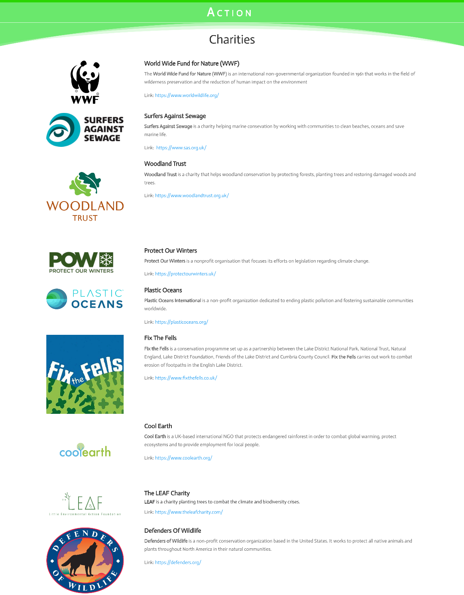
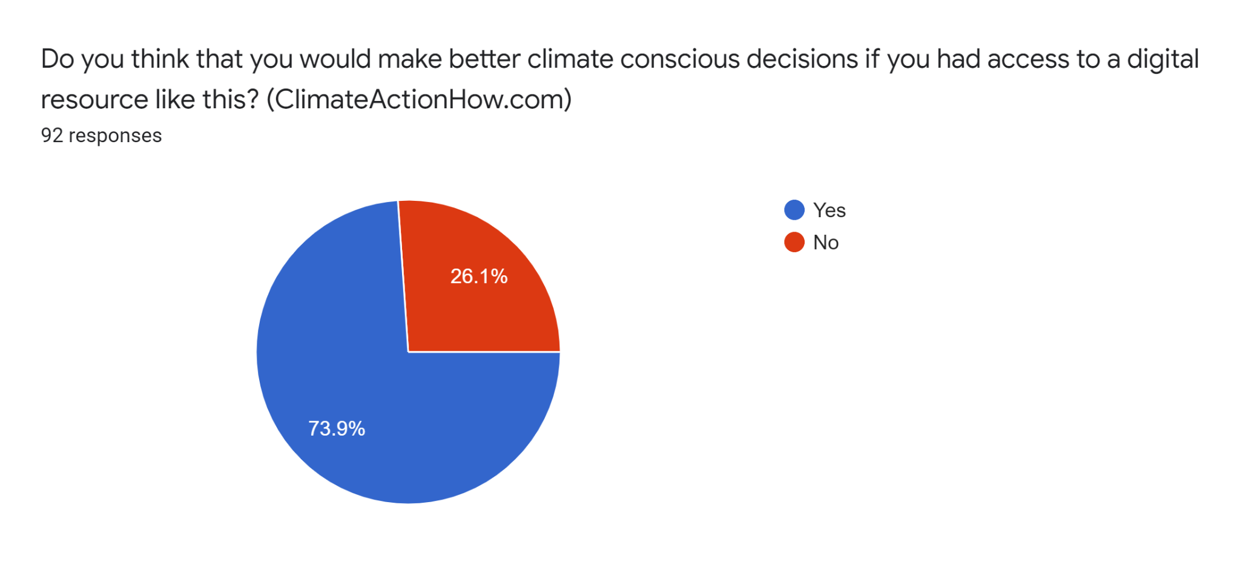
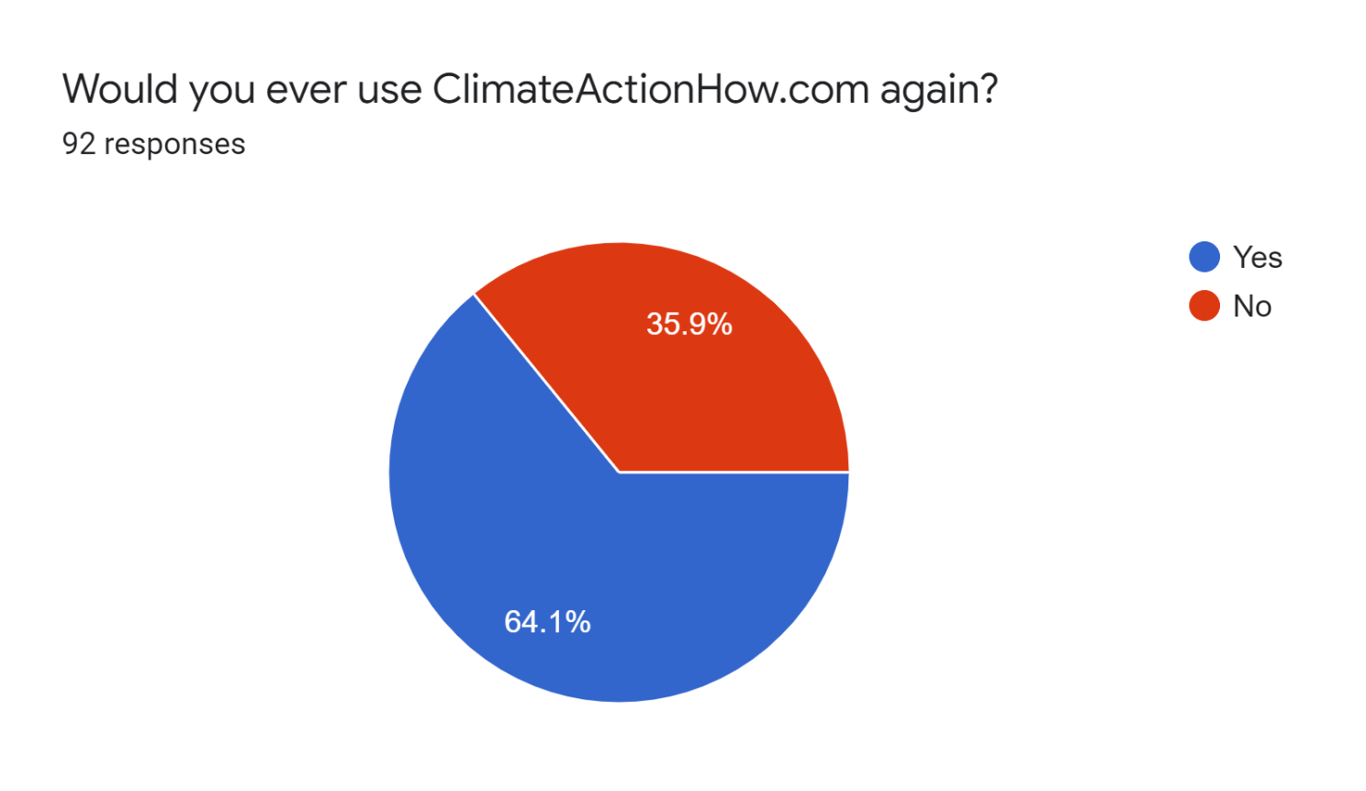
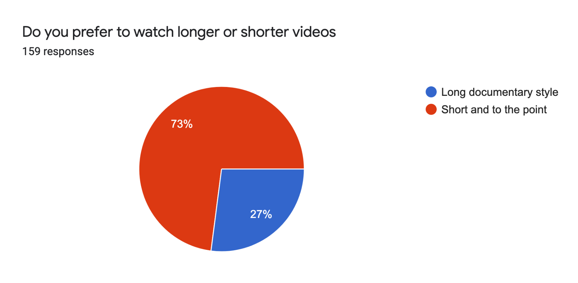
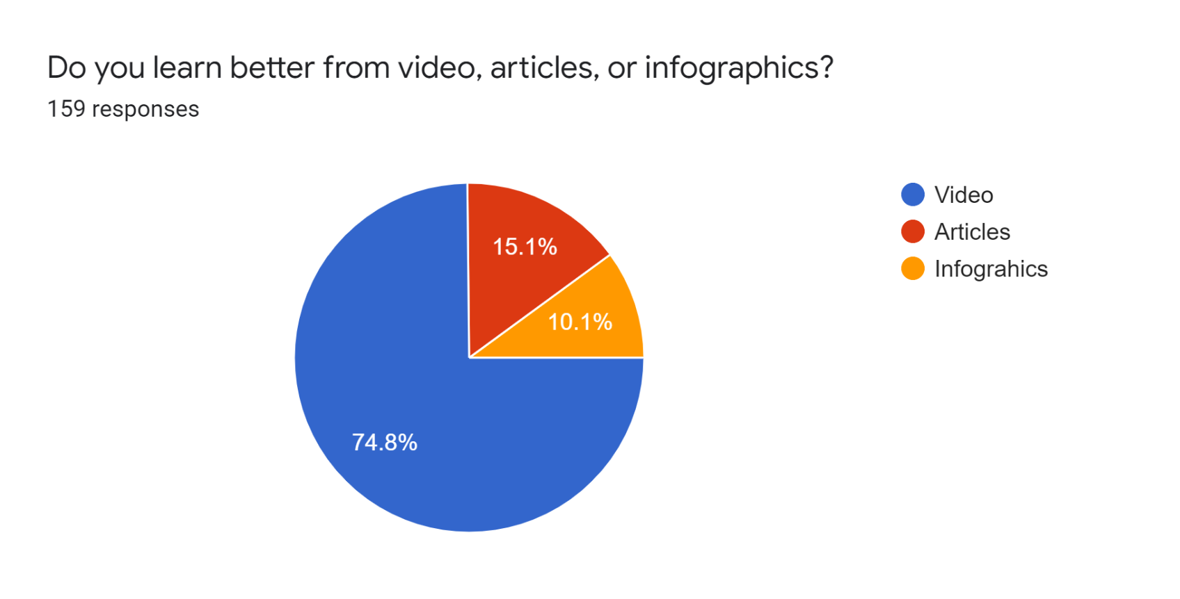



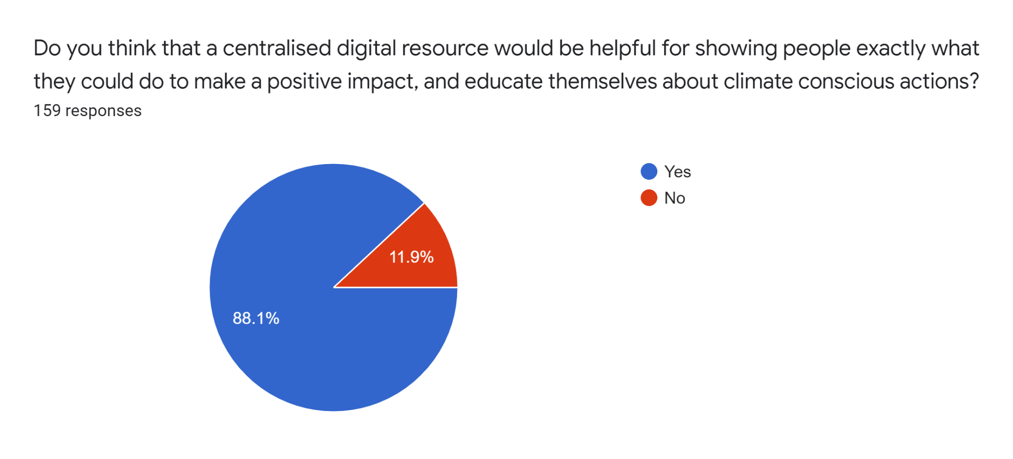
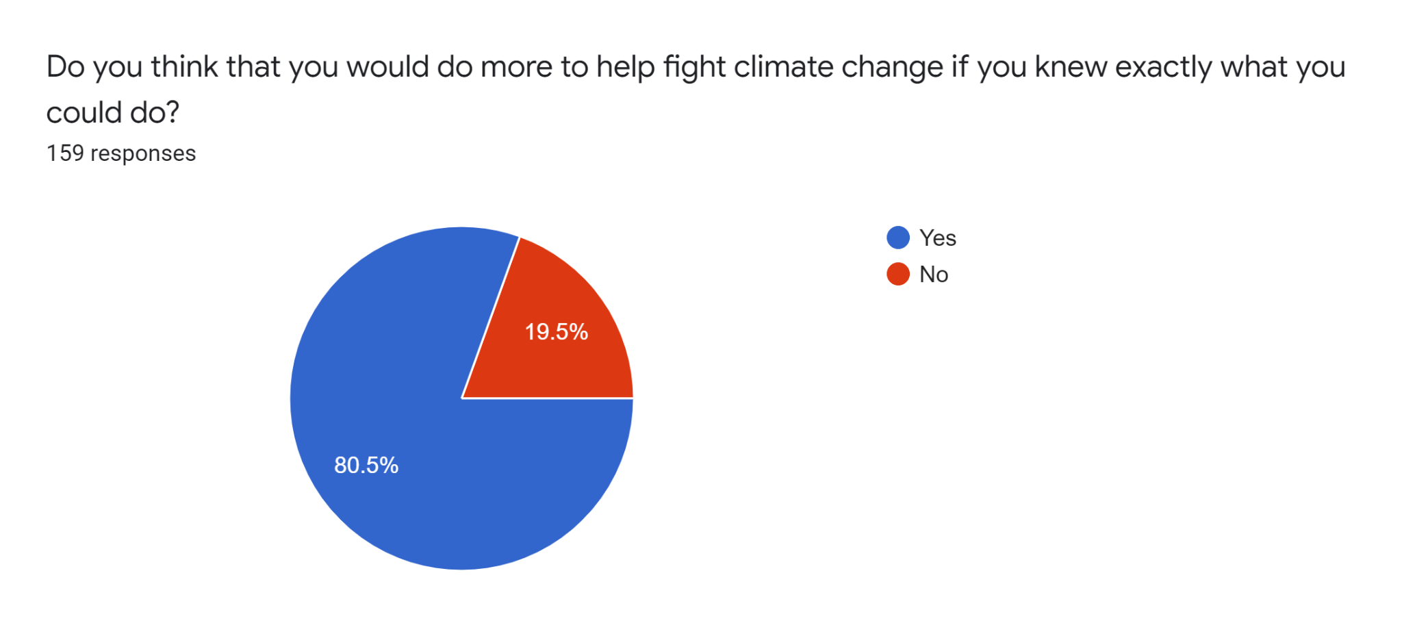
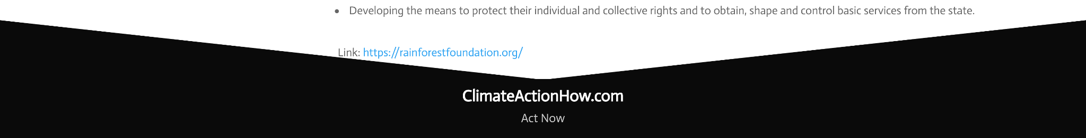
ClimateActionHow.com
SciFest 2022, Seán O’Sullivan.
Coláiste Chiaráin.
— Preliminary Survey —
— Post-Use Survey —
159 Students were surveyed about their opinions towards climate change and their views about online learning.
92 Students were surveyed after using ClimateActionHow.com about their opinions towards its usability and educational value.
90% Believe climate change and its impacts will be dangerous to human life.
– The Solution –
ClimateActionHow.com
A web-resource which provides information on practical actions that people can take to help fight climate change.
It includes information about actions big and small that people can take to make a difference, inspirational videos to encourage people to take action, and a large list of climate active charities that can be supported.
When asked about the layout of the website the majority rated 4/5 80%
\
67% When asked about their experience with our website the average rating was 3.3.
89%
Believe that their voice isn’t fully listened to in regards to climate action.
Mobile Version
Desktop Version
Say they are not confident in what they can do to help fight climate change. 58%
80% When asked to rate the categories the information was divided into, the majority rated 4/5 .
84% Responded saying that they have never donated to a form of climate action charity.
67% When asked about their experience with the standard article style, the average rating was 3.3.
83% Believe that taking climate conscious actions will help fight climate change.
When asked about the website’s accessibility for all ages, the average was 3.6. 72%
64% Responded that they have never searched for what they can do to help fight climate change online.
68% When asked about the educational videos in the inspire section, the average rating was 3.3.
Believe that the internet is a good source of information and learning tool. 94%
83% Said after using our website they had a better idea of how they can help fight climate change.
50% Was the average amount of actions found that were applicable to young people when online.
77% Said that they learned something in their short visit to our website.
65% Said that they make climate conscious decisions each day.
Said that they would use ClimateActionHow.com again in the future. 64%
74% Said that they would make better climate conscious decisions if they had access to a digital resource like this.
81% Said that they want to do more help fight climate change.
Believe that they learn best from video when online. 75%
- The Key Pillars of ClimateActionHow.com -
73% Prefer short and concise videos to long documentary style films.
Educate
In the Educate page there are blog post categories listings of the following: At home, When Outdoors, When Buying, When Travelling, At Work and Collective Action. All of which hold posts explaining ways in which people can take action against climate change as individuals, but more importantly, as a part of the collective.
Inspire
In the Inspire page there are short inspirational videos sorted into three categories “Why must we care?”, “What can we do?” and “What is working?”.
To provide information and inspiration on what is working an why people should take action against climate change.
Action
In the Action page there are a list of charities and organizations that are fighting climate change. A lot of which wouldn’t be making the headlines or have as much publicity as others.
88% Believe that a centralised online resource would be of use to them.
81% Believe that they would do more to help fight climate change if they knew exactly what they could do.
- Future Areas for Development -
The improve the aesthetic and design of the website.
Build a presence on social media.
Upload more content to our website.
Try contact more people and get more video content.
Increase the length of the list of charities.
Increase the amount of videos we have in our Inspire section.
To conclude, the true aim of this project and that of ClimateActionHow.com as a whole is to help foster a climate conscious mentality. Where people will do what they can to help fight this crisis. This doesn’t mean sacrificing your livelihood so that you don’t have to use a car to get to work. Fossil fuels got us to where we are today and without them we’d never have gotten here; But rather vote for change, protest for change, work for change and be a part of a movement greater than ourselves. The individual actions of all however big or small, collectively is the solution to climate change. These actions begin with education and inspiration.

