Slide 1
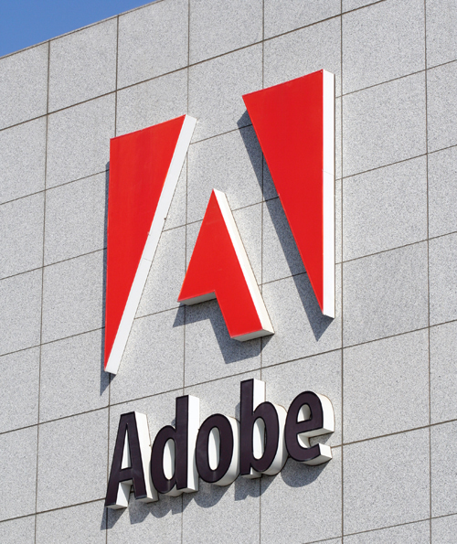
A Possible Future of
Software Development
Sean Parent
Principal Scientist & Manager
Software Technology Lab
July 25, 2007
Notes:
Introduce self -
Principal Scientest & Engineering Manager, Software Technology Lab
Charter - Improve Software Development Practice at Adobe
Adobe
Founded: 1982
Headquarters: San Jose, CA
Annual Revenue: ≈3B
Number of Employees: 4,000
Acquired Aldus in 1994
Acquired Macromedia in 2005
Known for PostScript, Photoshop, Acrobat, and Flash
Other major products:
GoLive, InDesign, Illustrator, PageMaker, FrameMaker, AfterEffects, Premier, Encore, Audition, Dreamweaver, Flash, Fireworks, LiveCycle and server products

Slide 2


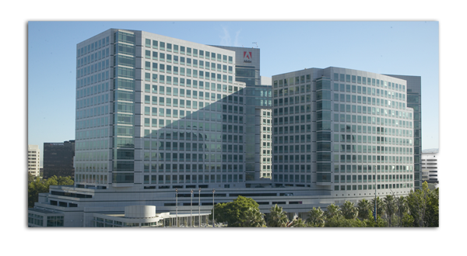
Adobe Today
Worldwide Offices
Key Statistics
Adobe FY 2006 Revenue | $2.575B
Adobe Q2 2007 Revenue | $745.6M
Years in Business | 25
Employees | 6,000
Corporate Headquarters – San Jose, California
Notes:
Adobe Today
Adobe is headquartered in San Jose, California, and has over 5,000 employees worldwide.
It is the fifth largest software company in the world.
Adobe Fiscal 2004 Revenues
US$1.667 billion (FYE Dec. 3, 2004)
Macromedia Fiscal 2005 Revenues
US$436.2 million (FYE Mar. 31, 2005)
Across the world, in virtually every conceivable medium, Adobe is creating leading-edge solutions that enable media-rich communications to engage customers and address the needs of the global marketplace. Our major sales regions include:
Europe, the Middle East, and Africa (EMEA)
Asia Pacific
Japan
Americas

Slide 3
Adobe Product Lines
Creative Solutions
Enterprise & Mobile
Technologies
Creative Suite
Photoshop
InDesign
Premiere Pro
After Effects
Flash
Dreamweaver
Acrobat
Acrobat Connect
LiveCycle
Flex
Flash Lite
FlashCast
Reader LE
Portable Document Format (PDF)
Reader
Flash Player
Postscript

Slide 4
Engineering Team Structure
Product Line:
  Photoshop, Acrobat, InDesign, …
Products:
  Photoshop CS3, Photoshop CS3 Extended, Photoshop Elements, Photoshop Lightroom, …
Product Team:
  Developers ≈20
  Testers ≈30
  User Interface Designers ≈1
Shared Technology Groups: ≈20
  Libraries for Vector Graphics, Type, Color, Help, Localization, XML Parsing, File Handling, etc.

Slide 5
Development Process
Process is constrained by business model
Schedule driven, incremental development model on 18-24 month cycles
  Larger products and suites forced toward waterfall model
  Press for manuals must be reserved up to 5 months in advance
Most products ship simultaneously for Macintosh and Windows in English, French, German, and Japanese
  Other languages follow shortly to about 24 languages

Slide 6
The Analysts Future
“Best practices”, methodologies, and process are changing continuously
Trend towards Java and C# languages
  As well as JavaScript and VisualBasic is still strong
  Java still has only a small presence on the desktop
  Object Oriented is ubiquitous
XML growing as data interchange format
Web services
Open source
  Foundation technologies commoditized

Slide 7
The Analysts Future
“Organizations need to integrate security best practices, security testing tools and security-focused processes into their software development life cycle. Proper execution improves application security, reduces overall costs, increases customer satisfaction and yields a more-efficient SDLC.”
- Gartner Research, February 2006
“Microsoft has been slowly moving to a new development process that will affect how partners and customers evaluate and test its software… The new process should help Microsoft gain more feedback earlier in the development cycle, but it won’t necessarily help the company ship its products on time or with fewer bugs.”
- Directions on Microsoft, March 2006

Slide 8
Why Status Quo Will Fail
“I’ve assigned this problem [binary search] in courses at Bell Labs and IBM. Professional programmers had a couple of hours to convert the description into a programming language of their choice; a high-level pseudo code was fine… Ninety percent of the programmers found bugs in their programs (and I wasn’t always convinced of the correctness of the code in which no bugs were found).”
- Jon Bentley, Programming Pearls, 1986

Slide 9
Binary Search Solution
int* binary_search(int* first, int* last, int x)
{
while (first != last){
int* middle = first + (last - first) / 2;
if (*middle < x) first = middle + 1;
else last = middle;
}
return first;
}

Slide 10
Question: If We Can’t Write Binary Search…
Jon Bentley’s solution is considerably more complicated (and slower)
Photoshop uses this problem as a take home test for candidates
  More than 90% of candidates fail
Our experience teaching algorithms would indicate that more than 90% of engineers, regardless of experience, cannot write this simple code
…then how is it possible that Photoshop, Acrobat, and Microsoft Word exist?

Slide 11
Bugs During Product Cycle

Slide 12
Bugs During Product Cycle

Slide 13
Answer: Iterative Refinement.
Current programming methodologies lend themselves to iterative refinement.
We don’t solve problems, we approximate solutions.

Slide 14
Writing Correct Algorithms
Study how to write correct algorithms
Write algorithms once in a general form that can be reused
Focus on the common algorithms

Slide 15
Generic Programming
Start with a concrete algorithm
Refine the algorithm, reducing it to its minimal requirements
Clusters of related requirements are known as Concepts
Define the algorithms in terms of Concepts - supporting maximum reuse
Data structures (containers) are created to support algorithms

Slide 16
Programming is Mathematics
Generic Programming
  Semantic Requirement
  Concept
  Model (types model concepts)
  Algorithms
  Regular Function
  Complexity
Mathematics
  Axiom
  Algebraic Structure
  Model
  Theorems
  Function
  __________
Refined Concept - a Concept defined by adding requirements to an existing concept.
  monoid: semigroup with an identity element
  BidirectionalIterator: ForwardIterator with constant complexity decrement
Refined Algorithm - an algorithm performing the same function as another but with lower complexity or space requirements on a refined concept

Slide 17
Syntax of Concepts - According to the Standard
Concept Regular
expression | return type | post-condition
T(t) |  | t is equivalent to T(t)
T(u) |  | u is equivalent to T(u)
t.~T()
&t | T* | denotes address of t
&u | const T* | denotes address of u
Table 30 - CopyConstructable
t = u | T& | t is equivalent to u
Table 64 - Assignable
a == b | bool | == is an equivalence relation
Table 3 – EqualityComparable

Slide 18
Semantics of Concepts
A Concept is an algebraic structure formed of connected requirements
Equality is a unique equivalence relation…
…connected to copy and assignment:
A model of Regular supports equational reasoning with computability
Notes:
Point out that to define copy we must define equality.
In short – we want our objects to “behave like int.”
And a pointer as a proxy is a poor approximation of this.
A pointer satisfies all of these semantics – but not as a proxy to what it points to, specifically if modify(a) changes the value pointed to by a and not the pointer.
Non-solution, define a set of axioms for a machine abstraction that doesn’t exist – then simulate it with current hardware. Everything will “work” except complexity! We have to describe memory, not hide it.

Slide 19
Importance of Concepts
Concepts enable equational reasoning about code
Concepts can be applied to any coding style
  Generic programming is not a programming style, it is the mathematics of code
As with mathematics, the success of this approach requires years of individual study and organized effort by the community
Notes:
Point out that to define copy we must define equality.
In short – we want our objects to “behave like int.”
And a pointer as a proxy is a poor approximation of this.
A pointer satisfies all of these semantics – but not as a proxy to what it points to, specifically if modify(a) changes the value pointed to by a and not the pointer.
Non-solution, define a set of axioms for a machine abstraction that doesn’t exist – then simulate it with current hardware. Everything will “work” except complexity! We have to describe memory, not hide it.

Slide 20
Simple Generic Algorithm
template < typename I, // I models RandomAccessIterator
typename T, // T models Regular
typename O> // O models BinaryFunction on T
// requires value_type(I) == T
// precondition: o provides a strict weak ordering on T
// precondition: [first, last) is in non-decreasing order by o
I lower_bound(I first, I last, T x, O o)
{
while (first != last) {
I middle = first + (last - first) / 2;
if (o(*middle, x)) first = middle + 1;
else last = middle;
}
return first;
}

Slide 21
Future of Concepts
Language support for Concepts
  This is a large area of focus for the C++ committee
Learn to teach programming in terms of Concepts
Extending Concepts to runtime
  Replacing inheritance as a mechanism for polymorphism
Construct a large library of algorithms and containers
  STL is only a beginning - must be considered an example
Notes:
Briefly discuss requirement of polymorphism

Slide 22
Question: Is this enough to build an application?
Notes:
Sermon on Wirt data-structures + algorithms -
Structured programming

Slide 23
Changing Gears...
Notes:
Sermon on Wirt data-structures + algorithms -
Structured programming

Slide 24
Conjecture: All problems of scale become a network problem
Notes:
Sermon on Wirt data-structures + algorithms -
Structured programming

Slide 25
Current Design of Large Systems
Networks of objects form implicit data structures
Messaging among objects form implicit algorithms
Design Patterns assist in reasoning about these systems
  Local rules which approximate correct algorithms and structures
Iteratively refine until quality is good enough

Slide 26
A "Generic Algorithm" for Solving Large Systems
Identify the components and how they connect and inter-relate
Organize the system into a directed acyclic graph (DAG)
  Identify the algorithm in any cyclic areas, factor them into a separate algorithm and replace that area with a node executing the algorithm
Ensure that for all states of the system a DAG structure is maintained
Describe similar problems as similar structures

Slide 27
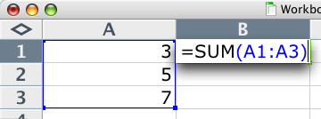
Solving a Spreadsheet

Slide 28
A DAG Representation

Slide 29
Declarative Programming
Describe software in terms of rules rather than sequences of instructions
  Rules define a structure upon which solving algorithms can operate
Examples of non-Turing complete* systems:
  Lex and YACC (and BNF based parsers)
  Sequel Query Language (SQL)
  HTML (if we ignore scripting extensions)
  Spreadsheet
Can be Turing complete (i.e. Prolog)
  But Turing complete systems lead us back to the complexity of algorithms
*Some of these systems are “accidentally” Turing complete or support extensions that make them Turing complete (such as allowing cycles in a spreadsheet engine). In practice though, this can often be effectively ignored and disallowed
Notes:
We know that users can use PS - therefore the structure must be simple.

Slide 30
Property Model Library

Slide 31
Event Flow in a Simple User Interface

Slide 32
Facts:
1/3 of the code in Adobe’s desktop applications is devoted to event handling logic
1/2 of the bugs reported during a product cycle exist in this code

Slide 33
If Writing Correct Algorithms is Difficult…
…Writing correct implicit algorithms is very difficult
We need to study what these implicit algorithms do, and express the algorithms explicitly on declared data structures

Slide 34
STLab Research: “Declarative UI Logic”
Definition: A User Interface (UI) is a system for assisting a user in selecting a function and providing a valid set of parameters to the function.
Definition: A Graphical User Interface (GUI) is a visual and interactive UI.
We’re starting with what it means to assist the user in providing a valid set of arguments to a function…

Slide 35
STLab Research: “Declarative UI Logic”
We can define "valid" as a predicate which described the pre-conditions on the set of arguments.
There are many ways to assist - but we've focused on four common forms:
  validation
  correction
  prediction
  related values

Slide 36
Demo

Slide 37
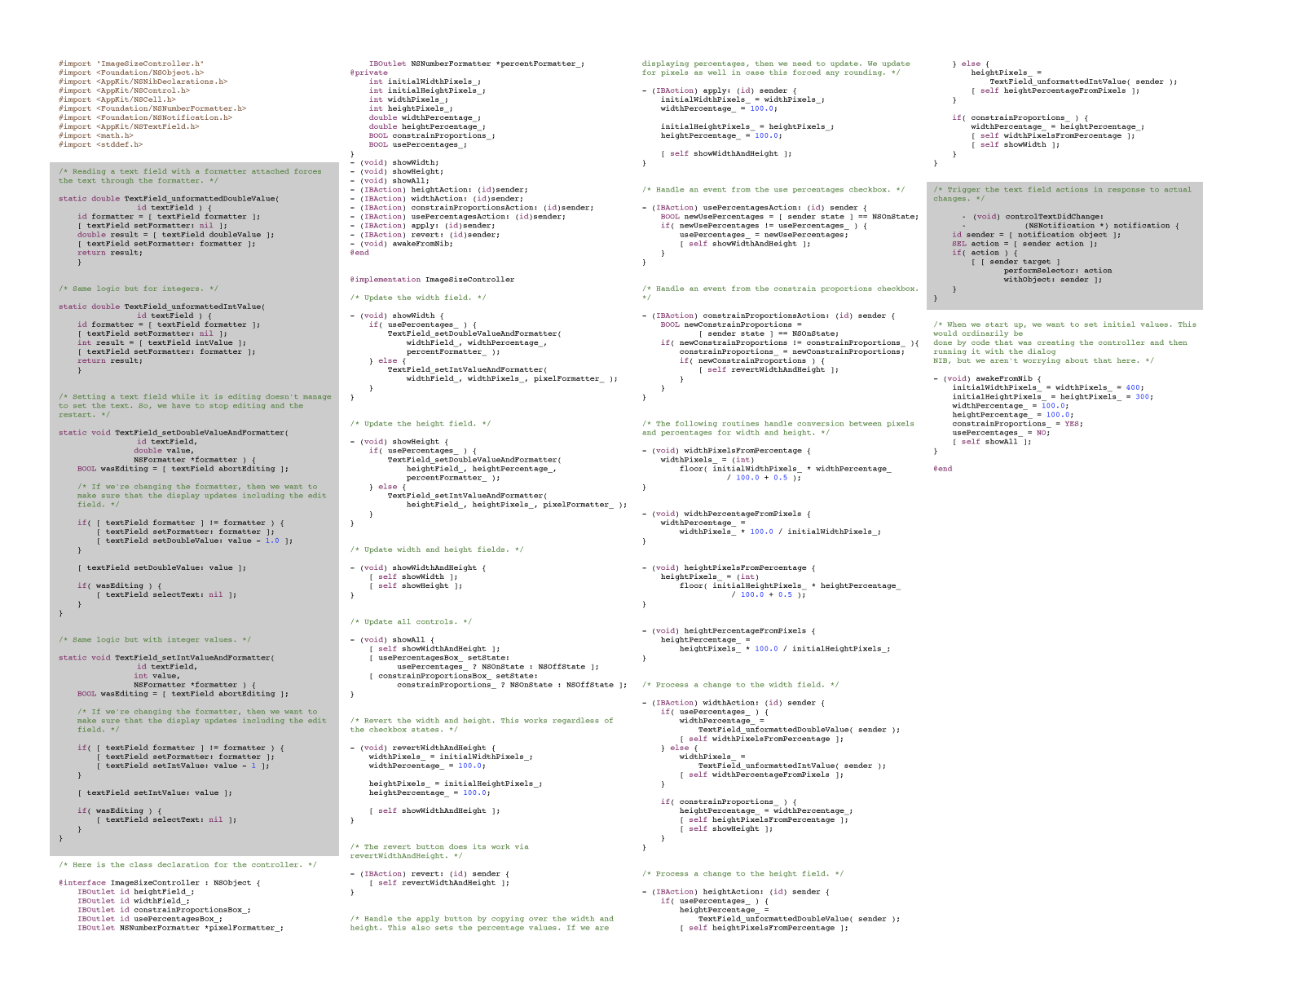
Imperative Solution to Mini-Image Size

Slide 38
Declarative Solution using the Property Model Library
sheet mini_image_size
{
input:
original_width : 5 * 300;
original_height : 7 * 300;
interface:
constrain : true;
width_pixels : original_width <== round(width_pixels);
height_pixels : original_height <== round(height_pixels);
width_percent;
height_percent;
logic:
relate {
width_pixels <== round(width_percent * original_width / 100);
width_percent <== width_pixels * 100 / original_width;
}
relate {
height_pixels <== round(height_percent * original_height / 100);
height_percent <== height_pixels * 100 / original_height;
}
when (constrain) relate {
width_percent <== height_percent;
height_percent <== width_percent;
}
output:
result <== { height: height_pixels, width: width_pixels };
}

Slide 39
Structure of Simple User Interface

Slide 40
Property Model Structure
A bipartite graph consisting of values and relations
Similar in structure to a spreadsheet, except directionality can be determined at runtime based on priority of cells
Data is flowed from higher priority cells outward to dependent cells
  a link reversal algorithm is employed to resolve soft cycles
A cell which is acting as a source (no inputs) is said to contribute
The priority among contributing cells does not change the structure
All permutations can be checked for hard cycles by checking each permutation of contributing values and pruning out clusters
Same model used for UI, script recording, and playback

Slide 41
Property Model Primitives

Slide 42
Future of Software Development
The property model library attacks 30% of the problem
Estimate 85% of existing code base can be replaced with small declarations and a small library of generic algorithms
  My gut-feeling is that we are a full 2 orders of magnitude off from the minimal expression of any large application
Formally describe application behavior by expressing algorithm requirements and structure invariants
Extend the ideas from STL to encompass richer structures
Extend generic programming to apply to runtime polymorphism
  Replace inheritance with non-intrusive modeling

Slide 43
More Information
http://opensource.adobe.com
http://stepanovpapers.com
  Specifically:
    http://www.stepanovpapers.com/eop/lecture_all.pdf
    http://www.stepanovpapers.com/notes.pdf
    http://www.stepanovpapers.com/PAM.pdf

Slide 44


