Slide 1
Local Reasoning in Any Language
Rust
Sean Parent | Sr. Principal Scientist Software Technology Lab
Notes:
The original idea for this talk was "Local Reasoning in Any Language" to document how I think about code, regardless of the language I'm programming in. The talk gets mired in language details, so I'm doing multiple versions; the first was for C++, and this is the second for Rust. Except for the details, the rules in this talk apply to all languages. I present here how I map these ideas into Rust, and if you program in a different language, figure out a set of conventions to map the ideas into that language.

Slide 2
Some Links
https://sean-parent.stlab.cc/papers-and-presentations/
https://www.hylo-lang.org/
Local Reasoning Can Help Prove Correctness
https://accu.org/journals/overload/33/188/teodorescu-parent/
Notes:
The first link is to my vanity page - you'll find links to nearly all of my talks (at least all the ones I've been able to hunt down). This talk will be posted there soon.
Lucian Teh-oh-doh-RES-koo

Slide 3

Network of Object
Notes:
In the 1980s and '90s, when object-oriented programming was in its heyday, the idea that we could build complex systems from large networks of objects was the rage. This is an issue of Byte magazine from 1981 - it had a massive influence on the entire industry and launched "Object Oriented Programming." Even though Smalltalk never gained widespread adoption, it was a very influential language.

Slide 4
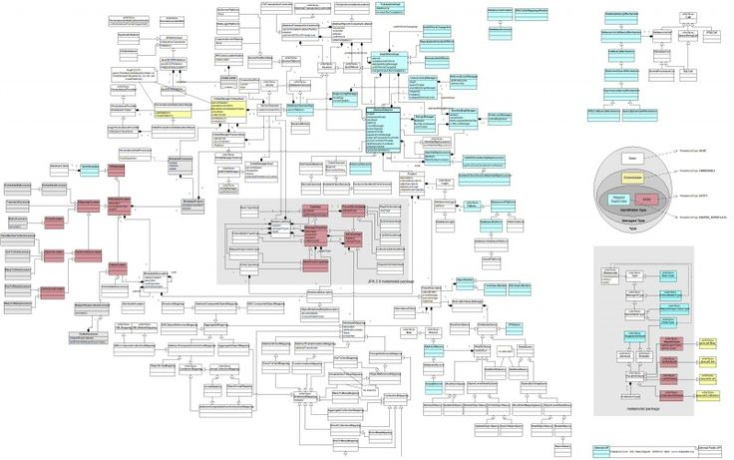
Network of Object
Notes:
The seductive idea was that, as long as each component had a well-defined interface, we could build complex systems by simply connecting them like Lego bricks. This is a UML diagram - does anyone here currently use UML? This is a relatively small system - but it fits on a slide. A collection of classes all interconnected, what could go wrong?

Slide 5
Software Crisis
OOP was supposed to solve the software crisis
Wikipedia lists 17 major failed software projects totaling billions of dollars in losses since 1980
List of failed and overbudget custom software projects. (2024, August 28). In Wikipedia.
Notes:
NATO coined the term "software crisis" in 1968, and Dijkstra referenced it in his 1972 Turing Award Lecture.

Slide 6
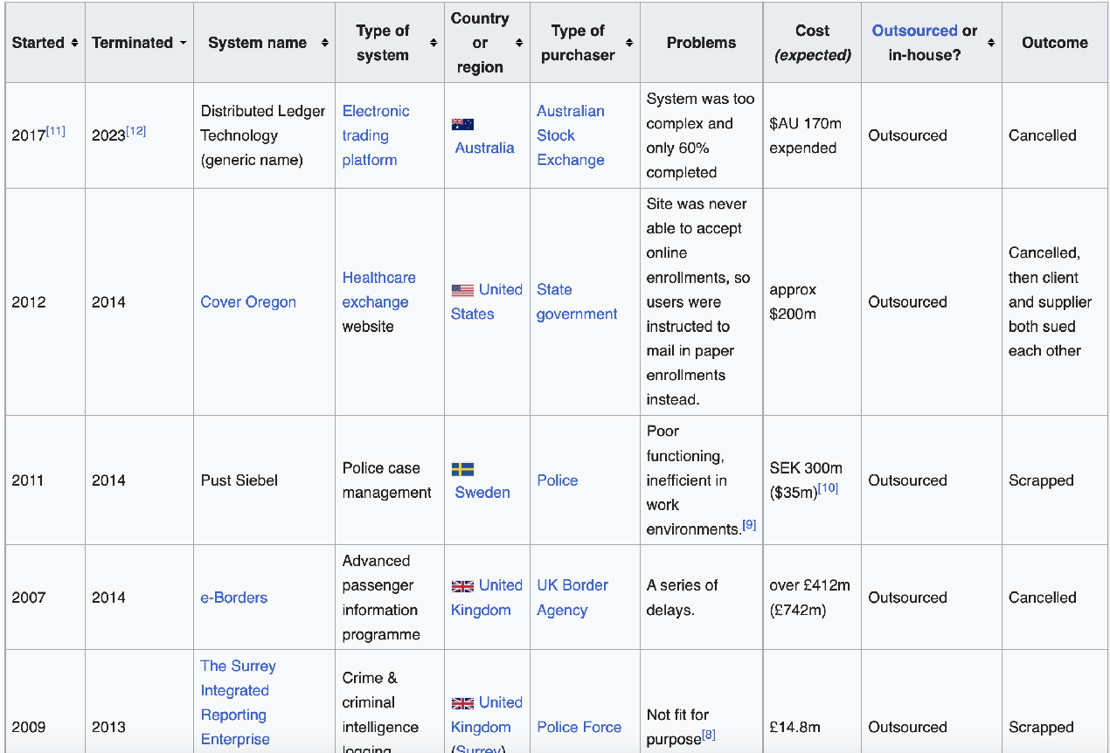
Failed Software Projects
Notes:
"Failed" here means failed to ship or shipped but was so riddled with defects it was scrapped or so late it was irrelevant.

Slide 7
Software Crisis
In all cases, mismanagement and development processes are blamed for the failures
Software practice, available languages, libraries, tools, and fundamental algorithms and types are ignored
List of failed and overbudget custom software projects. (2024, August 28). In Wikipedia.
Notes:
I'm sure someone will say, "If only these people knew about Agile and story points!"
I can't find a reference that considers the _code_ or the system's design.
These failures are as much an engineering failure as a management failure. Are there any university students here today? If you want a thesis, write a report on the engineering failures for some of these projects.

Slide 8
Why Software Projects Fail
Notes:
That is a big topic. I spent significant time looking for engineering analysis about why software projects fail. There are a _lot_ of management analyses, but I could not find a single paper with an engineering analysis. I will argue there is a specific point where engineering will, and often does, fail.
The failure occurs at the point where we lose the ability to reason _locally_ about code.

Slide 9
Why Software Projects Fail
"The greatest limitation in writing software is our ability to understand the systems we are creating."
– A Philosophy of Software Design, John Osterhaut
Notes:
At some point, our ability to reason about the system breaks down. We can no longer understand what we are building or what effect a change will have, and we lose sight of the goal in the details of the code. Who here has worked on a software project that failed? Who has worked on a project where they felt lost? Uncertain of the effect any change in the code will have. Photoshop has over 30M lines of code... I can tell you that the engineering team feels uneasy every day.

Slide 10
Local Reasoning
Local reasoning is the idea that the reader can make sense of the code directly in front of them, without going on a journey discovering how the code works.
—Nathan Gitter
The two units of code this talk is concerned with are:
Functions
Classes
The API is the key to local reasoning
Notes:
The solution is to construct systems that can be reasoned about locally. This is a talk about a practical approach to writing correct code. Formal methods mainly focus on how you prove the code you write is correct - here we focus on constructing correct code. STLab is looking to build a culture of correctness at Adobe. Local reasoning is a key part of that.

Slide 11
Terminology
Local Reasoning is concerned with both sides of an API
The consumer is the code using operations and classes from an API
The provider is the code implementing the API
Notes:
I'll sometime use _caller_ and _callee_ when discussing functions, but consumer and provider generalize to classes and other constructs like callbacks.
[ client and library? Make the point that everything is a library. ]

Slide 12
Functions
fn f() -> ()
Notes:
Let's start with a simple function interface. <click>
Either this function does nothing, or whatever it does is entirely through side effects. Either way, we should document it. <click>
Now we can implement `f` <click>

Slide 13
Functions
/// Does nothing.
fn f() -> ()
Notes:
Let's start with a simple function interface. <click>
Either this function does nothing, or whatever it does is entirely through side effects. Either way, we must document it. <click>
Now we can implement `f` <click>

Slide 14
Functions
/// Does nothing.
fn f() -> () {}
Notes:
I hope everyone is convinced that `f()` is implemented correctly.
A specification, or contract, is a requirement for local reasoning. Without it, we cannot know what the operation is supposed to do or what a class represents.
Again: a contract is a requirement for local reasoning.
Suppose a piece of code has a contract, and everything it invokes also has one. In that case, we can read the implementation and verify that the function body is correct and fulfills the contract.
Let's make our function a little more complicated<click>

Slide 15
Contracts
Precondition: A condition that must be true before an operation is called
Postcondition: A condition that must be true after an operation, or the operation must result in an error
If the precondition is not satisfied, the postcondition is unspecified
Type Invariant: A condition that must be true when an instance of a type is created, and is a postcondition of any mutating operation on the instance
Notes:
The idea of contracts comes from Bertrand Meyer's Design by Contract. Contracts allow us to reason about code locally and are fundamental to local reasoning.

Slide 16
Functions
/// Returns the successor of `x`.
fn f(x: i32) -> i32 { x + 1 }
Notes:
Still very simple, this code is easy to understand at a glance. It doesn't have a great name—but it does what the specification says.
But there is an issue. Do you see it? What happens if there is no successor of `x`?
The rule of contracts is that if preconditions are satisfied, and the function cannot satisfy the postconditions, the function must return an error. We can argue if the precondition here is implied by the specification, but let's make it explicit.

Slide 17
Functions
/// Returns the successor of `x`.
/// Precondition: `x < i32::MAX`.
fn f(x: i32) -> i32 { x + 1 }
Notes:
The contract provides the scaffolding for us to reason about the function locally. The process is straightforward; for each operation, we need to ensure that the preconditions are satisfied by the arguments or the prior operation. The arguments play a key role in our ability to reason about an operation, so let's break down the different kinds of arguments.

Slide 18
Function Arguments

Slide 19
Function Arguments
/// Increments the value of `x` by 1.
/// Precondition: `x < i32::MAX`.
fn a(x: &mut i32) {
*x += 1;
}
Notes:
Here is the same operation but written as an _action_ that mutates the argument.
This function is still simple; is it correct?
In most other languages, this would add the precondition that no other thread is accessing `*x` when we update it. That would be a data race. The Rust borrow-checker verifies this implicit precondition so it doesn't need to be stated.
Rust disallows mutation under aliasing.
<click>

Slide 20
Rust Borrow Checker:
Arguments passed to a function by mutable reference cannot be accessed by other threads or indirectly through another operation.
Arguments passed to a function by reference cannot be written to, either directly or indirectly, for the duration of the call.

Slide 21
Function Arguments
/// Increments the value of `x` by 1.
/// Precondition: `x < i32::MAX`.
fn a(x: &mut i32) {
*x += 1;
}
Notes:
We don't usually pass an `i32` by reference; we pass larger or non-Copy types by reference to avoid unnecessary moves or clones. But for types where the cost of taking a reference is comparable to passing the value, we pass the value directly. By convention, scalar types like integers, floats, and pointers (e.g., *const T, *mut T) are passed by value. In generic code, iterators and closures are often passed by value as well, since they are often zero-sized or implement Copy, making value-passing efficient and ergonomic.
[ Move this discussion. ]

Slide 22
Why Mutation?
Mutation is space efficient
Mutation is often:
more performant.
simpler to reason about.
Notes:
How would I replace the battery in my car, compared to rebuilding an equivalent vehicle with a new battery?
In situ operations are more space-efficient and may be more time-efficient.

Slide 23
Transformations and Actions
A transformation is a regular unary function.
Changing the state of an object by applying a transformation to it defines an action on the object.
x = f(x);
Notes:
We can always express a mutating operation in terms of a non-mutating one and vice versa.

Slide 24
Transformations and Actions
There is a duality between transformations and the corresponding actions: An action is defined in terms of a transformation, and vice versa:
fn a(x: &mut T) { *x = f(*x); } // action from transformation
and
fn f(x: &T) -> T { a(x.clone()); x } // transformation from action
– Elements of Programming, Section 2.5
Notes:
The code in EoP is in C++ - this is a transcription.
For a given operation, either an action or a transformation may be a more efficient implementation. All other things being equal, prefer transformations.
Because of the duality, you only need to write one. However, the nature of the operation may indicate which one to implement. [ And we'll see later that sometimes there is value in writing both forms. - [Do we?]]
sort is an example that is more efficient in situ, and stable-partition is more efficient as a transformation.
The transformation is taking the argument by value, but we need to say a little more about passing arguments <click>
[ Maybe leave this out? ]

Slide 25
Argument Qualifiers
let arguments
&T (or T if it conforms to Copy)
inout arguments
&mut T
sink arguments
T (unless T conforms to Copy)
Notes:
I'm borrowing the terminology for arguments from Hylo because Rust doesn't have a good nomenclature for them.
In Rust, if an object can be copied (as opposed to cloned), the copy operation is as inexpensive as consumption, and so the value is not consumed. This means that pass by value may mean "let" or "sink" depending on the type.

Slide 26
Argument Guarantees
let arguments
Postcondition: The argument is not modified
inout arguments
Postcondition: None (The argument may be modified)
sink arguments
Postcondition: The argument is consumed
Notes:
sink arguments are used when the argument is escaped - either stored or returned, possibly with modification.

Slide 27
A more complex action
/// Offsets the value of `x` by `n`.
/// Precondition: `(x + n) < INT_MAX`.
fn offset(x: &mut i32, n: &i32) {
*x += n;
}
What if this is called as:
let x = 2;
offset(&mut x, &x);
println!("{x}");
Notes:
It "feels like" this should print 4.

Slide 28
A more complex action
error[E0502]: cannot borrow `x` as immutable because it is also borrowed as mutable
|
| offset(&mut x, &x);
| ------ ------ ^^ immutable borrow occurs here
| | |
| | mutable borrow occurs here
| mutable borrow later used by call
Notes:
The postconditions for `x` and `n` conflict. x cannot both be unchanged and be the offset value.

Slide 29
A more complex action
let mut x = 2;
x += x;
println!("{x}");
4
Notes:
This will print 4

Slide 30
A more complex action
let mut x = 2;
let x_ref = &mut x;
*x_ref += *x_ref;
println!("{x_ref}");
4
Notes:
This will print 4

Slide 31
A more complex action
let mut x = 2;
let x_ref = &mut x;
*x_ref += *x_ref;
println!("{x_ref}");
4
Notes:
The star is required because AddAssign is implemented for both reference and values on the right-hand side. The `*` forces the value case and does an implicit copy.
Adding the `*` in our offset function wouldn't help - because we break at the interface level.

Slide 32
A more complex action
// Offsets the value of `x` by `n`
// Precondition: `(x + n) < INT_MAX`
fn offset(x: &mut i32, n: &i32) {
for _ in 0..*n {
*x += 1;
}
}
What will this print?
let x = 2;
offset(&mut x, &x);
println!("{x}");
Notes:
Consider this implementation. This is also a correct implementation.
If it weren't for the borrow checker, what would this print?
It would not print 4 - it would never terminate.

Slide 33
A more complex action
vector a{ 0, 1, 1, 0 };
erase(a, a[0]);
println("{}", a);
What will this print?
[1, 1]
or
[1, 0]
– https://godbolt.org/z/z381aM1r7
Notes:
I'm showing the C++ code for this example to make a point, this is the only C++ code in this talk. The intention of this code is to erase all elements in a vector matching the first element. That is "erase all `0`s"
What will this print... <click>
We would expect this, and maybe that is what it prints. But it might also print this <click>
Why? After the code removes the first element matching a[0] (0), a[0] holds a 1, so the remaining 1s are removed, leaving the trailing 0.
It is because of a clause in the standard that allows, but does not require, an operation to make a copy of its arguments, that the first answer is possible.
Both implementations conform to the standard.
If arguments are mutated under aliasing, local reasoning is broken for both the client and implementor.

Slide 34
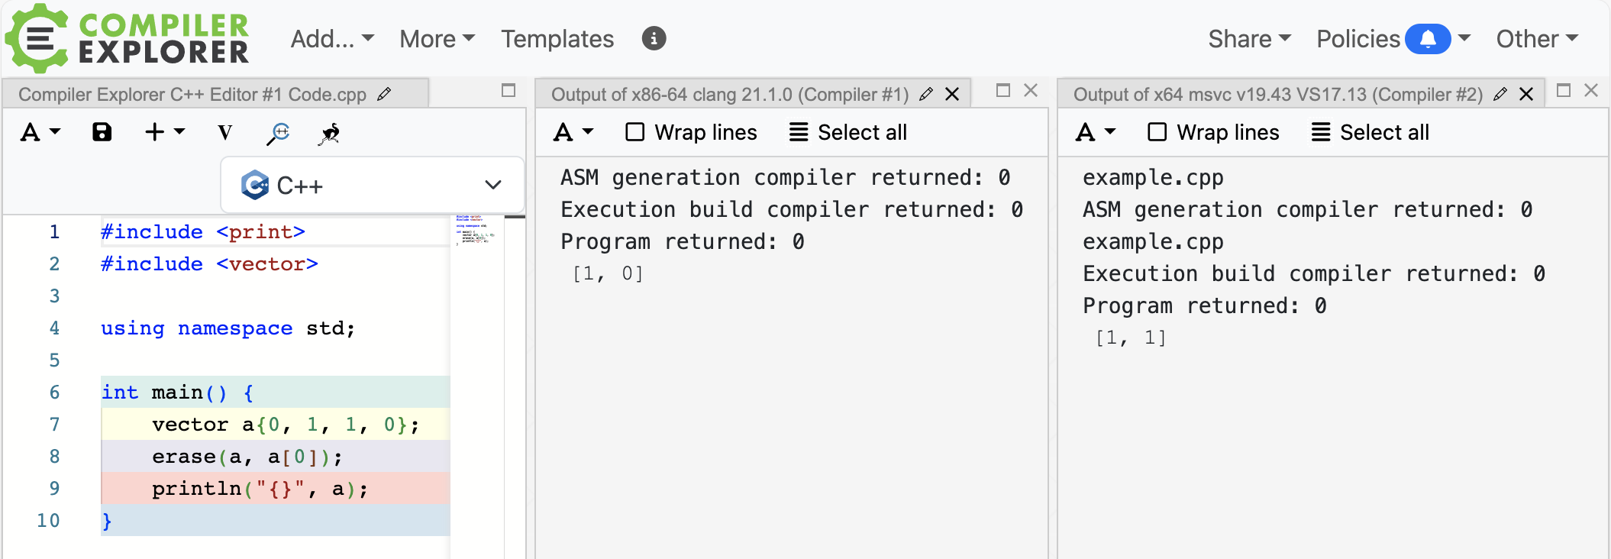
A more complex action
Notes:
Here is the code with two implementations of the standard library, each producing a different result.

Slide 35
A more complex action
vector a{ 0, 1, 1, 0 };
erase(a, int{a[0]});
println("{}", a);
What will this print?
[1, 1]
– https://godbolt.org/z/PYdj3W5Ma
Notes:
To get a defined result, we need to remove the aliasing by forcing a copy of `a[0]`.
C++ is littered with aliasing and lifetime-of-reference issues foot-guns.

Slide 36
A more complex action
let mut a = vec![0, 1, 1, 0];
a.retain(|x| *x != a[0]);
println!("{:?}", a);
What will this print?
error: cannot borrow `a` as mutable because it is also borrowed as immutable
|
| a.retain_mut(|x| *x != a[0]);
| ^^----------^---^^^^^^^-^^^^
| | | | |
| | | | first borrow occurs due to use of `a` in closure
| | | immutable borrow occurs here
| | immutable borrow later used by call
| mutable borrow occurs here
Notes:
Here is the equivalent code in Rust - the Rust borrow checker prevents this code from compiling.

Slide 37
A more complex action
let mut a = vec![0, 1, 1, 0];
let first = a[0];
a.retain(|x| *x != first);
println!("{:?}", a);
What will this print?
[1, 1]
Notes:
We have to explicitly make a named copy in Rust.

Slide 38
Invalid References and References to Uninitialized Objects
vector<int> a{a};
terminate called after throwing an instance of 'std::bad_alloc'
what(): std::bad_alloc
Program terminated with signal: SIGSEGV
https://godbolt.org/z/6zqM8neax
Notes:
We do have to say one more thing about references in C++. What does this line of code do?

Slide 39


Slide 40
Rust Borrow Checker:
Referenced objects must be within the objects lifetime
inout and sink arguments cannot be accessed except directly by the callee
let arguments passed by reference cannot be mutated by either the caller or indirectly by the callee
Notes:
The Rust borrow checker provides strong guarantees for references.

Slide 41
Law of Exclusivity
A variable cannot be accessed via a different name for the duration in which the same variable is being modified as an inout argument.
– Swift 5 Exclusivity Enforcement
Notes:
In Swift, this is known as "The Law of Exclusivity", a term coined by John McCall.

Slide 42
Law of Exclusivity
If you have a mutable reference to a value, you can have no other references to that value.
– The Rust Programming Language: References and Borrowing
Notes:
In Rust, the borrow checker enforces this restriction. C++ does not have such a restriction. We must rely on conventions and diligence. This phrasing is actually wrong - you can have all the references, you just can't use them.

Slide 43
The Law of Exclusivity is a General Law of Programming
In every mainstream language other than Rust and Swift, upholding the LoE is the programmer's responsibility
Notes:
To reason about a function locally, you have to know that values don't change as a side effect of other operations.
What would you say in the contract? The documentation for C++ std::erase() is the implementation. This is not local reasoning.

Slide 44
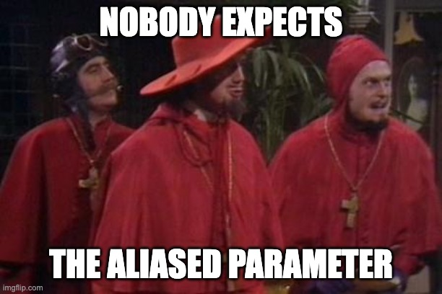
Notes:
To reason about a function locally, you have to know that things don't aliasing - what would you say in the contract?

Slide 45
Return Values
Notes:
We haven't talked about function results yet.

Slide 46
Return Values
// Returns the successor of `x`.
// Precondition: `x < i32::MAX`
fn f(x: i32) -> i32 {
x + 1
}
Notes:
Let's go back to an early simple function. Here, we are returning a new value. Would it ever make sense to return a reference from a function?

Slide 47
Return-by-reference
let mut a = vec![0, 1, 2, 3];
*a.last_mut().unwrap() = 42;
println!("{:?}", a);
[0, 1, 2, 42]
Notes:
Vec::last_mut() is an example of returning an optional reference. There are many examples of returning references in the standard library, including indexing, slices, and iterators.
When we return a reference, or anything containing a reference, we call that a _projection_.

Slide 48
Projection Qualifiers
Projections qualifiers mirror argument qualifiers
Constant (&T) projections do not allow the projected object to be modified
Mutable (&mut T) projections allow the projected objects to be modified
Returning by value is the mirror of sink arguments
Value (T) allows the object to be consumed
Notes:
The fact that projection qualifiers mirror argument qualifiers is not a coincidence -
- Returning a constant projection pairs with a Let argument
- Returning a mutable projection pairs with an InOut argument
- Returning a value pairs with pairs with a sync argument

Slide 49
Projection Qualifiers
Returning consumable projections are uncommon
Usually return by-value is used but consumables may be more efficient when extracting a value from an rvalue:
T&& extract() &&;
Mutable projections may also be consumed but require an additional operation to restore invariants on the owning object. i.e.
auto e{std::move(a.back());}
a.pop_back(); // erase the moved-from object

Slide 50
Projection Validity Enforced By Borrow Checker
A projection is invalidated when:
The object they are projected from is modified other than through the projection.
let mut a = vec![0];
let p = &a[0]; // p is a projection
a.push(1); // ERROR
Notes:
These are the general rules, a specific operation my provide stronger guarantees. It is the client responsibility to only pass valid projections to an operation

Slide 51
Projection Validity Enforced By Borrow Checker
A projection is invalidated when:
The source of the projection is modified or destroyed
let mut a = vec![0];
let p = &a[0]; // p is a projection
a.push(1); // ERROR
The lifetime of the object they are projected from ends
fn f() -> &String {
let s = String::from("Hello");
&s // ERROR
}
Notes:
A mutation of the part is a mutation of the whole - unless you have special knowledge.

Slide 52
Projecting Multiple Values
Iterators and slices may project a collection of values from an object
They follow the same rules as reference projections
let mut a = vec![3, 2, 1, 0];
let src = &a[0..2];
let dst = &mut a[2..]; // ERROR
dst.copy_from_slice(src);
let mut a = vec![3, 2, 1, 0];
let (left, right) = a.split_at_mut(2); // Ensure non-overlapping
right.copy_from_slice(&left);
Notes:
Let's say we wanted to copy the first half of a vector over the second. The obvious way runs into the borrow checker.
To mutate sections of a whole, we may need operations like `split` to convince the borrow-checker that the projections do not overlap. The borrow-checker knows that members do not overlap. This allows us to parallelize operations on non-overlapping components.

Slide 53
Lifetime Annotations
Mostly inferred
Use 'a for projection objects
struct EveryNth<'a, T> { slice: &'a [T], n: usize, i: usize }
impl<'a, T> Iterator for EveryNth<'a, T> {
type Item = &'a T;
fn next(&mut self) -> Option<Self::Item> {
(self.i < self.slice.len()).then(|| {
let item = &self.slice[self.i];
self.i += self.n;
item
})
}
}
Notes:
Lifetime annotations are mostly inferred; you may need them if you create an object as a projection. <click>
Here is a very terse example of an iterator that returns every Nth element from a slice: the lifetime annotations or the bold `'a`s.

Slide 54
Objects
Notes:
Argument independence allows us to reason about a function in isolation, but for that to work, our objects must be independent.

Slide 55
Objects
fn f(a: &mut Box<Widget>) -> ();
What is the type of the argument for f()?
To understand f() we need to understand the intended extent of a
Notes:
This seems like a ridiculous question - of course, the type is a mutable reference to a Box<Widget>!
But is the thing being modified the Box or the Widget?
The rules in Rust around references mostly prevent us from creating objects with unknown extent - but will still need to be clear in our interfaces. Pass the narrowest extent possible for the operation - avoid Optional, Box, Arc, Result, and even Vec in interfaces. If "Box<Widget>" _is_ the whole that is being operated on, then it should be a separate type, encapsulating the Box.

Slide 56
Equational Reasoning
Equational reasoning is proving that expressions are equal by substituting equals for equals.
Equational reasoning explains how code works and is a component part of larger proofs.
To know if two values are equal, we need to know the extent of the values.
Notes:
Quick refresher on equality -

Slide 57
Equality
Equality is an equivalence relation (reflexive, symmetric, and transitive)
Equality connects to copy (equal and disjoint)
In Rust copy is also spelled clone
Notes:
Equality also connects to move and copy - a moved from object is equal to the prior version of the object.
Recall the duality between transformations and actions -

Slide 58
Transformations and Actions
There is a duality between transformations and the corresponding actions: An action is defined in terms of a transformation, and vice versa:
fn a(x: &mut T) { *x = f(*x); } // action from transformation
and
fn f(x: &T) -> T { a(x.clone()); x } // transformation from action
– Elements of Programming, Section 2.5
Notes:
This is an example of equational reasoning. Projections are a proxy for a value, with rules governing the validity of the proxy.

Slide 59
Composite Objects and Whole-Part Relationships
A composite object is made up of other objects, called its parts.
The whole–part relationship satisfies the four properties of connectedness, noncircularity, disjointness, and ownership
let a = vec![0, 1, 2, 3];
struct Person {
name: String,
id: i32,
}
let b = Person {
name: "John".to_string(),
id: 0,
};
Notes:
a is a composite object with 4 integer part
b is a composite object with two named parts
Disjointness - logically disjoint under mutation from other objects - not necessarily other parts. Immutable and copy-on-write objects may share storage.
Pointers, shared, unique or otherwise, witness a relationship. Which may, or may not, be a whole-part relationship. In an interface, their meaning is ambiguous, and they are best avoided. Alone, they are disconnected from any whole.

Slide 60
Objects
fn a(p: &mut Widget) { ... }
This should only modify an instance of Widget
And could be expressed as:
fn f(p: Widget) -> Widget { ... }
Notes:
In general, I prefer the sink/return-by-value form over mutation for composition and readability. But Rust lacks an in-place transform for members or parts.
But we need to talk about non-whole part relationships.

Slide 61
Objects, Copies, and Argument Independence
To reason locally:
Objects used as arguments must be independent under mutation to uphold the Law of Exclusivity
Copies are equal and logically disjoint
Notes:
[ Say more here... To reason locally... ]

Slide 62
Achieving Independence
No mutation
No sharing
Copy-on-write (mutation un-shares)
Borrowing (no mutation if shared)
Notes:
No mutation is the functional programming approach.
Static single assignment (SSA) is the no-sharing approach
Swift relies heavily on copy-on-write. It uses function bundles to associate a transform and action. When modifying an object, if the object is uniquely owned, the action is used. Otherwise, the transform is used, and the "copy" is free. For example, if we have a copy-on-write dynamic array that is shared, and we insert an element, instead of copying, then inserting, we copy up to the insertion point, then move in the elements to be inserted, the copy the remaining elements.
Rust relies on borrow to (mostly) statically ensure. Rust also has the Cow type for copy-on-write.

Slide 63
Extending Independence with Mutation
A mutable object may extend permission for mutation to its parts through projections
So long as those projections do not overlap
Notes:
In Rust this is done with ownership and borrowing, in Swift (and Hylo), this is done through whole/part relationships and projections. The advantage of Hylo is fewer annotations.
In C++, the developer must manage projections. In reference-semantic languages (Jave, JavaScript, Python...), immutability is the only scalable option.

Slide 64
whole/part examples
#[derive(Debug, Clone, PartialEq)]
pub struct Whole {
part: Part,
}
impl Whole {
pub fn new(state: State) -> Self {
Self {
part: Part::from(state),
}
}
}
Notes:
This is the canonical template for a class. Well-behaved parts compose into well-behaved wholes. Copy and equality are part-wise. We don't need a default constructor unless there is a meaningful default value.

Slide 65
whole/part examples
#[derive(Debug, Clone, PartialEq)]
pub struct Whole {
shared_part: Arc<Part>,
}
impl Whole {
pub fn new(state: State) -> Self {
Self {
shared_part: Arc::new(Part::from(state)),
}
}
}
Notes:
The parts may be shared (immutable in Rust)

Slide 66
whole/part examples
#[derive(Debug, Clone, PartialEq)]
pub struct Whole {
remote_part: Box<Part>,
}
impl Whole {
pub fn new(state: State) -> Self {
Self {
remote_part: Box::new(Part::from(state)),
}
}
}
Notes:
The parts may be heap allocated...

Slide 67
Errors & Safety
Notes:
But there is more to a system than just a bunch of objects - the objects are often somehow related.

Slide 68
Errors
Postcondition: A condition that must be true after an operation, or the operation must result in an error
If the precondition is not satisfied, the postcondition is unspecified
Type Invariant: A condition that must be true when an instance of a type is created, and is a postcondition of any mutating operation on the instance
Notes:
These are general rules - any particular operation may provide stronger guarantees

Slide 69
Errors
An object under mutation when an error occurs is left in an unspecified state
The class invariants may not hold
Any object under mutation when an error occurs must be discarded
Notes:
These are general rules - any particular operation may provide stronger guarantees
By dropping or replacing, as if by assignment, with a known value

Slide 70
Error Handling Composes
Local objects are discarded during propagation
Discarding inout arguments is the responsibility of the caller
We only need to be concerned with objects passed as inout arguments to a failed operation when error propagation stops
fn a(&mut self) -> Result<()> {
let mut x = f()?.g()?;
h(&mut x)?;
h(self)?;
Ok(())
}
Notes:
These are general rules - any particular operation may provide stronger guarantees
By dropping or replacing, as if by assignment, with a known value

Slide 71
Error Handling Composes
fn transaction(&mut self) -> () {
let tmp = self.clone();
if let Err(e) = self.op() {
notify(e);
*self = tmp;
}
}
Notes:
This is how we can stop error propagation and leave the system in a known state. Cow is a tool that can be used to make the clone efficient. See the history feature in Photoshop.

Slide 72
Safety
For an unsafe operation the default contract is:
If the precondition is not satisfied, the postcondition is undefined
Avoid using unsafe, but if you do
Keep the scope of the unsafe block as small as possible
Include a comment that states the preconditions for the unsafe code and why, or under what circumstances, they are satisfied
If there are circumstances, the calling operation also must be marked as unsafe with documented preconditions
Notes:
The circumstances would then be a precondition of the caller.

Slide 73
Safety
/// Pushes a value into storage and registers its dropper.
fn push_storage<T: 'static>(&mut self, value: T) {
self.storage.push(value);
self.dropper.push(|storage, p| unsafe {
// `drop_in_place` is only invoked with the corresponding
// value in `storage` - see invariants.
storage.drop_in_place::<T>(p)
});
}
Notes:
The circumstances would then be a precondition of the caller.

Slide 74
Summary

Slide 75
Existing Code
Be conservative
Avoid modifying shared data (the borrow checker makes this the default)
Avoid creating new sharing, including by holding indices
Remember the power of preconditions and push responsibility to the caller

Slide 76
Summary
Local Reasoning is built on:
Whole-part relationships
Projections for local operations
Use these and embrace the Borrow Checker as a tool to achieve correctness

Slide 77


About the artist
Leandro Alzate
Berlin-based illustrator Leandro Alzate mixes bright color palettes and stylized characters in his fanciful work for editorial and advertising clients. He draws inspiration from observing the ways people interact, and combines that with his passion for architectural shapes and spaces. He created this piece for the German Ministry of Economy to encourage people to explore work-from-home career opportunities. Working with brushes and vector shapes, Alzate created this piece entirely in Adobe Photoshop.
Made with

Slide 78




Slide 79
Extrinsic Relationships
Notes:
But there is more to a system than just a bunch of objects - the objects are often somehow related.

Slide 80
Extrinsic Relationships
An extrinsic relationship is a relationship that is not a whole-part relationship
let a = vec![0, 1, 2, 3];
a[0] is before a[1] is an extrinsic relationship
Notes:
Relationships exist all over in the code - the main challenge in programming isn't in functions or classes, but in finding and managing the _essential relationships_.

Slide 81
Relationships
A relationship is a connection between elements of two sets
For every relationship, there is a corresponding binary predicate. i.e., is_married(a, b)
A relationship between objects may be severed by modifying or destroying either object
A relationship may be witnessed by an object such as a pointer or index
An object that is a witness to a severed relationship may be invalid
Notes:
I'm emphasizing index - sometimes memory-safe or functional languages are described as solving the problems with pointers. They solve the memory-safety problems and assist with local reasoning by forcing resolution to go through an owning object. But they do not ensure correctness (because correctness doesn't compose), and can be used to break local reasoning.
In any Turing complete language, you can build a C machine and write buggy C code. [ Move this sentence ]
If I have an index to the largest element of an array, and I change the element such that it is no longer the largest, my index, as a witness to the relationship, is invalid.
The severing of relationships and invalidation of witnesses we describe as "spooky action at a distance."
An invalid witness is one for which there is no (direct) way to determine whether the corresponding relationship is severed. Any result depending on an invalid witness is unspecified.

Slide 82
You Have an Extrinsic Relationship If...
Your class stores a reference.
Your class stores a key, index, or ID that refers to another object.
You reference a (mutable) global variable.
You use any primitive facility to share mutable data (Cell, RefCell, Atomic, Mutex, RwLock)
Shared mutable access breaks local reasoning even if the exclusivity is checked at runtime.

Slide 83
Local Reasoning and Extrinsic Relationship
To reason locally about extrinsic relationships, they should be encapsulated in a class
The relationships are maintained between the parts by the class
The class ensures the validity and correctness of the relationships by controlling access to the related objects
The validity and correctness of the relationships are the class invariants
An intrusive witness in a part should only be manipulated by the owning class, and explicitly severed if the object is moved or copied outside the whole
Containers are examples of classes that manage extrinsic relationships between their parts
Notes:
Class invariants are extrinsic relationships on or between parts that always hold (for some definition of always).
Private access is used to protect the class invariants.
By encapsulating, we mean managing all the elements involved in a relationship. Those elements are _parts_.
"explicitly severed," such as by nulling a pointer or optional, or assigning a sentinel value such as a negative index to represent severed.
Linked list example. Splicing doesn't entangle lists—a container view of the world.

Slide 84
Class Invariants
A class invariant is a general postcondition on any mutating operation
If members involved in the invariant are private, this invariant must only be shown to hold on mutating operations that have access to the members
Care must be taken not to invoke an external operation with a reference to the object while the object invariants are violated
The borrow checker prevents most accidental cases
Notes:
Class invariants are extrinsic relationships on or between parts that always hold (for some definition of always).
Private access is used to protect the class invariants.
By encapsulating, we mean managing all the elements involved in a relationship. Those elements are _parts_.
"explicitly severed," such as by nulling a pointer or optional, or assigning a sentinel value such as a negative index to represent severed.
Linked list example. Splicing doesn't entangle lists—a container view of the world.

Slide 85
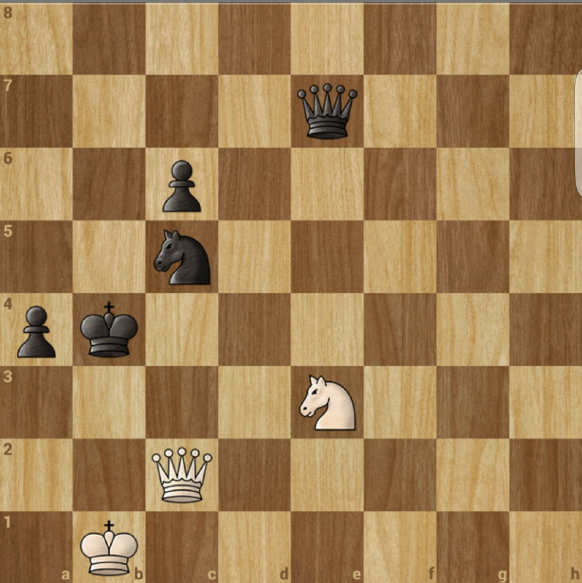
An Analogy
Notes:
I started this talk by claiming that software projects fail because local reasoning breaks down. Failing to manage extrinsic relationships is where that happens.
This is why it is essential to avoid creating _potential_ extrinsic relationships where a whole/part relationship would suffice. This is why we don't want incidental data structures, but we want data structures encapsulated in a class, so we can reason about the relationships locally.
Even if we are well principled in doing this. If every component we write has a well-defined contract. Extrinsic relationships are _hard_. Computer scientists are bad at relationships.
To illustrate - consider this chess board. Not any chess board or chess game, just _this_ board. There are four distinct pieces. King, queen, knight, pawn. Seven classes if we encode color in the class. We can represent these as very simple types.
Chess pieces do not have state. You might say "position is their state" - but that is false. The relationship is extrinsic to the part, even if I use an intrusive witness to represent the relationship.
This is an end-game. We are not concerned with pawns moving 1 or 2 spaces, en passant, or castling. The board is only 8x8 - just 64 cells containing one of eight pieces or nothing.
The relationship between the piece and the board is explicit. But that creates relationships and potential relationships between the pieces. Is another piece along a line of immediate attack? How do those relationships change if I move a piece? Is a king in check? In mate?
Even with this simple example, I cannot reason through the relationship considering every possible move independently. There are just 30 allowed moves for white to take _next_, ruling out invalid moves, and about 30 responses to consider for each...
Now consider a system with shared mutable references, state-owned by more than one class, and multiple instances... If you think, "it isn't that hard" add concurrency and non-determinism.

Slide 86
Object Independence
Notes:
Here we have three objects, and three relationships. All have well-defined contracts (the physics are known). The resulting system is chaotic.
A chaotic system is a deterministic system one where given an initial stage, the nth stage is not predictable.

Slide 87

Object Independence
Notes:
This is a Hénon map—a chaotic system with just two relationships.
[ - To build systems we can reason about, we need to:
- make whole/part (strict hierarchical) relationships explicit in the code so we don't have to worry about them.
- encapsulate extrinsic relationships in an explicit class
- limit extrinsic relationships to a _small number_ (two might be too many if cyclical), up to about 12 if heterogeneous and acyclic.
- Larger numbers of relationships must be homogenous and solved algorithmically.]
Chaotic software - a small change in the code or input leads to a dramatic change in output.

Slide 88
Structural Complexity ≈ Reasoning Complexity
Notes:
Tables and Trees are both expressible directly as whole-part relationships.
With poly-trees, joins must be managed - this is the structure of race conditions and LoE violations. Joins are potential contradictions. Joins should be explicit and managed (last-one-in wins is almost always a bad join).
DAGs can rejoin - if not directed, they would contain cycles. They introduce consistency concerns (is the data calculated on this path consistent with this other path). The s-combinator is a diamond-shaped DAG relationship. S-combinators allow us to build a system effectively Turing-complete without iteration or recursion.
Directed graphs: Cycles should be factored out and replaced with a single node. "No raw loops" includes structural loops. Reasoning about traversing cycles requires proving termination and loop invariants.
Chessboards are filled with essential cyclic relationships - the queen is related to the king and the king to the queen. Chaotic systems are cyclic relationships. Bugs that don't reproduce are chaotic.
Finally, we have undirected graphs - these can be viewed as all possible directed graphs.

Slide 89
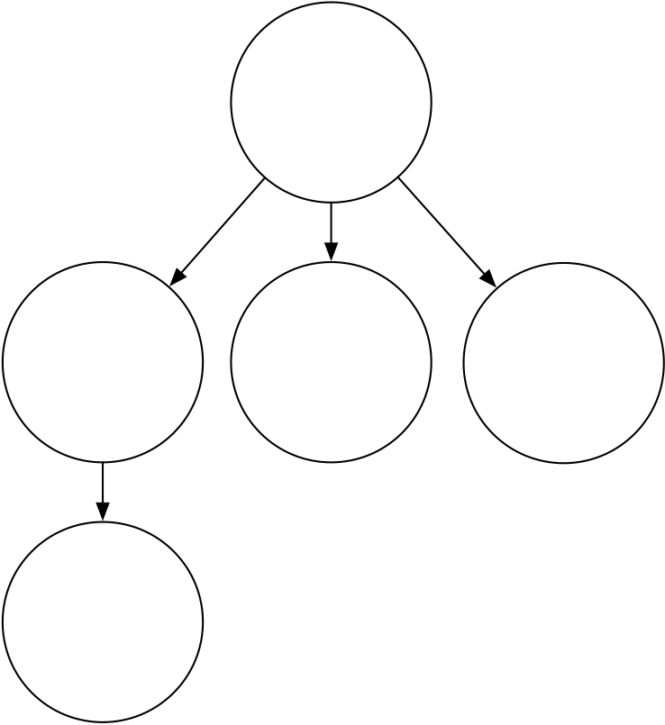
Structural Complexity - Trees and Tables
Notes:
This is the whole/part relationship - little can go wrong here. Projections allow us to reason about local hierarchical structure.

Slide 90
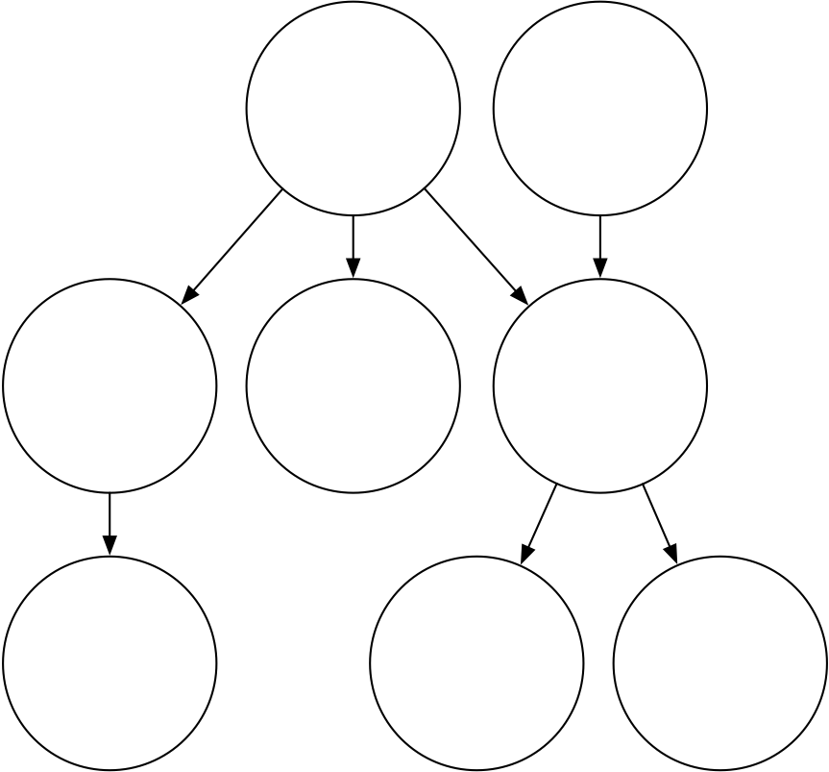
Structural Complexity - Polytrees
Notes:
Joins must be managed - this is the structure of race conditions and LOE violations. Joins are potential contradictions. Joins should be explicit and managed (last-one-in wins is almost always a bad join).
This isn't "bad" just more complex. Isolate polytrees between parts of a class.

Slide 91
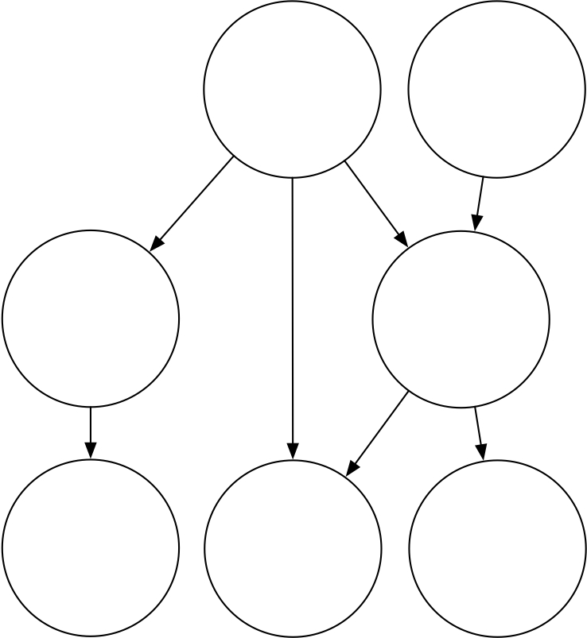
Structural Complexity - DAGs
Notes:
DAGs can rejoin - if not directed, they would contain cycles. They introduce consistency concerns (is the data calculated on this path consistent with this other path). The s-combinator is a diamond-shaped relationship. S-combinators allow us to build a system effectively Turing complete without iteration or recursion.

Slide 92
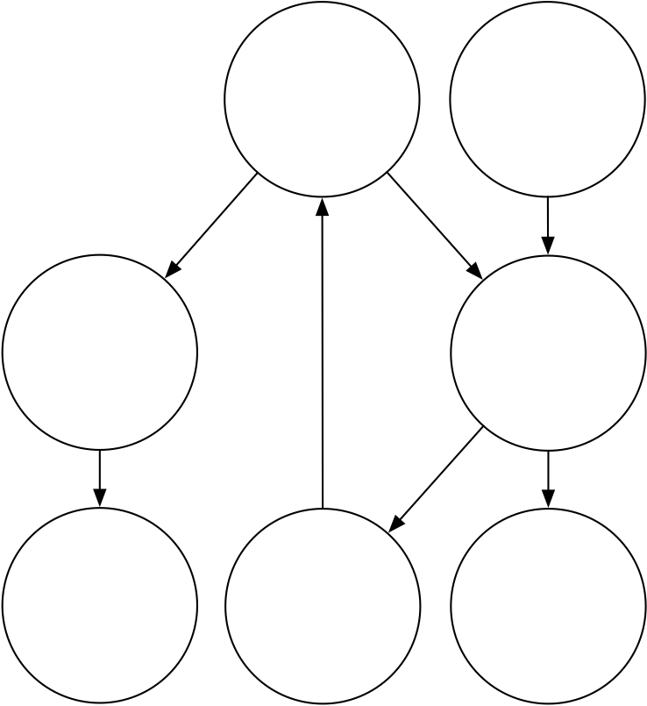
Structural Complexity - Directed Graphs
Notes:
Cycles should be factored out and replaced with a single node. "No raw loops" includes structural loops. Reasoning about traversing cycles requires proving termination and loop invariants.
Chessboards are filled with essential cyclic relationships - the queen is related to the king and the king to the queen. Chaotic systems are cyclic relationships. A chaotic node in your graph means you cannot predict the output from the input unless you know exactly how you arrived at the current state. Bugs that don't reproduce are chaotic.

Slide 93
Free Relationships
Notes:
In the 80s and into the 90s, there was a view that you could build systems at scale consisting of networks of objects. The entire OOP ethos was built around this idea. The view was always flawed but persists in reference-semantic languages.
The 80s programmers were the hippies from the 60s and 70s. Free the objects!

Slide 94
Free relationships
A free relationship is an extrinsic relationship that is not managed between parts of an object
Rust does not require extrinsic relationships to be encapsulated; these may be witnessed by:
References, iterators, slices, and indices
Mutex, Atomic, and RefMut
Safety properties are a tool to assist with local reasoning
Within any safe Turing-complete system, you can implement a C machine and write unsafe code (see asm.js)
Notes:
All too often, we circumvent safety and local reasoning for efficiency or expressibility - but doing so is fraught with issues.

Slide 95
Free relationships
Are there structures we can reason about locally composed of free relationships?
Notes:
We only have local knowledge of each object, which follows a set of rules.

Slide 96
CALM
"Question: What is the family of problems that can be consistently computed in a distributed fashion without coordination, and what problems lie outside that family?"
– Keeping CALM: WhenDistributed Consistency is Easy
Notes:
This paper is from 2019. Relatively recent.

Slide 97
CALM
"A program has a consistent, coordination-free distributed implementation if and only if it is monotonic."
– Keeping CALM: WhenDistributed Consistency is Easy
Notes:
Consistency As Logical Monotonicity (CALM).

Slide 98
CALM
Conflict-free replicated data types(CRDTs) provide a framework for monotonic programming patterns
An immutable variable is a monotonic pattern that transitions from undefined to its final value and never returns. Immutable variables generalize to immutable data structures
Notes:
Immutable globals are okay. They don't require any additional coordination. A monotonic system can never repeat its state. This is related to the class ABA problem in concurrent programming.
In 2008, I gave a Google tech talk on a possible future of software development. I conjectured that _at_ some scale, we require coordination-free computation. That scale is determined by the latency required for coordination. Significant progress has been made in recent years in this space (see CRDT and operational transforms), but many open issues remain. But we now know the bounds within which we are working.

Slide 99

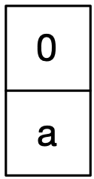

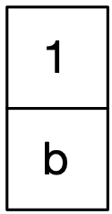
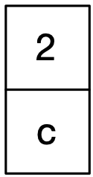
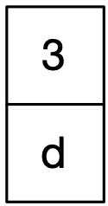
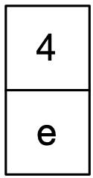
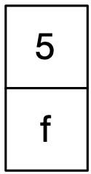
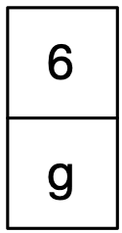
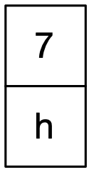
Russian Coat Check Algorithm
Notes:
In my relationships talk I presented this structure. The Russian Coat Check Algorithm (so named because I thought of it while watching how a woman managed coats at a coat check in Russia and as a nod to the Russian Peasant Algorithm - aka Egyptian Multiplication). Probably every coat check algorithm, but we don’t have coats in CA
ordered is a relationship we can exploit
[ every add is a wide gap ]

Slide 100

Russian Coat Check Algorithm
Notes:
In my relationships talk I presented this structure. The Russian Coat Check Algorithm (so named because I thought of it while watching how a woman managed coats at a coat check in Russia and as a nod to the Russian Peasant Algorithm - aka Egyptian Multiplication).
ordered is a relationship we can exploit
Probably every coat check algorithm but we don’t have coats in CA
[ every add is a wide gap ]

Slide 101
Russian Coat Check Algorithm
Notes:
ordered is a relationship we can exploit
Probably every coat check algorithm but we don’t have coats in CA
[ every add is a wide gap ]

Slide 102
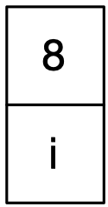
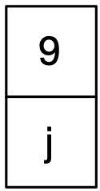
Russian Coat Check Algorithm
Notes:
This structure is monotonic. It will never repeat the same state. A given element has 3 states and never cycles.
• Has not been there
• Is there
• Was there
A Russian Coat Check can be safely shared without coordination. Generation counts in heap allocation is a related mechanism that avoids the need for explicit coordination.
CALM is a tool to help you reason about what can be meaningfully shared and provides a framework for how to reason about objects required to be shared.

Slide 103
Summary

Slide 104
Existing Code
Be conservative
Avoid modifying shared data (the borrow checker makes this the default)
Avoid creating new sharing, including by holding indices
Remember the power of preconditions and push responsibility to the caller

Slide 105
Summary
Interfaces should make the scope of the operation clear
Projections provide an efficient way to achieve value semantics and manipulate parts
Let Rust uphold the Law of Exclusivity
Implementors provide types with value semantics
Confine extrinsic relationships between parts within a class
As the relationships between parts scale, seek a general solution

Slide 106
About the artist
Leandro Alzate
Berlin-based illustrator Leandro Alzate mixes bright color palettes and stylized characters in his fanciful work for editorial and advertising clients. He draws inspiration from observing the ways people interact, and combines that with his passion for architectural shapes and spaces. He created this piece for the German Ministry of Economy to encourage people to explore work-from-home career opportunities. Working with brushes and vector shapes, Alzate created this piece entirely in Adobe Photoshop.
Made with

