Slide 1
Item-based collaborative filtering
Finding similar movies using Spark and the MovieLens data set
Introducing caching RDD’s

Slide 2
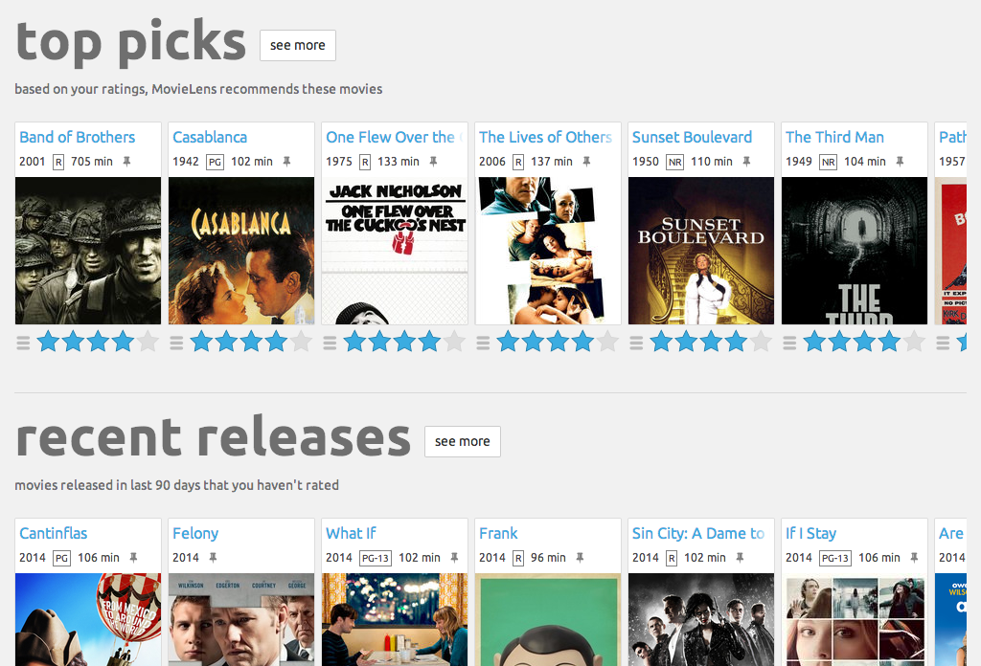
Similar movies

Slide 3
Item-based collaborative filtering
Find every pair of movies that were watched by the same person
Measure the similarity of their ratings across all users who watched both
Sort by movie, then by similarity strength
(This is just one way to do it!)

Slide 4





Item-based collaborative filtering

Slide 5
Item-based collaborative filtering

Slide 6
Item-based collaborative filtering

Slide 7
Item-based collaborative filtering

Slide 8
Making it a spark problem
Map input ratings to (userID, (movieID, rating))
Find every movie pair rated by the same user
This can be done with a “self-join” operation
At this point we have (userID, ((movieID1, rating1), (movieID2, rating2)))
Filter out duplicate pairs
Make the movie pairs the key
map to ((movieID1, movieID2), (rating1, rating2))
groupByKey() to get every rating pair found for each movie pair
Compute similaritiy between ratings for each movie in the pair
Sort, save, and display results.

Slide 9
It’s getting real
This is some heavy lifting! Let’s use every core of our computer. conf = SparkConf().setMaster("local[*]").setAppName("MovieSimilarities") sc = SparkContext(conf = conf)

Slide 10
Caching rdd’s
In this example, we’ll query the final RDD of movie similarities a couple of times
Any time you will perform more than one action on an RDD, you must cache it!
Otherwise, Spark might re-evaluate the entire RDD all over again!
Use .cache() or .persist() to do this.
What’s the difference?
Persist() optionally lets you cache it to disk instead of just memory, just in case a node fails or something.

Slide 11
Off to the code

Slide 12
Learning activity
Improve the results! Some ideas to try:
Discard bad ratings – only recommend good movies
Try different similarity metrics (Pearson Correlation Coefficient, Jaccard Coefficient, Conditional Probability)
Adjust the thresholds for minimum co-raters or minimum score
Invent a new similarity metric that takes the number of co-raters into account
Use genre information in u.items to boost scores from movies in the same genre

