Slide 1
















License Server Architecture
Region
AWS ParallelCluster
VPC
Availability Zone
Public subnet
Private subnet
Head node
SSM connection
SLURM
GPU queue
Job queue
Amazon EC2
Auto Scaling
DCV
Compute queue
Private subnet
hpc6a
hpc6a
hpc6a
FlexLM Security group
License Server
High memory queue
lmgrd
eth0
Elastic network interface
Notes:
FSx Lustre
S3
EBS
Local Storage (NVME, IO2)
1

Slide 2
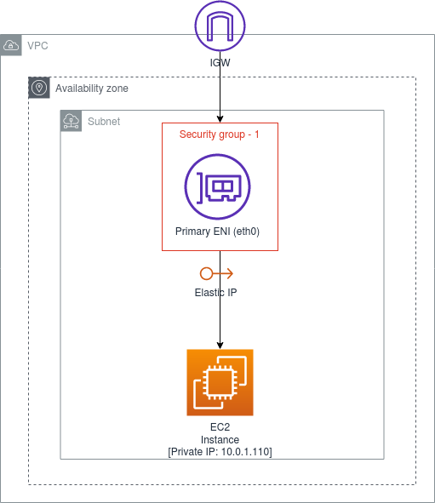

ENI Configurations
Private subnet
FlexLM Security group
License Server
Elastic IP (EIP)
lmgrd
eth0
172.31.23.39
Elastic network interface
02:73:ae:2a:dc:81

