Slide 1
Book Recommendation
Team 4
Chenghao Xu 001442383
Yingjie Yun 001388960

Slide 2
Goals of Project
Get familiar with the whole frame and workflow about how to build a recommend system & combined with data processing and algorithm implementation.
Get more project experience about Scala, Spark, RDD…
1

Slide 3
Use Cases
I like Harry Potter, what else is relevant？
Users rate books they like and will receive related result of book recommendation list
？
Exist users can update the rating of specific book
2

Slide 4
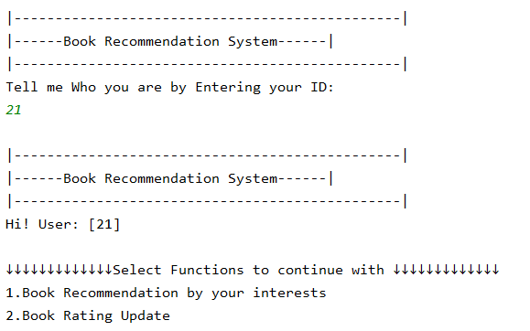
Use Cases
3

Slide 5
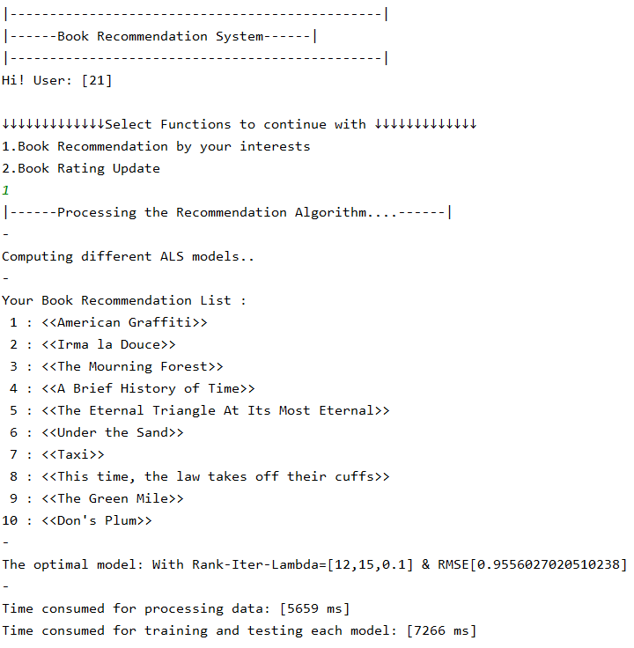
Use Cases
4

Slide 6
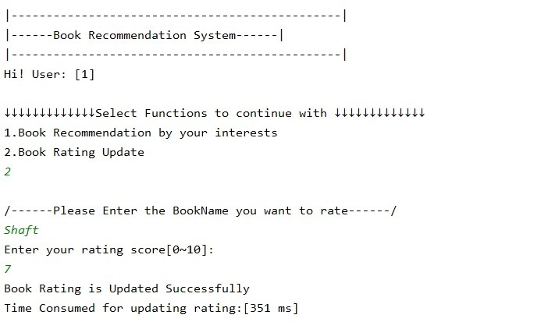
Use Cases
5

Slide 7
Data Sources
Extract the data from Book-Corssing dataset website
(http://www2.informatik.uni-freiburg.de/~cziegler/BX/)
Collected from the Book-Crossing community .Contains 278,858 users (anonymized but with demographic information) providing 1,149,780 ratings (explicit / implicit) about 271,379 books.
6

Slide 8
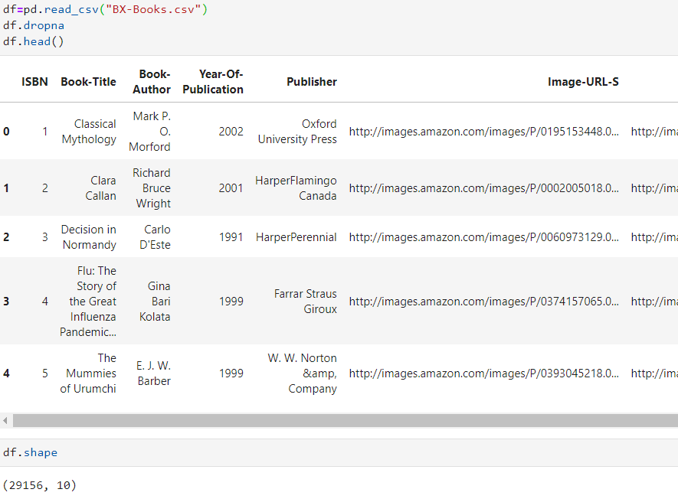
Data Quick View
7

Slide 9
Main Data Files
BookInfo-data
Rating-data
(29156,10)
(9957,4)
8

Slide 10
Methodology
Extract the data from Book-Corssing dataset website
(http://www2.informatik.uni-freiburg.de/~cziegler/BX/)
Reformat and generate structured data
Clean and break down the text of JSON format into words
Develop data- driven model and Train the model
Evaluate the result of Recommendation List
9

Slide 11
Methodology-Work Flow
User Input ID
Book: Map[Int,String]
Model
Book Recommendation
Book_information
User ID
ValidationRDD
ALS
RMSE
Raw data
Ratings data
Data
Reformat
TestRDD
Book ID
RDD[String]
User_information
TrainRDD
Parameters
Ratings
10

Slide 12
Program in Scala & Repository
Program in Scala
Repository
ALS algorithm Implementation
Extract data
Unit tests
https://github.com/sean-yun/CSYE7200_SCALA_PROJECT
11

Slide 13
ALS Algorithm
Alternating Least Squares Algorithm
ALS.train(ratings:RDD[Rating],rank:Int,iterations:Int,lambda:Double):MatrixFactorizationModel
Parameters:
Rating(userID,productID,rating)
Rank: The number of the rank represents how to Decompose matrix
Iterations: The iterations represent how many times of iteration is needed.
Lambda: The lambda represents the regularization parameter.
The smaller the value of RMSE is, means the better the model fits、
12

Slide 14
Acceptance Criteria
 | RMSE | Time for Data Process | Time for Train&Test each model
Acceptance Expected | <1 | 6s | 10s
Actual | 0.95560 | 5659ms | 7266ms
13

Slide 15
Milestone
Week1: by Nov 15
Understand Dataset& Setup all needed tools and environment
Week3: by Nov 29th
Implement filter algorithm & Match user cases
Week2: by Nov 22
Data Cleaning & Process in Scala
Week4: by Dec 6th
Final implementation & Unit test cases
14

Slide 16
Thank you!

