Slide 1
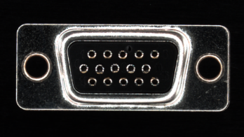
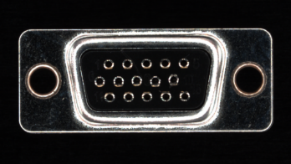
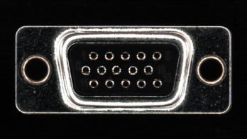
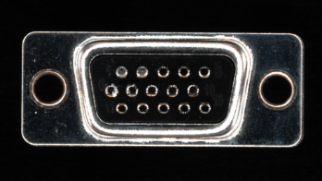
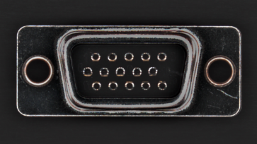
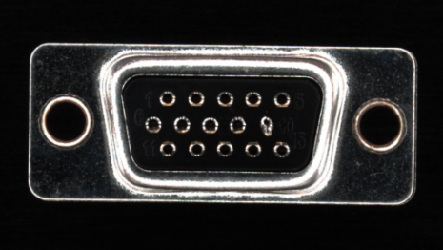
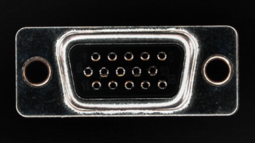
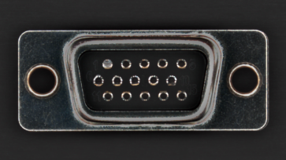
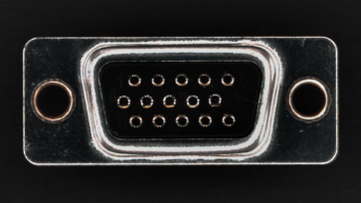
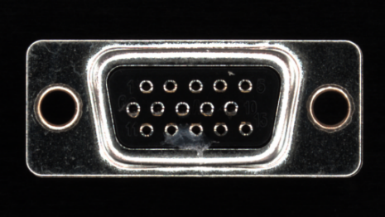
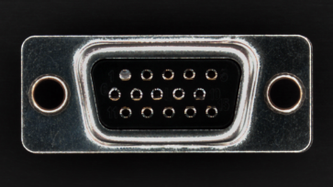
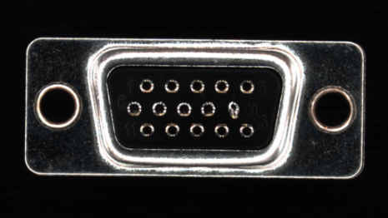
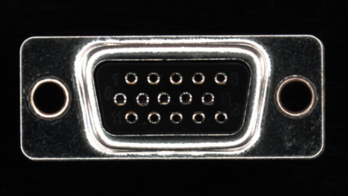

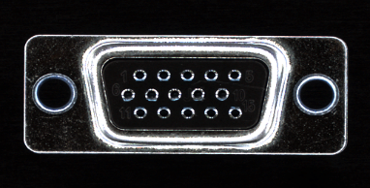


Proposed Framework
Augmentation Method 1
Augmented
Domain 1
⊕
Augmentation Method 2
Augmented
Domain 2
Augmented Domain Dataset
Multi-Source Domain Generalization Model
⊕
…
…
…
Source Domain 1
⊕
Augmentation Method N
Augmented
Domain N
Single Source-Domain Dataset
Domain Augmentation Framework

Slide 2
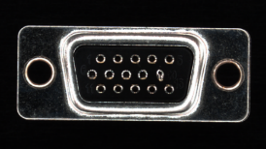
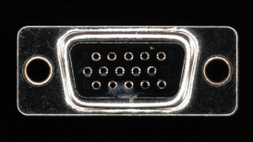

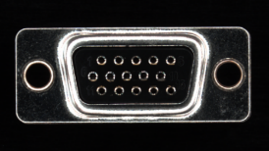
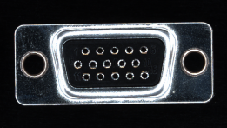

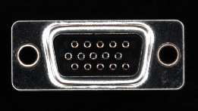
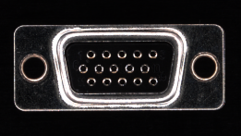

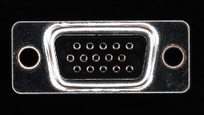
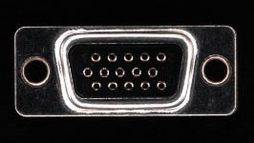
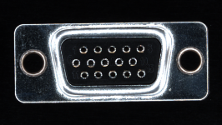
Train Phase
Augmentation Method 1
Virtual Source
Domain 1
⊕
Augmentation Method 2
Virtual Source
Domain 2
Virtual
Multi-Source Domain Dataset
Multi-Source Domain Generalization Model
⊕
…
…
…
Source Domain 1
⊕
Augmentation Method N
Virtual Source
Domain N
Single Source-Domain Dataset
Offline Augmentation for Virtual Domain
Real Target Domain 1
Test Phase
Real Target Domain 2
Multi-Source Domain Generalization Model
Test
Predict
…
Real Target Domain K
Output
Real Target Domain Dataset

Slide 3

Training phase
Production phase
Acquisition
Dataset
Production Line1
Train
Production Line1
Production Line2
Production Line3
Production Line4
Deploy
Model
99%
98%
63%
86%
42%

