Slide 1
Memory Addressing in Linux
(Chap. 2 in Understanding the Linux Kernel)
J. H. Wang
Oct. 15, 2009

Slide 2
Outline
Memory Addresses
Segmentation in Hardware
Segmentation in Linux
Paging in Hardware
Paging in Linux

Slide 3
Memory Addresses
3 kinds of addresses in 80x86 microprocessors
  Logical address
    Included in the machine language instructions
  Linear address (virtual address)
    A single 32-bit unsigned integer that can be used to address up to 4GB
  Physical address (32-bit unsigned integers)
    Used to address memory cells in memory chips

Slide 4

Segmentation in Hardware
Logical address
  Segment id: 16-bit (Segment Selector)
  Offset: 32-bit
Segment selector
  Index: of the segment descriptor
  TI (Table Indicator): GDT or LDT
  RPL (Requestor Privilege Level)
Segmentation registers
  To hold segment selectors
  Special purpose
    cs: code segment, ss: stack segment, ds: data segment
  General purpose: es, fs, gs

Slide 5
Segment descriptors: 8-byte
  Stored either in GDT (global descriptor table) or in LDT (local descriptor table)
  Address/size of segment descriptor contained in processor control registers: gdtr, ldtr
Fields in segment descriptor
  Base: 32-bit linear address
  G granularity flag: 1-bit (segment size in bytes or 4KB)
  Limit: 20-bit offset
  S system flag: 1-bit (system segment or not)
  Type: 4-bit
    Code, Data, Task Sate (TSSD), Local Descriptor Table (LDTD)

Slide 6
  DPL (descriptor privilege level): 2-bit
    To restrict access to the segment
  Segment-present flag: 1-bit (in memory or not)
  D or B flag: 1-bit (depending on code or data)
  Reserved bit (bit 53): 0
  AVL flag: 1-bit (ignored by Linux)

Slide 7
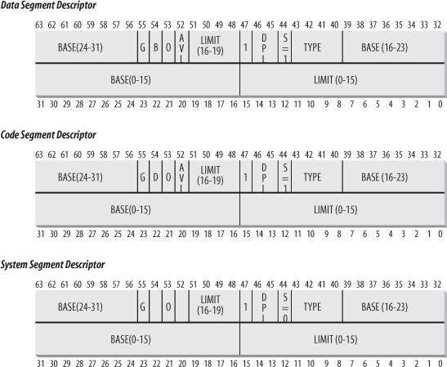
Segment Descriptor Format

Slide 8
Fast Access to Segment Descriptors
For each of the six programmable segmentation registers, 80x86 provides an additional nonprogrammable register, which is loaded every time a segment selector is loaded in a segment register
  Without accessing the GDT or LDT in memory

Slide 9
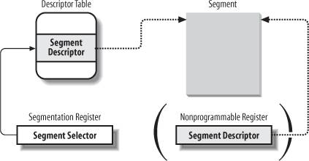
Segment Selector and Segment Descriptor

Slide 10
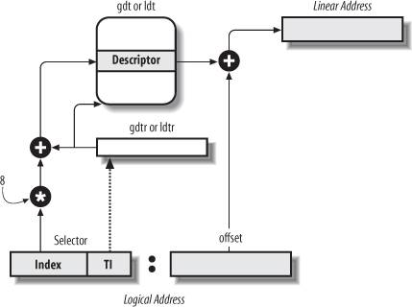
Segmentation Unit

Slide 11
Segmentation in Linux
Used in a limited way
Linux prefers paging to segmentation
  Memory management is simpler
  Portability to wide range of architectures such as RISC
-> Linux 2.6 uses segmentation only when required

Slide 12
4 main segments used by Linux
  Kernel code segment: __KERNEL_CS macro
  Kernel data segment: __KERNEL_DS macro
  User code segment: __USER_CS macro
  User data segment: __USER_DS macro

Slide 13
Linux GDTs
Linux GDTs
  One GDT per CPU
    Stored in cpu_gdt_table array
    Addresses/sizes stored in cpu_gdt_descr array
18 segment descriptors
  4 user/kernel code/data segments
  Task state segment (TSS): init_tss array
  A default LDT: default_ldt
  3 Thread-Local-Storage (TLS) segments
  3 segments related to APM (Advanced Power Management)
  5 segments related to PnP (Plug and Play)
  A special TSS segment to handle “double fault” exceptions

Slide 14
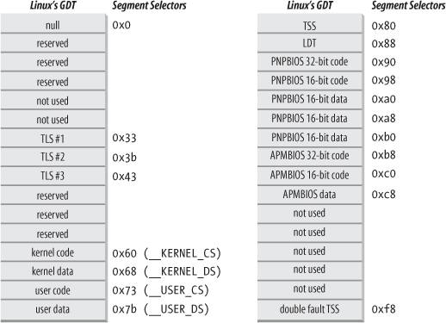
Linux GDTs

Slide 15
Linux LDTs
Default LDT: stored in default_ldt array
  5 entries included, but only two are effectively used by the kernel
    A call gate for iBCS executables
    A call gate for Solaris/x86 executables
    Call gates: mechanism provided by 80x86 microprocessors to change the privilege level of the CPU

Slide 16
Paging in Hardware
Pages: linear addresses grouped in fixed-length intervals
Page frames (physical pages): RAM partitioned into fixed-length blocks
In 80x86 processors, paging is enabled by setting the PG flag of control register cr0
  4KM pages

Slide 17
Regular Paging
4KB pages
  Linear address: 32-bit
    Directory: 10 bits
    Table: 10 bits
    Offset: 12 bits
  Two-step translation
    Page directory: physical address stored in cr3 register
    Page table

Slide 18
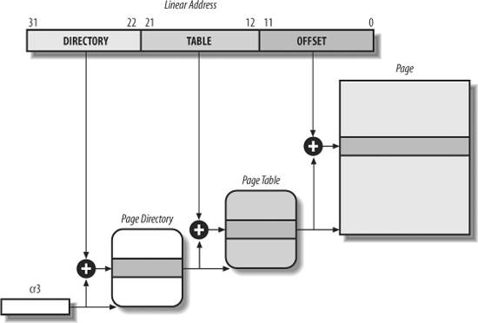
Paging by 80x86 Processors

Slide 19
Same structure for the entries in page directories and page tables
  Present flag: in memory or not
  20-MSB of a page physical address
  Accessed flag: used to select pages to be swapped out
  Dirty flag: applies only to page table entries
  Read/write flag: access right of the page
  User/supervisor flag: privilege level
  PCD and PWT flag: hardware cache
  Page size flag: applies only to page directory entries (2MB or 4MB)
  Global flag: applies only to page table entries (to prevent frequently used pages from being flushed from the TLB cache)

Slide 20
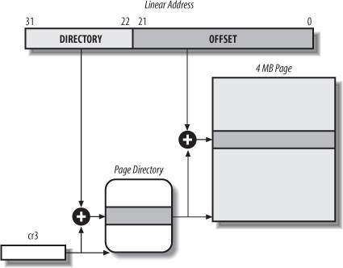
Extended Paging

Slide 21
Extended Paging
Used to translate large contiguous linear address ranges
  Page size: 4MB
Linear address: 32 bits
  Directory: 10 bits
  Offset: 22 bits
Page directory entries for extended paging are the same as for regular paging, except that:
  The Page Size flag must be set
  Only the 10 most significant bits of the 20-bit physical address are significant

Slide 22
Hardware Protection scheme for Paging
Hardware protection scheme
  Only two privilege levels associated with pages
    by user/supervisor flag
  Only two types of access rights associated with pages
    by read/write flag

Slide 23
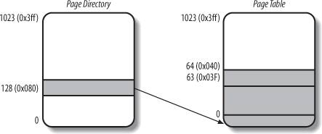
An Example of Regular Paging
Ex: 0x20000000-0x2003ffff
Zero
Valid

Slide 24
Physical Address Extension (PAE) Paging Mechanism
Starting with Pentium Pro, the number of address pins are increased to 36
  Up to 64GB RAM
  PAE is activated by setting the PAE flag in cr4 control register

Slide 25
Paging mechanism changes
  2²⁴ page frames, physical address field of page table entries expanded from 20 to 24 bits
  A new level of page table called PDPT (Page Directory Pointer Table)
    Consists of 4 64-bit entries
    Cr3 register contains 27-bit PDPT base address field

Slide 26
  When mapping 4KB pages
    Bits 31-30: points to entries in PDPT
    Bits 29-21: points to entries in page directory
    Bits 20-12: points to entries in page table
    Bits 11-0: offset
  When mapping 2MB pages
    Bits 31-30: points to entries in PDPT
    Bits 29-21: points to entries in page directory
    Bits 20-0: offset

Slide 27
Paging for 64-bit Architectures
Two-level paging is not suitable
  The number of levels depends on the type of processor
    3-level: alpha, ia64, ppc64, sh64
    4-level: x86_64

Slide 28
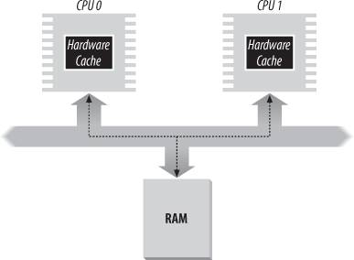
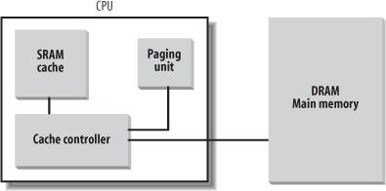
Hardware Cache
TLB: Translation Lookaside Buffers

Slide 29
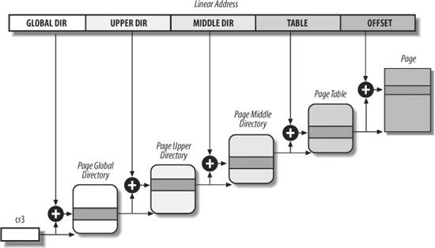
Paging in Linux

Slide 30
Paging in Linux
A common paging model for both 32-bit and 64-bit architectures
  Up to Linux version 2.6.10, 3-level paging
  Starting with 2.6.11, 4-level paging
With no PAE, 2-level paging is enough
  Linux essentially eliminates the Page Upper Directory and Page Middle Directory fields
With PAE, 2-level paging is used
  Page Global Directory: x86’s PDPT
  Page Upper Directory: (eliminated)
  Page Middle Directory: x86’s Page Directory
  Page Table: x86’s Page Table

Slide 31
Page Table Handling Functions/Macros (see pp. 57-61)
Macros for simplifying page table handling:
  PAGE_SHIFT, PMD_SHIFT, PUD_SHIFT, PGDIR_SHIFT
  PTRS_PER_PTE, PTRS_PER_PMD, PTRS_PER_PUD, PTRS_PER_PGD
Data structures for page table handling:
  pte_t, pmd_t, pud_t, pgd_t
  pgprot_t
Macros for page table type conversions:
  Macros: __pte, __pmd, __pud, __pgd, __pgprot
  Macros: pte_val, pmd_val, pud_val, pgd_val, pgprot_val

Slide 32
Macros and functions to read or modify page table entries:
  pte_none, pmd_none, pud_none, pgd_none
  pte_clear, pmd_clear, pud_clear, pgd_clear
  set_pte, set_pmd, set_pud, set_pgd
  pte_same(a,b), pmd_large(e)
  pte_present, pmd_present, pud_present, pgd_present
Macros to check page table entries
  pmd_bad, pud_bad, pgd_bad
Functions to query the current value of any flag in a page table entry:
  pte_user(), pte_read(), pte_write(), pte_exec(), pte_dirty(), pte_young(), pte_file()
Functions to set the value of flags in a page table entry:
  mk_pte_huge(), pte_wrprotect(), pte_rdprotect(), pte_exprotect(), pte_mkwrite(), pte_mkread(), pte_mkexec(), pte_mkdirty(), pte_mkclean(), pte_mkyound(), pte_mkold(), pte_modify(p,v),
  ptep_set_wrprotect(), ptep_set_access_flags(), ptep_mkdirty(), ptep_test_and_clear_dirty(), ptep_test_and_clear_young()

Slide 33
Macros to combine/extract page address into/from a page entry
  mk_pte, mk_pte_phys, pte_page(), pmd_page(), pgd_offset(p,a), pmd_offset(p,a), pte_offset(p,a)
Functions to create and delete page table entries:
  pgd_alloc(m), pud_alloc(m, p, a), pmd_alloc(m,p,a), pte_alloc(m,p,a)
  pte_free(p), pmd_free(x), pud_free(x), pgd_free(p), free_one_pmd(), free_one_pgd(), clear_page_tables()

Slide 34
Physical Address Layout
In general, Linux kernel is installed in RAM starting from the second megabyte (0x00100000)
  Page frame 0: used by BIOS (to store system configuration detected during POST
  0x000a0000 to 0x000fffff: reserved to BIOS (to map ISA cards)
  Some page frames within the first megabytes may be reserved by specific computer models

Slide 35
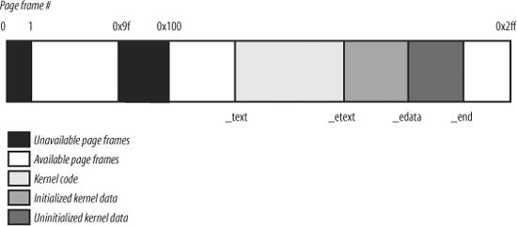
The First 768 Page Frames (3MB) in Linux 2.6

Slide 36
Thanks for Your Attention!

