Slide 1
Processes and Threads in Linux
(Chap. 3 in Understanding the Linux Kernel)
J. H. Wang
Sep. 30, 2009

Slide 2
Processes, Lightweight Processes, and Threads
Process: an instance of a program in execution
(User) Thread: an execution flow of the process
  Pthread (POSIX thread) library
Lightweight process (LWP): used to offer better support for multithreaded applications
  LWP may share resources: address space, open files, …
  To associate a lightweight process with each thread
  Examples of pthread libraries that use LWP: LinuxThreads, IBM’s Next Generation Posix Threading Package (NGPT)

Slide 3
Process Descriptor
task_struct data structure
  state: process state
  thread_info: low-level information for the process
  mm: pointers to memory area descriptors
  tty: tty associated with the process
  fs: current directory
  files: pointers to file descriptors
  signal: signals received
  …

Slide 4
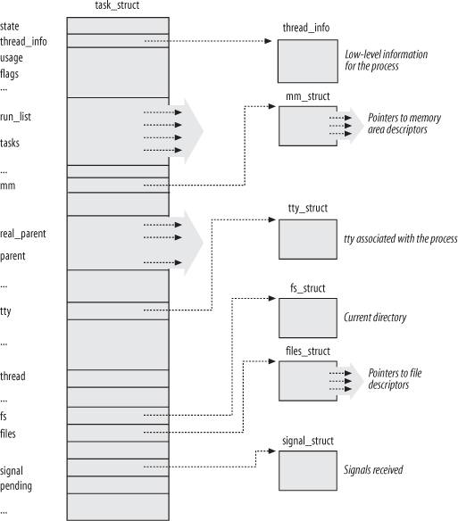
Linux Process Descriptor

Slide 5
Process State
TASK_RUNNING: executing
TASK_INTERRUPTABLE: suspended (sleeping)
TASK_UNINTERRUPTABLE: (seldom used)
TASK_STOPPED
TASK_TRACED
EXIT_ZOMBIE
EXIT_DEAD

Slide 6
Identifying a Process
Process descriptor pointers: 32-bit
Process ID (PID): 16-bit (~32767 for compatibility)
  Linux associates different PID with each process or LWP
  Programmers expect threads in the same group to have a common PID
  Thread group: a collection of LWPs (kernel 2.4)
    The PID of the first LWP in the group
    tgid field in process descriptor: using getpid() system call

Slide 7
Process Descriptor Handling
union thread_union {
struct thread_info thread_info;
unsigned long stack[2048];
};
Two data structures in 8KB (2 pages)
  thread_info structure (new to 3rd ed.)
  Kernel mode process stack

Slide 8
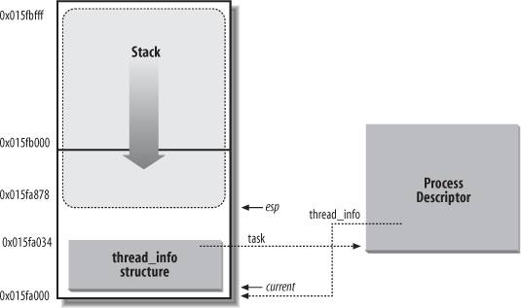
Storing the thread_info Structure and the Process Kernel Stack

Slide 9
Identifying the Current Process
Obtain the address of thread_info structure from the esp register
  current_thread_info()
  movl $0xffffe000, %ecx
  andl %esp, %ecx
  movl %ecx, p
The process descriptor pointer of the process currently running on a CPU
  The current macro: equivalent to current_thread_info()->task
  movl $0xffffe000, %ecx
  andl %esp, %ecx
  movl (%ecx), p

Slide 10
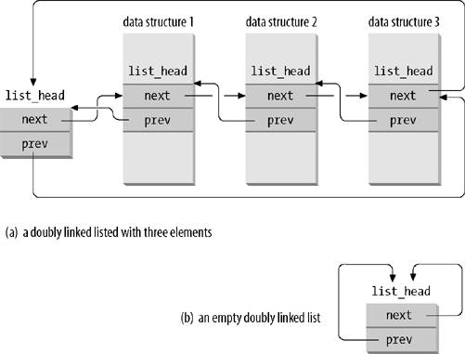
Doubly Linked Lists Built with the list_head Data Structure

Slide 11
List Handling Functions and Macros
LIST_HEAD(list_name)
list_add(n,p)
list_add_tail(n,p)
list_del(p)
list_empty(p)
list_entry(p,t,m)
list_for_each(p,h)
list_for_each_entry(p,h,m)

Slide 12
The Process List
tasks field in task_struct structure
  type list_head
  prev, next fields point to the previous and the next task_struct
Process 0 (swapper): init_task
Useful macros:
  SET_LINKS, REMOVE_LINKS: insert and remove a process descriptor
  #define for_each_process(p) \
  for (p=&init_task; (p=list_entry((p)->tasks.next), \
  struct task_struct, tasks) \
  ) != &init_task; )

Slide 13
List of TASK_RUNNING processes
runqueue
  run_list field in task_struct structure: type list_head
Linux 2.6 implements the runqueue differently
  To achieve scheduler speedup, Linux 2.6 splits the runqueue into 140 lists of each priority!
  array filed of process descriptor: pointer to the prio_array_t data structure
    nr_active: # of process descriptors in the list
    bitmap: priority bitmap
    queue: the 140 list_heads
  enqueue_task(p, array), dequeue_task(p, array)

Slide 14
Parenthood Relationships among Processes
Process 0 and 1: created by the kernel
  Process 1 (init): the ancestor of all processes
Fields in process descriptor for parenthood relationships
  real_parent
  parent
  children
  sibling

Slide 15
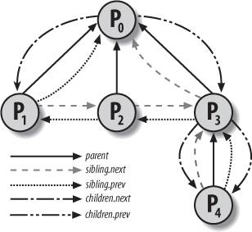
Parenthood Relationships among Five Processes

Slide 16
Pidhash Table and Chained Lists
To search up the search for the process descriptor of a PID
  Sequential search in the process list is inefficient
The pid_hash array contains four hash tables and corresponding filed in the process descriptor
  pid: PIDTYPE_PID
  tgid: PIDTYPE_TGID (thread group leader)
  pgrp: PIDTYPE_PGID (group leader)
  session: PIDTYPE_SID (session leader)
Chaining is used to handle PID collisions

Slide 17
The pidhash Table
Size of each pidhash table: dependent on the available memory
PID is transformed into table index using pid_hashfn macro
  #define pid_hashfn(x) hash_long((unsigned long)x, pidhash_shift)
  unsigned long hash_long(unsigned long val, unsigned int bits)
  {
  unsigned long hash = val * 0x9e370001UL;
  return hash >> (32-bits);
  }

Slide 18
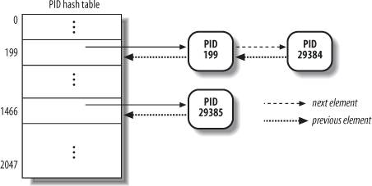
A Simple Example PID Hash Table and Chained Lists

Slide 19
pids field of the process descriptor: the pid data structures
  nr: PID number
  pid_chain: links to the previous and the next elements in the hash chain list
  pid_list: head of the per-PID list (in thread group)

Slide 20
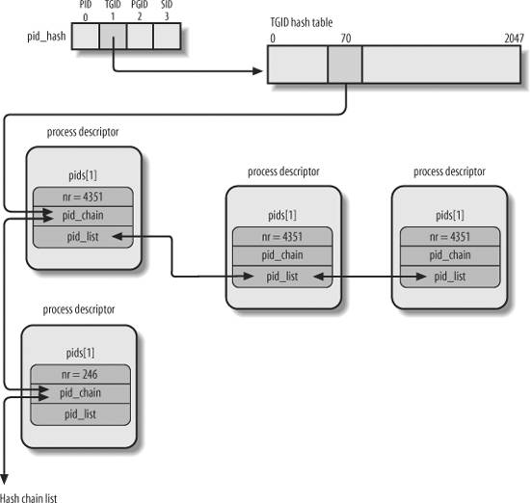
The PID Hash Tables

Slide 21
PID Hash Table Handling Functions and Macros
do_each_trask_pid(nr, type, task)
while_each_trask_pid(nr, type, task)
find_trask_by_pid_type(type, nr)
find_trask_by_pid(nr)
attach_pid(task, type, nr)
detach_pid(task, type)
next_thread(task)

Slide 22
How Processes are Organized
Processes in TASK_STOPPED, EXIT_ZOMBIE, EXIT_DEAD: not linked in lists
Processes in TASK_INTERRUPTABLE, TASK_UNINTERRUPTABLE: wait queues
Two kinds of sleeping processes
  Exclusive process
  Nonexclusive process: always woken up by the kernel when the event occurs

Slide 23
Wait Queues
struct _ _wait_queue_head {
spinlock_t lock;
struct list_head task_list;
};
typedef struct _ _wait_queue_head wait_queue_head_t;
struct _ _wait_queue {
unsigned int flags;
struct task_struct * task;
wait_queue_func_t func;
struct list_head task_list;
};
typedef struct _ _wait_queue wait_queue_t;

Slide 24
Handling Wait Queues
Wait queue handling functions:
  add_wait_queue()
  add_wait_queue_exclusive()
  remove_wait_queue()
  wait_queue_active()
  DECLARE_WAIT_QUEUE_HEAD(name)
  init_waitqueue_head()
To wait:
  sleep_on()
  interruptible_sleep_on()
  sleep_on_timeout(), interruptible_sleep_on_timeout()
  Prepare_to_wait(), prepare_to_wait_exclusive(), finish_wait()
  Macros: wait_event, wait_event_interruptible

Slide 25
To be woken up:
  Wake_up, wake_up_nr, wake_up_all, wake_up_sync, wake_up_sync_nr, wake_up_interruptible, wake_up_interruptible_nr, wake_up_interruptible_all, wake_up_interruptible_sync, wake_up_interruptible_sync_nr

Slide 26
Process Resource Limits
RLIMIT_AS
RLIMIT_CORE
RLIMIT_CPU
RLIMIT_DATA
RLIMIT_FSIZE
RLIMIT_LOCKS
RLIMIT_MEMLOCK
RLIMIT_MSGQUEUE
RLIMIT_NOFILE
RLIMIT_NPROC
RLIMIT_RSS
RLIMIT_SIGPENDING
RLIMIT_STACK

Slide 27
Process Switch
Process switch, task switch, context switch
  Hardware context switch: a far jmp (in older Linux)
  Software context switch: a sequence of mov instructions
    It allows better control over the validity of data being loaded
    The amount of time required is about the same
Performing the Process Switch
  Switching the Page Global Directory
  Switching the Kernel Mode stack and the hardware context

Slide 28
Task State Segment
TSS: a specific segment type in x86 architecture to store hardware contexts

Slide 29
Creating Processes
In traditional UNIX, resources owned by parent process are duplicated
  Very slow and inefficient
Mechanisms to solve this problem
  Copy on Write: parent and child read the same physical pages
  Lightweight process: parent and child share per-process kernel data structures
  vfork() system call: parent and child share the memory address space

Slide 30
clone(), fork(), and vfork() System Calls
clone(fn, arg, flags, child_stack, tls, ptid, ctid): creating lightweight process
  A wrapper function in C library
  Uses clone() system call
fork() and vfork() system calls: implemented by clone() with different parameters
Each invokes do_fork() function

Slide 31
Kernel Threads
Kernel threads run only in kernel mode
They use only linear addresses greater than PAGE_OFFSET

Slide 32
Kernel Threads
kernel_thread(): to create a kernel thread
Example kernel threads
  Process 0 (swapper process), the ancestor of all processes
  Process 1 (init process)
  Others: keventd, kapm, kswapd, kflushd (also bdflush), kupdated, ksoftirqd, …

Slide 33
Destroying Processes
exit() library function
  Two system calls in Linux 2.6
    _exit() system call
      Handled by do_exit() function
    exit_group() system call
      By do_group_exit() function
Process removal
  Releasing the process descriptor of a zombie process by release_task()

Slide 34
Thanks for Your Attention!

