Slide 1
Virtual File System in Linux
(Chap. 12 in Understanding the Linux Kernel)
J. H. Wang
Nov. 22, 2011

Slide 2
Outline
Role of VFS
VFS Data Structures
Filesystem Types
Filesystem Handling
Pathname Lookup
Implementation of VFS System Calls
File Locking

Slide 3
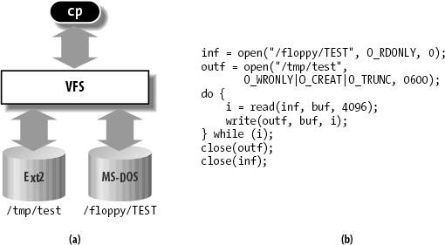
Role of VFS
A common interface to several kinds of filesystems
  Ex: cp /floppy/TEST /tmp/test

Slide 4
Filesystems supported by the VFS
  Disk-based filesystems
    Ext2, ext3, ReiserFS
    Sysv, UFS, MINIX, VxFS
    VFAT, NTFS
    ISO9660 CD-ROM, UDF DVD
    HPFS, HFS, AFFS, ADFS,
  Network filesystems
    NFS, Coda, AFS, CIFS, NCP
  Special filesystems
    E.g. /proc

Slide 5
The Common File Model
Capable of representing all supported filesystems
  Each specific filesystem implementation must translate its physical organization into VFS’s common file model
  E.g.: read(…): file->f_op->read(…);
Object-oriented: data structures and associated operations
  Superblock object: a mounted filesystem
  Inode object: information about a file
  File object: interaction between an open file and a process
  Dentry object: directory entry

Slide 6
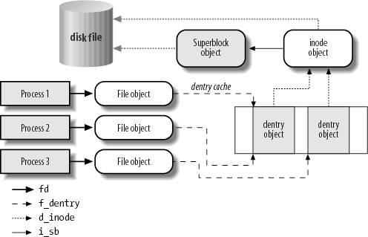

Slide 7
Some System Calls Handled by the VFS
Filesystem
  Mount(), umount(), umount2()
  Sysfs()
  Statfs(), fstatfs(), statfs64(), fstatfs64(), ustat()
Directories
  Chroot(), pivot_root()
  Chdir(), fchdir(), getcwd()
  Mkdir(), rmdir()
  Getdents(), getdents64(), readdir(), link(), unlink(), rename(), lookup_dcookie()
Links
  Readlink(), symlink()

Slide 8
Files
  Chown(), fchown(), lchown(), chown16(), fchown16(), lchown16()
  Chmod(), fchmod(), utime()
  Stat(), fstat(), lstat(), acess(), oldstat(), oldfstat(), oldlstat(), stat64(), lstat64(), fstat64()
  Open(), close(), creat(), umask()
  Dup(), dup2(), fcntl(), fcntl64()
  Select(), poll()
  Truncate(), ftruncate(), truncate64(), ftruncate64()
  Lseek(). _llseek()
  Read(), write(), readv(), writev(), sendfile(), sendfile64(), readahead()

Slide 9
Others
  Io_setup(), io_submit(), io_getevents(), io_cancel(), io_destroy()
  Pread64(), pwrite64()
  Mmap(), mmap2(), munmap(), madvise(), mincore(), remap_file_pages()
  Fdatasync(), fsync(), sync(), msync()
  Flock()
  Setxattr(), lsetxattr(), fsetxattr(), getxattr(), lgetxattr(0, fgetxattr(), listxattr(), llistxattr(), flistxattr(), removexattr(), lremovexattr(), fremovexattr()

Slide 10
VFS Data Structures
Superblock objects: super_block structure
  (Table 12-2)
  S_op: superblock operations – super_operations structure
    Alloc_inode(), destroy_inode()
    Read_inode(), dirty_inode(), write_inode(),
    Put_inode(), drop_inode(), delete_inode()
    Put_super(), write_super()
    Sync_fs(), write_super_lockfs(), unlokcfs(), statfs(), remount_fs()
    Clear_inode(), umount_begin()
    Show_options(), quota_read(), quota_write()

Slide 11
Inode objects (Table 12-3): inode structure
  i_op: inode operations – inode_operations structure
    Create(), lookup(), link(), unlink(), symlink()
    Mkdir(), rmdir(), mknod(), rename()
    readlink(), follow_link(), put_link()
    Truncate(), permission(),
    Setattr(), getattr(), setxattr(), getxattr(), listxattr(), removexattr()

Slide 12
File objects: file structure (Table 12-4)
  File operations
    Llseek(), read(), aio_read(), write(), auio_write()
    Readdir(), poll(), ioctl(), unlocked_ioctl(), compat_ioctl()
    Mmap(), open(), flush(), release()
    Fsync(), aio_fsync(), fasync(), lock()
    Readv(), writev(), sendfile(), sendpage()
    Get_unmapped_area(), check_flags(), dir_notify(), flock()

Slide 13
Dentry objects: (Table 12-5)
  States: free, unused, in use, negative
  Dentry operations
    D_revalidate()
    D_hash()
    D_compare()
    D_delete()
    D_release()
    D_input()
Dentry cache
  A set of dentry objects
  A hash table

Slide 14
Files Associated with a Process
fs field: fs_struct structure (Table 12-6)
files field: files_struct structure (Table 12-7)
  fd: file descriptors
    fd[0]: stdin
    fd[1]: stdout
    fd[2]: stderr
  NR_OPEN: max # of file descriptors for a process
    Usually 1,048,576

Slide 15
Special Filesystems
(Tabel 12-8)
  /dev/pts: pseudo terminal support
  /proc: general access point to kernel data structures
  /sys: general access point to system data
  /proc/bus/usb: USB devices
  …

Slide 16
Filesystem Type Registration
File_system_type object: (Table 12-9)
Fs_flags: (Table 12-10)

Slide 17
Filesystem Handling
Root filesystem
Mount point
Namespaces: in Linux 2.6, each process might have its own tree of mounted filesystems
  Namespace structure (Table 12-11)
Filesystem mounting
  It’s possible in Linux to mount the same filesystem several times
  Mounted filesystem descriptor: of type vfsmount (Tabel 12-12)
  Mounting/unmounting the filesystem

Slide 18
Pathname lookup
  Pathname -> inode
  Pathlookup(): return the nameidata structure (Table 12-15)
  Standard pathname lookup
  Parent pathname lookup
  Lookup of symbolic links

Slide 19
Implementation of VFS System Calls
Open()
Read()
Write()
Close()

Slide 20
File Locking
Advisory locks: by POSIX
  Based on fcntl() system call
  Possible to lock an arbitrary region of a file
Mandatory locks: by System V Release 3
  The kernel checks every invocation of open(), read(), write() system calls does not violate a mandatory lock
Linux supports both + fcntl() and flock() system calls

Slide 21
Thanks for Your Attention!

