Slide 1
RCJ Soccer

Slide 2
Input & output
Input:
IR
Light Sensor
IMU(BNO055)
Output:
Kicker
Motor Driver

Slide 3
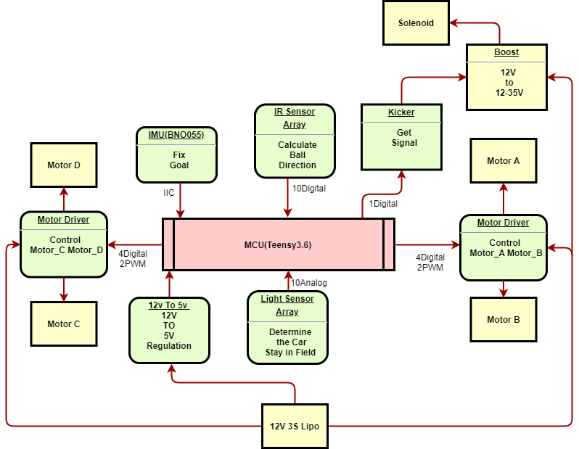
Block diagram

Slide 4
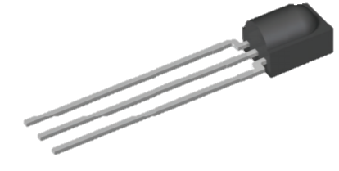
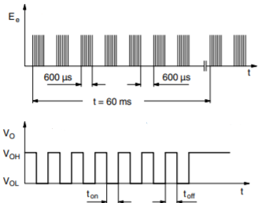
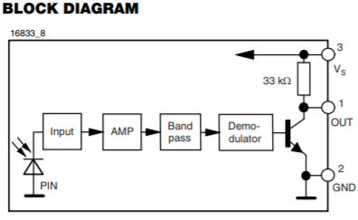
IR
外部測試訊號
1
2
3
1 = Output, 2 = GND, 3 = Vs
IR輸出訊號

Slide 5
code

Slide 6
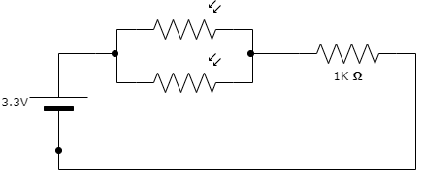
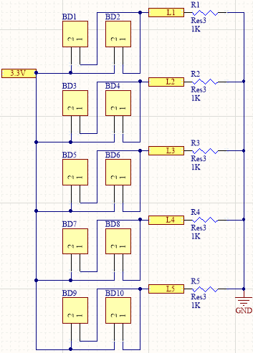
Light sensor
signal

Slide 7
code

Slide 8
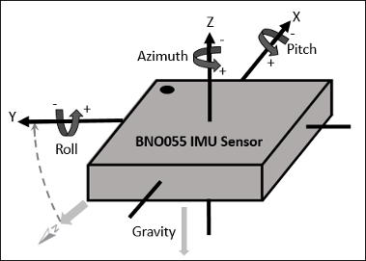
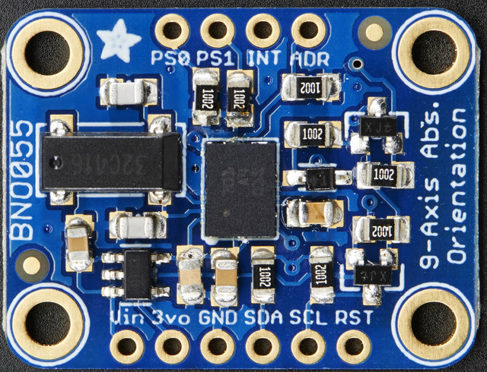
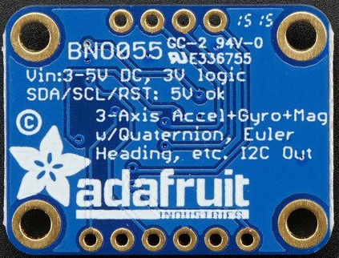
IMU

Slide 9
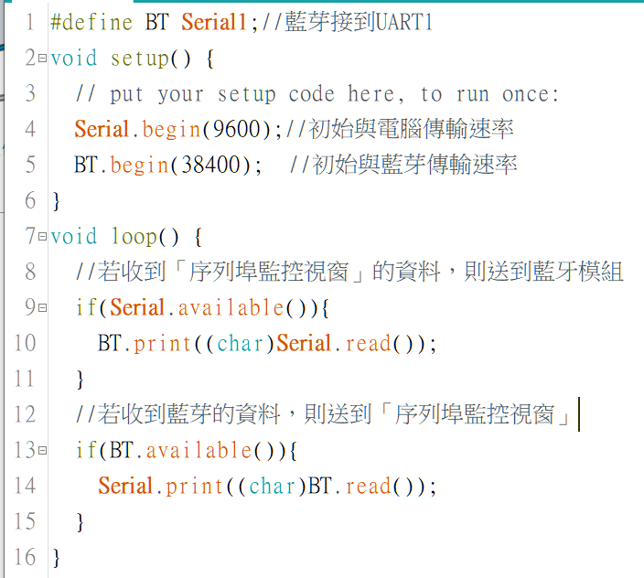
code

Slide 10
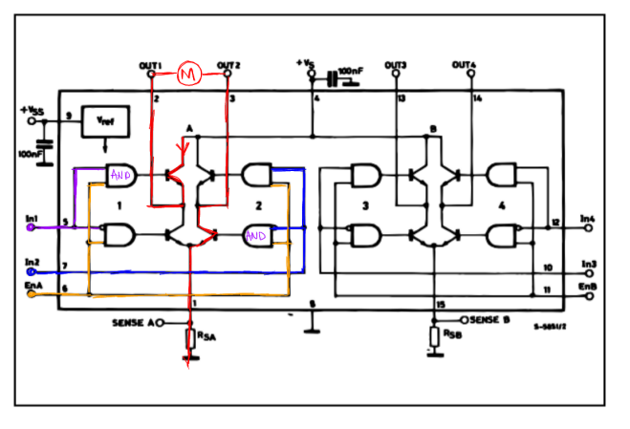
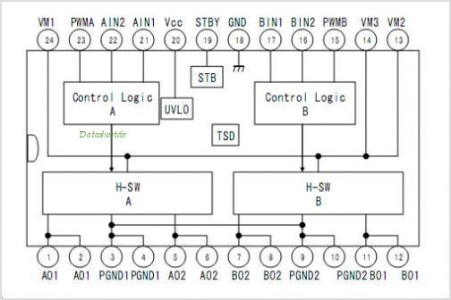
Motion
2Digitanl 1PWM for 1Motor
2PWM for 1Motor

Slide 11
code

Slide 12
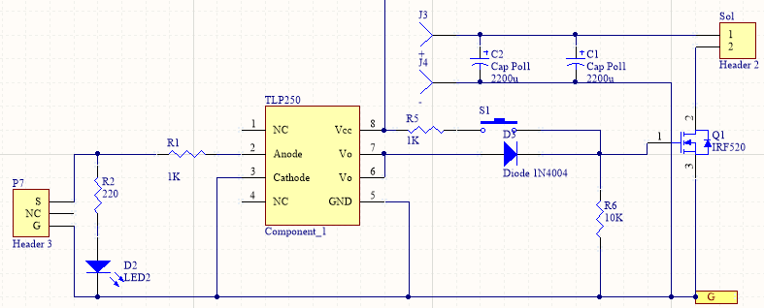
kicker
Boost Input
12V

Slide 13
code

