Slide 1
Mood player
Team 20 R漱漱一

Slide 2
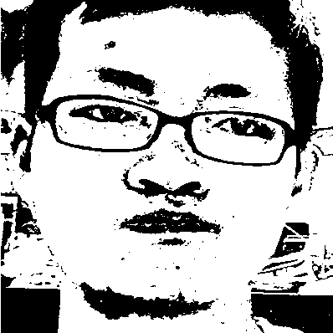
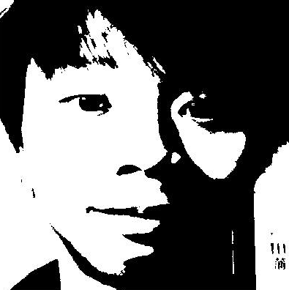
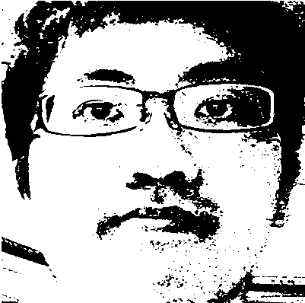
Team Members
R04922125 李啟維
Job: Show me the face
R04922102 郭世展
Job: Take the face
R04943052 林柏成
Job: Beauty the face
Collaboration mechanism:
Github https://github.com/sean2249/AI_Project_FaceDetection

Slide 3

Background
We listen to MUSIC when we’re GLAD
We listen to MUSIC when we’re SAD
We listen to MUSIC when we’re MAD
Our mood decide what we want to listen!!
Every time we’d like to play some songs, usually we will choose a song that we already known before.
If we would like to try something new, the only way we do is to judge the song by its title.
If it hits our moods, it’s nice; but if it don’t…

Slide 4




Problem definition
Let’s build a system that automatically provide songs by user’s mood.
Problems:
How to get user’s mood?
How to extract faces feature in photos?
How does computer decide one’s mood?
How to improve our system accuracy?
How to combine with music recommend?

Slide 5
Proposed methods
Take photo
Preprocessing Image
Mood detector
Face detector
Play corresponding music!
Input stage
Take one’s picture on the camera of laptop.
Pre-processing stage
Draw ROI by MATLAB vision.CascadeObjectDetector.
Feature computing stage
Quantize the face image into gray level.
Compute HOG of the face image extracted in the previous step.
Train classifier (SVM)
Use KDEF images to pass through stage 1-3, to get train set and uses them to train SVM model.
Classifying, play music
With the model, we can build our system.
KDEF: Karolinska Directed Emotional Faces http://goo.gl/h220y8

Slide 6
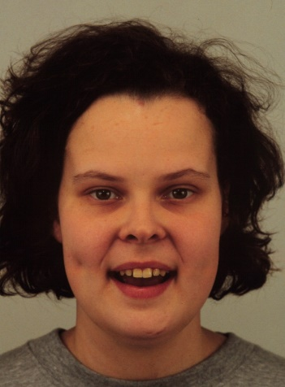
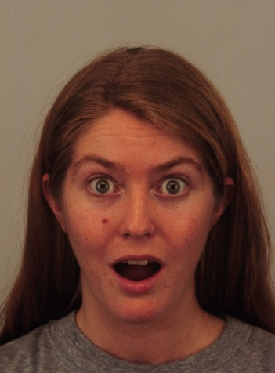
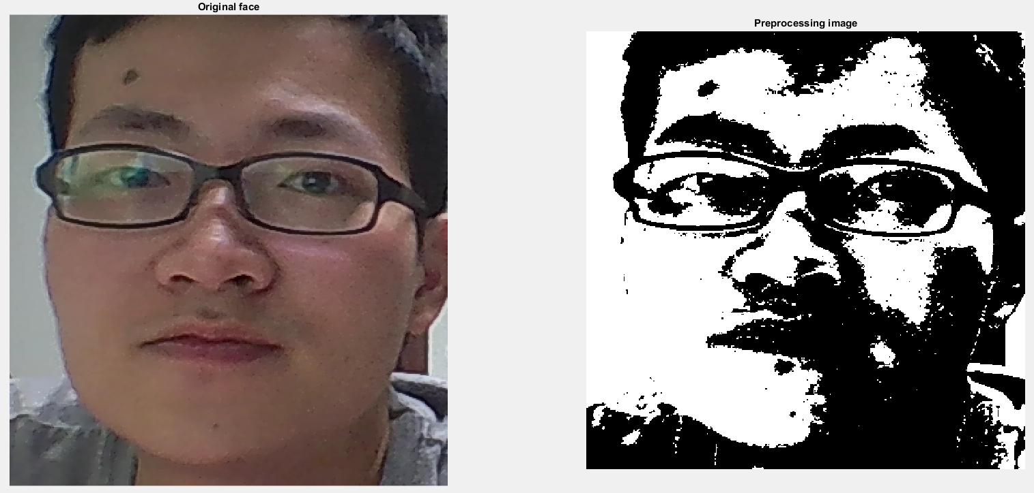
Results
HOG
cellSize = [8 8], blockSize = [2 2]
SVM
With train set of nearly 1000 images.
Validation accuracy 82%
Validation test image: 100
Demo: Our tested with camera, laptop and speaker
Happy
Surprised
Afraid

Slide 7
Discussion
Bad accuracy when trying to use gabor as feature extraction.
Binary image is good for HOG extract.
Work well (80%) in validation, but in our test often label to afraid, sad, happy.
Future work
Maybe AAM would improve performance of classifying?
Facial expressions are hard to define?
(surprised vs afraid, discussed vs sad …)
Improve our song recommend system by adding music mood classification which can collect user’s song data.

Slide 8


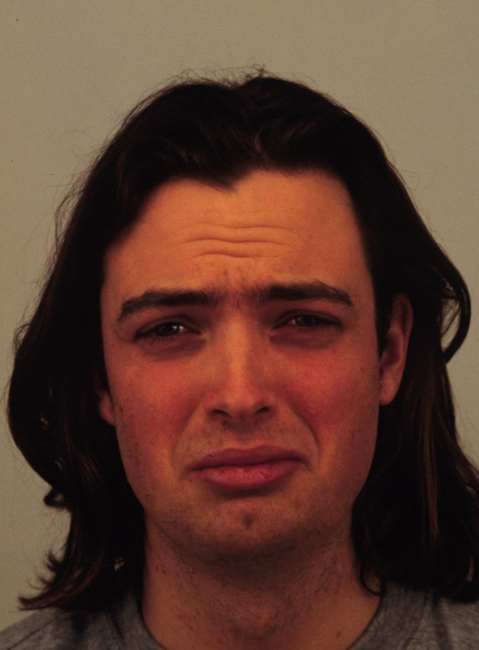
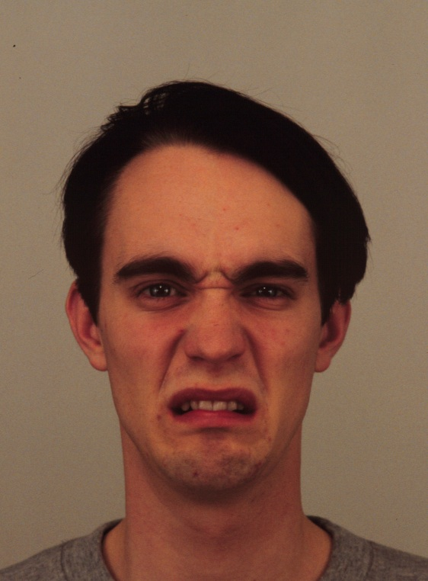
KDEF
Happy
Surprised
Sad
Disgusted

Slide 9
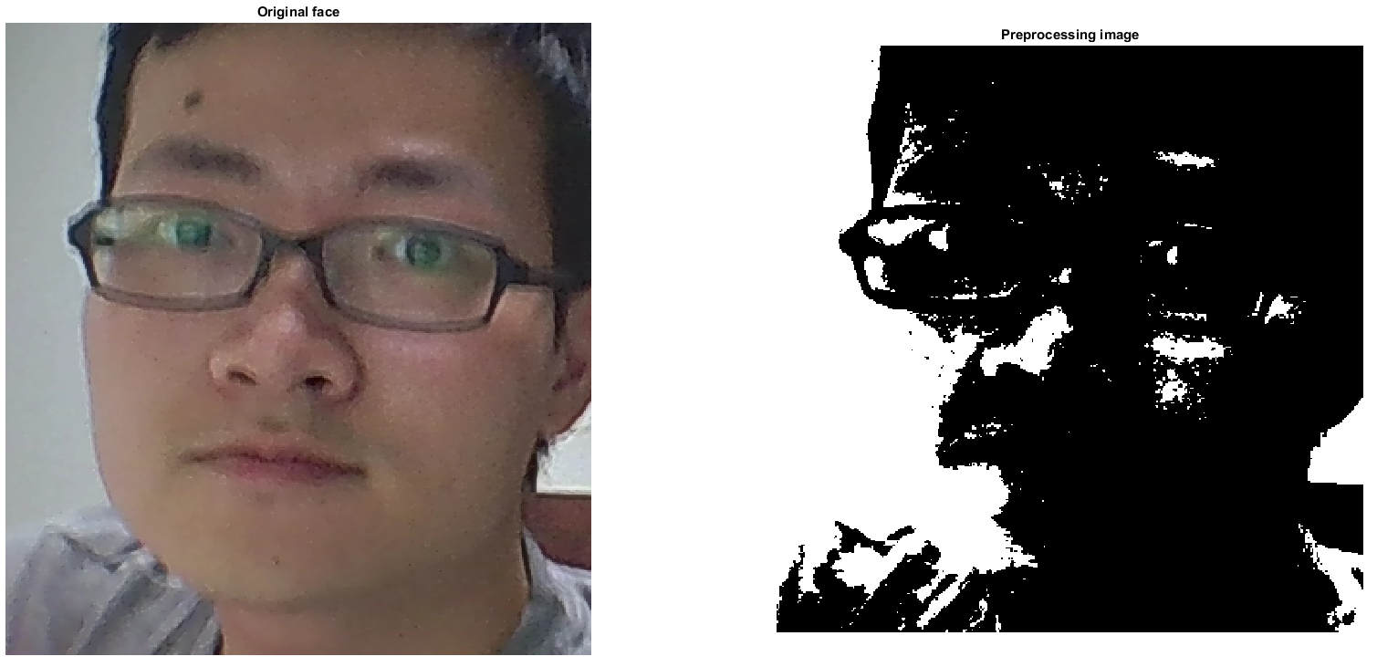

Slide 10
Reference
https://i.ytimg.com/vi/oCqGtM3yAig/maxresdefault.jpg
http://blog.enjoycss.com/wp-content/uploads/2015/09/woman-making-list.jpg
http://thumbs.dreamstime.com/z/happy-teenage-laugh-closeup-close-up-portrait-loudly-laughing-young-man-isolated-white-background-35325424.jpg
http://i.dailymail.co.uk/i/pix/2014/08/29/1409331226296_Image_galleryImage_17_Jan_2013_Businessman_y.JPG
https://blog.udemy.com/wp-content/uploads/2014/05/bigstock-Portrait-of-a-sad-man-41540233-300x234.jpg
http://www.thetailgatetimes.com/wp-content/uploads/2016/02/Curry-and-Lebron-James.jpg
http://core0.staticworld.net/images/article/2012/10/v5-471p20win820left20facin-100008105-orig.jpg
http://wrightrobinson.co.uk/wp-content/uploads/2014/01/music_notes_stock_by_bassgeisha-d3h9mpv.jpg

Slide 11

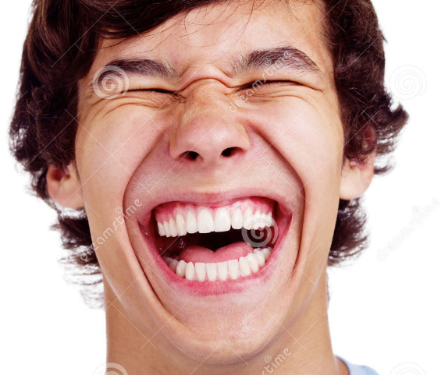


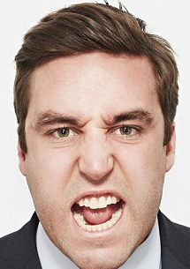
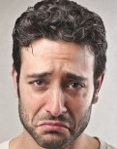
Our vision architecture (可刪)
Step1: Read faces through camera.
Step2: Processing the face images and classify mood label.
Step3: Output a song list for users.

Slide 12
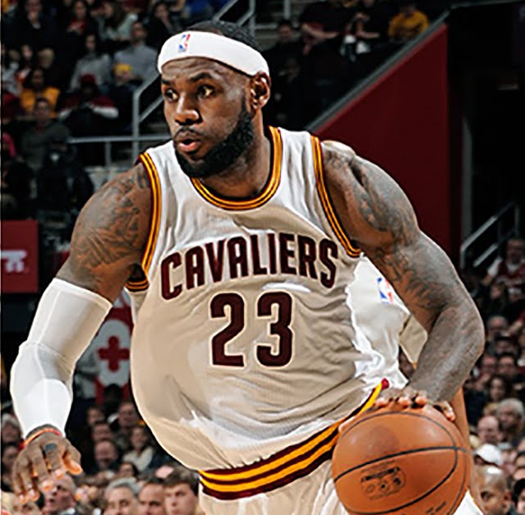
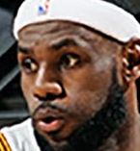
Proposed methods(cont.) (可刪)
Pre-processing
vision.CascadeObjectDetector from MATLAB
Cascade of classifiers to gradually remove the unwanted part.
Input image
Positive
Positive
Negative
Negative
Input
Stage 1
Stage 2
Wanted
Stage 3
Negative
classifiers

Slide 13
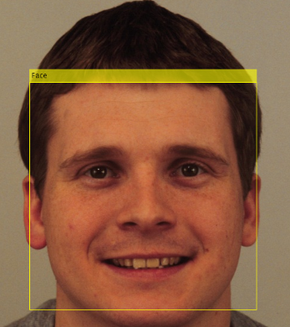
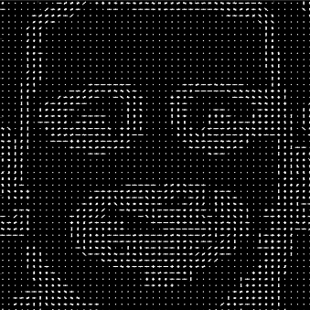
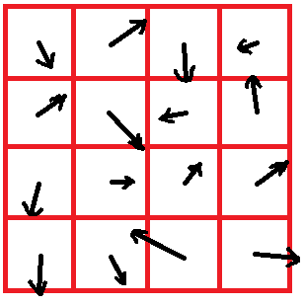
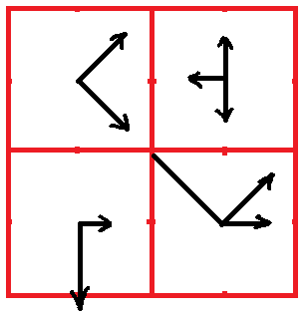
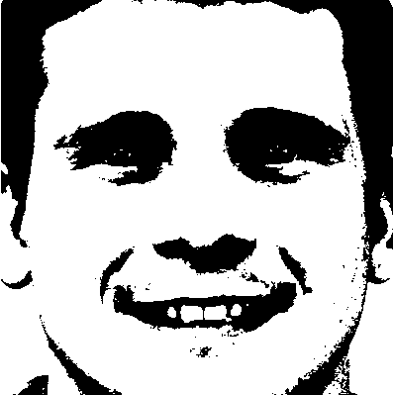
Proposed methods (cont.) (可刪)
Histogram of gradients (HOG)
Quantize the face image into gray level.
Partition the face image into small cells.
Compute gradients of each pixels in each small cells, then combine them into histogram of gradients.
Use the histogram of gradients as feature to train SVM model.

