Slide 1
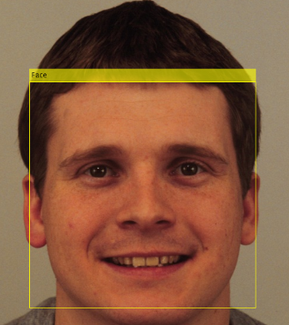
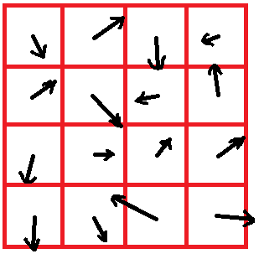













It KNOWS
Group 21:
R漱漱一
組員:
李啟維，郭世展，林柏成
what
YOU want.
Abstract
We listen to music every day.
But every time we want to choose a song to
play, all we can do is select the songs that
we already know, or we have to randomly
choose one. But what if there’s a machine
that can detect your moods and then
automatically gives you a song list…
Feature extraction
HOG (histogram of oriented gradient)
Partition face image into several small cells, and compute the gradient orientation of each pixels in each cell, forming histogram of gradients, combining all of the above data of each cell to form the feature of the face.
System frame
Training model for classification
SVM
Happy
Afraid
SVM
Surprised
Sad
Angry
Classifier
Face detection
Music genre classification
We use SVM to train our classifier, taking ____ faces as training set.
Face detection
Result
Preprocessing
Cascade classifiers
In our testing , the classifier can have accuracy of ____.
Testing with our camera
With total ___ times of demos by our own camera and photos, we reach an accuracy of ____.
Use ‘vision.CascadeObjectDetector’, a cascaded classifiers structure to remove the unwanted part of the images, namely the background of the image, and extract the faces of the input images.
happy!
classifiers
Input image
Wanted
Wanted
Unwanted
Unwanted
Input
Stage 1
Stage 2
Wanted
Stage 3
Unwanted
Reference
http://blog.enjoycss.com/wp-content/uploads/2015/09/woman-making-list.jpg
http://thumbs.dreamstime.com/z/happy-teenage-laugh-closeup-close-up-portrait-loudly-laughing-young-man-isolated-white-background-35325424.jpg
http://i.dailymail.co.uk/i/pix/2014/08/29/1409331226296_Image_galleryImage_17_Jan_2013_Businessman_y.JPG
https://blog.udemy.com/wp-content/uploads/2014/05/bigstock-Portrait-of-a-sad-man-41540233-300x234.jpg
http://www.thetailgatetimes.com/wp-content/uploads/2016/02/Curry-and-Lebron-James.jpg
http://core0.staticworld.net/images/article/2012/10/v5-471p20win820left20facin-100008105-orig.jpg
http://wrightrobinson.co.uk/wp-content/uploads/2014/01/music_notes_stock_by_bassgeisha-d3h9mpv.jpg

