Slide 1
Pattern Analysis and Classification Vehicle Detection Presentation
郭世展 r04922102
李啟維 r04922125
張乘若 r04922100
Group 1

Slide 2
Outline
1
2
3
Algorithm
Experiment
Conclusion

Slide 3
Algorithm
Outline
HOG feature
SVM
trainCascade

Slide 4
Algorithm : Feature Select/ Hypothesis Generate / Hypothesis Verification
Feature
HG
HV
HOG Feature Extract
LIBSVM Classifier
trainCascadeObjectDetector.m (MATLAB)
Edge of car feature
1/0 classifier
Bounding Box
LIBSVM -- A Library for Support Vector Machines (Chih-Jen Lin) https://www.csie.ntu.edu.tw/~cjlin/libsvm/

Slide 5
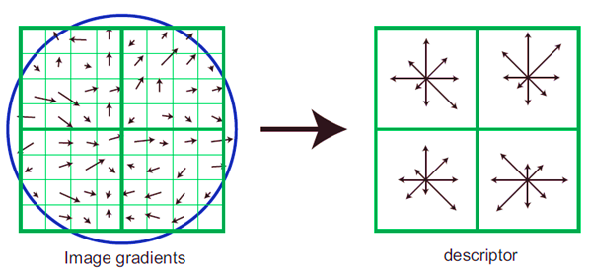
HOG Feature Extract
[4 4]
[6 6]
[8 8]
[10 10]
TrainCascadeObject =[32 39]
SVM = [100 100]
CellSize = [8 8]
BlockSize =[2 2]
numBin = 9

Slide 6
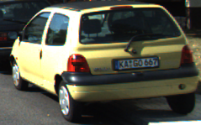
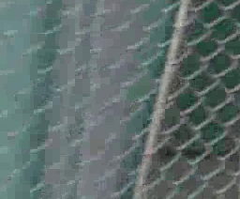
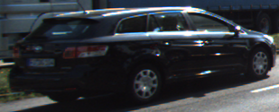
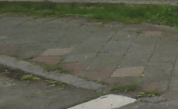
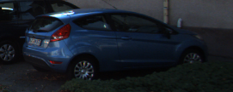
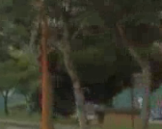
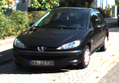
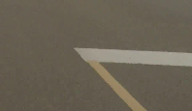
Training a Cascade Object Detector
Predict
Positive
Negative
Trained Stages
Stage
False Alarm Rate
decision stumps
Negative
Positive
Sample
Boosting
Positive
True Positive
False Negative
Discard Image
Next Trained Stage
Negative
Positive
Negative
False Positive
(FalseAlarmRate)
True Negative
Discard Image
Next Trained Stage
Negative
Positive
Discard Image
Next Trained Stage
http://www.mathworks.com/help/vision/ug/train-a-cascade-object-detector.html?refresh=true
Notes:
Using weak learner but many stage create good choice!!!!!!!
The weak learners are simple classifiers called decision stumps.
Each stage is trained using a technique called boosting.
Boosting provides the ability to train a highly accurate classifier by taking a weighted average of the decisions made by the weak learners.

Slide 7
trainCascadeObjectDetector.m
The cascade classifier consists of stages, where each stage is an ensemble of weak learners. The weak learners are simple classifiers called decision stumps. Each stage is trained using a technique called boosting. Boosting provides the ability to train a highly accurate classifier by taking a weighted average of the decisions made by the weak learners.
http://www.mathworks.com/help/vision/ug/train-a-cascade-object-detector.html?refresh=true

Slide 8
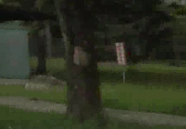
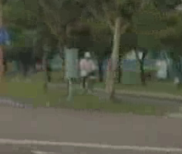
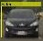
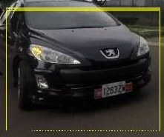
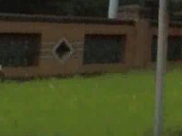
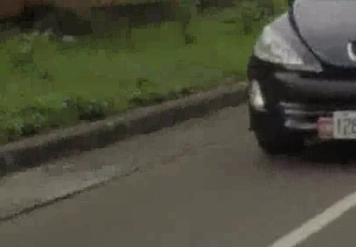
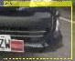
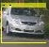

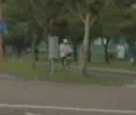

Training a SVM classifier
HG
Positive
HOGFeature
LibSVM
Classifier
Negative
HV
Negative
HOGFeature
Positive

Slide 9
Experiment
Preprocessing of image
Method
Result

Slide 10
Experiment::Method
Method
Data Select
Preprocessing
Training Data Select
Tune parameter
KITTI_positive
TrainCascadeObject
Detector.m
SVM Classifier
Image RGB to gray
Image rescale
SVM model
FalseAlarmRate & Stage

Slide 11
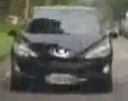
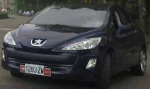
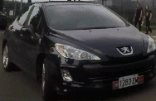


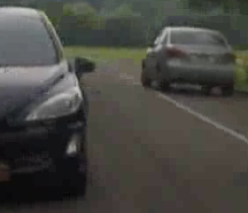
1 Data Select
Detector
Train 出
Positive data
Negative data
trainCascadeObjectDetector
Detector

Slide 12
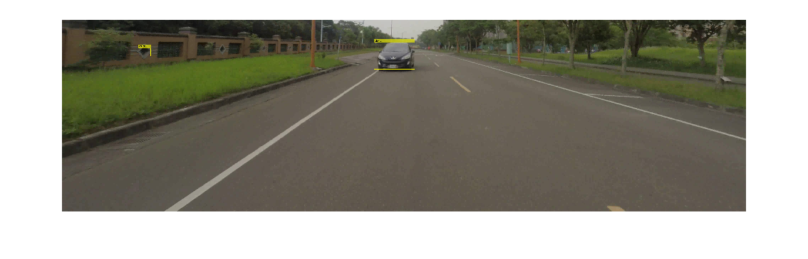
2.1 trainCascadeObjectDetector.m
1.用 找BoundingBox
Detector
Detector
File: imLab5566.png

Slide 13
2.2 SVM Classifier
2.用 檢查 Bbox
框出來的image是不是車
Detector
SVM model
File: imLab5566.png
SVM model
SVM model
imLab5566.csv
X Negative
O Positive

Slide 14
Result
KITTI_Negative 有車子的資料過多，故需篩選
KITTI—Positive 車子遮擋及重疊，也需篩選
Use imLab 可以增加辨識度
KITTI_Negative 不加入，因場地變化性過大。可以大幅提高
KITTI_Positive 加入檔案大小較大的，亦會提高，相較起來

Slide 15
Experiment::Preprocessing
Method
Data Select
Preprocessing
Training Data Select
Tune parameter
KITTI_positive
TrainCascadeObject
Detector.m
SVM Classifier
Image RGB to gray
Image rescale
SVM model
FalseAlarmRate & Stage

Slide 16



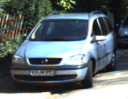
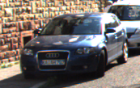
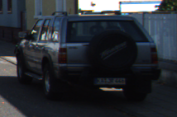
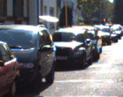

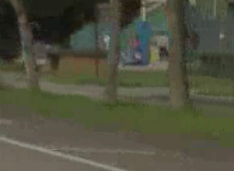
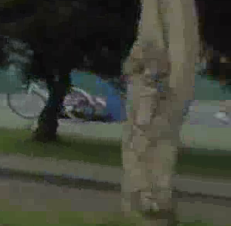
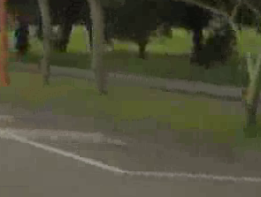
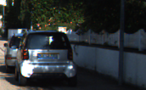
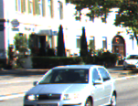
Training Data Select
KITTI_Positive Discard
KITTI_Positive Selected
KITTI_Negative Discard
Create more Negative Image
from testFile of imLab

Slide 17
Experiment::Tune Parameter
Method
Data Select
Preprocessing
Training Data Select
Tune parameter
KITTI_positive
TrainCascadeObject
Detector.m
SVM Classifier
Image RGB to gray
Image rescale
SVM model
FalseAlarmRate & Stage

Slide 18
TrainCacade: Increase KITTI_positive data
Use Stage 15 to train
Doing good on using KITTI_Positive 100

Slide 19
TrainCacade: FalseAlarmRate & Stage
Use Stage 15 to train
FalseAlarmRate:
Good at 0.5
Poor at 0.6
Too many little bounding box create

Slide 20
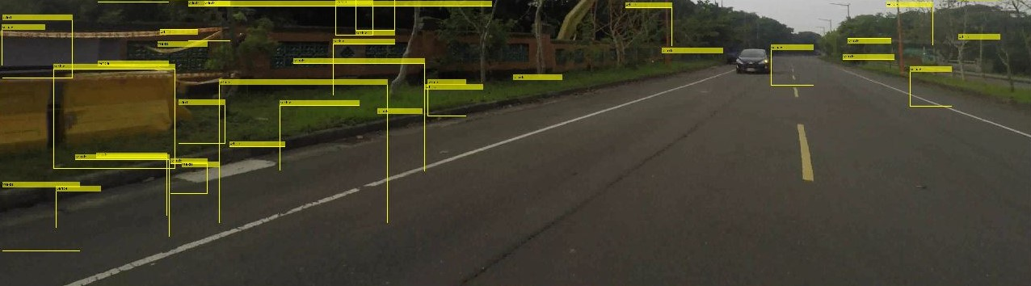
TrainCacade: FalseAlarmRate Sample

Slide 21
TrainCacade: FalseAlarmRate & KITTI
imLab Data Only
Stage higher, FalseAlarmRate must higher
Stage increase, training time rapid increase

Slide 22
Conclusion
1
2
3
4
5
Pre Data Select
SVM model
KITTI_Positive add
using some partial of car, increase precsion
Discard unnecessary image
Use part of them
Increase stage and false alarm rate when data is enough
Recall increase but training and detect time increase
Add testfile(big) into training
Can increase negative sample to TrainCascade

Slide 23
Result
Stage | FalseAlarmRate | F1 | Recall | Precision
10 | 0.3 | 0.6963 | 0.82456 | 0.60256
10 | 0.3 | 0.7874 | 0.89286 | 0.70423
10 | 0.3 | 0.68519 | 0.78723 | 0.60656
10 | 0.3 | 0.72131 | 0.81481 | 0.64706
Class types count: 12
1-Negative::855___KITTI_Negative_SpecialBig
2-Positive::1401___KITTI_Positive_Select(0-2105)
3-Positive::1082___MIX_Positive
4-Negative::2712___imLab_Negative
5-Negative::5477___imLab_Negative_Create
6-Negative::108___imLab_Negative_Ground
7-Negative::312___imLab_Negative_Kick
8-Positive::336___imLab_positive
9-Positive::272___kitti_positive
10-Negative::505___mix_neg
Negative | 8802
Positive | 1418

Slide 24
Thank you for your listening

Slide 25
HypothesisGenerate
trainCascadeObjectDetector
histogram of oriented gradients (HOG)
Feature Extract
Support Vector Machine (SVM)

Slide 27
2.2 SVM Classifier
2.用 檢查 Bbox
框出來的image是不是車
Detector
SVM model
File: imLab5566.png
trainCascadeObjectDetector
SVM model
SVM model
X Negative
O Positive

Slide 28
5.1 Data Preprocessing
5.2 Tune Parameter

