Slide 1
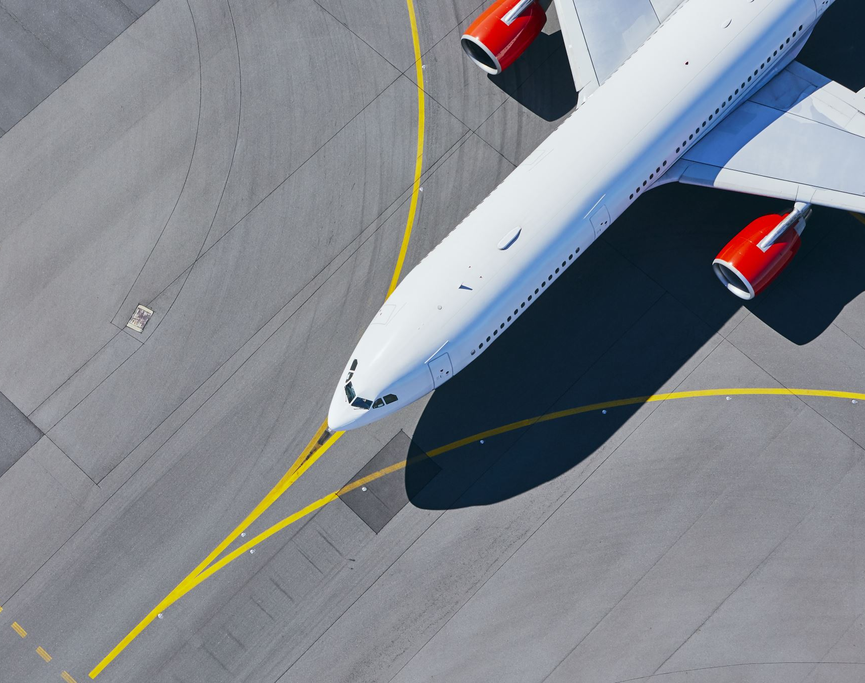
Dashboard Effectiveness
Using San Francisco airport cargo data
Sean Caldwell

Slide 2
Table of contents
Data explanation
Overview of Analysis
Dashboard
Conclusion
References

Slide 3
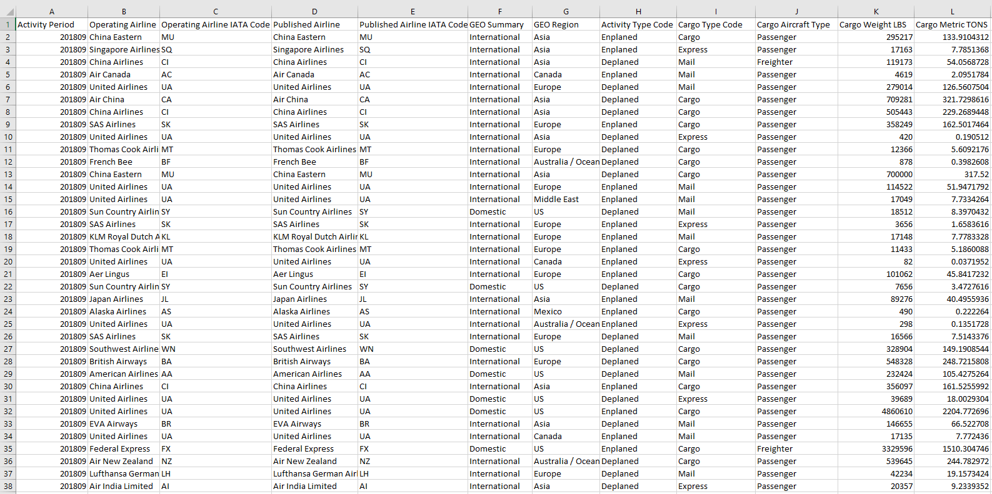
The Dataset

Slide 4
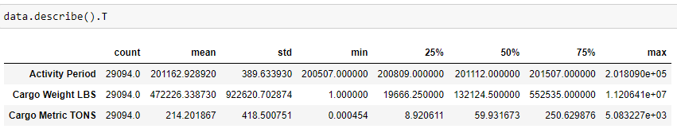
Descriptive statistics

Slide 5
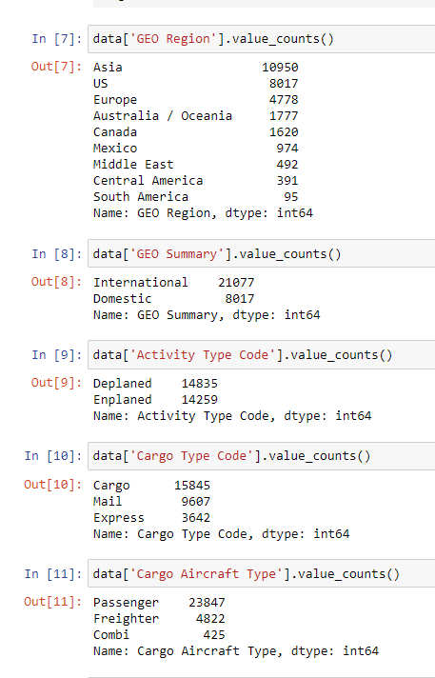
Value counts

Slide 6
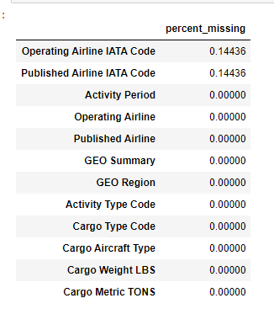
Missing value percentages

Slide 7
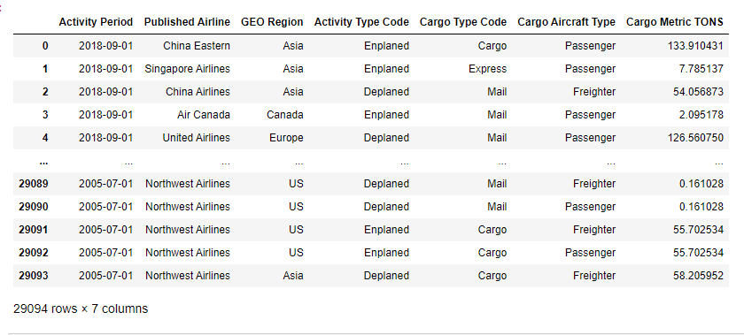
Data after processing
Reformatted the Activity period column to the year/month/day format for easier reading from tableau.

Slide 8
Overview of Analysis
Performed exploratory data analysis on the dataset to answer the business questions.
Which quarter sees the most cargo movement?
What regions use this airport the most?
What type of plane moves the most cargo?
Does the US import or export more cargo?

Slide 9
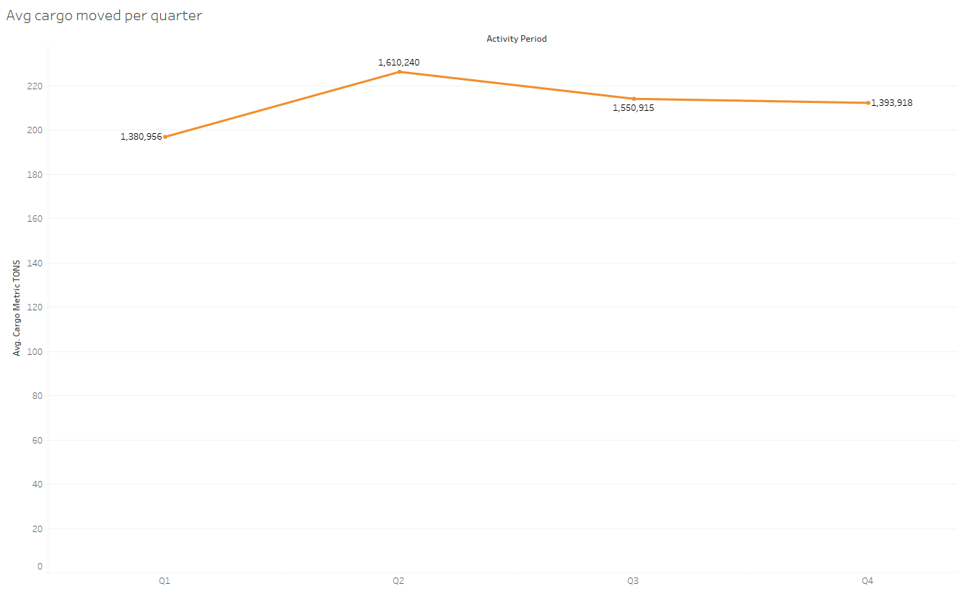
Average cargo moved per quarter

Slide 10
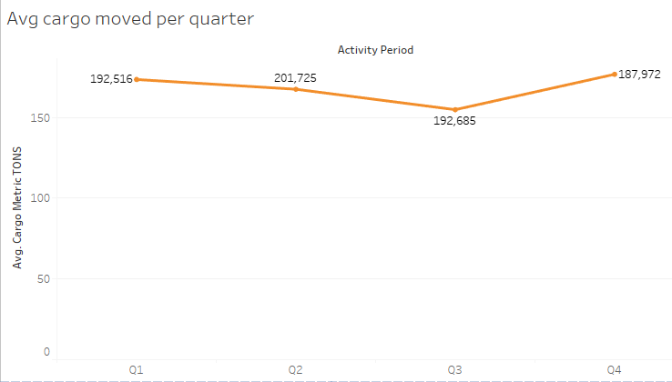
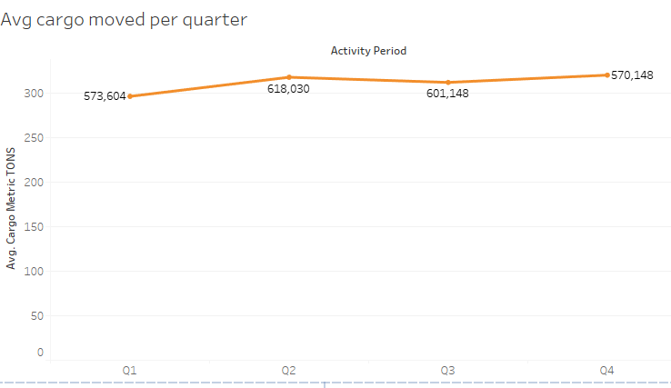
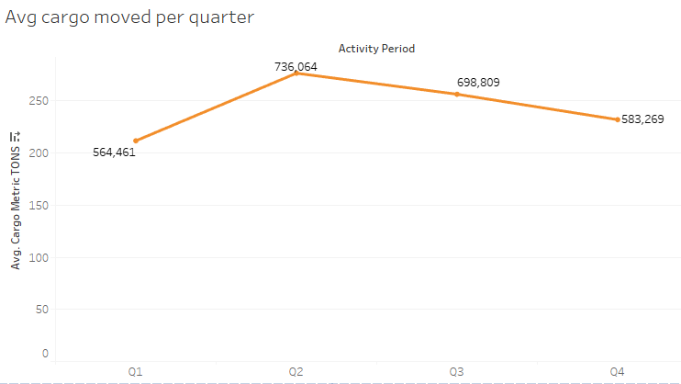
Europe vs US vs Asia

Slide 11
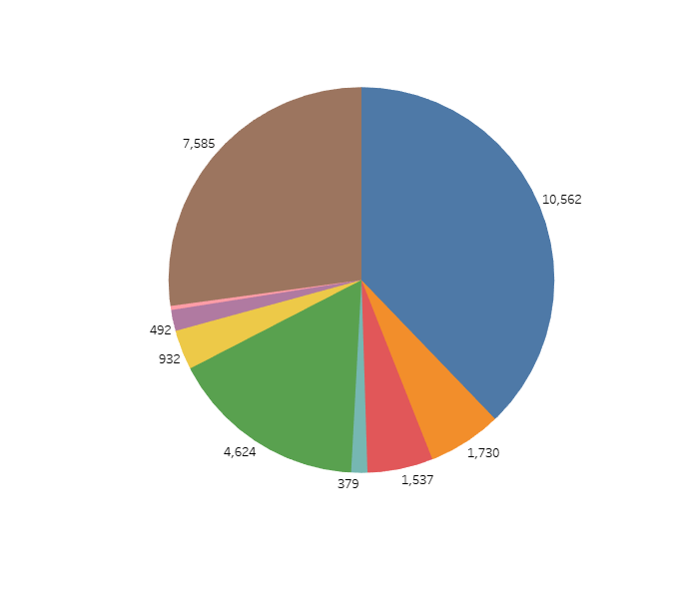
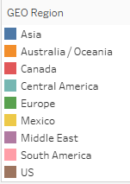
Airport usage by region

Slide 12

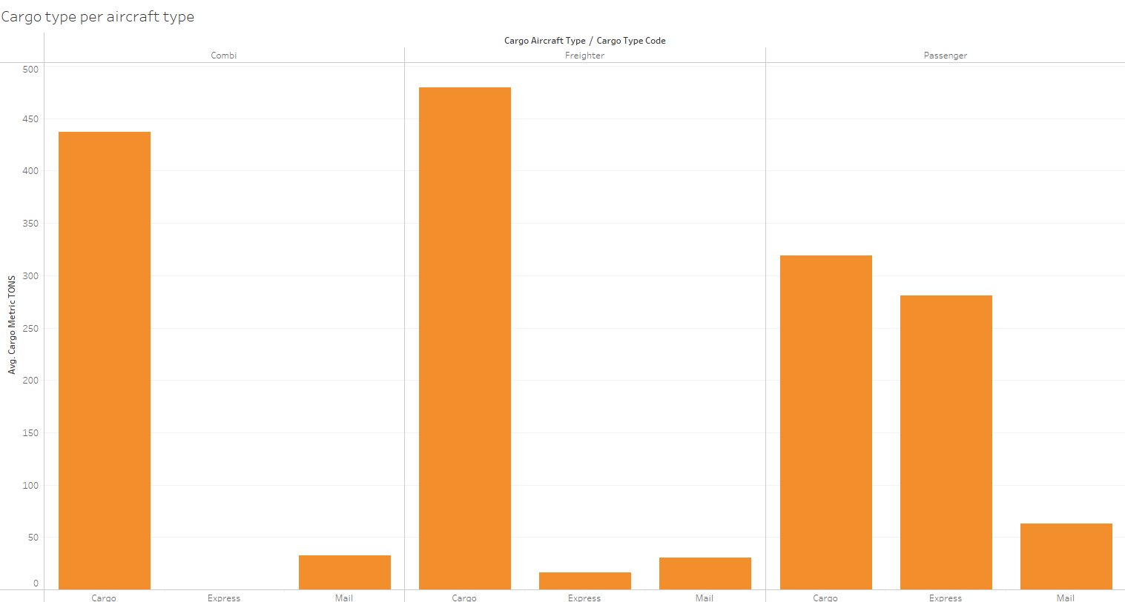
Cargo Moved by Plane type

Slide 13
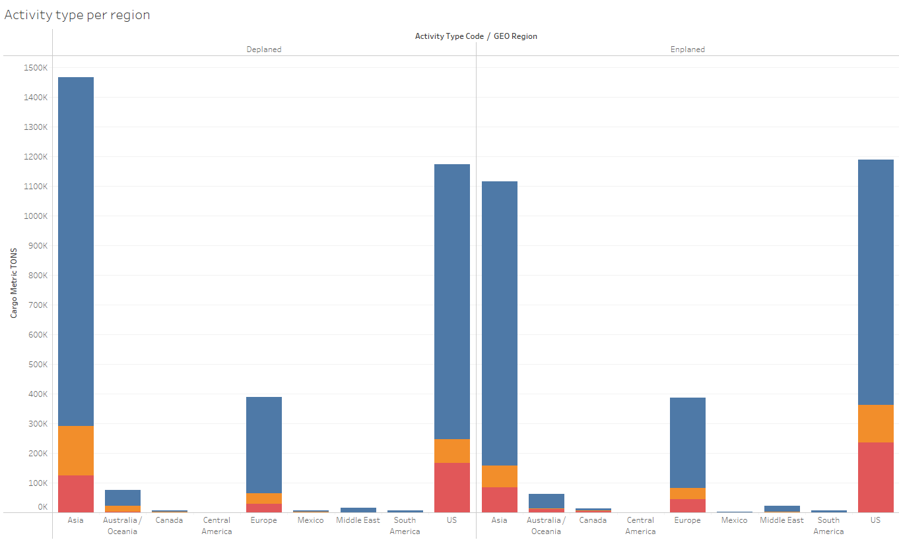

Imports vs exports

Slide 14
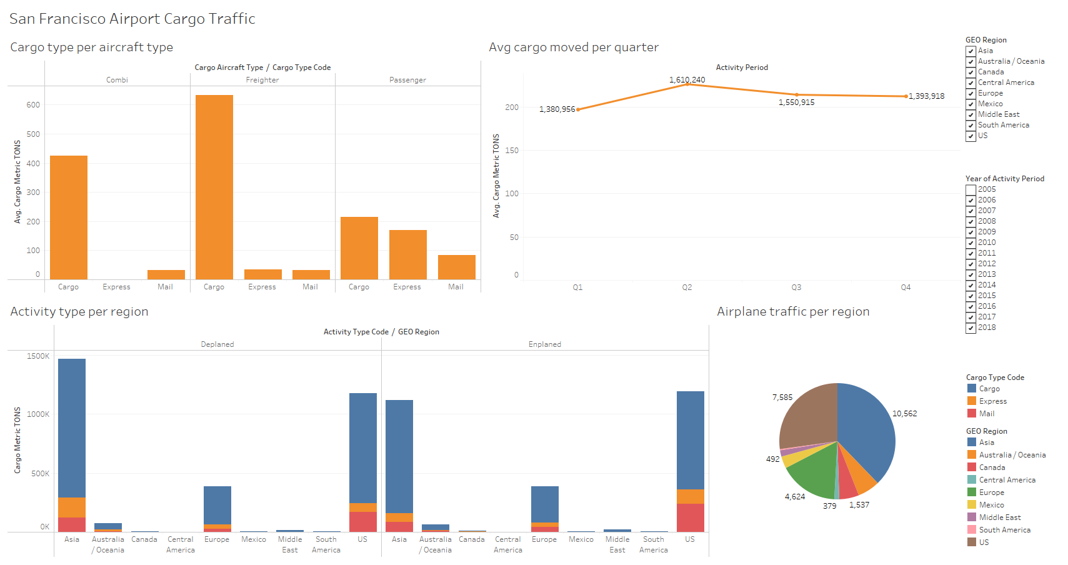

Slide 15
Conclusion
The second quarter sees the most cargo movement, but it differs by region.
Asia uses the airport the most, with the US and Europe following.
On average cargo planes move the most cargo, however there are significantly more passenger planes flying carrying a smaller amount.
This airport takes in more cargo from planes than it sends out, most of the incoming cargo comes from Asia.

Slide 16
References
https://data.world/sanfrancisco/u397-j8nr/

