Slide 1
Introducing Python
Niti / TDMDAL

Slide 2
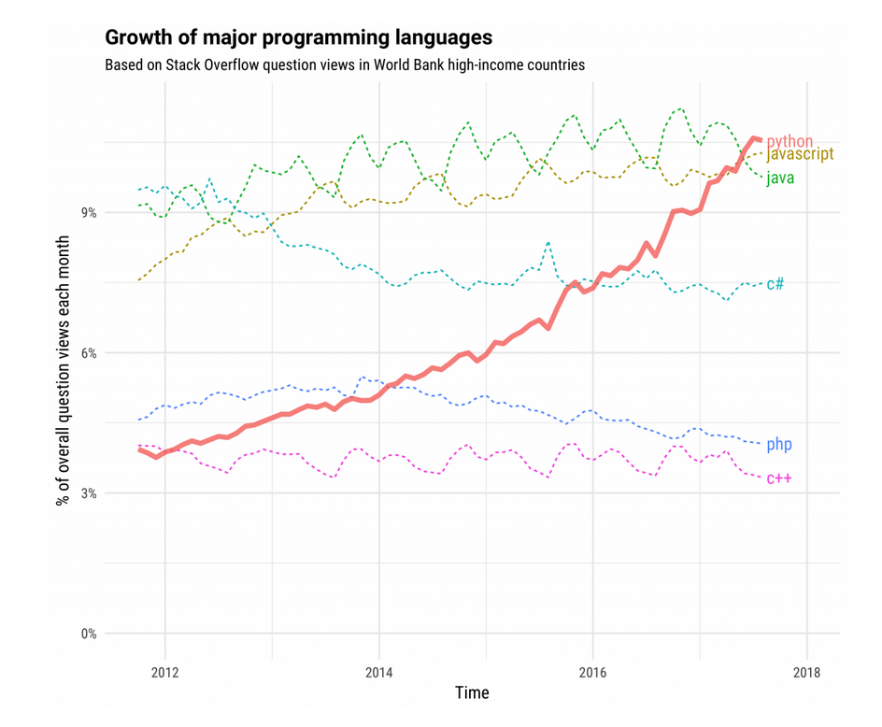
Python’s Popularity
In 2018, Python became the biggest gainer in the Tiobe index of language popularity
In June 2017, Python became the most visited tag on Stack Overflow
In 2016, Python became the most frequently taught language in colleges and universities
Fig. 1 Six of the ten most-visited Stack Overflow tags in high-income countries from 2012 to 2018 (Source: https://stackoverflow.blog/2017/09/06/incredible-growth-python/ )
Notes:
TIOBE: The main reason for this is that software engineering is booming.
It attracts lots of newcomers to the field.
Java is too verbose for beginners because to run a simple program such as "hello world" in Java you need to have knowledge of classes, static methods and packages.
C this is a bit easier, but then you need to face explicit memory management.
In Python this is just a one-liner.
STACKOVERFLOW: wealthy countries (defined as high income by World Bank).
the six of the ten most-visited Stack Overflow tags
Python’s use is also growing in non-high income countries, although it has not surpassed the level of javascript, java, C#, and php.

Slide 3
Python leads in many domains
Statistical analysis
Scientific computing
Machine learning
Data visualization
Artificial intelligence
Others:
Scripting & automation
Web development
Systems testing & prototyping
Desktop & mobile applications
Education!
Notes:
Fun fact. Python is not named after the snake. It’s named after the British TV show Monty Python.
was designed as a numerical computing languages like Fortran, R SAS or the more recent Julia.
originally conceptualized by Guido van Rossum in the late 1980s as a member of the National Research Institute of Mathematics and Computer Science.
had exception handling and was targeted for the Amoeba operating system

Slide 4
Python’s Key Advantages
General-purpose language
Interpreted language
Dynamically-typed language
Easy to learn
Broad support
Data science libraries
Machine learning
Text analysis
Web scrapping
Others:
Object-oriented programming
Functional programming
Big data application
Scripting and automation
Rapid prototyping
Web development

Slide 5
1. General-Purpose Language
Greatness for many over excellence for one application
Solve a lot of different problems across a lot of different domains
No need to switch to another language when writing scientific code
Becoming better at Python leads to genuine programming skill!
Notes:
Matlab’s one liner equations is unsurpassed
R’s interactive data analysis
Mathematica not intended for programming
Python can be build just about anything.
General purpose language
is used to create programs by typing letters, numbers and symbols
and requires programmers to use formal syntax.
allows one to easily leverage other libraries (e.g. databases) for scientific research.
So, the coder doesn’t have to switch to another language when writing non-scientific code
From automating Microsoft Excel processing using openpyxl to natural language processing with NLTK.
It can also be used to meet various development needs.
Examples of general-purpose programming languages include C#, C++, Java, JavaScript, Python, Ruby and Visual Basic.
https://www.stat.washington.edu/~hoytak/blog/whypython.html

Slide 6
2. Interpreted language
Ease of Use
Time
Portable and Extensible
Modes of use:
Command-line mode
Script mode
Jupyter notebook
Notes:
Ease of Use
Codes are shorter and easier to write
WHEN THE SOURCE CODE IS TRANSLATED TO SOMETHING MACHINE CAN READ
Time
Needs to be processed by the machine before they can run
But the coding takes less time to write
Interpreted languages allow codes to be read and executed as soon as it is written.
Compilers read the program and translate it completely before the program starts running
Command-line mode
you type Python programs and
the interpreter prints the results
Script mode
you write a program in a file and
use the interpreter to execute the contents of the file.
Such file is called a script.
Once you have a working program, you should store it in a script, so you can execute or modify it in the future.
Python scripts have names that end with .py.
Interactive mode
you interact directly with the interpreter like jupyter notebook. It’s an easy way to get started.
However, when working with more than a few lines of code, it can be clumsy.
The alternative is to use the script mode
Portable
Portable and Extensible
Windows, Mac, Linux to Solaris, Play-stations, etc
Integrates with libraries of other languages easily

Slide 7
3. Dynamically-typed language
Different type-systems differ based on when types are checked.
In Python, types are checked on the fly i.e. during the execution
Allows type of the variable to change over its lifetime
This makes testing/debugging slightly faster and easier
Notes:
All programming languages include some kind of type system that
formalizes which categories of objects it can work with and how those categories are treated.
In languages like C, when we declare a variable, this sets aside an area of memory for holding values allowed by the data type declared. During compile, initial value or assigned value will be checked and an error is raised if they do not match.
In python, it doesn’t know about the type of the variable until the code is run. It stores the value at some memory location and then binds that variable name to that memory container and makes the content of the container accessible through that variable name. So the data type does not matter.
3 + “5” will raise a type error in strongly types languages, such as Python
because they do not allow for ‘type coercion’: the ability for a value to change type implicitly in certain contexts.

Slide 8
4. Easy to Learn
Simple and straightforward syntax
Easy to read and closely resembles the English language
More time solving problem and less time on language complexities
Can still learn about programming paradigms
Notes:
There is no need to deal with complex syntax and extensive rules. Python is easy to read and closely resembles the English language.
No need to deal with class path problems like Java or compiler issues like C++.
Just install python.
Add Python in PATH and
you can run it from anywhere on your machine.

Slide 9
5. Broad Support
Free and open source
Runs on every major operating systems and platforms
Contributions from a large community of users
Well-furnished standard library - https://docs.python.org/3/library/
Free and seamless interfaces for major libraries and API-powered servers
Notes:
Python itself isn't very competitive for numerical computing performance,
but
performant code can be wrapped and used from python as a supporting library.
This gives users the best of both worlds - the ease of use of python, and the performance of optimised low level code.

Slide 10
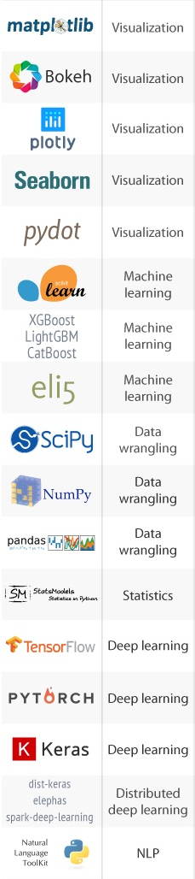
6. Data Science - Machine Learning
Leading language of many data scientists
One of the best collection of machine learning and deep learning libraries
Numerical engines have attracted academic scholars and private researchers
Popular data visualization libraries
Notes:
The main reason experienced programmers should learn Python is for Data Science and Machine Learning applications. Python is a leading language of many data scientist. It has one of the best collection of machine learning and deep learning libraries such as TensorFlow, Scikit-Learn, Keras and many more.
Not too long ago R was considered best but Python became leading language because of the diversity of its application such as automation, data analytics, web development and much more.
Similarly, academic scholars and private researchers were using MATLAB language for scientific research for years but it all started to change with the release of Python numerical engines such as ‘Numpy’ and ‘Pandas’. Python also deals with tabular, matrix as well as statistical data and it even visualizes it with popular libraries such as Matplotlib and seaborn.

Slide 11
6. Data Science - Text Analysis
Popular for text mining and Natural Language Processing (NLP)
NLTK
been around a long time as an education and research tool
provides common natural language functions
spaCy
modern library that invested in performance and accuracy benchmarking and tuning
Gensim
leading state-of-the-art package for processing text and working with word vector models, a notable advancement in NLP
Notes:
Spacy becoming the choice for building products and

Slide 12
6. Data Science - Web Scraping
Web scraping is about extracting data from websites.
Python is one of the most popular language for web scraping
No need to start from scratch
Python libraries for web-scrapping to get started:
To make web requests - requests
To process HTML content - Scrapy and Beautiful Soup
Other libraries - lxml, Selenium, etc
Notes:
When you start out with web scraping, you don’t really need to start from the scratch as there are many third party libraries dedicated to web scraping which you can easily master. To find a web scraping library for the language you know, you can do a simple google search like this:
Python is the most popular language for web scraping. It’s more like an all-rounder and can handle most of the web crawling related processes smoothly.
Scrapy and Beautiful Soup are among the widely used frameworks based on Python that makes scraping using this language such an easy route to take.
Scrapy has some great features like support for XPath, enhanced performance owing to the Twisted library and a variety of debugging tools.
Beautiful soup is a Python library that’s designed for fast and highly efficient web scraping. Some of the notable features are Pythonic idioms for navigation, searching, and modifying a parse tree. Beautiful Soup can also convert incoming documents to Unicode and outgoing documents to UTF-8. Beautiful Soup works on popular Python parsers like lxml and html5lib, which allow you to try different parsing methodologies.
These highly evolved web scraping libraries make Python the best language for web scraping.
These libraries and frameworks can help you learn the basics of web scraping and could even cover small-scale use cases. However, if you’re looking to extract data from the web for business use cases, it’s better to go with a web scraping service that can take end-to-end ownership of the project. There are several reasons why an in-house crawling setup isn’t the best option, you can learn more about it here.

Slide 13
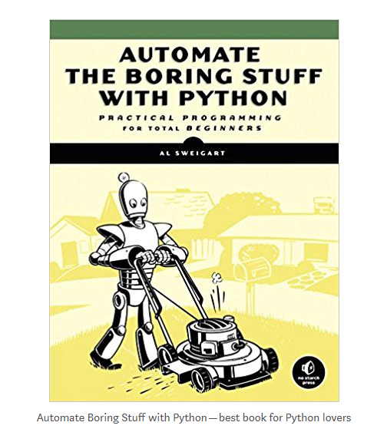
8. Others
Object-oriented programming
Functional programming
Scripting & Automation*
Big data application
Rapid Prototyping
Web-Development
Desktop & Mobile Applications
Education!

Slide 14
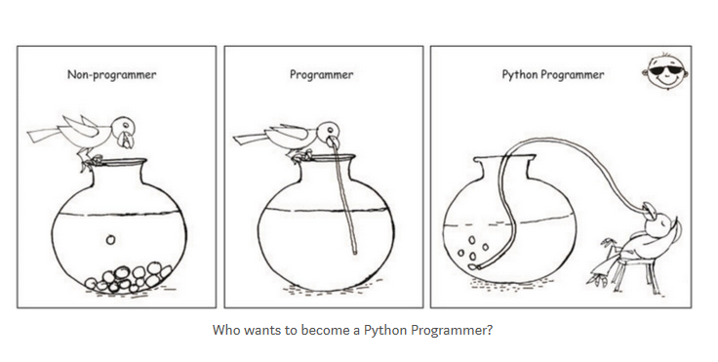

Slide 15
Session 2 : Agenda
1. Data Structures
Basic
Values and Types
Type - String
Variables
Native to Python
List
Dictionary
2. Operations
Indexing & Slicing
Membership
Arithmetic
Functions
Iterations
Conditionals

Slide 16
Data Structure - Values and Types
A program works with values
Values can be numbers or texts, special characters, etc.
Values belong to different types
Numbers are usually of type integer (e.g. 42) or float (e.g. 35.5)
Texts are of type string (e.g. ‘Hello World!’)
True or False are of type boolean

Slide 17
Data Structure - Strings
Strings are sequence of character(s)
Strings are contained by either single or double quotes
Two strings can be combined by using + operator
Strings can be repeated by * operator

Slide 18
Data Structure - Variables
A powerful feature of programming languages is the ability to manipulate variables
Variable is a name that it refers to a value
Variable names must follow naming rules
NameError is a common error

Slide 19
Operation - Functions
Variables are manipulated using functions (and operators)
The name of the function is bound to compound operation
Functions that are attached to specific class of objects are called methods and are accessed using the dot expression
Python has
Built-in functions
Third party functions and
You can create your own functions
Notes:
The name of the function bounds to itself compound operations

Slide 20
Data Structure - List
A list is a mutable, ordered sequence of items
It can be indexed, sliced, and changed
Each element can be accessed using its position in the list
Positions are indicated by an integer value called index

Slide 21
Operation – Indexing and Slicing
Indexing
[ ] operator
Selects one element from a sequence
Integer inside [ ] indicates the position of the element
Slicing
[ : ] operator
Selects a subsequence from a sequence
Integer before and after : indicates start and stop indices
If no integers are defined then it returns everything
Python index starts at 0
A minus sign before index indicates backward indexing

Slide 22
Operation – Arithmetic
Elements of lists and lists themselves can be manipulated using
+
-
*
and other such operators known as arithmetic operators
Arithmetic operators behave differently on
lists and strings vs
integers and float

Slide 23
Operation - Iterations
Iterations are useful for manipulating each item in a list
“for”statement combined with “in” is most commonly used for iterating over sequence of item
“in” is a membership operator

Slide 24
Operation - Conditionals
In order to write useful programs
we almost always need the ability to check conditions and
change the behavior of program accordingly
In Python, conditionals can be created with ‘if’ directive
Conditionals are often combined with comparison operators
==
!=
>=
< , etc

Slide 25
Data Structure - Dictionary
A mutable, unordered set of key-value pairs separated by :
Each key must be unique
To access a given element, refer to it by its key
Are written using curly brackets
Each key-value pair is separated from the next with a comma

Slide 26
List vs Dictionary
List
ordered collection of items
contains only values
Dictionaries
don’t have any order
associates each key with a value
Use dictionary when there is an unordered set of unique keys that map to values
Because keys and values linked to each other, the performance will be better than lists when checking membership of an element

Slide 27
Session 3 : Agenda
NumPy
List vs ndarray
Pandas
Matplotlib

Slide 28
NumPy
On its own Python isn't ideal for working with large data
This is where Numpy comes in:
Stands for “Numerical Python”
Core of Python’s scientific computing
Provides “ndarray” objects i.e. multidimensional arrays
Ndarray takes up less space and are faster in performance
Supports optimized implementations of arrays such as vectorised operations
Bears similarities with R and MATLAB
Pandas is built on top of Numpy
Notes:
The main issue working with each item in a python list isn't very efficient, and can lead to performance problems well before other languages designed for working with data.
Ndarray stores data in a simpler form, and manipulates it more directly in memory.
One of these tools is a high-performance multidimensional array object that is a powerful data structure for efficient computation of arrays and matrices.
To work with these arrays, there’s a vast amount of high-level mathematical functions operate on these matrices and arrays.

Slide 29
List vs ndarray
List
made for heterogeneous types
support adding and removing elements
takes more memory space
performance can lag
ndarray
works on homogeneous types
does not allow removing or adding items
packed into memory more efficiently
Performance is usually faster

Slide 30
Pandas
Most widely used python library in data science
Provides high-performance tools to extract, clean, transform and analyze your data
Data structures:
2d table object called “Dataframe”
1d array object called “Series
Additional functionalities over Numpy:
Pivot table
Column based computations
Plotting graphs

Slide 31
Pandas
Importing
Indexing
By column names
By index numbers
By index labels (if applicable)
Changing data types
Math Operations
Resetting Index
Dropping Columns
Creating new columns
Aggregating and Grouping in Pandas
Visualization
Built-in functions
Matplotlib
Seaborn

Slide 32
End of presentation

