Slide 1
Intro to Python
February 3, 2020 Prepared by Niti / TDMDAL

Slide 2
Agenda
Python’s Popularity
Data Structures
Programming Structures
Functions
Third Party Modules for Data Science

Slide 3
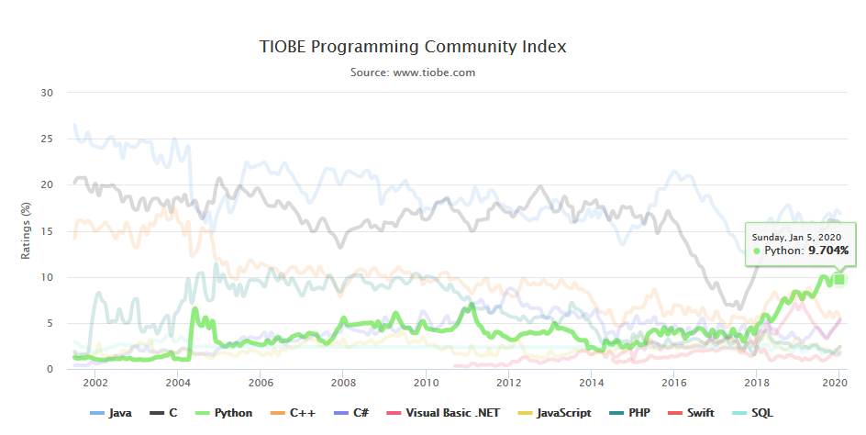
Python’s Popularity
In 2019, Python became the biggest gainer in the Tiobe index of language popularity, again!
Source: https://www.tiobe.com/tiobe-index/

Slide 4
Python’s Popularity
Statistical analysis
Scientific computing
Machine learning
Data visualization
Artificial intelligence
Others:
Scripting & automation
Web development
Systems testing & prototyping
Desktop & mobile applications
Education!

Slide 5
Data Structures

Slide 6
Data Structures
Basic
Values
Types
Variables
2. Native to Python
List
Dictionary

Slide 7
Data Structures: Basic
A program works with values
Values can be numbers, texts and/or special characters
Values belong to different data types
a
Variable
Assignment Operator
5
Value
“Integer” Type
=
assignment statement
Statements carry out some action
expressions typically describe computations

Slide 8
Data Structures: Native to Python
1. LIST
[ ‘apple’ , ‘orange’ , ‘peach’ ]
- Mutable
- Ordered
- Sequence of items
All elements contained inside square brackets.
- Each element separated by comma.

Slide 9
Data Structures: Native to Python
2. DICTIONARY
- Mutable
- Unordered
- Key-value pairs
{‘apple’ : 5 , ‘orange’ : 2, ‘peach’ : 3}
key value
All key-value pairs are contained inside curly brackets.
Key and its value are separated by colon.

Slide 10
Programming Structures

Slide 11
Programming Structures
Sequential
Iteration
Conditional

Slide 12
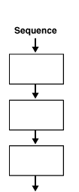
Programming Structures
1. SEQUENIAL
Programs are mostly written sequentially, meaning the first line of program runs first followed by the program in the second line, then the third line and so on.
a = 5
b = 8
c = ‘cat’

Slide 13
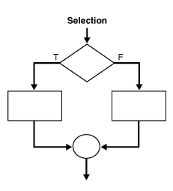
Programming Structures
numlist = [4,6,10, 15]
2. Conditional
Programs become more useful when we can change its behavior given a condition is satisfied.
if
i > 5
do this
do that

Slide 14
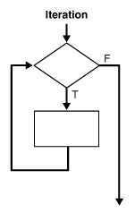
Programming Structures
numlist = [4,6,10,15]
newlist = [6,10,15]
3. ITERATION
Programs becomes powerful when the same block of code can be repeatedly executed on either identical tasks or similar tasks.
for
i > 5
add i
Go to next element
or end

Slide 15
Functions

Slide 16
Functions
Custom functions
Built-in functions
Methods
Third-party packages

Slide 17
Functions: Custom Functions
Give it a meaningful name
Parameters or input on which the function is designed to work
Declare a function with def keyword
def
celsuis_to_fahr
(celsuis):
fahr = 9/5 *celsuis + 32
Block of code that defines the operation to run
return
fahr
Return statement
Value to return (Output)

Slide 18
Functions: Custom Functions
def
celsuis_to_fahr
(celsuis):
fahr = 9/5 *celsuis + 32
return fahr

Slide 19
Functions: Built-in Functions
Python interpreter has a number of functions and types built into it that are always available.
print() is an example of built-in function. It prints the given object to the standard output device (screen) or to the text stream file.
Here is the list of Python’s built-in functions.

Slide 20
Functions: Methods
Functions that are attached to specific class of objects.
Methods are accessed using the dot expression.
Methods available to an object can be viewed using "dir" function.

Slide 21
Functions: Third Party Packages
Python has an active supporting community of contributors and users who also make their software available for other Python developers to use under its open source license terms.
The SciPy stack is a Python based eco-system of open-source software for mathematics, science, and engineering. In particular, these are some of its core packages that we will use:
NumPy
Pandas
Matplotlib
Scikit-Learn is another Python's go-to package for Machine Learning.

Slide 22
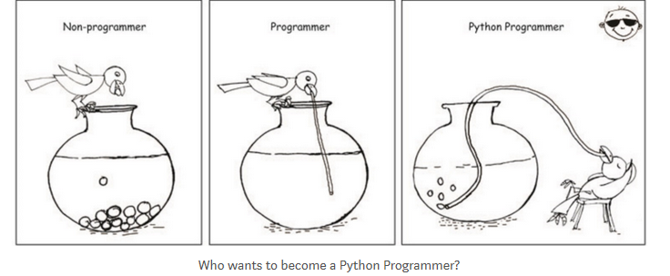
Questions?
Thank you

