Slide 1
War Simulation
Sean Johnston

Slide 2
Model
Competing Nations
Access to resources, technology, military units
Discrete time steps. Each country takes a turn at each time step
At each turn:
- Produce resources
- Invest resources into military purchasing and
researching technology
- Attack enemy

Slide 3
Nation Attributes
Initiated with random values before running simulation
Attack rate between 1 and 9
Specialization
Investment strategy
Research strategy

Slide 4
Specialization
Military – Increases “per unit” strength by 25%
Technology – Decreases cost of research by 25%
Each country has one specialization
Populated randomly

Slide 5
Investment Strategy
Each country has two variables determining investment strategy
These variables are weights which dictate the percentage of budget to spend in two areas:
military purchasing and researching tech
Variables initiated randomly and such that
x + y = 1

Slide 6
Research Strategy
Once the percentage of budget to spend on research is determined, research strategy dictates what percentages to invest in two areas
Military research decreases per unit purchase cost
Production research increases the amount of resources produced each turn

Slide 7
Each Turn...
At every turn, each country takes its turn
Each country produces resources
Invest percentages of budget into military and technology, determined by strategies
Attacks enemies, based on attack rate

Slide 8
Attack Strategy
Very simple
When a country returns from its turn, signals whether it is attacking or not
Country attacks the “next victim”, incrementing in round robin fashion
Each country defends and attacks with 50% of its standing forces

Slide 9
Simulation
Written in C++, executed in CUDA environment
Each thread runs a simulation having 5 countries
Each simulation/thread executes for 1000 time steps
After finishing 1000 time steps, record the input parameters of the highest scoring country
Total thread count: 2560

Slide 10
Scoring
How do countries gain score?
Successful attacks
At end of simulation, technology and remaining military units add to score

Slide 11
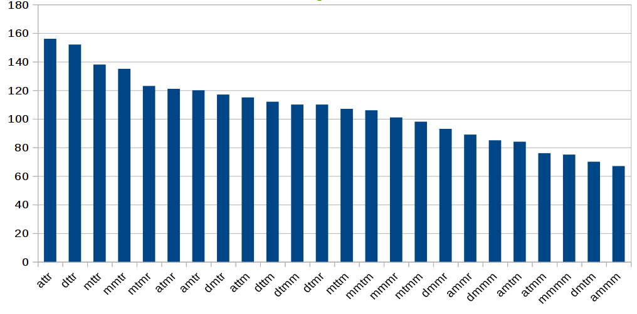
Results
Field 1 – a: aggressive, attack rate > 70% Field 3 – Investment strategy > 50%
m: mild, 30% < attack rate < 70 % m: military
d: defensive, attack rate < 30% t: technology
Field 2 – Specialization: Military or Tech Field 4 – Research strategy > 50%
m: military
r: resources production

Slide 12
Possible Improvements
Tune parameters, variables and weights
Cast the simulation as a matrix of weights/values
Apply techniques of line algebra
Improve model by including data collected from real world examples

Slide 13
Questions?

