Slide 1
Estimating Sign & Display The New Dimension in Digital Finishing
March 2016
Notes:
1

Slide 2

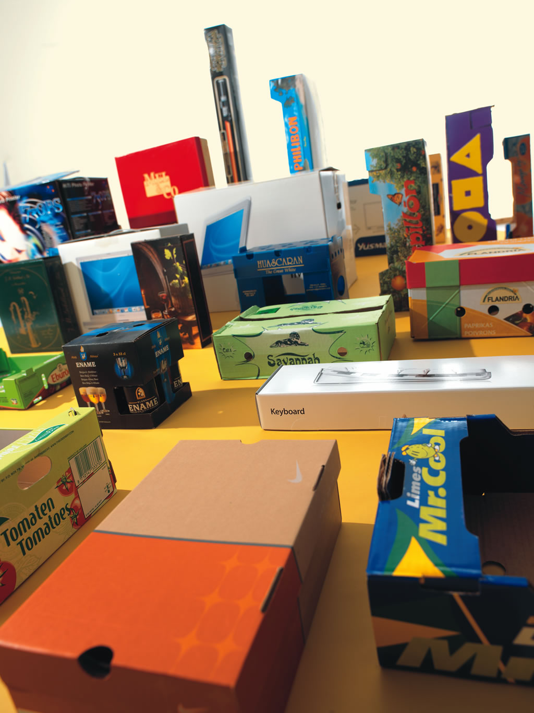
Your world has changed.
It’s now a wide format digital printing world with higher volumes that require faster turnaround times on a super wide variety of materials.

Slide 3

To make your customer happy and ensure you get a good price for your work, one criteria is more important than any other:
The final result

Slide 4
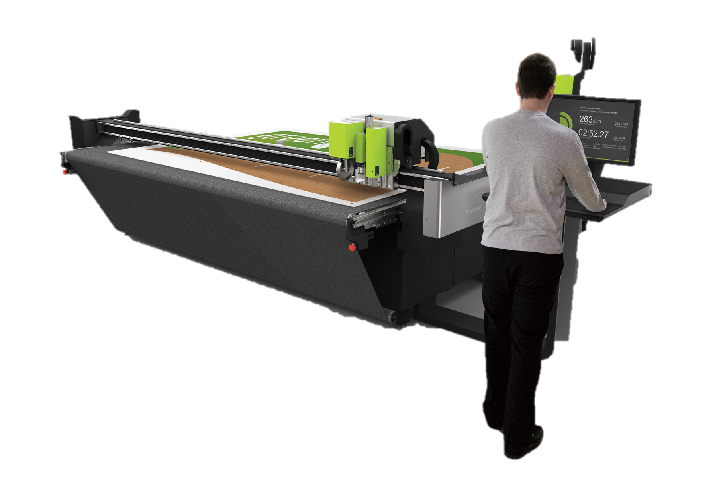
Estimating digital materials and cut times
Key barometers to quoting success
Customer
Requests
Automation
Sales
Results!

Slide 5
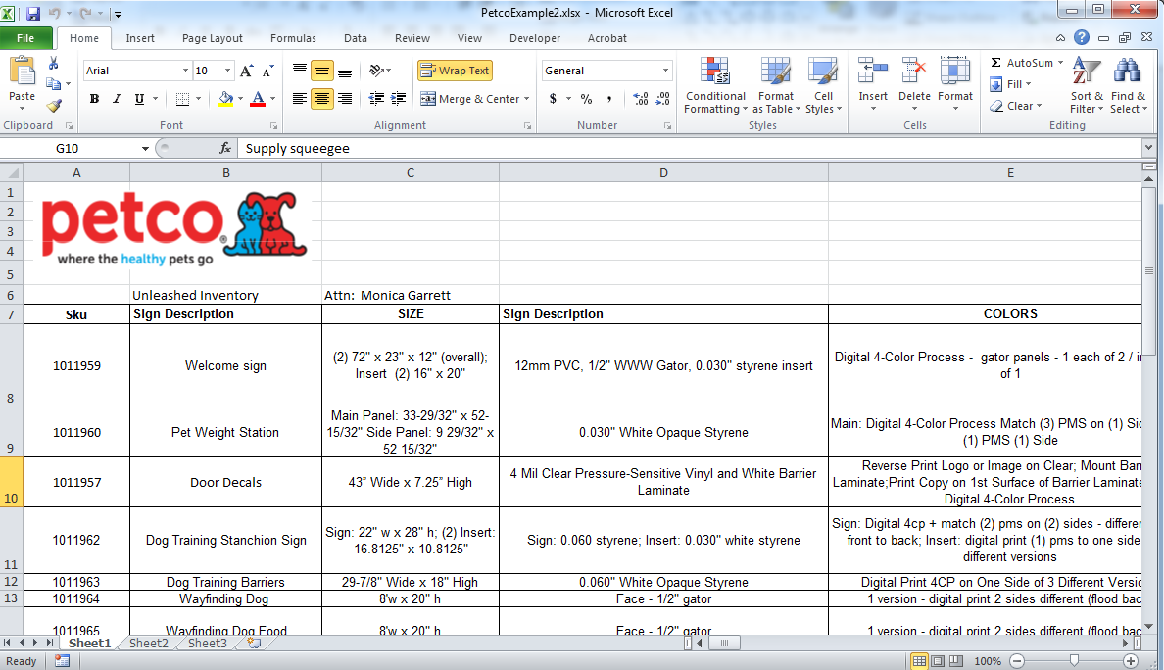
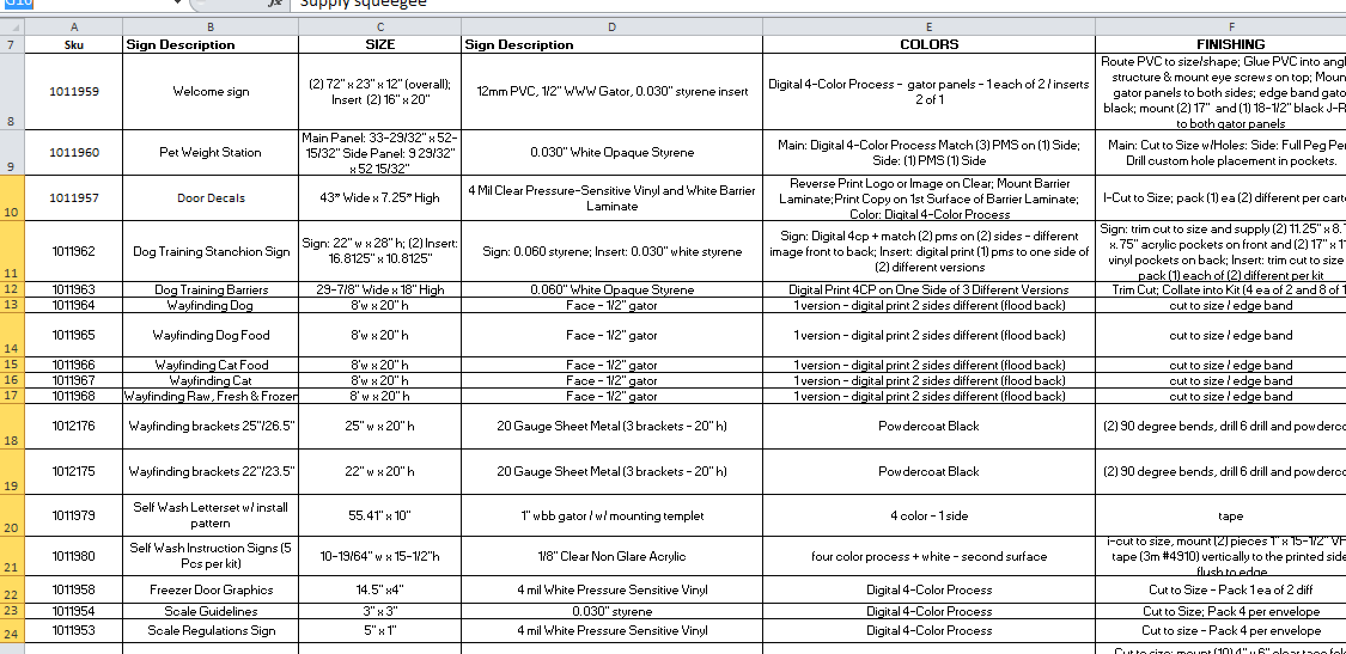
Customers
Requests
RFQ sheets coming in with varying formats
A variety of data formatting | Use the Add-in to aid in getting individual estimate items into a uniform request format that the automation engine can process
Notes:
5

Slide 6
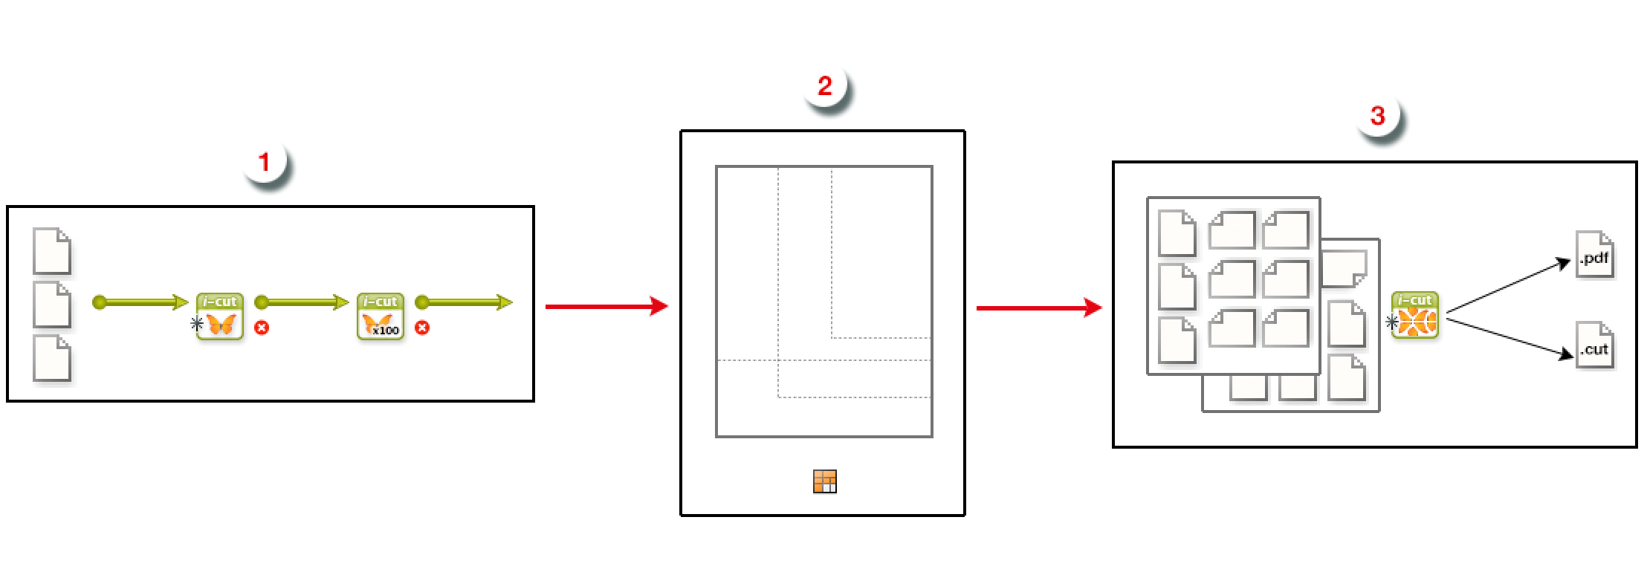
Automation Engine
Automation
Engine
Prepare & Submit Data
An Excel Add-in tool provides versatility, making it easy to set up data in spreadsheets and submit to Automation Engine.
Substrate Queues
Calculates the best possible nested layouts for all the pieces in a job. Whether sheet or roll based materials, maximize usage minimize waste.
Gang Run outputs
A complete set of advanced, reports including material usage and estimated cut times for all cutting machines via Email notification

Slide 7
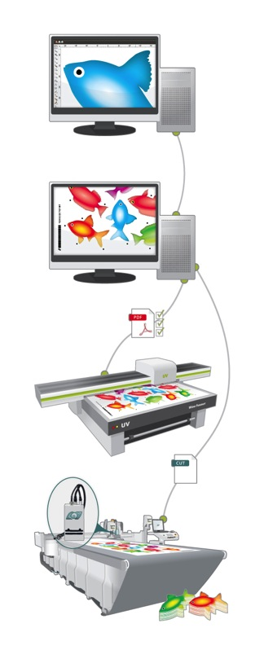
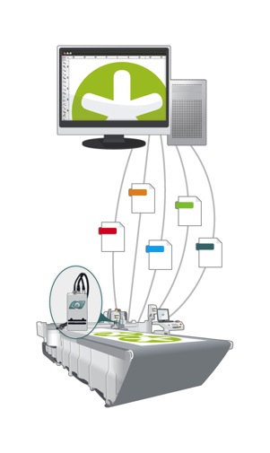
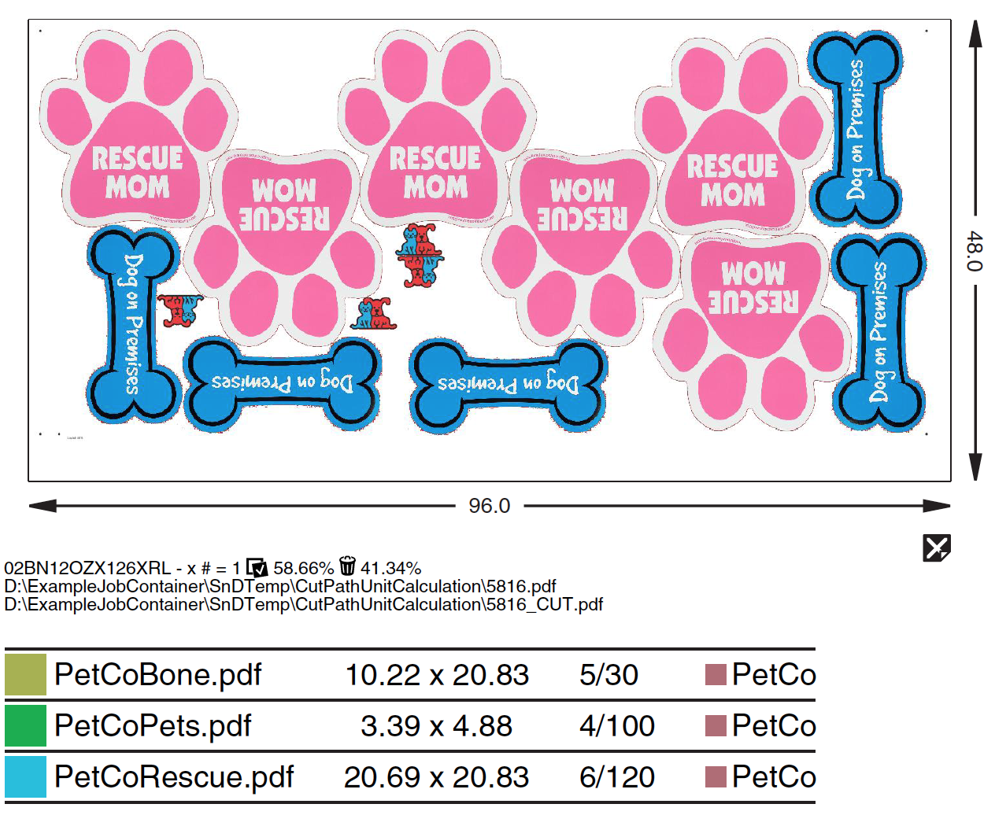
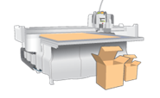
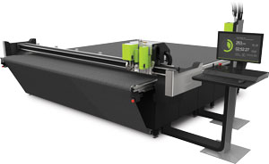
Sales
Results!
Esko solutions - Sign & Display workflows
Any shapes or none!
Start with any graphics files – good graphics, bad graphics, graphics with cut paths or no graphics at all. Quickly and efficiently find the most effective production results via Esko’s sophisticated nesting engine that follows your unique requirements.
CSR gets fast, accurate
Return data
PDF reports show the
Detailed results
True Shape Nesting
Any printer
You can also create your signage in ArtiosCAD or similar CAD software, then go directly to Kongsberg C using PDF
Kongsberg C
Notes:
7

Slide 8
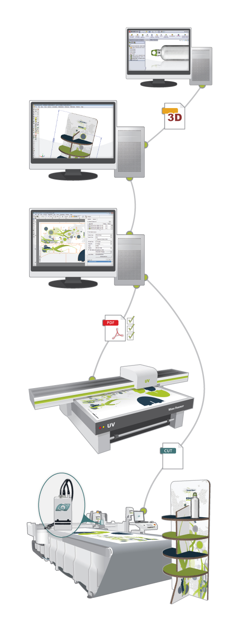
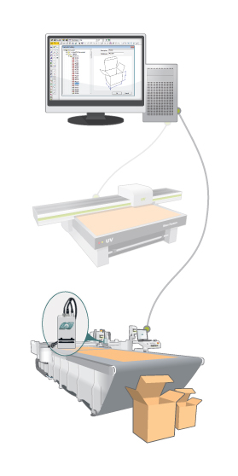
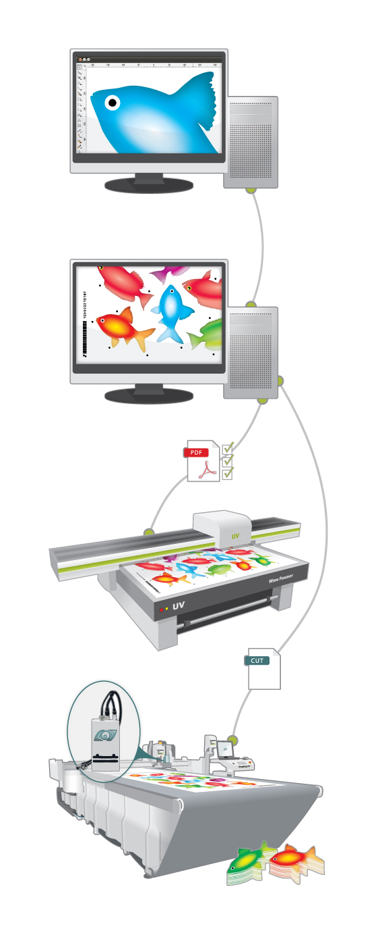
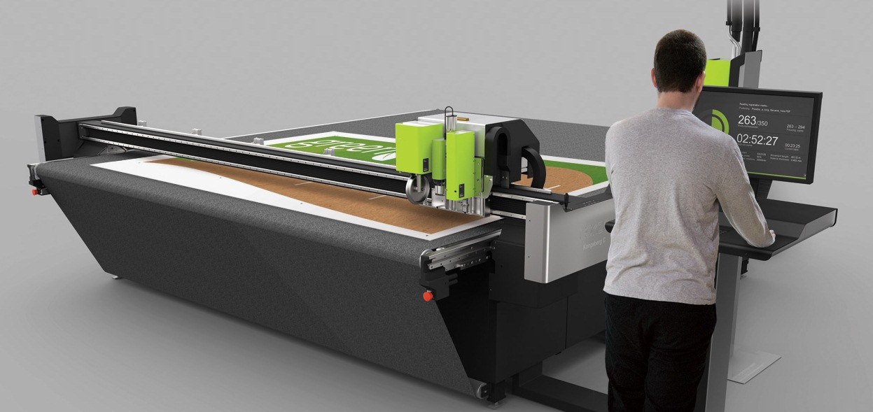
Esko Estimating - The Complete Solution
Sales
Results!
Today’s Major Question:
How do you avoid the expense and complexity of having Dedicated experts to meet the demands of each RFQ?
Answer:
Esko estimating software delivers the Capability, Capacity, Consistency, and Choices needed to link your estimating needs with your production requirements.
Capability
Consistency
Complete

Slide 9

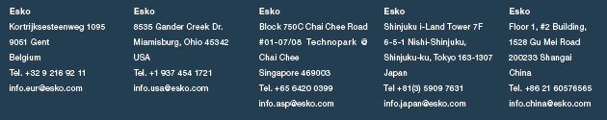
Partnering with Esko
Becoming an Esko solution owner partners your company with the global leader in packaging, sign, and display solutions and services.
Partner with Esko today to move your business into The New Dimension For Digital Finishing.
Visit the Esko web page for more information:
www.esko.com
Notes:
9

